Slide 1




Word of the Day
Spring Term 2024
Week 18 – 15th January 2024
'Words unlock the doors to a world of understanding...'

Slide 2

This Week's Words
Grasshopper
Shinobi
above
admire
act
bombard
bake
crave
burst
deliberate
itch
glimpse

Slide 3
Grasshopper (Tier 1)
above
act
bake
burst
itch

Slide 4
Shinobi (Tier 2)
admire
bombard
crave
deliberate
glimpse

Slide 5


Grasshopper Word of the Day
above
Word Class
Word of the Day:
(preposition)
(a-bove)
Pronunciation / Syllables
Definition:
If one thing is above another one, it is directly over it or higher than it.
Suzie put her hand above her head to answer the question.
Synonym: | Antonym: | Prefix / Suffix: | Rhyme: | Link Word:
over | under |  | love | lifted
on top | below |  | dove | seen

Slide 6

Grasshopper Word of the Day
act
Word Class
Word of the Day:
(verb / noun)
(act)
Pronunciation / Syllables
Definition:
If someone or something acts as a particular thing, they have that role or function
Don tried to act bravely after he hurt his knee.
Synonym: | Antonym: | Prefix / Suffix: | Rhyme: | Link Word:
behave |  | re- | fact | shocked
perform |  | -ed | impact | behalf

Slide 7

Grasshopper Word of the Day
bake
Word Class
Word of the Day:
(verb)
(bake)
Pronunciation / Syllables
Definition:
If you bake, you spend some time preparing and mixing together ingredients to make bread, cakes, pies, or other food which is cooked in the oven.
The class were taught to bake biscuits.
Synonym: | Antonym: | Prefix / Suffix: | Rhyme: | Link Word:
cook |  | -ing | make | oven
roast |  | -ed | take | taste

Slide 8


Grasshopper Word of the Day
burst
Word Class
Word of the Day:
(verb)
(burst)
Pronunciation / Syllables
Definition:
If something bursts or if you burst it, it suddenly breaks open or splits open and the air or other substance inside it comes out.
The ball burst when it was kicked too hard.
Synonym: | Antonym: | Prefix / Suffix: | Rhyme: | Link Word:
crack |  | -ing | first | pipe
rupture |  | -s | worst | tyre

Slide 9

Grasshopper Word of the Day
itch
Word Class
Word of the Day:
(verb/noun)
(itch)
Pronunciation / Syllables
Definition:
When a part of your body itches, you have an unpleasant feeling on your skin that makes you want to scratch.
Neville itched his head in confusion.
Synonym: | Antonym: | Prefix / Suffix: | Rhyme: | Link Word:
scratch |  | -ing | which | skin
prickling |  | -y | rich | back

Slide 10

Shinobi Word of the Day
admire
Word Class
Word of the Day:
(verb)
(ad-mire)
Pronunciation / Syllables
Definition:
If you admire someone or something, you like and respect them very much.
Jenny admired Sol for his good performance in the play.
Synonym: | Antonym: | Prefix / Suffix: | Rhyme: | Link Word:
praise | loath | -ed | fire | view
applaud | hate | -er | wire | her

Slide 11

Shinobi Word of the Day
bombard
Word Class
Word of the Day:
(verb)
(bom-bard)
Pronunciation / Syllables
Definition:
If you bombard someone with something, you make them face a great deal of it.
Vimal was bombarded with questions about his holiday.
Synonym: | Antonym: | Prefix / Suffix: | Rhyme: | Link Word:
inundate |  | -ed | hard | questions
swamp |  | -ing | guard | criticise

Slide 12

Shinobi Word of the Day
crave
Word Class
Word of the Day:
(verb)
(crave)
Pronunciation / Syllables
Definition:
If you crave something, or crave for it, you want to have it very much.
Sandra craved the chocolate cake on the lunch menu.
Synonym: | Antonym: | Prefix / Suffix | Rhyme: | Link Word:
desire |  | -ed | gave | chocolate
want |  | -ing | wave | air

Slide 13

Shinobi Word of the Day
deliberate
Word Class
Word of the Day:
(adjective)
(de-lib-er-ate)
Pronunciation / Syllables
Definition:
If you do something that is deliberate, you planned or decided to do it beforehand.
Glen was being deliberate kicked the chair.
Synonym: | Antonym: | Prefix / Suffix: | Rhyme: | Link Word:
intentional | accidental | -ly |  | look
conscious | unintentional | -tion |  | change

Slide 14

Shinobi Word of the Day
glimpse
Word Class
Word of the Day:
(noun/verb)
(glimpse)
Pronunciation / Syllables
Definition:
If you get a glimpse of someone or something, you see them very briefly and not very well.
Hailey glimpsed at Theo’s homework.
Synonym: | Antonym: | Prefix / Suffix: | Rhyme: | Link Word:
peek |  | -s | shrimps | spy
peep |  | -ed |  | catch

Slide 15
Vocabulary Laboratory
Describe / Definition:
Use it in a sentence:
Focus Word (write below):
Word Class:
Synonyms: (words with same / similar meaning) | Antonyms: (words with opposite meaning)
Rhymes: (words that sound the same) | Link Words: (Example: football = pitch, team, player)
Draw your sentence:

Slide 16

Vocabulary Visualiser
Draw the Grasshopper words and bring them to life.
Word: above | Word: burst
Word: bake | Word: itch

Slide 17
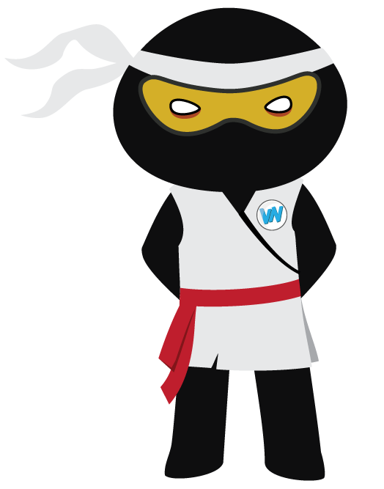
Vocabulary Visualiser
Draw the Shinobi words and bring them to life.
Word: admire | Word: deliberate
Word: crave | Word: glimpse

Slide 18
Matching Meanings
Draw lines from the Grasshopper words to their definitions.
Grasshopper Word
above
act
bake
burst
itch
Grasshopper Definitions
If you ***, you spend some time preparing and mixing together ingredients to make bread, cakes, pies, or other food which is cooked in the oven.
When a part of your body ***, you have an unpleasant feeling on your skin that makes you want to scratch.
If someone or something *** as a particular thing, they have that role or function
If one thing is *** another one, it is directly over it or higher than it.
If something *** or if you *** it, it suddenly breaks open or splits open and the air or other substance inside it comes out.

Slide 19
Matching Meanings
Draw lines from the Shinobi words to their definitions.
Shinobi Word
admire
bombard
crave
deliberate
glimpse
Shinobi Definitions
If you *** something, or crave for it, you want to have it very much.
If you *** someone with something, you make them face a great deal of it.
If you do something that is ***, you planned or decided to do it beforehand, and so it happens on purpose rather than by chance.
If you get a *** of someone or something, you see them very briefly and not very well.
If you *** someone or something, you like and respect them very much.

Slide 20






Display Slips
The following slides are for classroom display. As you teach each Word of the Day, words can be displayed in the classroom to enable pupils to use the taught vocabulary in an independent manner.

Slide 21
above
act

Slide 22
bake
burst

Slide 23
itch
admire

Slide 24
bombard
crave

Slide 25
deliberate
glimpse

Slide 26
Font Variation
The following display slips contain the same words, but have a more regular font, which have a more regular formation of ‘a’ and ‘g’. Futura is the name of the font.

Slide 27
above
night
act

Slide 28
bake
burst

Slide 29
itch
admire

Slide 30
bombard
crave

Slide 31
deliberate
glimpse

