Slide 1
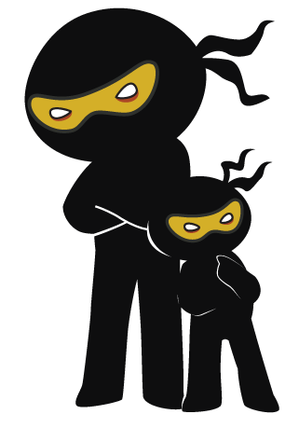



Word of the Day
Spring Term 2024
Week 19 – 22nd January 2024
'Words unlock the doors to a world of understanding...'

Slide 2

This Week's Words
Grasshopper
Shinobi
scrape
envy
ban
familiar
cool
generous
fill
hinder
follow
irate

Slide 3
Grasshopper (Tier 1)
scrape
ban
cool
fill
follow

Slide 4
Shinobi (Tier 2)
envy
familiar
generous
hinder
irate

Slide 5

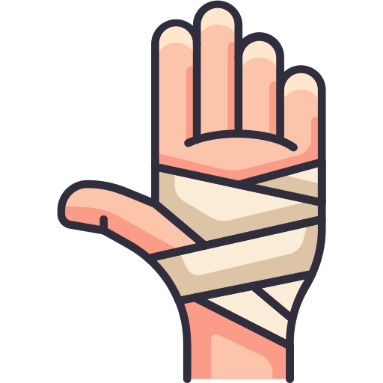
Grasshopper Word of the Day
scrape
Word Class
Word of the Day:
(verb / noun)
(scrape)
Pronunciation / Syllables
Definition:
If you scrape something from a surface, you remove it, especially by pulling a sharp object over the surface.
Ella scraped her knuckles on the school wall.
Synonym: | Antonym: | Prefix / Suffix: | Rhyme: | Link Word:
grate |  | -ed | shape | frost
brush |  | -ing | tape | knee

Slide 6

Grasshopper Word of the Day
ban
Word Class
Word of the Day:
(verb / noun)
(ban)
Pronunciation / Syllables
Definition:
To ban something means to state officially that it must not be done, shown, or used.
Taking sweets into school was banned.
Synonym: | Antonym: | Prefix / Suffix: | Rhyme: | Link Word:
forbit | permit | -ing | man | driving
prohibit |  | -ed | plan | entrance

Slide 7

Grasshopper Word of the Day
cool
Word Class
Word of the Day:
(adjective)
(cool)
Pronunciation / Syllables
Definition:
Something that is cool has a temperature which is low but not very low.
The weather outside was very cool.
Synonym: | Antonym: | Prefix / Suffix: | Rhyme: | Link Word:
chilly | warm | un- | school | temperature
cold | hot | -ing | rule | water

Slide 8

Grasshopper Word of the Day
fill
Word Class
Word of the Day:
(verb)
(fill)
Pronunciation / Syllables
Definition:
If you fill a container or area, or if it fills, an amount of something enters it that is enough to make it full.
Mrs Dobson filled the bin with rubbish from the art lesson.
Synonym: | Antonym: | Prefix / Suffix: | Rhyme: | Link Word:
pack | empty | re- | still | box
load | open | -ed | bill | fluid

Slide 9

Grasshopper Word of the Day
follow
Word Class
Word of the Day:
(verb)
(fol-low)
Pronunciation / Syllables
Definition:
If you follow someone who is going somewhere, you move along behind them because you want to go to the same place.
Daniel followed Rupa to the library.
Synonym: | Antonym: | Prefix / Suffix: | Rhyme: | Link Word:
accompany | lead | -ing | hollow | me
attend |  | -ed | swallow | steps

Slide 10

Shinobi Word of the Day
envy
Word Class
Word of the Day:
(verb / noun)
(en-vy)
Pronunciation / Syllables
Definition:
Envy is the feeling you have when you wish you could have the same thing or quality that someone else has.
Joanne envied Sarah for her long hair.
Synonym: | Antonym: | Prefix / Suffix: | Rhyme: | Link Word:
jealousy | generosity | -ing |  | feelings
spite |  |  |  | admiration

Slide 11

Shinobi Word of the Day
familiar
Word Class
Word of the Day:
(adjective)
(fam-il-iar)
Pronunciation / Syllables
Definition:
If you are familiar with something, you know or understand it well.
Charlie was already familiar with the book.
Synonym: | Antonym: | Prefix / Suffix: | Rhyme: | Link Word:
known | unfamiliar | un- |  | face
recognised |  | -ity |  | author

Slide 12

Shinobi Word of the Day
generous
Word Class
Word of the Day:
(adjective)
(gen-er-ous)
Pronunciation / Syllables
Definition:
A generous person is friendly, helpful, and willing to see the good qualities in someone or something.
Jill was always generous with her time for others.
Synonym: | Antonym: | Prefix / Suffix | Rhyme: | Link Word:
lavish | selfish | over- |  | always
giving |  | -ly |  | lent

Slide 13

Shinobi Word of the Day
hinder
Word Class
Word of the Day:
(verb)
(hin-der)
Pronunciation / Syllables
Definition:
If something hinders you, it makes it more difficult for you to do something or make progress.
Jane didn’t do her homework, which hindered her learning.
Synonym: | Antonym: | Prefix / Suffix: | Rhyme: | Link Word:
hamper | help | -ed |  | progress
obstruct | facilitate | -ing |  | mobility

Slide 14

Shinobi Word of the Day
irate
Word Class
Word of the Day:
(adjective)
(i-rate)
Pronunciation / Syllables
Definition:
If someone is irate, they are very angry about something.
Tony was irate that there was no cake left at lunchtime.
Synonym: | Antonym: | Prefix / Suffix: | Rhyme: | Link Word:
angry | calm | -ly | state | threw
furious | composed |  | great | extremely

Slide 15
Vocabulary Laboratory
Describe / Definition:
Use it in a sentence:
Focus Word (write below):
Word Class:
Synonyms: (words with same / similar meaning) | Antonyms: (words with opposite meaning)
Rhymes: (words that sound the same) | Link Words: (Example: football = pitch, team, player)
Draw your sentence:

Slide 16

Vocabulary Visualiser
Draw the Grasshopper words and bring them to life.
Word: scrape | Word: fill
Word: cool | Word: follow

Slide 17
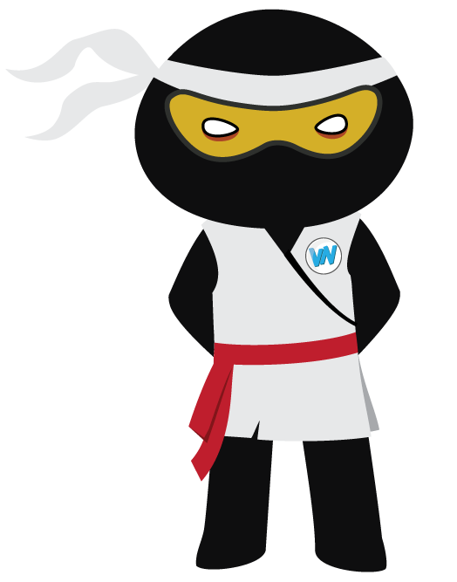
Vocabulary Visualiser
Draw the Shinobi words and bring them to life.
Word: envy | Word: hinder
Word: generous | Word: irate

Slide 18
Matching Meanings
Draw lines from the Grasshopper words to their definitions.
Grasshopper Word
scrape
ban
cool
fill
follow
Grasshopper Definitions
Something that is *** has a temperature which is low but not very low.
If you *** something from a surface, you remove it, especially by pulling a sharp object over the surface.
If you *** a container or area, or if it ***, an amount of something enters it that is enough to make it ***.
If you *** someone who is going somewhere, you move along behind them because you want to go to the same place.
To *** something means to state officially that it must not be done, shown, or used.

Slide 19
Matching Meanings
Draw lines from the Shinobi words to their definitions.
Shinobi Word
envy
familiar
generous
hinder
irate
Shinobi Definitions
If you are *** with something, you know or understand it well.
A *** person is friendly, helpful, and willing to see the good qualities in someone or something.
If something *** you, it makes it more difficult for you to do something or make progress.
If someone is ***, they are very angry about something.
*** is the feeling you have when you wish you could have the same thing or quality that someone else has.

Slide 20






Display Slips
The following slides are for classroom display. As you teach each Word of the Day, words can be displayed in the classroom to enable pupils to use the taught vocabulary in an independent manner.

Slide 21
scrape
ban

Slide 22
cool
fill

Slide 23
follow
envy

Slide 24
familiar
generous

Slide 25
hinder
irate

Slide 26
Font Variation
The following display slips contain the same words, but have a more regular font, which have a more regular formation of ‘a’ and ‘g’. Futura is the name of the font.

Slide 27
scape
night
ban

Slide 28
cool
fill

Slide 29
follow
envy

Slide 30
familiar
generous

Slide 31
hinder
irate

