Slide 1




Word of the Day
Autumn Term 2023
Week 16 – 18th December 2023
'Words unlock the doors to a world of understanding...'

Slide 2

This Week's Words
Grasshopper
Shinobi
pie
charity
wreath
eve
carol
reunion
sleigh
shop
pudding
belong

Slide 3
Grasshopper (Tier 1)
pie
wreath
carol
sleigh
pudding

Slide 4
Shinobi (Tier 2)
charity
eve
reunion
shop
belong

Slide 5


Grasshopper Word of the Day
pie
Word Class
Word of the Day:
(noun)
(pie)
Pronunciation / Syllables
Definition:
A pie consists of meat, vegetables, or fruit baked in pastry.
Chicken pie was on the school lunch menu.
Synonym: | Antonym: | Prefix / Suffix: | Rhyme: | Link Word:
pastry |  | -s | high | eat
tart |  |  | why | warm

Slide 6

Grasshopper Word of the Day
wreath
Word Class
Word of the Day:
(noun)
(wreath)
Pronunciation / Syllables
Definition:
A wreath is a circle of leaves which some people hang on the front door of their house at Christmas.
Mrs Carr hung a Christmas wreath on the classroom door.
Synonym: | Antonym: | Prefix / Suffix: | Rhyme: | Link Word:
garland |  | -s | teeth | door
chaplet |  |  | beneath | hang

Slide 7

Grasshopper Word of the Day
carol
Word Class
Word of the Day:
(noun/verb)
(car-ol)
Pronunciation / Syllables
Definition:
Carols are Christian religious songs that are sung at Christmas.
The children sang carols in the Nativity.
Synonym: | Antonym: | Prefix / Suffix: | Rhyme: | Link Word:
hymn |  | -ing | barrel | sing
psalm |  | -s |  | loudly

Slide 8

Grasshopper Word of the Day
sleigh
Word Class
Word of the Day:
(noun)
(sleigh)
Pronunciation / Syllables
Definition:
A sleigh is a vehicle which can slide over snow. Sleighs are usually pulled by horses.
The children were hoping to see Santa’s sleigh.
Synonym: | Antonym: | Prefix / Suffix: | Rhyme: | Link Word:
sledge |  |  | way | ride
 |  |  | day | snow

Slide 9
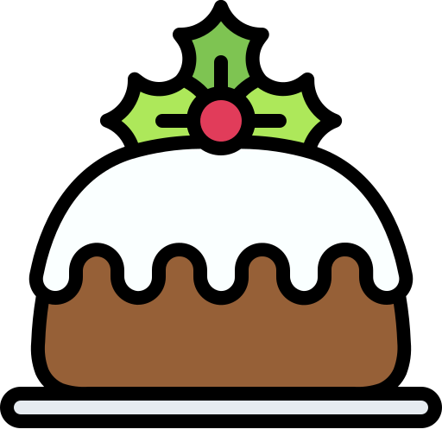
Grasshopper Word of the Day
pudding
Word Class
Word of the Day:
(noun)
(pud-ding)
Pronunciation / Syllables
Definition:
A pudding is a cooked sweet food made with flour, fat, and eggs, and usually served hot.
There was Christmas pudding on the menu.
Synonym: | Antonym: | Prefix / Suffix: | Rhyme: | Link Word:
dessert |  | -s |  | hot
sweet |  |  |  | tasty

Slide 10

Shinobi Word of the Day
charity
Word Class
Word of the Day:
(noun)
(chat-ty)
Pronunciation / Syllables
Definition:
Charity is kindness and understanding towards other people.
The school showed charity to the local foodbank.
Synonym: | Antonym: | Prefix / Suffix: | Rhyme: | Link Word:
aid |  | -ties | clarity | person
support |  | -able | parity | help

Slide 11
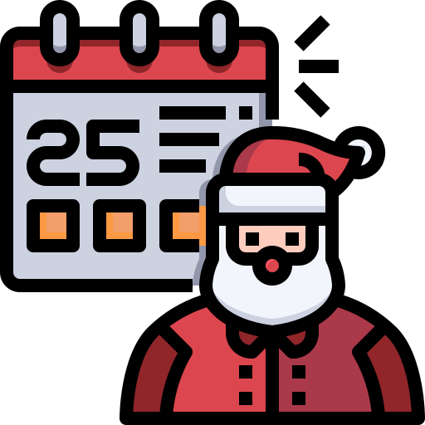
Shinobi Word of the Day
eve
Word Class
Word of the Day:
(noun)
(eve)
Pronunciation / Syllables
Definition:
The eve of a particular event or occasion is the day before it, or the period of time just before it.
It was the eve of the Christmas performance.
Synonym: | Antonym: | Prefix / Suffix: | Rhyme: | Link Word:
day before | day after |  | leave | dark
night |  |  | sleeve | cold

Slide 12

Shinobi Word of the Day
reunion
Word Class
Word of the Day:
(noun)
(re-un-ion)
Pronunciation / Syllables
Definition:
A reunion is a meeting between people who have been separated for some time.
Mr Laham had a reunion with his students after being away for a long time.
Synonym: | Antonym: | Prefix / Suffix | Rhyme: | Link Word:
get-together |  | -s | communion | party
 |  |  |  | happy

Slide 13

Shinobi Word of the Day
shop
Word Class
Word of the Day:
(verb/noun)
(shop)
Pronunciation / Syllables
Definition:
When you shop, you go to shops and buy things.
Mrs Daves needed to shop for Christmas presents.
Synonym: | Antonym: | Prefix / Suffix: | Rhyme: | Link Word:
buy |  | -ing | top | money
purchase |  | -ed | stop | gifts

Slide 14

Shinobi Word of the Day
belong
Word Class
Word of the Day:
(verb)
(be-long)
Pronunciation / Syllables
Definition:
If something belongs to you, you own it.
Samantha belonged in Class 5.
Synonym: | Antonym: | Prefix / Suffix: | Rhyme: | Link Word:
fit in | alienation | -ing | along | group
be in |  | -ed | strong | family

Slide 15
Vocabulary Laboratory
Describe / Definition:
Use it in a sentence:
Focus Word (write below):
Word Class:
Synonyms: (words with same / similar meaning) | Antonyms: (words with opposite meaning)
Rhymes: (words that sound the same) | Link Words: (Example: football = pitch, team, player)
Draw your sentence:

Slide 16

Vocabulary Visualiser
Draw the Grasshopper words and bring them to life.
Word: pie | Word: sleigh
Word: wreath | Word: pudding

Slide 17

Vocabulary Visualiser
Draw the Shinobi words and bring them to life.
Word: charity | Word: shop
Word: eve | Word: belong

Slide 18
Matching Meanings
Draw lines from the Grasshopper words to their definitions.
Grasshopper Word
pie
wreath
carol
sleigh
pudding
Grasshopper Definitions
A *** is a circle of leaves which some people hang on the front door of their house at Christmas.
A *** is a vehicle which can slide over snow. *** are usually pulled by horses.
A *** consists of meat, vegetables, or fruit baked in pastry.
A *** is a cooked sweet food made with flour, fat, and eggs, and usually served hot.
*** are Christian religious songs that are sung at Christmas.

Slide 19
Matching Meanings
Draw lines from the Shinobi words to their definitions.
Shinobi Word
charity
eve
reunion
shop
belong
Shinobi Definitions
A *** is a meeting between people who have been separated for some time.
When you ***, you go to shops and buy things.
If something *** to you, you own it.
*** is kindness and understanding towards other people.
The *** of a particular event or occasion is the day before it, or the period of time just before it.

Slide 20






Display Slips
The following slides are for classroom display. As you teach each Word of the Day, words can be displayed in the classroom to enable pupils to use the taught vocabulary in an independent manner.

Slide 21
pie
wreath

Slide 22
carol
sleigh

Slide 23
pudding
charity

Slide 24
eve
reunion

Slide 25
shop
belong

Slide 26
Font Variation
The following display slips contain the same words, but have a more regular font, which have a more regular formation of ‘a’ and ‘g’. Futura is the name of the font.

Slide 27
pie
night
wreath

Slide 28
carol
sleigh

Slide 29
pudding
charity

Slide 30
eve
reunion

Slide 31
shop
belong

