Slide 1




Word of the Day
Autumn Term 2023
Week 12 – 20th November 2023
'Words unlock the doors to a world of understanding...'

Slide 2

This Week's Words
Grasshopper
Shinobi
busy
patter
queue
wheeze
flash
caution
menu
extension
hop
hover

Slide 3
Grasshopper (Tier 1)
busy
queue
flash
menu
hop

Slide 4
Shinobi (Tier 2)
patter
wheeze
caution
extension
hover

Slide 5


Grasshopper Word of the Day
busy
Word Class
Word of the Day:
(adjective)
(bus-y)
Pronunciation / Syllables
Definition:
When you are busy, you are working hard or
concentrating on a task, so that you are not free to do anything else.
Mrs Smith was busy marking the classes’ homework.
Synonym: | Antonym: | Prefix / Suffix: | Rhyme: | Link Word:
bustling | idle | -ness | dizzy | day
tireless | lazy | -ily | frizzy | activity

Slide 6

Grasshopper Word of the Day
queue
Word Class
Word of the Day:
(verb/noun)
(queue)
Pronunciation / Syllables
Definition:
When people queue, they stand in a line waiting for something.
The children were told to queue for their lunch.
Synonym: | Antonym: | Prefix / Suffix: | Rhyme: | Link Word:
line |  | -ing | you | form
row |  | -ed | who | while

Slide 7

Grasshopper Word of the Day
flash
Word Class
Word of the Day:
(verb/noun)
(flash)
Pronunciation / Syllables
Definition:
If a light flashes or if you flash a light, it shines with a sudden bright light, especially as quick, regular flashes of light.
The lightening flashed brightly outside.
Synonym: | Antonym: | Prefix / Suffix: | Rhyme: | Link Word:
shine |  | -ed | cash | dark
beam |  | -ing | ash | headlights

Slide 8

Grasshopper Word of the Day
menu
Word Class
Word of the Day:
(noun)
(men-u)
Pronunciation / Syllables
Definition:
In a restaurant or café, or at a formal meal, the menu is a list of the food and drinks that are available.
Noelle thought the school lunch menu looked tasty.
Synonym: | Antonym: | Prefix / Suffix: | Rhyme: | Link Word:
list |  |  | venue | waiter
 |  |  |  | dish

Slide 9

Grasshopper Word of the Day
hop
Word Class
Word of the Day:
(verb)
(hop)
Pronunciation / Syllables
Definition:
If you hop, you move along by jumping on one foot.
The children were told to hop on one leg during PE.
Synonym: | Antonym: | Prefix / Suffix: | Rhyme: | Link Word:
jump |  | -ed | mop | across
spring |  | -ing | stop | on board

Slide 10
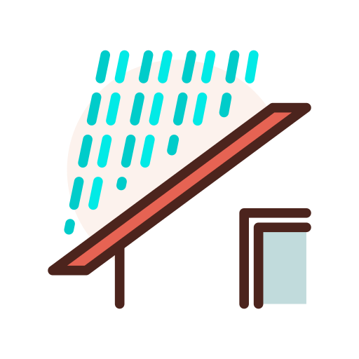
Shinobi Word of the Day
patter
Word Class
Word of the Day:
(noun)
(pat-ter)
Pronunciation / Syllables
Definition:
A patter is a series of quick, quiet, tapping sounds.
The class could hear the patter on rain on the roof.
Synonym: | Antonym: | Prefix / Suffix: | Rhyme: | Link Word:
tapping |  | -ed | matter | rain
beating |  | -ing | latter | footsteps

Slide 11
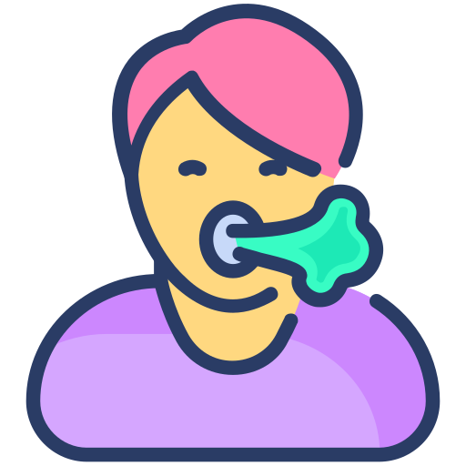
Shinobi Word of the Day
wheeze
Word Class
Word of the Day:
(verb/noun)
(wheeze)
Pronunciation / Syllables
Definition:
If someone wheezes, they breathe with difficulty and make a whistling sound.
Opal wheezed after she had finished the race.
Synonym: | Antonym: | Prefix / Suffix: | Rhyme: | Link Word:
gasp |  | -ed | trees | chest
wisp |  | -ing | please | cough

Slide 12

Shinobi Word of the Day
caution
Word Class
Word of the Day:
(noun)
(cau-tion)
Pronunciation / Syllables
Definition:
Caution is great care which you take in order to avoid possible danger.
Mr Nat put a caution sign out as the floor was slippy.
Synonym: | Antonym: | Prefix / Suffix | Rhyme: | Link Word:
care | incaution | -ed |  | extreme
wariness | recklessness | -ing |  | danger

Slide 13

Shinobi Word of the Day
extension
Word Class
Word of the Day:
(noun)
(extension)
Pronunciation / Syllables
Definition:
An extension is an extra period of time for which something lasts or is valid, usually as a result of official permission.
James asked for an extension to finish his work in class.
Synonym: | Antonym: | Prefix / Suffix: | Rhyme: | Link Word:
lengthening | shortening | -al | attention | essay
increase |  |  | mention | homework

Slide 14

Shinobi Word of the Day
hover
Word Class
Word of the Day:
(verb)
(hov-er)
Pronunciation / Syllables
Definition:
If you hover, you stay in one place and move slightly in a nervous way, for example because you cannot decide what to do.
Jun hovered outside the classroom until it was time to go in.
Synonym: | Antonym: | Prefix / Suffix: | Rhyme: | Link Word:
linger |  | -ed | cover | doorway
loiter |  | -ing | discover | hand

Slide 15
Vocabulary Laboratory
Describe / Definition:
Use it in a sentence:
Focus Word (write below):
Word Class:
Synonyms: (words with same / similar meaning) | Antonyms: (words with opposite meaning)
Rhymes: (words that sound the same) | Link Words: (Example: football = pitch, team, player)
Draw your sentence:

Slide 16

Vocabulary Visualiser
Draw the Grasshopper words and bring them to life.
Word: busy | Word: flash
Word: queue | Word: menu

Slide 17

Vocabulary Visualiser
Draw the Shinobi words and bring them to life.
Word: patter | Word: extension
Word: wheeze | Word: hover

Slide 18
Matching Meanings
Draw lines from the Grasshopper words to their definitions.
Grasshopper Word
busy
queue
flash
menu
hop
Grasshopper Definitions
If you ***, you move along by jumping on one foot.
When you are ***, you are working hard or concentrating on a task, so that you are not free to do anything else.
In a restaurant or café, or at a formal meal, the *** is a list of the food and drinks that are available.
If a light *** or if you *** a light, it shines with a sudden bright light, especially as quick, regular *** of light.
When people ***, they stand in a line waiting for something.

Slide 19
Matching Meanings
Draw lines from the Shinobi words to their definitions.
Shinobi Word
patter
wheeze
caution
extension
hover
Shinobi Definitions
An *** is an extra period of time for which something lasts or is valid, usually as a result of official permission.
If you ***, you stay in one place and move slightly in a nervous way, for example because you cannot decide what to do.
If someone ***, they breathe with difficulty and make a whistling sound.
*** is great care which you take in order to avoid possible danger.
A *** is a series of quick, quiet, tapping sounds.

Slide 20






Display Slips
The following slides are for classroom display. As you teach each Word of the Day, words can be displayed in the classroom to enable pupils to use the taught vocabulary in an independent manner.

Slide 21
busy
queue

Slide 22
flash
menu

Slide 23
hop
patter

Slide 24
wheeze
caution

Slide 25
extension
hover

Slide 26
Font Variation
The following display slips contain the same words, but have a more regular font, which have a more regular formation of ‘a’ and ‘g’. Futura is the name of the font.

Slide 27
busy
night
queue

Slide 28
flash
menu

Slide 29
hop
patter

Slide 30
wheeze
caution

Slide 31
extension
hover

