Slide 1
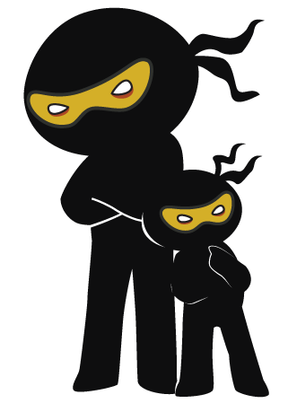



Word of the Day
Autumn Term 2023
Week 14 – 4th December 2023
'Words unlock the doors to a world of understanding...'

Slide 2

This Week's Words
Grasshopper
Shinobi
hair
mercy
top
relent
bottom
cackle
cuddle
compliment
dinner
ravenous

Slide 3
Grasshopper (Tier 1)
hair
top
bottom
cuddle
dinner

Slide 4
Shinobi (Tier 2)
mercy
relent
cackle
compliment
ravenous

Slide 5

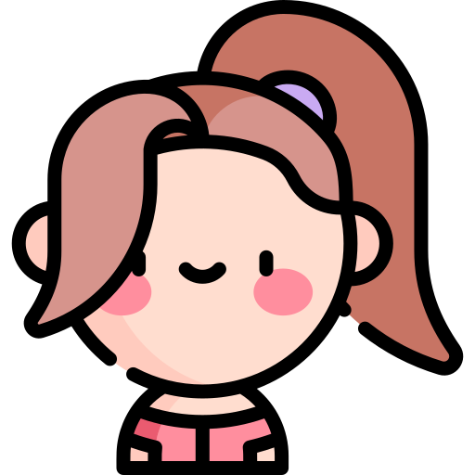
Grasshopper Word of the Day
hair
Word Class
Word of the Day:
(noun)
(hair)
Pronunciation / Syllables
Definition:
Your hair is the fine threads that grow in a mass on your head.
Maria always tied her hair back for school.
Synonym: | Antonym: | Prefix / Suffix: | Rhyme: | Link Word:
mane |  | -ier | there | long
locks |  | -iest | care | curly

Slide 6

Grasshopper Word of the Day
top
Word Class
Word of the Day:
(noun)
(top)
Pronunciation / Syllables
Definition:
The top of something is its highest point or part.
Mr McBride put the book on top of the bookshelf.
Synonym: | Antonym: | Prefix / Suffix: | Rhyme: | Link Word:
peak | bottom | -s | stop | page
head | base |  | drop | stairs

Slide 7
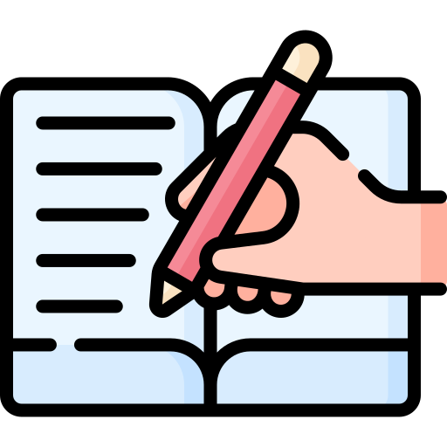
Grasshopper Word of the Day
bottom
Word Class
Word of the Day:
(noun)
(bot-tom)
Pronunciation / Syllables
Definition:
The bottom of something is the lowest or deepest part of it.
Gregory wrote in his book to the bottom of the page.
Synonym: | Antonym: | Prefix / Suffix: | Rhyme: | Link Word:
foot | top |  |  | sea
base | head |  |  | ground

Slide 8
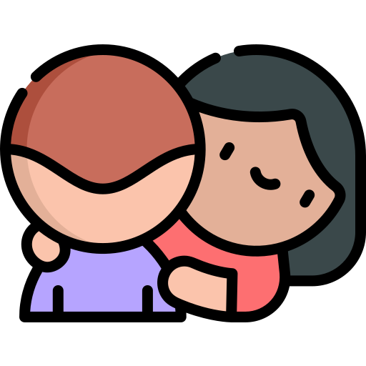
Grasshopper Word of the Day
cuddle
Word Class
Word of the Day:
(verb/noun)
(cud-dle)
Pronunciation / Syllables
Definition:
If you cuddle someone, you put your arms round them and hold them close as a way of showing your affection.
Aalia cuddled Trevor as he was upset.
Synonym: | Antonym: | Prefix / Suffix: | Rhyme: | Link Word:
hug |  | -d | puddle | long
embrace |  | -s | muddle | big

Slide 9

Grasshopper Word of the Day
dinner
Word Class
Word of the Day:
(noun)
(din-ner)
Pronunciation / Syllables
Definition:
Dinner is the main meal of the day, usually served in the early part of the evening.
Derek was looking forward to his dinner that evening.
Synonym: | Antonym: | Prefix / Suffix: | Rhyme: | Link Word:
supper |  | -s | winner | invited
meal |  |  | inner | enjoy

Slide 10

Shinobi Word of the Day
mercy
Word Class
Word of the Day:
(noun)
(mer-cy)
Pronunciation / Syllables
Definition:
If someone in authority shows mercy, they choose not to harm someone they have power over, or they forgive someone they have the right to punish.
Mrs Feron showed mercy to Johnny for forgetting his homework.
Synonym: | Antonym: | Prefix / Suffix: | Rhyme: | Link Word:
pity | ruthlessness | -ful |  | cried
grace | cruelty | -less |  | show

Slide 11
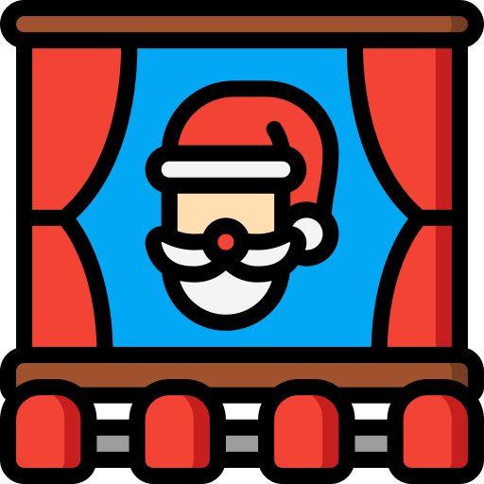
Shinobi Word of the Day
relent
Word Class
Word of the Day:
(verb)
(re-lent)
Pronunciation / Syllables
Definition:
If you relent, you allow someone to do something that you had previously refused to allow them to do.
Mr Feron relented and let the class watch a Christmas movie.
Synonym: | Antonym: | Prefix / Suffix: | Rhyme: | Link Word:
give in | harden | -ed | went | permission
weaken | strengthen | -less | sent | teacher

Slide 12

Shinobi Word of the Day
cackle
Word Class
Word of the Day:
(verb/noun)
(cack-le)
Pronunciation / Syllables
Definition:
If someone cackles, they laugh in a loud unpleasant way, often at something bad that happens to someone else.
Mao cackled at the joke Bill told.
Synonym: | Antonym: | Prefix / Suffix | Rhyme: | Link Word:
chortle |  | -ed | tackle | reaction
giggle |  | -ing | crackle | laughter

Slide 13
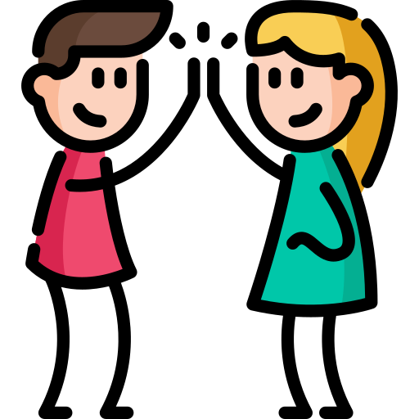
Shinobi Word of the Day
compliment
Word Class
Word of the Day:
(verb/noun)
(com-pli-ment)
Pronunciation / Syllables
Definition:
A compliment is a polite remark that you say to someone to show that you like their appearance, appreciate
their qualities or approve of what they have done.
Melissa complimented Curtis on his reading in class.
Synonym: | Antonym: | Prefix / Suffix: | Rhyme: | Link Word:
praise | insult | -ed |  | paid
admiration | criticism | -ary |  | accept

Slide 14
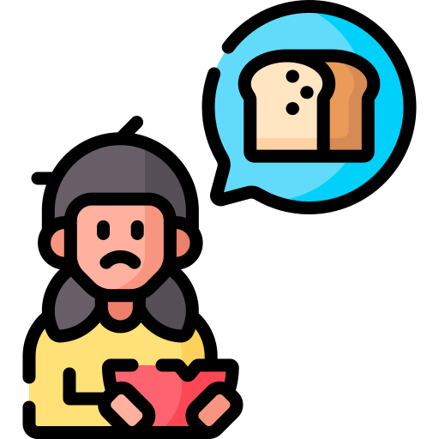
Shinobi Word of the Day
ravenous
Word Class
Word of the Day:
(adjective)
(rav-en-ous)
Pronunciation / Syllables
Definition:
If you are ravenous, you are extremely hungry.
Rani was ravenous and ready for lunch.
Synonym: | Antonym: | Prefix / Suffix: | Rhyme: | Link Word:
starving | full | -ly | cavernous | animals
famished |  |  |  | eat

Slide 15
Vocabulary Laboratory
Describe / Definition:
Use it in a sentence:
Focus Word (write below):
Word Class:
Synonyms: (words with same / similar meaning) | Antonyms: (words with opposite meaning)
Rhymes: (words that sound the same) | Link Words: (Example: football = pitch, team, player)
Draw your sentence:

Slide 16
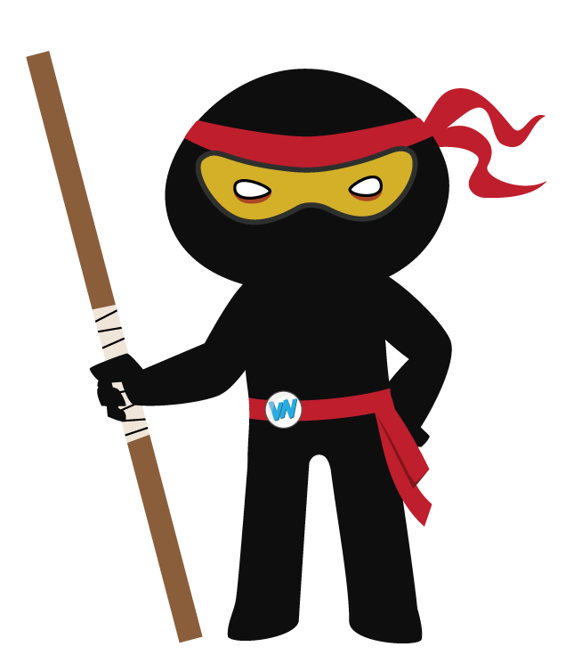
Vocabulary Visualiser
Draw the Grasshopper words and bring them to life.
Word: hair | Word: cuddle
Word: top | Word: dinner

Slide 17
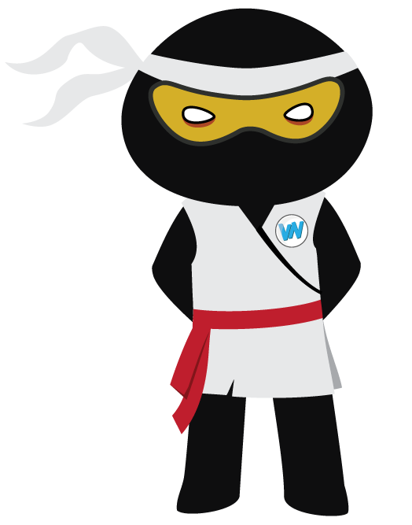
Vocabulary Visualiser
Draw the Shinobi words and bring them to life.
Word: mercy | Word: compliment
Word: cackle | Word: ravenous

Slide 18
Matching Meanings
Draw lines from the Grasshopper words to their definitions.
Grasshopper Word
hair
top
bottom
cuddle
dinner
Grasshopper Definitions
The *** of something is the lowest or deepest part of it.
Your *** is the fine threads that grow in a mass on your head.
If you *** someone, you put your arms round them and hold them close as a way of showing your affection.
*** is the main meal of the day, usually served in the early part of the evening.
The *** of something is its highest point or part.

Slide 19
Matching Meanings
Draw lines from the Shinobi words to their definitions.
Shinobi Word
mercy
relent
cackle
compliment
ravenous
Shinobi Definitions
If someone ***, they laugh in a loud unpleasant way, often at something bad that happens to someone else.
A *** is a polite remark that you say to someone to show that you like their appearance, appreciate their qualities, or approve of what they have done.
If someone in authority shows ***, they choose not to harm someone they have power over, or they forgive someone they have the right to punish.
If you ***, you allow someone to do something that you had previously refused to allow them to do.
If you are ***, you are extremely hungry.

Slide 20

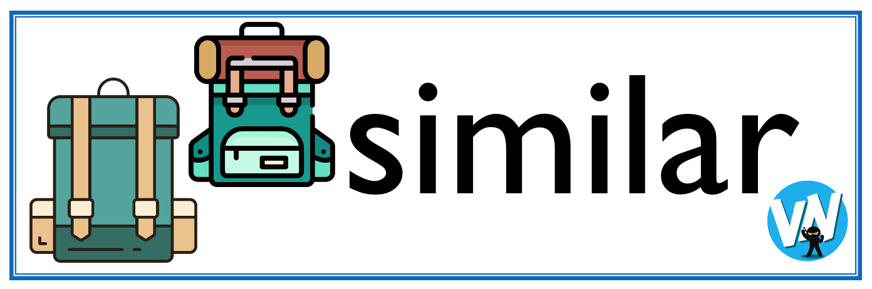




Display Slips
The following slides are for classroom display. As you teach each Word of the Day, words can be displayed in the classroom to enable pupils to use the taught vocabulary in an independent manner.

Slide 21
hair
top

Slide 22
bottom
cuddle

Slide 23
dinner
mercy

Slide 24
relent
cackle

Slide 25
compliment
ravenous

Slide 26
Font Variation
The following display slips contain the same words, but have a more regular font, which have a more regular formation of ‘a’ and ‘g’. Futura is the name of the font.

Slide 27
hair
night
top

Slide 28
bottom
cuddle

Slide 29
dinner
mercy

Slide 30
relent
cackle

Slide 31
compliment
ravenous

