Slide 1
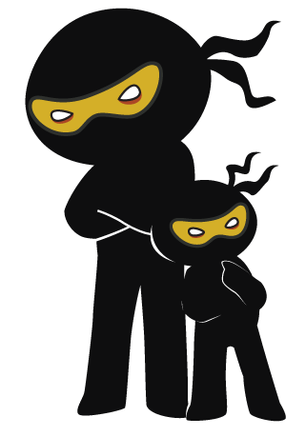



Word of the Day
Autumn Term 2023
Week 6 – 9th October 2023
'Words unlock the doors to a world of understanding...'

Slide 2

This Week's Words
Grasshopper
Shinobi
stay
survey
flat
ghost
injury
fury
out
steep
add
nurture

Slide 3
Grasshopper (Tier 1)
stay
flat
injury
out
add

Slide 4
Shinobi (Tier 2)
survey
ghost
fury
steep
nurture

Slide 5


Grasshopper Word of the Day
stay
Word Class
Word of the Day:
(verb)
(stay)
Pronunciation / Syllables
Definition:
If you stay where you are, you continue to be there and do not leave.
The children were told to stay in the classroom until the bell went.
Synonym: | Antonym: | Prefix / Suffix: | Rhyme: | Link Word:
remain | leave | home- | they | here
wait | go | -ing | way | over

Slide 6
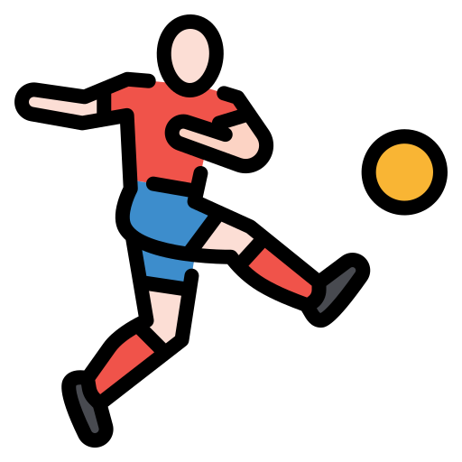
Grasshopper Word of the Day
flat
Word Class
Word of the Day:
(adjective)
(flat)
Pronunciation / Syllables
Definition:
Something that is flat is level, smooth, or even, rather than sloping, curved, or uneven.
The playground was flat enough to play football on.
Synonym: | Antonym: | Prefix / Suffix: | Rhyme: | Link Word:
levelled | bumpy | -ter | that | surface
smooth |  | -tened | sat | perfectly

Slide 7

Grasshopper Word of the Day
injury
Word Class
Word of the Day:
(noun)
(in-ju-ry)
Pronunciation / Syllables
Definition:
An injury is damage done to a person's or an animal's body.
Ellen injured her foot by kicking the table.
Synonym: | Antonym: | Prefix / Suffix: | Rhyme: | Link Word:
wound |  | pre- | gingery | serious
graze |  | re- |  | escaped

Slide 8

Grasshopper Word of the Day
out
Word Class
Word of the Day:
(adverb)
(out)
Pronunciation / Syllables
Definition:
When something is in a particular place and you take it out, you remove it from that place.
Harris took out the rubbish for Mrs Lynch during lunchtime.
Synonym: | Antonym: | Prefix / Suffix: | Rhyme: | Link Word:
away | in | ab- | shout | took
 |  | -side | doubt | drew

Slide 9

Grasshopper Word of the Day
add
Word Class
Word of the Day:
(verb)
(add)
Pronunciation / Syllables
Definition:
If you add one thing to another, you put it in or on the other thing, to increase, complete, or improve it.
Abha wanted to add water to his juice.
Synonym: | Antonym: | Prefix / Suffix: | Rhyme: | Link Word:
attach | remove | -ition | had | to the
connect |  | -ed | bad | huge

Slide 10

Shinobi Word of the Day
survey
Word Class
Word of the Day:
(verb)
(sur-vey)
Pronunciation / Syllables
Definition:
If you survey something, you look at or consider the whole of it carefully.
Mrs Horton surveyed the classroom for her missing pencil.
Synonym: | Antonym: | Prefix / Suffix: | Rhyme: | Link Word:
observe |  | -ed | way | room
view |  | -ing | day | view

Slide 11
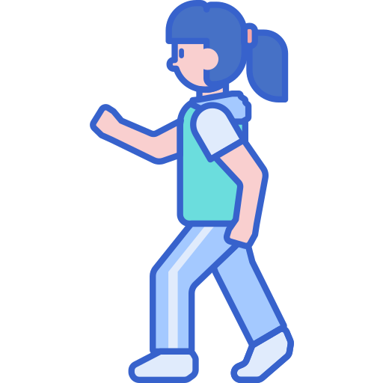
Shinobi Word of the Day
ghost
Word Class
Word of the Day:
(verb)
(ghost)
Pronunciation / Syllables
Definition:
If you move in a ghostly fashion, you move without being seen or noticed.
Tamara ghosted her was through the crowd.
Synonym: | Antonym: | Prefix / Suffix: | Rhyme: | Link Word:
unnoticed | seen | -ed | post | slip by
unseen | noticed | -like | coast | tip-toed

Slide 12

Shinobi Word of the Day
fury
Word Class
Word of the Day:
(noun)
(fu-ry)
Pronunciation / Syllables
Definition:
Fury is violent or very strong anger.
Lin was filled with fury when there was no pudding left at lunchtime.
Synonym: | Antonym: | Prefix / Suffix: | Rhyme: | Link Word:
rage | calmness |  | jury | screamed
anger | mildness |  |  | frustration

Slide 13
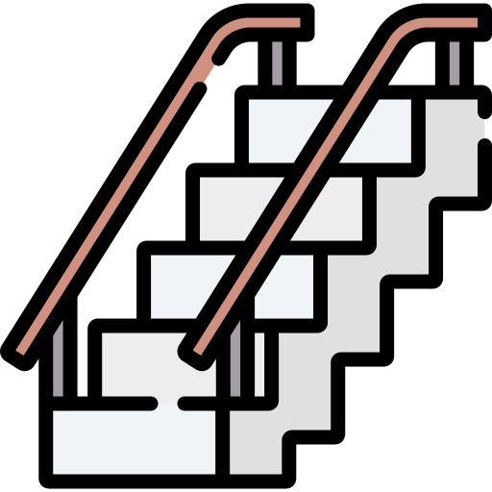
Shinobi Word of the Day
steep
Word Class
Word of the Day:
(adjective)
(steep)
Pronunciation / Syllables
Definition:
A steep slope rises at a very sharp angle and is difficult to go up.
The stairs were steep in the school.
Synonym: | Antonym: | Prefix / Suffix: | Rhyme: | Link Word:
sharp | gentle | -ly | keep | stairs
abrupt | reasonable | -est | deep | hill

Slide 14

Shinobi Word of the Day
nurture
Word Class
Word of the Day:
(verb)
(nur-ture)
Pronunciation / Syllables
Definition:
If you nurture something such as a young child or a young plant, you care for it while it is growing and developing.
The class plant needed to be nurtured to grow.
Synonym: | Antonym: | Prefix / Suffix | Rhyme: | Link Word:
rear | neglect | -ed | lurcher | child
support | hinder | -er |  | plant

Slide 15
Vocabulary Laboratory
Describe / Definition:
Use it in a sentence:
Focus Word (write below):
Word Class:
Synonyms: (words with same / similar meaning) | Antonyms: (words with opposite meaning)
Rhymes: (words that sound the same) | Link Words: (Example: football = pitch, team, player)
Draw your sentence:

Slide 16

Vocabulary Visualiser
Draw the Grasshopper words and bring them to life.
Word: stay | Word: injury
Word: flat | Word: add

Slide 17
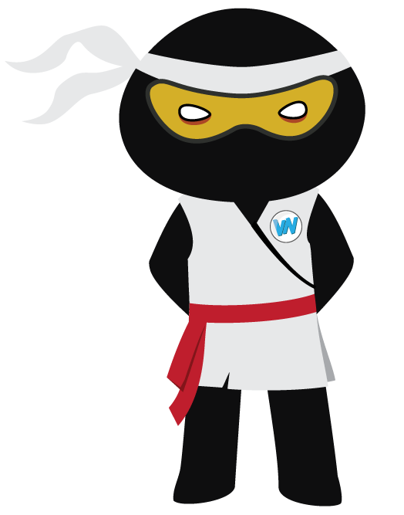
Vocabulary Visualiser
Draw the Shinobi words and bring them to life.
Word: ghost | Word: steep
Word: fury | Word: nurture

Slide 18
Matching Meanings
Draw lines from the Grasshopper words to their definitions.
Grasshopper Word
stay
flat
injury
out
add
Grasshopper Definitions
If you *** where you are, you continue to be there and do not leave.
When something is in a particular place and you take it ***, you remove it from that place.
If you *** one thing to another, you put it in or on the other thing, to increase, complete, or improve it.
An *** is damage done to a person's or an animal's body.
Something that is *** is level, smooth, or even, rather than sloping, curved, or uneven.

Slide 19
Matching Meanings
Draw lines from the Shinobi words to their definitions.
Shinobi Word
survey
ghost
fury
steep
nurture
Shinobi Definitions
*** is violent or very strong anger.
A *** slope rises at a very sharp angle and is difficult to go up.
If you *** something, you look at or consider the whole of it carefully.
If you *** something such as a young child or a young plant, you care for it while it is growing and developing.
If you move in a *** fashion, you move without being seen or noticed.

Slide 20






Display Slips
The following slides are for classroom display. As you teach each Word of the Day, words can be displayed in the classroom to enable pupils to use the taught vocabulary in an independent manner.

Slide 21
stay
flat

Slide 22
injury
out

Slide 23
add
survey

Slide 24
ghost
fury

Slide 25
steep
nurture

Slide 26
Font Variation
The following display slips contain the same words, but have a more regular font, which have a more regular formation of ‘a’ and ‘g’. Futura is the name of the font.

Slide 27
stay
night
flat

Slide 28
injury
out

Slide 29
add
survey

Slide 30
ghost
fury

Slide 31
steep
nurture

