Slide 1
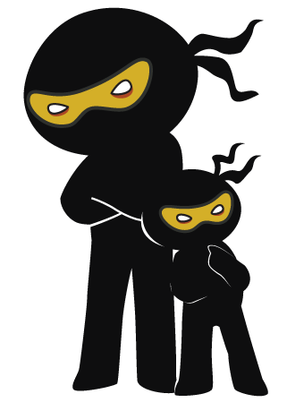



Word of the Day
Autumn Term 2023
Week 7 – 16th October 2023
'Words unlock the doors to a world of understanding...'

Slide 2

This Week's Words
Grasshopper
Shinobi
back
doom
glass
mouthful
clock
nerves
time
effort
dry
ripple

Slide 3
Grasshopper (Tier 1)
back
glass
clock
time
dry

Slide 4
Shinobi (Tier 2)
doom
mouthful
nerves
effort
ripple

Slide 5


Grasshopper Word of the Day
back
Word Class
Word of the Day:
(adverb)
(back)
Pronunciation / Syllables
Definition:
If you move back, you move in the opposite direction to the one in which you are facing or in which you were moving before.
Alison was asked to move back and listen.
Synonym: | Antonym: | Prefix / Suffix: | Rhyme: | Link Word:
rearwards | forwards | feed- | lack | moved
 |  | -ward | back | stepped

Slide 6
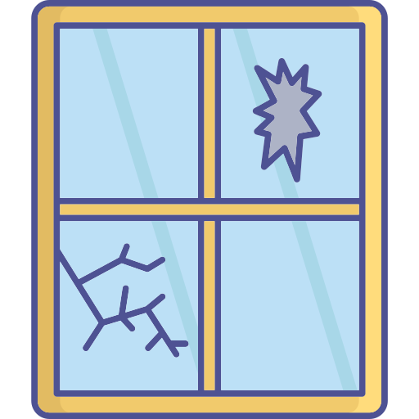
Grasshopper Word of the Day
glass
Word Class
Word of the Day:
(noun)
(glass)
Pronunciation / Syllables
Definition:
Glass is a hard transparent substance that is used to make things such as windows and bottles.
The glass in the window has a crack in it.
Synonym: | Antonym: | Prefix / Suffix: | Rhyme: | Link Word:
crystal |  | spy- | grass | pane
 |  | -ware | class | door

Slide 7

Grasshopper Word of the Day
clock
Word Class
Word of the Day:
(noun)
(clock)
Pronunciation / Syllables
Definition:
A clock is an instrument, for example in a room or on the outside of a building, that shows what time of day it is.
The class clock was 5 minutes behind time.
Synonym: | Antonym: | Prefix / Suffix: | Rhyme: | Link Word:
timepiece |  | over- | block | ticking
 |  | -wise | rock | wall

Slide 8
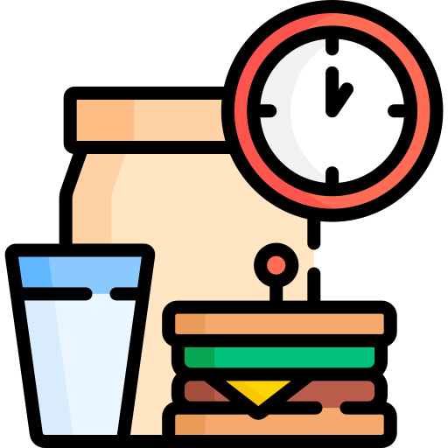
Grasshopper Word of the Day
time
Word Class
Word of the Day:
(noun)
(time)
Pronunciation / Syllables
Definition:
Time is what we measure in minutes, hours, days, and years.
Mr Grant told the children that it was time for lunch.
Synonym: | Antonym: | Prefix / Suffix: | Rhyme: | Link Word:
hour |  | show- | crime | passed
occasion |  | -less | prime | changed

Slide 9

Grasshopper Word of the Day
dry
Word Class
Word of the Day:
(adjective / verb)
(dry)
Pronunciation / Syllables
Definition:
If something is dry, there is no water or moisture on it or in it.
Emerson needed a dry surface to try out the experiment.
Synonym: | Antonym: | Prefix / Suffix: | Rhyme: | Link Word:
parched | fresh | -ing | why | cloth
wilted | moist | -ness | eye | paint

Slide 10

Shinobi Word of the Day
doom
Word Class
Word of the Day:
(noun / verb)
(doom)
Pronunciation / Syllables
Definition:
Doom is a terrible future state or event which you cannot prevent.
Yang felt doom when the school doors opened for registration.
Synonym: | Antonym: | Prefix / Suffix: | Rhyme: | Link Word:
downfall | happy | -ed | room | gloom
ruin | lucky | -ing | boom | mood

Slide 11

Shinobi Word of the Day
mouthful
Word Class
Word of the Day:
(noun)
(mouth-ful)
Pronunciation / Syllables
Definition:
A mouthful of drink or food is the amount that you put or have in your mouth.
The mouthful of cake that Murali had was delicious.
Synonym: | Antonym: | Prefix / Suffix: | Rhyme: | Link Word:
taste |  | -s |  | gulped
nibble |  |  |  | food

Slide 12
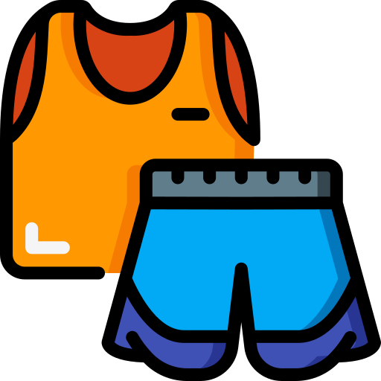
Shinobi Word of the Day
nerves
Word Class
Word of the Day:
(noun)
(nerves)
Pronunciation / Syllables
Definition:
A person’s steadiness and courage in a demanding situation.
Getting changed for sports got on Fern’s nerves.
Synonym: | Antonym: | Prefix / Suffix: | Rhyme: | Link Word:
confidence | timidly |  | curves | all
assurance |  |  | serves | on my

Slide 13

Shinobi Word of the Day
effort
Word Class
Word of the Day:
(noun)
(ef-fort)
Pronunciation / Syllables
Definition:
If you make an effort to do something, you try very hard to do it.
Dale put extra effort into his writing.
Synonym: | Antonym: | Prefix / Suffix: | Rhyme: | Link Word:
attempt |  | -less |  | hide
try |  | -ful |  | huge

Slide 14
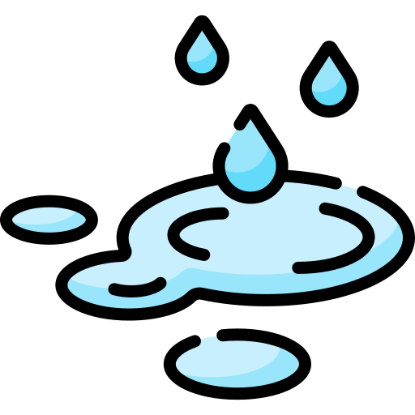
Shinobi Word of the Day
ripple
Word Class
Word of the Day:
(noun / verb)
(rip-ple)
Pronunciation / Syllables
Definition:
Ripples are little waves on the surface of water caused by the wind or by something moving in or on the water.
Joanne made a ripple in the puddle by jumping into it.
Synonym: | Antonym: | Prefix / Suffix | Rhyme: | Link Word:
wave |  | -ing | tipple | gentle
wrinkle |  | -ed | triple | forceful

Slide 15
Vocabulary Laboratory
Describe / Definition:
Use it in a sentence:
Focus Word (write below):
Word Class:
Synonyms: (words with same / similar meaning) | Antonyms: (words with opposite meaning)
Rhymes: (words that sound the same) | Link Words: (Example: football = pitch, team, player)
Draw your sentence:

Slide 16

Vocabulary Visualiser
Draw the Grasshopper words and bring them to life.
Word: back | Word: clock
Word: glass | Word: dry

Slide 17
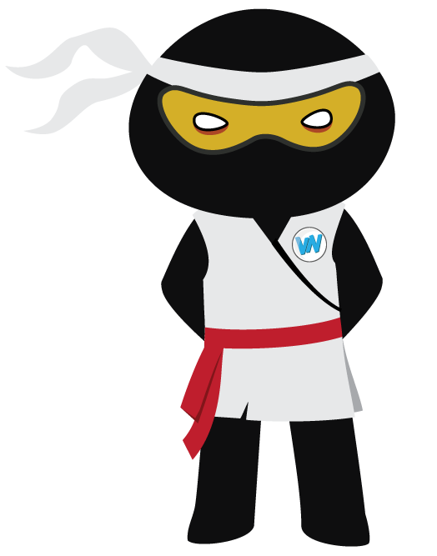
Vocabulary Visualiser
Draw the Shinobi words and bring them to life.
Word: doom | Word: effort
Word: mouthful | Word: ripple

Slide 18
Matching Meanings
Draw lines from the Grasshopper words to their definitions.
Grasshopper Word
back
glass
clock
time
dry
Grasshopper Definitions
*** is a hard transparent substance that is used to make things such as windows and bottles.
If you move ***, you move in the opposite direction to the one in which you are facing or in which you were moving before.
*** is what we measure in minutes, hours, days, and years.
If something is ***, there is no water or moisture on it or in it.
A *** is an instrument, for example in a room or on the outside of a building, that shows what time of day it is.

Slide 19
Matching Meanings
Draw lines from the Shinobi words to their definitions.
Shinobi Word
doom
mouthful
nerves
effort
ripple
Shinobi Definitions
A person’s steadiness and courage in a demanding situation.
If you make an *** to do something, you try very hard to do it.
A *** of drink or food is the amount that you put or have in your mouth.
*** are little waves on the surface of water caused by the wind or by something moving in or on the water.
*** is a terrible future state or event which you cannot prevent.

Slide 20






Display Slips
The following slides are for classroom display. As you teach each Word of the Day, words can be displayed in the classroom to enable pupils to use the taught vocabulary in an independent manner.

Slide 21
back
glass

Slide 22
clock
time

Slide 23
dry
doom

Slide 24
mouthful
nerves

Slide 25
effort
ripple

Slide 26
Font Variation
The following display slips contain the same words, but have a more regular font, which have a more regular formation of ‘a’ and ‘g’. Futura is the name of the font.

Slide 27
back
night
glass

Slide 28
clock
time

Slide 29
dry
doom

Slide 30
mouthful
nerves

Slide 31
effort
ripple

