Slide 1
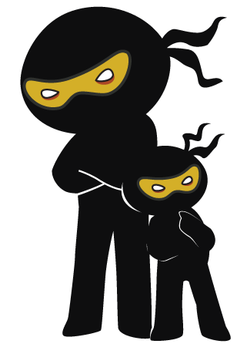



Word of the Day
Autumn Term 2023
Week 9 – 30th October 2023
'Words unlock the doors to a world of understanding...'

Slide 2

This Week's Words
Grasshopper
Shinobi
low
bulge
chat
prowl
pond
hatch
accident
favour
owe
cradle

Slide 3
Grasshopper (Tier 1)
low
chat
pond
accident
owe

Slide 4
Shinobi (Tier 2)
bulge
prowl
hatch
favour
cradle

Slide 5


Grasshopper Word of the Day
low
Word Class
Word of the Day:
(adjective)
(low)
Pronunciation / Syllables
Definition:
Something that is low measures only a short distance from the bottom to the top, or from the ground to the top.
The bookshelf was low enough for the children to place books on it.
Synonym: | Antonym: | Prefix / Suffix: | Rhyme: | Link Word:
short | high | -er | go | down
little |  | -est | know | sun

Slide 6

Grasshopper Word of the Day
chat
Word Class
Word of the Day:
(verb / noun)
(chat)
Pronunciation / Syllables
Definition:
When people chat, they talk to each other in an informal and friendly way.
Paisley was told off for chatting in class.
Synonym: | Antonym: | Prefix / Suffix: | Rhyme: | Link Word:
gossip |  | -ing | that | people
babble |  | -ed | flat | friends

Slide 7
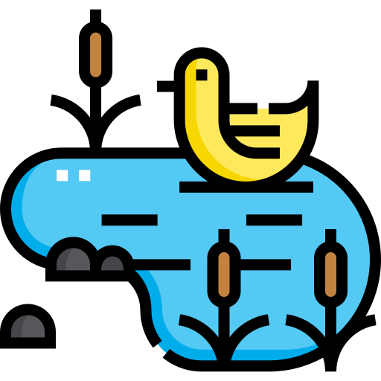
Grasshopper Word of the Day
pond
Word Class
Word of the Day:
(noun)
(pond)
Pronunciation / Syllables
Definition:
A pond is a small area of water that is smaller than a lake. Ponds are often made artificially.
Mia went to the local pond to feed the ducks.
Synonym: | Antonym: | Prefix / Suffix: | Rhyme: | Link Word:
pool |  |  | fond | deep
puddle |  |  | wand | duck

Slide 8
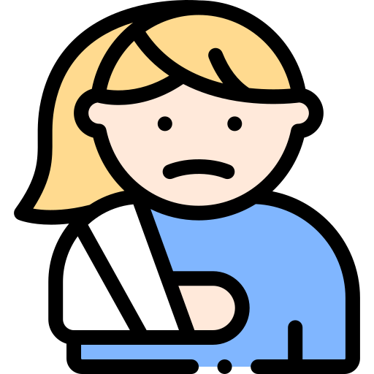
Grasshopper Word of the Day
accident
Word Class
Word of the Day:
(noun)
(ac-ci-dent)
Pronunciation / Syllables
Definition:
An accident happens when a vehicle hits a person, an object, or another vehicle, causing injury or damage.
Tamara had an accident in the playground.
Synonym: | Antonym: | Prefix / Suffix: | Rhyme: | Link Word:
mishap |  | -al |  | serious
calamity |  | -ally |  | home

Slide 9
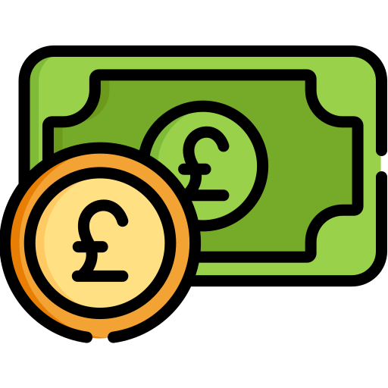
Grasshopper Word of the Day
owe
Word Class
Word of the Day:
(verb)
(owe)
Pronunciation / Syllables
Definition:
If you owe money to someone, they have lent it to you and you have not yet paid it back. You can also say that the money is owing.
Jason owed £10 for the school trip.
Synonym: | Antonym: | Prefix / Suffix: | Rhyme: | Link Word:
in debt | settle up | -ed | show | money
 |  | -ing | low | rent

Slide 10
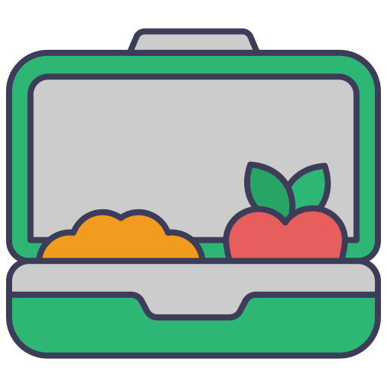
Shinobi Word of the Day
bulge
Word Class
Word of the Day:
(verb / noun)
(bulge)
Pronunciation / Syllables
Definition:
If something such as a person's stomach bulges, it sticks out.
Madison’s lunchbox was bulging with food.
Synonym: | Antonym: | Prefix / Suffix: | Rhyme: | Link Word:
swelling |  | -ed | indulge | out
bump |  | -ing |  | veins

Slide 11
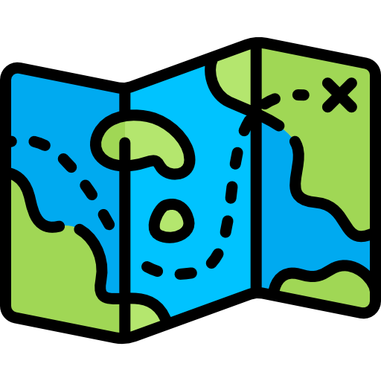
Shinobi Word of the Day
prowl
Word Class
Word of the Day:
(verb)
(prowl)
Pronunciation / Syllables
Definition:
If an animal or a person prowls around, they move around quietly, for example when they are hunting.
Fred was on the prowl for a glue stick.
Synonym: | Antonym: | Prefix / Suffix: | Rhyme: | Link Word:
skulk |  | -ing | foul | around
sneak |  | -ed | towel | lion

Slide 12
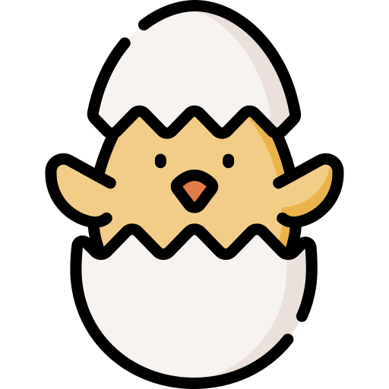
Shinobi Word of the Day
hatch
Word Class
Word of the Day:
(verb)
(hatch)
Pronunciation / Syllables
Definition:
When a baby bird, insect, or other animal hatches, or when it is hatched, it comes out of its egg by breaking the shell.
The children watched the chick's hatch.
Synonym: | Antonym: | Prefix / Suffix | Rhyme: | Link Word:
incubate |  | -ed | catch | chick
 |  | -ing | thatch | egg

Slide 13

Shinobi Word of the Day
favour
Word Class
Word of the Day:
(noun)
(fa-vour)
Pronunciation / Syllables
Definition:
If you do someone a favour, you do something for them even though you do not have to.
Ellen asked Dean for a favour and lend her his pencil.
Synonym: | Antonym: | Prefix / Suffix: | Rhyme: | Link Word:
service | disservice | -ed | savour | return
courtesy |  | -ite | flavour | friendship

Slide 14
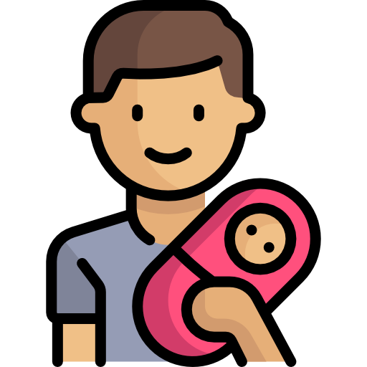
Shinobi Word of the Day
cradle
Word Class
Word of the Day:
(verb / noun)
(cra-dle)
Pronunciation / Syllables
Definition:
If you cradle someone or something in your arms or hands, you hold them carefully and gently.
Tad cradled the doll like a baby.
Synonym: | Antonym: | Prefix / Suffix: | Rhyme: | Link Word:
hold |  | -ed | ladle | arms
support |  | -ing |  | baby

Slide 15
Vocabulary Laboratory
Describe / Definition:
Use it in a sentence:
Focus Word (write below):
Word Class:
Synonyms: (words with same / similar meaning) | Antonyms: (words with opposite meaning)
Rhymes: (words that sound the same) | Link Words: (Example: football = pitch, team, player)
Draw your sentence:

Slide 16
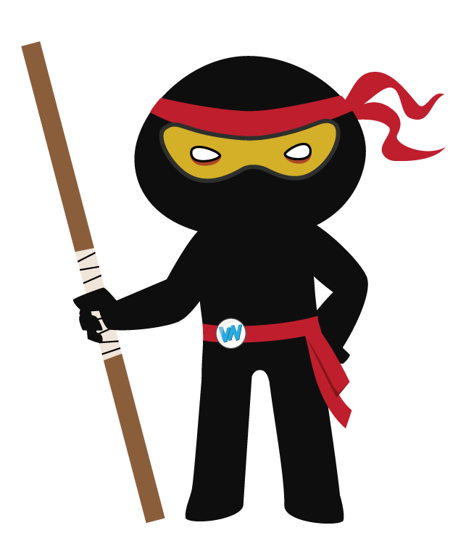
Vocabulary Visualiser
Draw the Grasshopper words and bring them to life.
Word: low | Word: pond
Word: chat | Word: accident

Slide 17
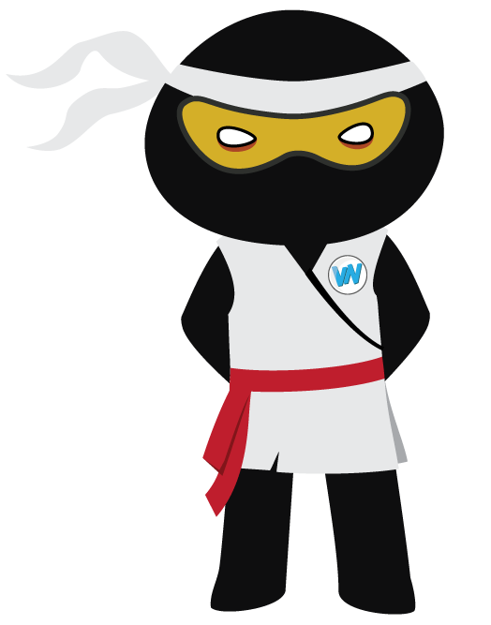
Vocabulary Visualiser
Draw the Shinobi words and bring them to life.
Word: bulge | Word: hatch
Word: prowl | Word: cradle

Slide 18
Matching Meanings
Draw lines from the Grasshopper words to their definitions.
Grasshopper Word
low
chat
pond
accident
owe
Grasshopper Definitions
When people ***, they talk to each other in an informal and friendly way.
An *** happens when a vehicle hits a person, an object, or another vehicle, causing injury or damage.
Something that is *** measures only a short distance from the bottom to the top, or from the ground to the top.
If you *** money to someone, they have lent it to you and you have not yet paid it back. You can also say that the money is ***.
A *** is a small area of water that is smaller than a lake. *** are often made artificially.

Slide 19
Matching Meanings
Draw lines from the Shinobi words to their definitions.
Shinobi Word
bulge
prowl
hatch
favour
cradle
Shinobi Definitions
When a baby bird, insect, or other animal ***, or when it is ***, it comes out of its egg by breaking the shell.
If you *** someone or something in your arms or hands, you hold them carefully and gently.
If an animal or a person *** around, they move around quietly, for example when they are hunting.
If you do someone a ***, you do something for them even though you do not have to.
If something such as a person's stomach ***, it sticks out.

Slide 20
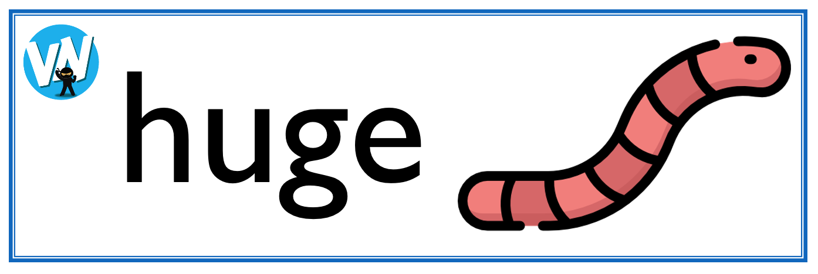
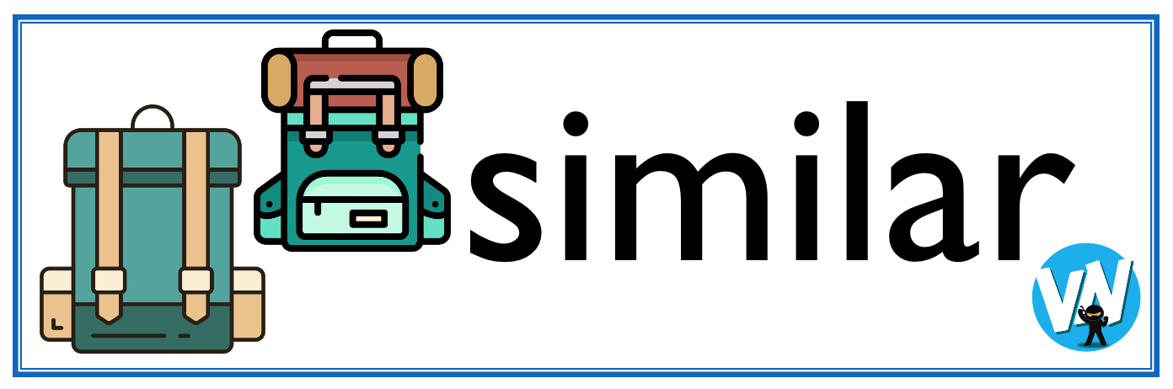




Display Slips
The following slides are for classroom display. As you teach each Word of the Day, words can be displayed in the classroom to enable pupils to use the taught vocabulary in an independent manner.

Slide 21
low
chat

Slide 22
pond
accident

Slide 23
owe
bulge

Slide 24
prowl
hatch

Slide 25
favour
cradle

Slide 26
Font Variation
The following display slips contain the same words, but have a more regular font, which have a more regular formation of ‘a’ and ‘g’. Futura is the name of the font.

Slide 27
low
night
chat

Slide 28
pond
accident

Slide 29
owe
bulge

Slide 30
prowl
hatch

Slide 31
favour
cradle

