Slide 1
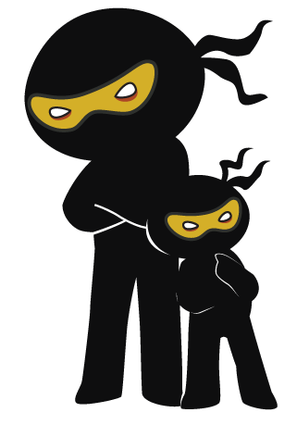



Word of the Day
Autumn Term 2023
Week 10 – 6th November 2023
'Words unlock the doors to a world of understanding...'

Slide 2

This Week's Words
Grasshopper
Shinobi
tell
proof
size
character
trouble
comprehend
nest
debt
need
react

Slide 3
Grasshopper (Tier 1)
tell
size
trouble
nest
need

Slide 4
Shinobi (Tier 2)
proof
character
comprehend
debt
react

Slide 5

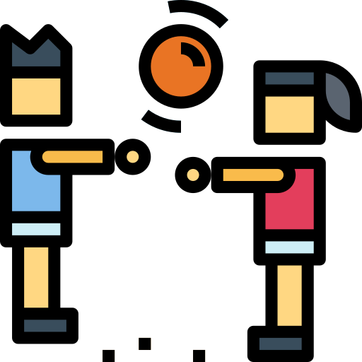
Grasshopper Word of the Day
tell
Word Class
Word of the Day:
(verb)
(tell)
Pronunciation / Syllables
Definition:
If you tell someone something, you give them information.
Mr Riley went to tell the class that they had to come in.
Synonym: | Antonym: | Prefix / Suffix: | Rhyme: | Link Word:
inform |  | -ing | well | called
notify |  | re- | sell | truth

Slide 6


Grasshopper Word of the Day
size
Word Class
Word of the Day:
(noun)
(size)
Pronunciation / Syllables
Definition:
The size of something is how big or small it is. Something's size is determined by comparing it to other things, counting it, or measuring it.
The class measured the size of each ball.
Synonym: | Antonym: | Prefix / Suffix: | Rhyme: | Link Word:
area |  |  | eyes | task
 |  |  | rise | right

Slide 7

Grasshopper Word of the Day
trouble
Word Class
Word of the Day:
(noun)
(trou-ble)
Pronunciation / Syllables
Definition:
You can refer to problems or difficulties as trouble.
Edmond got into trouble for throwing his bag down.
Synonym: | Antonym: | Prefix / Suffix: | Rhyme: | Link Word:
problems | peace | -some | double | cause
difficulty |  | -ing | bubble | serious

Slide 8
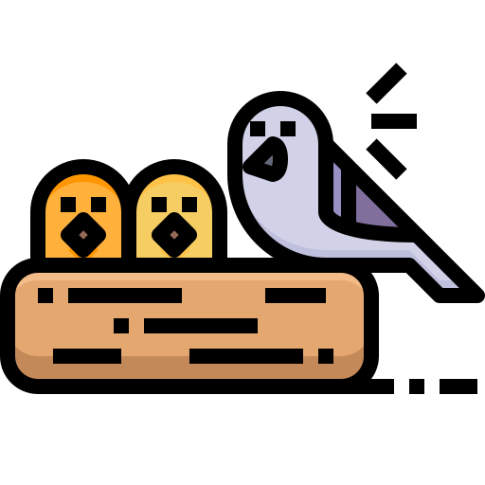
Grasshopper Word of the Day
nest
Word Class
Word of the Day:
(noun)
(nest)
Pronunciation / Syllables
Definition:
A bird's nest is the home that it makes to lay its eggs in.
The chicks were in their nest.
Synonym: | Antonym: | Prefix / Suffix: | Rhyme: | Link Word:
roost |  | -ing | best | bird
den |  |  | test | site

Slide 9

Grasshopper Word of the Day
need
Word Class
Word of the Day:
(verb)
(need)
Pronunciation / Syllables
Definition:
If you need something, or need to do something, you cannot successfully achieve what you want or live properly without it.
Kay needed a new textbook to write in.
Synonym: | Antonym: | Prefix / Suffix: | Rhyme: | Link Word:
require | optional | -ed | read | food
want |  | -s | lead | coat

Slide 10

Shinobi Word of the Day
proof
Word Class
Word of the Day:
(noun)
(proof)
Pronunciation / Syllables
Definition:
Proof is a fact, argument, or piece of evidence which shows that something is definitely true or definitely exists.
We need to find proof that plants need sunlight to grow.
Synonym: | Antonym: | Prefix / Suffix: | Rhyme: | Link Word:
evidence |  |  | hoof | of
verification |  |  | aloof | science

Slide 11

Shinobi Word of the Day
character
Word Class
Word of the Day:
(noun)
(char-ac-ter)
Pronunciation / Syllables
Definition:
You can use character to refer to the qualities that people from a particular place are believed to have.
Lyndsey showed character and told the truth.
Synonym: | Antonym: | Prefix / Suffix: | Rhyme: | Link Word:
personality |  | -istic |  | show
nature |  | -

Slide 12
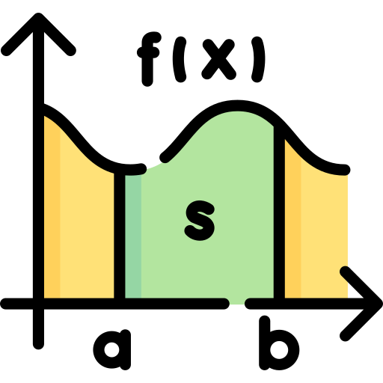
Shinobi Word of the Day
comprehend
Word Class
Word of the Day:
(verb)
(com-pre-hend)
Pronunciation / Syllables
Definition:
If you cannot comprehend something, you cannot understand it.
Rishi could not comprehend the math question.
Synonym: | Antonym: | Prefix / Suffix | Rhyme: | Link Word:
grasp |  | -ed | friend | fail to
apprehend |  | -ing | send | cannot

Slide 13

Shinobi Word of the Day
debt
Word Class
Word of the Day:
(noun)
(debt)
Pronunciation / Syllables
Definition:
You use debt in expressions such as I owe you a debt or I am in your debt when you are expressing gratitude for something that someone has done for you.
Daisy was in debt to Adam for helping her.
Synonym: | Antonym: | Prefix / Suffix: | Rhyme: | Link Word:
dues | in credit |  | get | owe
arrears |  |  | set | thanks

Slide 14

Shinobi Word of the Day
react
Word Class
Word of the Day:
(verb)
(re-act)
Pronunciation / Syllables
Definition:
When you react to something that has happened to you, you behave in a particular way because of it.
William reacted kindly to Brooke when she said ‘Hello’.
Synonym: | Antonym: | Prefix / Suffix: | Rhyme: | Link Word:
behave |  | over- | fact | news
proceed |  | -ive | impact | again

Slide 15
Vocabulary Laboratory
Describe / Definition:
Use it in a sentence:
Focus Word (write below):
Word Class:
Synonyms: (words with same / similar meaning) | Antonyms: (words with opposite meaning)
Rhymes: (words that sound the same) | Link Words: (Example: football = pitch, team, player)
Draw your sentence:

Slide 16

Vocabulary Visualiser
Draw the Grasshopper words and bring them to life.
Word: low | Word: pond
Word: chat | Word: accident

Slide 17
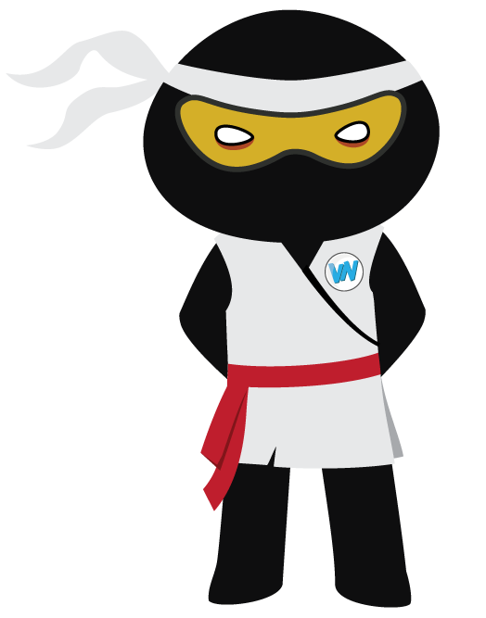
Vocabulary Visualiser
Draw the Shinobi words and bring them to life.
Word: bulge | Word: hatch
Word: prowl | Word: cradle

Slide 18
Matching Meanings
Draw lines from the Grasshopper words to their definitions.
Grasshopper Word
tell
size
trouble
nest
need
Grasshopper Definitions
You can refer to problems or difficulties as ***.
If you *** someone something, you give them information.
A bird’s *** is the home that it makes to lay its eggs in.
If you *** something, or *** to do something, you cannot successfully achieve what you want or live properly without it.
The *** of something is how big or small it is. Something's size is determined by comparing it to other things, counting it, or measuring it.

Slide 19
Matching Meanings
Draw lines from the Shinobi words to their definitions.
Shinobi Word
proof
character
comprehend
debt
react
Shinobi Definitions
If you cannot *** something, you cannot understand it.
You use *** in expressions such as I *** you a debt or I am in your debt when you are expressing gratitude for something that someone has done for you.
You can use *** to refer to the qualities that people from a particular place are believed to have.
When you *** to something that has happened to you, you behave in a particular way because of it.
*** is a fact, argument, or piece of evidence which shows that something is definitely true or definitely exists.

Slide 20
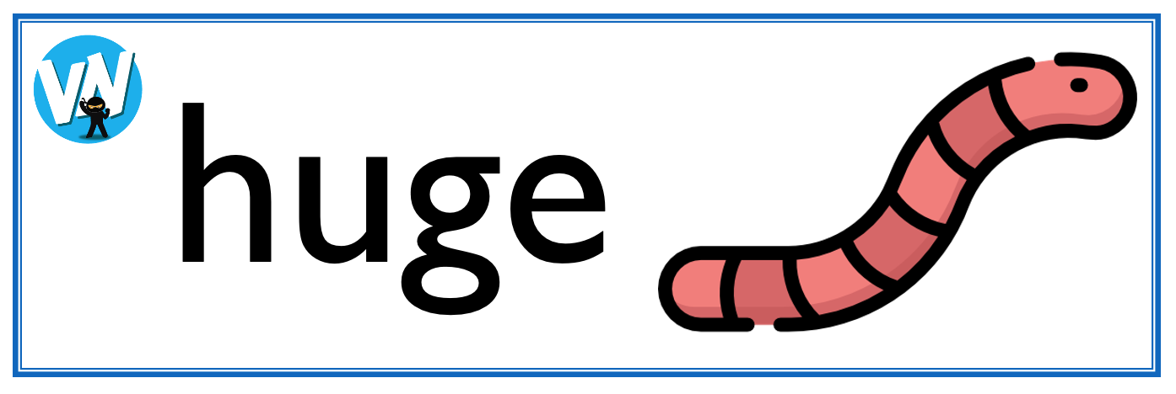
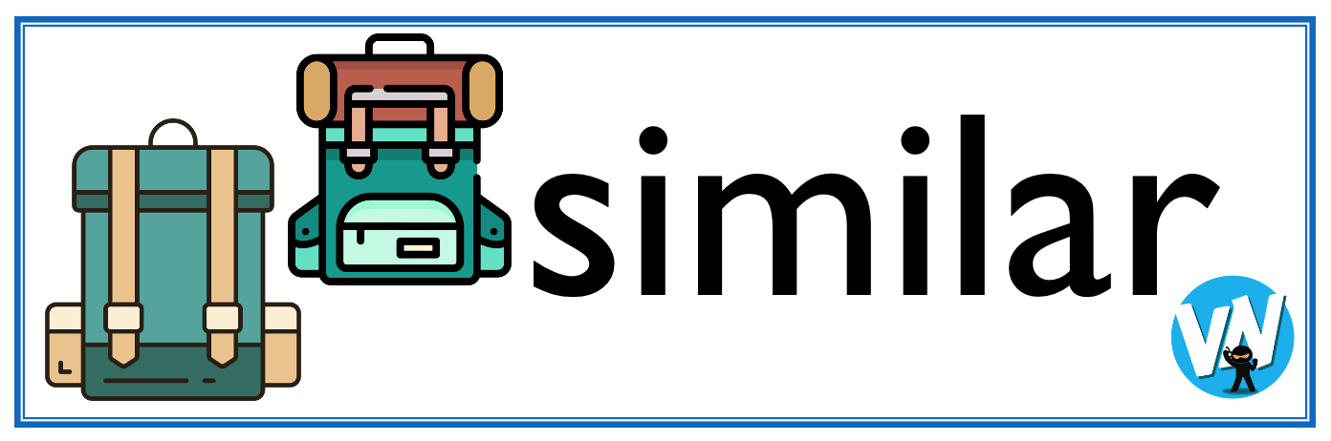




Display Slips
The following slides are for classroom display. As you teach each Word of the Day, words can be displayed in the classroom to enable pupils to use the taught vocabulary in an independent manner.

Slide 21
tell
size

Slide 22
trouble
nest

Slide 23
need
proof

Slide 24
character
comprehend

Slide 25
debt
react

Slide 26
Font Variation
The following display slips contain the same words, but have a more regular font, which have a more regular formation of ‘a’ and ‘g’. Futura is the name of the font.

Slide 27
tell
night
size

Slide 28
trouble
nest

Slide 29
need
proof

Slide 30
character
comprehend

Slide 31
debt
react

