Slide 1
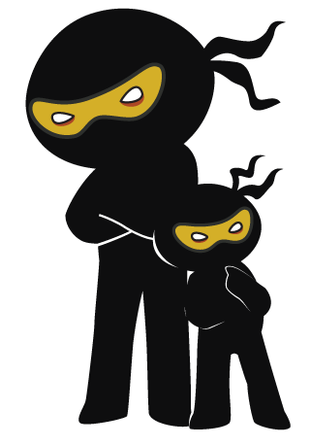



Word of the Day
Autumn Term 2023
Week 2 – 11th September 2023
'Words unlock the doors to a world of understanding...'

Slide 2

This Week's Words
Grasshopper
Shinobi
stick
drone
canopy
adamant
ledge
sturdy
never
mottled
kind
placid

Slide 3
Grasshopper (Tier 1)
stick
canopy
ledge
never
kind

Slide 4
Shinobi (Tier 2)
drone
adamant
sturdy
mottled
placid

Slide 5

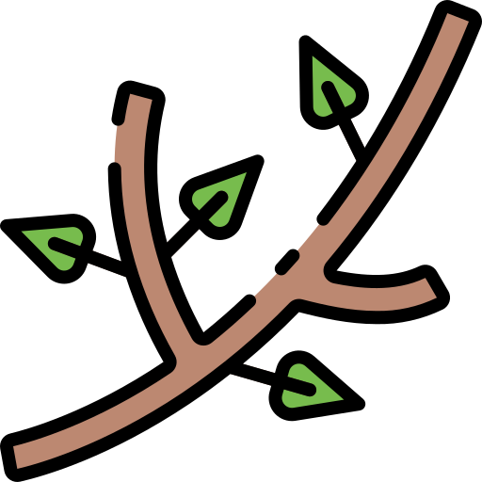
Grasshopper Word of the Day
stick
Word Class
Word of the Day:
(noun / verb)
(stick)
Pronunciation / Syllables
Definition:
A stick is a thin branch which has fallen off a tree.
Suzanne picked up a large stick in the playground.
Synonym: | Antonym: | Prefix / Suffix: | Rhyme: | Link Word:
twig |  | lip- | thick | spikey
cane |  | -ing | slick | brown

Slide 6

Grasshopper Word of the Day
canopy
Word Class
Word of the Day:
(noun)
(con-o-py)
Pronunciation / Syllables
Definition:
A canopy is a decorated cover, often made of cloth, which is placed above something such as a bed or a seat.
The class hid under the canopy when it started to rain.
Synonym: | Antonym: | Prefix / Suffix: | Rhyme: | Link Word:
awning |  |  |  | large
shade |  |  |  | fabric

Slide 7
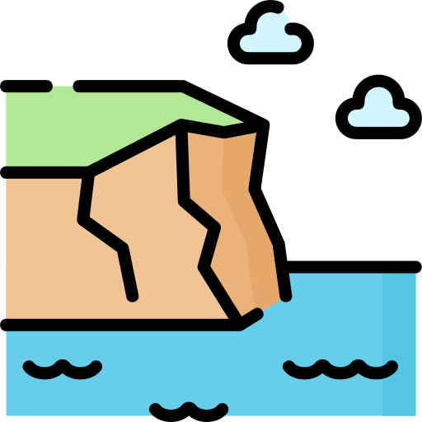
Grasshopper Word of the Day
ledge
Word Class
Word of the Day:
(noun)
(ledge)
Pronunciation / Syllables
Definition:
A ledge is a piece of rock on the side of a cliff or mountain, which is in the shape of a narrow shelf.
The class were told to come away from the ledge of the cliff.
Synonym: | Antonym: | Prefix / Suffix: | Rhyme: | Link Word:
shelf |  |  | edge | sat
mantel |  |  | pledge | high

Slide 8

Grasshopper Word of the Day
never
Word Class
Word of the Day:
(adverb)
(nev-er)
Pronunciation / Syllables
Definition:
Never means 'not in any circumstances at all'.
Amit was never disruptive in class.
Synonym: | Antonym: | Prefix / Suffix: | Rhyme: | Link Word:
at no time | always | when- | clever | again
no way | forever | -more |  | mistake

Slide 9
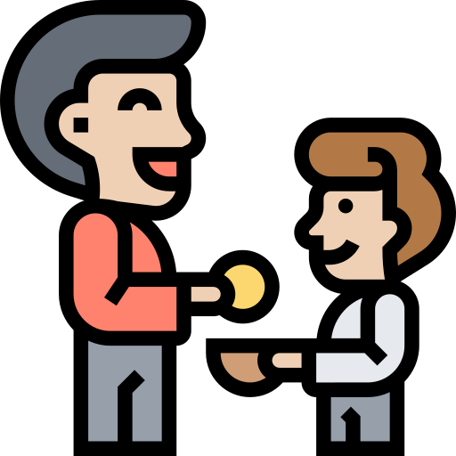
Grasshopper Word of the Day
kind
Word Class
Word of the Day:
(adjective)
(kind)
Pronunciation / Syllables
Definition:
Someone who is kind behaves in a gentle, caring, and helpful way towards other people.
Mr Jevons told Sonny he was kind for sharing his sweets.
Synonym: | Antonym: | Prefix / Suffix: | Rhyme: | Link Word:
caring | mean | -ness | find | person
tender | cruel | un- | mind | friend

Slide 10

Shinobi Word of the Day
drone
Word Class
Word of the Day:
(noun)
(drone)
Pronunciation / Syllables
Definition:
People who do not contribute anything to society or to an organisation are sometimes described as drones.
Jemma was called a drone by Durga for copying Jack.
Synonym: | Antonym: | Prefix / Suffix: | Rhyme: | Link Word:
parasite |  | a- | own | boring
 |  | -ness | zone | mindless

Slide 11
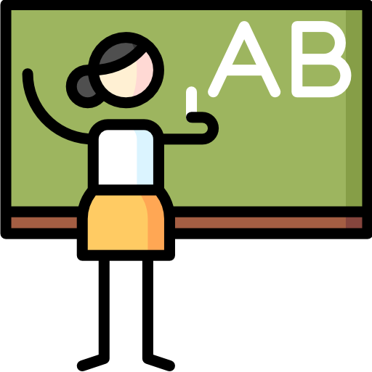
Shinobi Word of the Day
adamant
Word Class
Word of the Day:
(noun)
(ad-a-mant)
Pronunciation / Syllables
Definition:
If someone is adamant about something, they are determined not to change their mind about it.
Katy was adamant that she got the spelling correct.
Synonym: | Antonym: | Prefix / Suffix: | Rhyme: | Link Word:
firm | unsure |  |  | strongly
rigid |  |  |  | consistently

Slide 12

Shinobi Word of the Day
sturdy
Word Class
Word of the Day:
(adjective)
(stur-dy)
Pronunciation / Syllables
Definition:
Someone or something that is sturdy looks strong and is unlikely to be easily injured or damaged.
The class chairs were sturdy.
Synonym: | Antonym: | Prefix / Suffix: | Rhyme: | Link Word:
powerful | puny |  | thirty | person
robust | frail |  |  | very

Slide 13
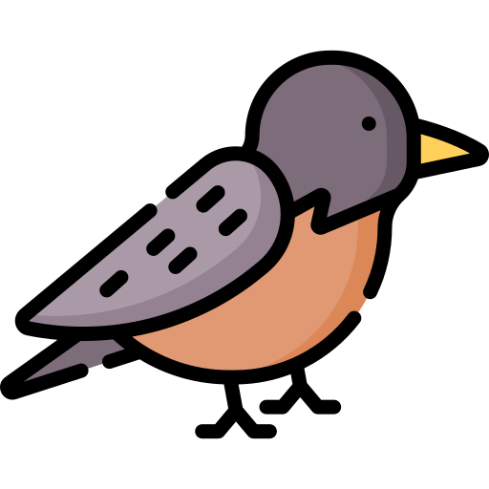
Shinobi Word of the Day
mottled
Word Class
Word of the Day:
(adjective)
(mot-tled)
Pronunciation / Syllables
Definition:
Something that is mottled is covered with patches of different colours which do not form a regular pattern.
The bird outside the class window had mottled plumage.
Synonym: | Antonym: | Prefix / Suffix: | Rhyme: | Link Word:
blotchy |  | -led | throttled | brown
spotted |  |  |  | skin

Slide 14
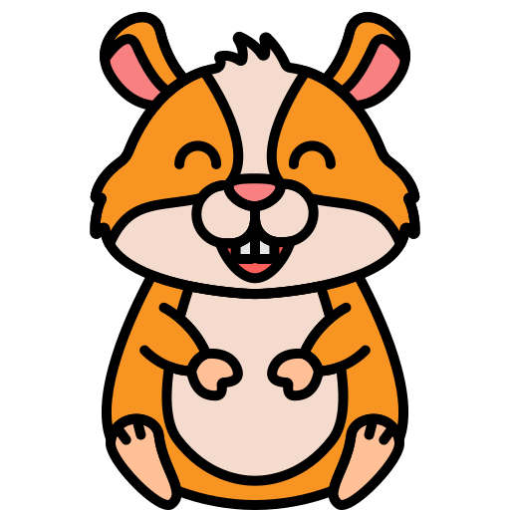
Shinobi Word of the Day
placid
Word Class
Word of the Day:
(adjective)
(plac-id)
Pronunciation / Syllables
Definition:
A placid person or animal is calm and does not easily become excited,
angry, or upset.
The class hamster was very placid.
Synonym: | Antonym: | Prefix / Suffix | Rhyme: | Link Word:
calm | excitable | -ly |  | dog
mild | temperamental |  |  | child

Slide 15
Vocabulary Laboratory
Describe / Definition:
Use it in a sentence:
Focus Word (write below):
Word Class:
Synonyms: (words with same / similar meaning) | Antonyms: (words with opposite meaning)
Rhymes: (words that sound the same) | Link Words: (Example: football = pitch, team, player)
Draw your sentence:

Slide 16
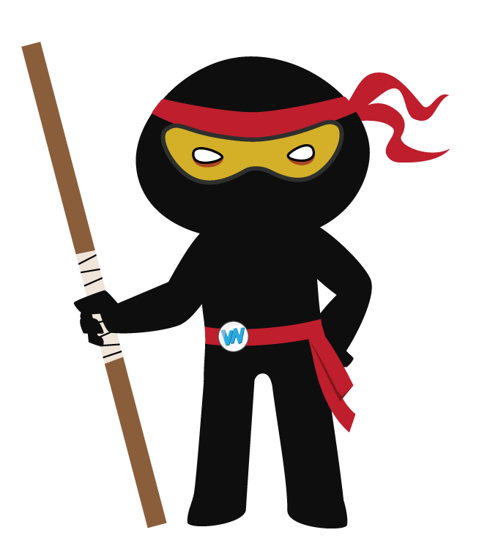
Vocabulary Visualiser
Draw the Grasshopper words and bring them to life.
Word: stick | Word: ledge
Word: canopy | Word: kind

Slide 17
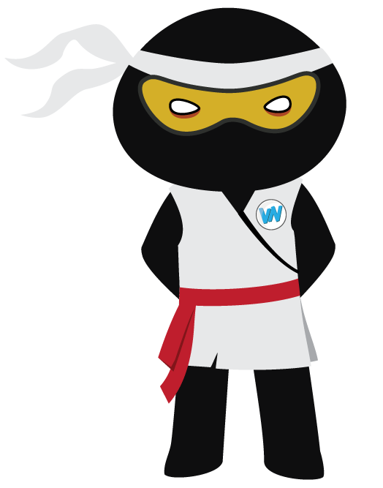
Vocabulary Visualiser
Draw the Shinobi words and bring them to life.
Word: drone | Word: mottled
Word: sturdy | Word: placid

Slide 18
Matching Meanings
Draw lines from the Grasshopper words to their definitions.
Grasshopper Word
stick
canopy
ledge
never
kind
Grasshopper Definitions
A *** is a piece of rock on the side of a cliff or mountain, which is in the shape of a narrow shelf.
A *** is a thin branch which has fallen off a tree.
*** means 'not in any circumstances at all'.
Someone who is *** behaves in a gentle, caring, and helpful way towards other people.
A *** is a decorated cover, often made of cloth, which is placed above something such as a bed or a seat.

Slide 19
Matching Meanings
Draw lines from the Shinobi words to their definitions.
Shinobi Word
drone
adamant
sturdy
mottled
placid
Shinobi Definitions
Someone or something that is *** looks strong and is unlikely to be easily injured or damaged.
Something that is *** is covered with patches of different colours which do not form a regular pattern.
If someone is *** about something, they are determined not to change their mind about it.
A *** person or animal is calm and does not easily become excited, angry, or upset.
People who do not contribute anything to society or to an organisation are sometimes described as ***.

Slide 20
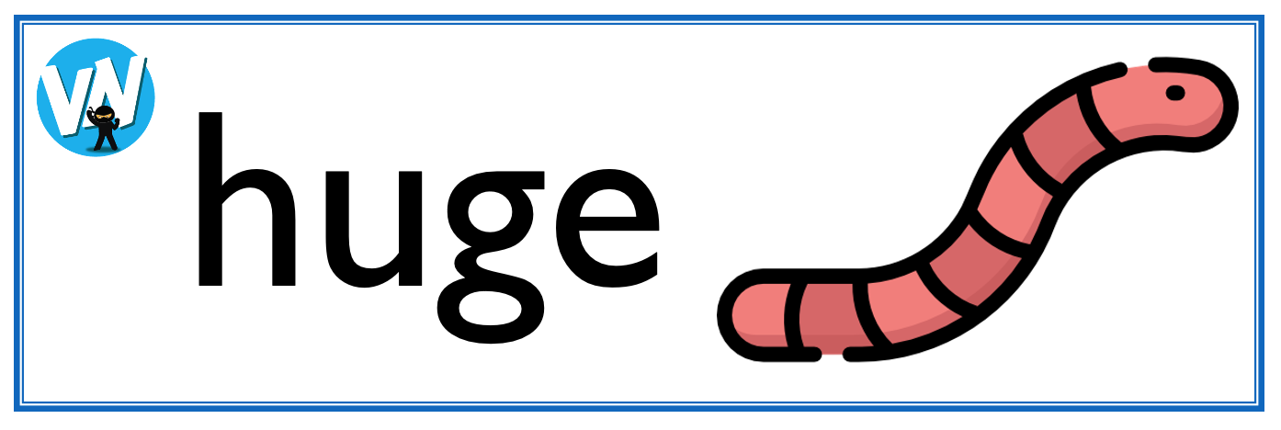
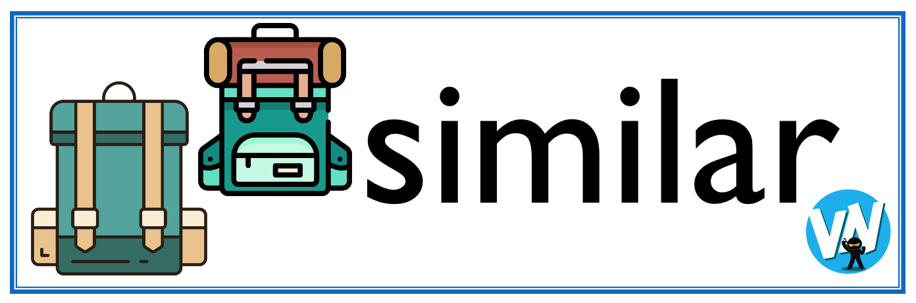




Display Slips
The following slides are for classroom display. As you teach each Word of the Day, words can be displayed in the classroom to enable pupils to use the taught vocabulary in an independent manner.

Slide 21
stick
canopy

Slide 22
ledge
never

Slide 23
kind
drone

Slide 24
adamant
sturdy

Slide 25
mottled
placid

Slide 26
Font Variation
The following display slips contain the same words, but have a more regular font, which have a more regular formation of ‘a’ and ‘g’. Futura is the name of the font.

Slide 27
stick
canopy

Slide 28
ledge
never

Slide 29
kind
drone

Slide 30
adamant
sturdy

Slide 31
mottled
placid

