Slide 1
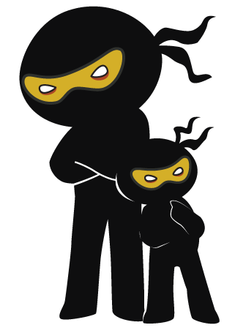



Word of the Day
Autumn Term 2023
Week 3 – 18th September 2023
'Words unlock the doors to a world of understanding...'

Slide 2

This Week's Words
Grasshopper
Shinobi
load
conserve
dim
pelt
know
coat
coat
submerge
blind
progress

Slide 3
Grasshopper (Tier 1)
load
dim
know
coat
blind

Slide 4
Shinobi (Tier 2)
conserve
pelt
coat
submerge
progress

Slide 5


Grasshopper Word of the Day
load
Word Class
Word of the Day:
(verb / noun)
(load)
Pronunciation / Syllables
Definition:
If you load a vehicle or a container, you put a large quantity of things into it.
Abdur loaded the pencils into the class pencil holder.
Synonym: | Antonym: | Prefix / Suffix: | Rhyme: | Link Word:
fill | upload | over- | road | heavy
pack |  | -ed | code | deposited

Slide 6

Grasshopper Word of the Day
dim
Word Class
Word of the Day:
(adjective / verb)
(dim)
Pronunciation / Syllables
Definition:
A dim place is rather dark because there is not much light in it.
Mrs Mckee turned the lights down to make the classroom dim.
Synonym: | Antonym: | Prefix / Suffix: | Rhyme: | Link Word:
soft | bright | -inished | him | light
dingy | clear | -ly | limb | room

Slide 7

Grasshopper Word of the Day
know
Word Class
Word of the Day:
(verb)
(know)
Pronunciation / Syllables
Definition:
If you know a fact, a piece of information, or an answer, you have it correctly in your mind.
Iris knew the answer to the difficult maths question.
Synonym: | Antonym: | Prefix / Suffix: | Rhyme: | Link Word:
notice |  | -n | so | name
sense |  |  | low | don’t

Slide 8
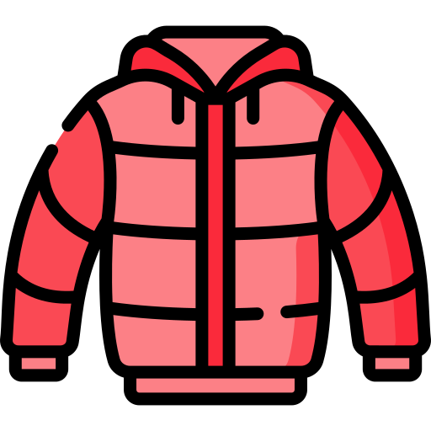
Grasshopper Word of the Day
coat
Word Class
Word of the Day:
(noun)
(coat)
Pronunciation / Syllables
Definition:
A coat is a piece of clothing with long sleeves which you wear over your other clothes when you go outside.
Ismael loved his new school coat.
Synonym: | Antonym: | Prefix / Suffix: | Rhyme: | Link Word:
jacket |  | over- | note | warm
parka |  | -ed | wrote | fancy

Slide 9

Grasshopper Word of the Day
blind
Word Class
Word of the Day:
(verb/adjective)
(blind)
Pronunciation / Syllables
Definition:
If something blinds you, it makes you unable to see, either for a short time or permanently.
When the lights went on in the classroom, they blinded Pippa.
Synonym: | Antonym: | Prefix / Suffix: | Rhyme: | Link Word:
visually impaired | sighted | colour- | find | tears
sightless |  | -ness | mind | torch

Slide 10

Shinobi Word of the Day
conserve
Word Class
Word of the Day:
(verb)
(con-serve)
Pronunciation / Syllables
Definition:
If you conserve a supply of something, you use it carefully so that it lasts for a long time.
Frank wanted to conserve his energy before the school race.
Synonym: | Antonym: | Prefix / Suffix: | Rhyme: | Link Word:
protect | squander | -ed | deserve | food
maintain | waste | -ing | curve | rest

Slide 11

Shinobi Word of the Day
pelt
Word Class
Word of the Day:
(verb)
(pelt)
Pronunciation / Syllables
Definition:
If you pelt someone with things, you throw things at them.
Lexi pelted the classroom with paper aeroplanes.
Synonym: | Antonym: | Prefix / Suffix: | Rhyme: | Link Word:
attack |  | s- | felt | snowball
blitz |  | miss- | belt | down

Slide 12

Shinobi Word of the Day
coat
Word Class
Word of the Day:
(verb)
(coat)
Pronunciation / Syllables
Definition:
If you coat something with a substance or in a substance, you cover it with a thin layer of the substance.
The class table was coated in paint after the art lesson.
Synonym: | Antonym: | Prefix / Suffix: | Rhyme: | Link Word:
cover |  | top- | throat | gloss
overlay |  | -ed | moat | flour

Slide 13

Shinobi Word of the Day
submerge
Word Class
Word of the Day:
(verb)
(sub-merge)
Pronunciation / Syllables
Definition:
If something submerges or if you submerge it, it goes below the surface of some water or another liquid.
Verity submerged her water bottle in the sink.
Synonym: | Antonym: | Prefix / Suffix: | Rhyme: | Link Word:
flood |  | sub- | surge | river
engulf |  | -ment | converge | fully

Slide 14

Shinobi Word of the Day
progress
Word Class
Word of the Day:
(noun)
(prog-ress)
Pronunciation / Syllables
Definition:
Progress is the process of gradually improving or getting nearer to achieving or completing something.
Awais made great progress in literacy.
Synonym: | Antonym: | Prefix / Suffix | Rhyme: | Link Word:
develop | regress | -ion |  | towards
advance | deteriorate | -ive |  | quickly

Slide 15
Vocabulary Laboratory
Describe / Definition:
Use it in a sentence:
Focus Word (write below):
Word Class:
Synonyms: (words with same / similar meaning) | Antonyms: (words with opposite meaning)
Rhymes: (words that sound the same) | Link Words: (Example: football = pitch, team, player)
Draw your sentence:

Slide 16

Vocabulary Visualiser
Draw the Grasshopper words and bring them to life.
Word: load | Word: coat
Word: coat | Word: blind

Slide 17

Vocabulary Visualiser
Draw the Shinobi words and bring them to life.
Word: conserve | Word: coat
Word: pelt | Word: submerge

Slide 18
Matching Meanings
Draw lines from the Grasshopper words to their definitions.
Grasshopper Word
load
dim
know
coat
blind
Grasshopper Definitions
A *** place is rather dark because there is not much light in it.
If you *** a fact, a piece of information, or an answer, you have it correctly in your mind.
If you *** a vehicle or a container, you put a large quantity of things into it.
If something *** you, it makes you unable to see, either for a short time or permanently.
A *** is a piece of clothing with long sleeves which you wear over your other clothes when you go outside.

Slide 19
Matching Meanings
Draw lines from the Shinobi words to their definitions.
Shinobi Word
conserve
pelt
coat
submerge
progress
Shinobi Definitions
If you *** a supply of something, you use it carefully so that it lasts for a long time.
If you *** something with a substance or in a substance, you cover it with a thin layer of the substance.
If something *** or if you *** it, it goes below the surface of some water or another liquid.
*** is the process of gradually improving or getting nearer to achieving or completing something.
If you *** someone with things, you throw things at them.

Slide 20






Display Slips
The following slides are for classroom display. As you teach each Word of the Day, words can be displayed in the classroom to enable pupils to use the taught vocabulary in an independent manner.

Slide 21
load
dim

Slide 22
know
coat

Slide 23
blind
conserve

Slide 24
pelt
coat

Slide 25
submerge
progress

Slide 26
Font Variation
The following display slips contain the same words, but have a more regular font, which have a more regular formation of ‘a’ and ‘g’. Futura is the name of the font.

Slide 27
load
dim

Slide 28
know
coat

Slide 29
blind
conserve

Slide 30
pelt
coat

Slide 31
submerge
progress

