Slide 1
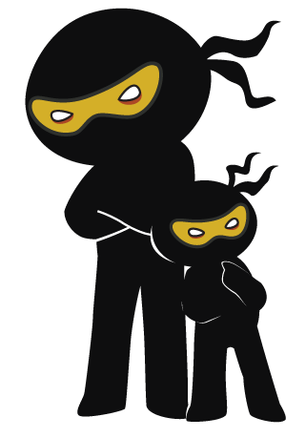



Word of the Day
Autumn Term 2023
Week 4 – 25th September 2023
'Words unlock the doors to a world of understanding...'

Slide 2

This Week's Words
Grasshopper
Shinobi
glove
weave
branch
motionless
within
irregular
trap
artificial
Autumn
rooted

Slide 3
Grasshopper (Tier 1)
glove
branch
within
trap
Autumn

Slide 4
Shinobi (Tier 2)
weave
motionless
irregular
artificial
rooted

Slide 5


Grasshopper Word of the Day
glove
Word Class
Word of the Day:
(noun)
(glove)
Pronunciation / Syllables
Definition:
Gloves are pieces of clothing which cover your hands and wrists and have individual sections for each finger.
Finton wore his new gloves to school.
Synonym: | Antonym: | Prefix / Suffix: | Rhyme: | Link Word:
mitten |  | fox- | love | fitted
 |  | -less | dove | warm

Slide 6
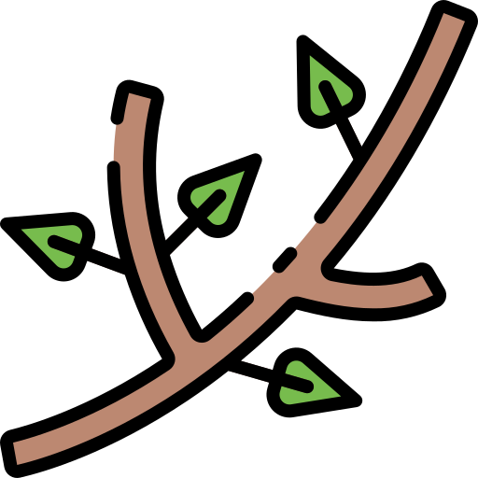
Grasshopper Word of the Day
branch
Word Class
Word of the Day:
(noun)
(branch)
Pronunciation / Syllables
Definition:
The branches of a tree are the parts that grow out from its trunk and have leaves, flowers, or fruit growing on them.
The branch kept tapping on the classroom window in the wind.
Synonym: | Antonym: | Prefix / Suffix: | Rhyme: | Link Word:
bough |  | -es | ranch | spiked
limb |  | -ing | blanch | brown

Slide 7

Grasshopper Word of the Day
within
Word Class
Word of the Day:
(preposition)
(with-in)
Pronunciation / Syllables
Definition:
If something is within a place, area, or object, it is inside it or surrounded by it.
Within the classroom, the students eagerly gathered around Mrs Crosby to listen to a captivating story.
Synonym: | Antonym: | Prefix / Suffix: | Rhyme: | Link Word:
inside | outside |  | begin | the
 |  |  | skin | sight

Slide 8

Grasshopper Word of the Day
trap
Word Class
Word of the Day:
(noun/verb)
(trap)
Pronunciation / Syllables
Definition:
A trap is a device which is placed somewhere or a hole which is dug somewhere in order to catch animals or birds.
Mr Foley placed a cleverly disguised trap near the classroom's bookshelf for the mouse.
Synonym: | Antonym: | Prefix / Suffix: | Rhyme: | Link Word:
trick |  | s- | gap | dangerous
ploy |  | -ped | cap | sensed

Slide 9
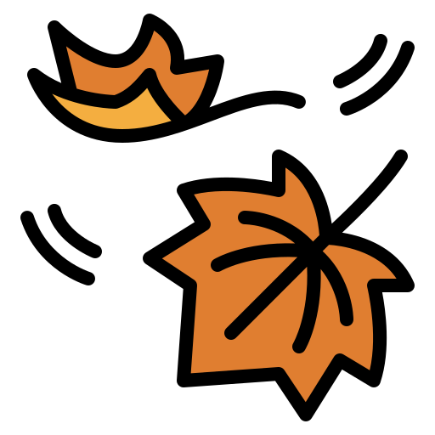
Grasshopper Word of the Day
Autumn
Word Class
Word of the Day:
(noun)
(Au-tumn)
Pronunciation / Syllables
Definition:
Autumn is the season between summer and winter when the weather becomes cooler and the leaves fall off the trees.
The leaves fell from the trees in the playground as it was Autumn.
Synonym: | Antonym: | Prefix / Suffix: | Rhyme: | Link Word:
fall |  | mid- |  | leaves
 |  | -al |  | cool

Slide 10
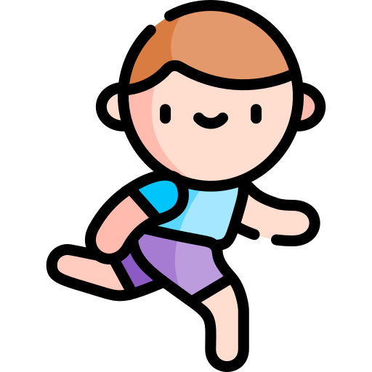

Shinobi Word of the Day
weave
Word Class
Word of the Day:
(verb)
(weave)
Pronunciation / Syllables
Definition:
If you weave your way somewhere, you move between and around things as you go there.
Farrah wove in and out of the other students to get to the front of the class.
Synonym: | Antonym: | Prefix / Suffix: | Rhyme: | Link Word:
ripple |  | micro- | gave | in
flutter |  | -length | cave | out

Slide 11

Shinobi Word of the Day
motionless
Word Class
Word of the Day:
(adjective)
(mo-tion-less)
Pronunciation / Syllables
Definition:
Someone or something that is motionless is not moving at all.
Farrah was motionless when he saw a spider in the classroom.
Synonym: | Antonym: | Prefix / Suffix: | Rhyme: | Link Word:
unmoving | moving | e- | emotionless | stood
still | mobile | -ly |  | were

Slide 12

Shinobi Word of the Day
irregular
Word Class
Word of the Day:
(verb)
(i-reg-u-lar)
Pronunciation / Syllables
Definition:
If events or actions occur at irregular intervals, the periods of time between them are of different lengths.
Mrs Bass introduced the concept of irregular shapes by showing the students a polygon.
Synonym: | Antonym: | Prefix / Suffix: | Rhyme: | Link Word:
asymmetrical | regular | -ities |  | intervals
crooked | straight | -ity |  | worked

Slide 13

Shinobi Word of the Day
artificial
Word Class
Word of the Day:
(adjective)
(ar-ti-fi-cial)
Pronunciation / Syllables
Definition:
Artificial objects, materials, or processes do not occur naturally and are created by human beings, for example using science or technology.
Mr Stein put artificial flowers in the classroom.
Synonym: | Antonym: | Prefix / Suffix: | Rhyme: | Link Word:
fake | genuine | in- | official | sweetened
synthetic | sincere | -ly | superficial | environment

Slide 14

Shinobi Word of the Day
rooted
Word Class
Word of the Day:
(adjective)
(root-ed)
Pronunciation / Syllables
Definition:
If you say that one thing is rooted in another, you mean that it is strongly influenced by it or has developed from it.
Billy was rooted to the spot when he was told off by Mrs Foley.
Synonym: | Antonym: | Prefix / Suffix | Rhyme: | Link Word:
embedded | regress | up- | suited | traditional
fixed | deteriorate | -ness | looted | deep

Slide 15
Vocabulary Laboratory
Describe / Definition:
Use it in a sentence:
Focus Word (write below):
Word Class:
Synonyms: (words with same / similar meaning) | Antonyms: (words with opposite meaning)
Rhymes: (words that sound the same) | Link Words: (Example: football = pitch, team, player)
Draw your sentence:

Slide 16

Vocabulary Visualiser
Draw the Grasshopper words and bring them to life.
Word: glove | Word: trap
Word: branch | Word: Autumn

Slide 17

Vocabulary Visualiser
Draw the Shinobi words and bring them to life.
Word: weave | Word: artificial
Word: motionless | Word: rooted

Slide 18
Matching Meanings
Draw lines from the Grasshopper words to their definitions.
Grasshopper Word
glove
branch
within
trap
Autumn
Grasshopper Definitions
The *** of a tree are the parts that grow out from its trunk and have leaves, flowers, or fruit growing on them.
A *** is a device which is placed somewhere or a hole which is dug somewhere in order to catch animals or birds.
*** are pieces of clothing which cover your hands and wrists and have individual sections for each finger.
*** is the season between summer and winter when the weather becomes cooler and the leaves fall off the trees.
If something is *** a place, area, or object, it is inside it or surrounded by it.

Slide 19
Matching Meanings
Draw lines from the Shinobi words to their definitions.
Shinobi Word
weave
motionless
irregular
artificial
rooted
Shinobi Definitions
*** objects, materials, or processes do not occur naturally and are created by human beings, for example using science or technology.
If you say that one thing is *** in another, you mean that it is strongly influenced by it or has developed from it.
Someone or something that is *** is not moving at all.
If events or actions occur at *** intervals, the periods of time between them are of different lengths.
If you *** your way somewhere, you move between and around things as you go there.

Slide 20
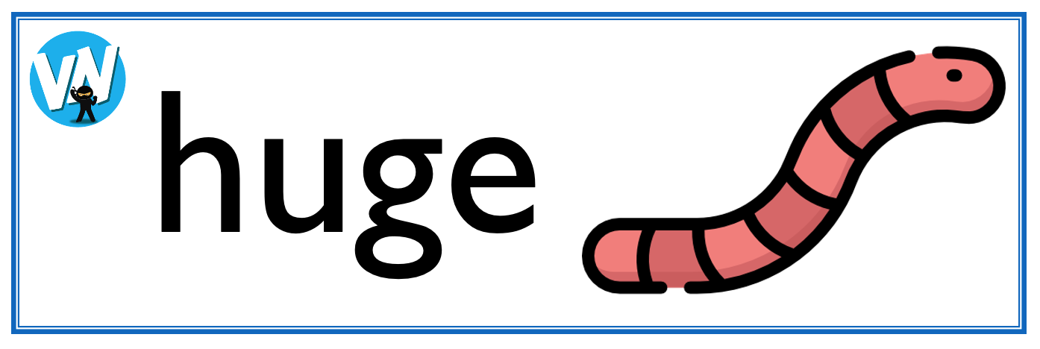
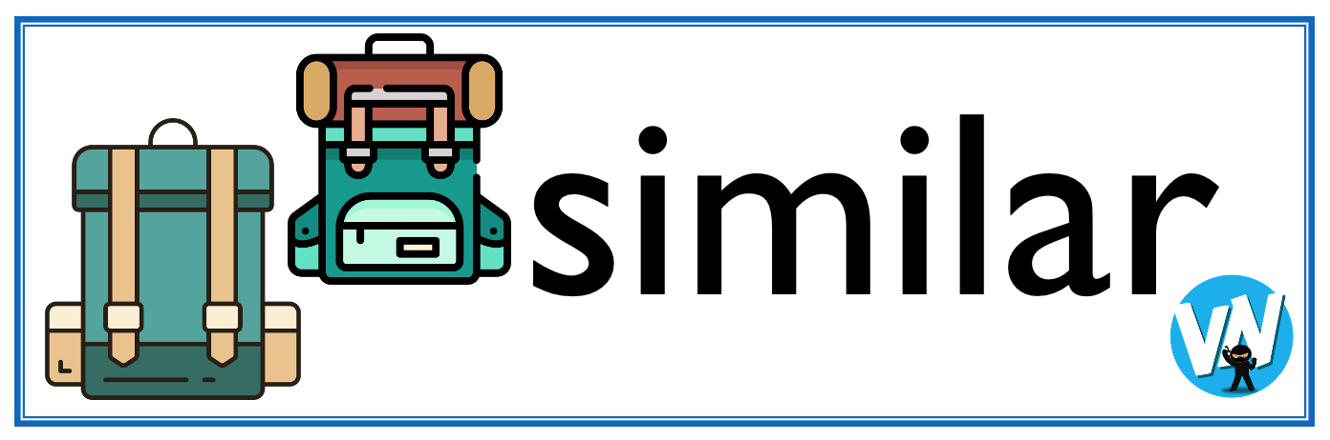




Display Slips
The following slides are for classroom display. As you teach each Word of the Day, words can be displayed in the classroom to enable pupils to use the taught vocabulary in an independent manner.

Slide 21
glove
branch

Slide 22
within
trap

Slide 23
Autumn
weave

Slide 24
motionless
irregular

Slide 25
artificial
rooted

Slide 26
Font Variation
The following display slips contain the same words, but have a more regular font, which have a more regular formation of ‘a’ and ‘g’. Futura is the name of the font.

Slide 27
glove
branch

Slide 28
within
trap

Slide 29
Autumn
weave

Slide 30
motionless
irregular

Slide 31
artificial
rooted

