Slide 1
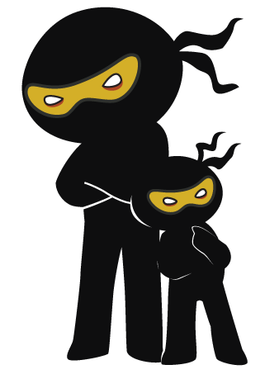



Word of the Day
Autumn Term 2023
Week 5 – 2nd October 2023
'Words unlock the doors to a world of understanding...'

Slide 2

This Week's Words
Grasshopper
Shinobi
night
scrumple
mist
plump
little
cavern
stiff
abyss
mop
row

Slide 3
Grasshopper (Tier 1)
night
mist
little
stiff
mop

Slide 4
Shinobi (Tier 2)
scrumple
plump
cavern
abyss
row

Slide 5


Grasshopper Word of the Day
night
Word Class
Word of the Day:
(noun)
(night)
Pronunciation / Syllables
Definition:
The night is the part of each day when the sun has set and it is dark outside, especially the time when people are sleeping.
Jim thought that it was night as it was so dark outside.
Synonym: | Antonym: | Prefix / Suffix: | Rhyme: | Link Word:
darkness | day | mid- | fight | last
 | light | -mare | white | following

Slide 6

Grasshopper Word of the Day
mist
Word Class
Word of the Day:
(noun)
(mist)
Pronunciation / Syllables
Definition:
Mist consists of a large number of tiny drops of water in the air, which make it difficult to see very far.
There was thick mist outside the classroom.
Synonym: | Antonym: | Prefix / Suffix: | Rhyme: | Link Word:
haze |  | che- | list | swirled
fog |  | -ake | wrist | hung

Slide 7

Grasshopper Word of the Day
little
Word Class
Word of the Day:
(adjective / determiner)
(lit-tle)
Pronunciation / Syllables
Definition:
You use little to indicate that there is only a very small amount of something.
Mrs Gibson needed a little help with handing out the class books.
Synonym: | Antonym: | Prefix / Suffix: | Rhyme: | Link Word:
small | big | be- | brittle | money
mini | large | -ness | skittle | attention

Slide 8

Grasshopper Word of the Day
stiff
Word Class
Word of the Day:
(adjective)
(stiff)
Pronunciation / Syllables
Definition:
Something that is stiff is firm or does not bend easily.
The classroom door was very stiff to open.
Synonym: | Antonym: | Prefix / Suffix: | Rhyme: | Link Word:
rigid | flexible | ma- | gap | cliff
hard | limp | -ness | cap | sniff

Slide 9

Grasshopper Word of the Day
mop
Word Class
Word of the Day:
(noun/verb)
(mop)
Pronunciation / Syllables
Definition:
A mop is a piece of equipment for washing floors. It consists of a sponge or many pieces of string attached to a long handle.
Mr Horton used the mop to clean up the spill in the hall.
Synonym: | Antonym: | Prefix / Suffix: | Rhyme: | Link Word:
sponge |  | -ping | top | cleaned
 |  | -ed | stop | swished

Slide 10
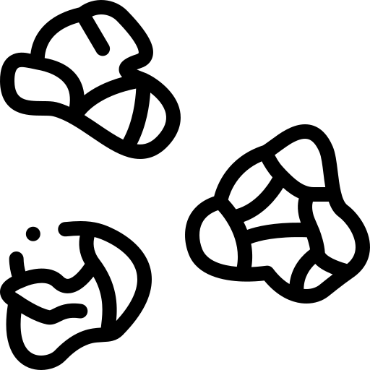
Shinobi Word of the Day
scrumple
Word Class
Word of the Day:
(verb)
(scrum-ple)
Pronunciation / Syllables
Definition:
To crumple or crush (something, esp a piece of paper) or (esp of a piece of paper) to become crumpled or crushed
Inez scrumpled up his work as he got a maths question wrong.
Synonym: | Antonym: | Prefix / Suffix: | Rhyme: | Link Word:
crush | smooth out | -d | rumple | bin
crumple | iron | -s |  | work

Slide 11

Shinobi Word of the Day
plump
Word Class
Word of the Day:
(verb)
(plump)
Pronunciation / Syllables
Definition:
If you plump a pillow or cushion, you shake it and hit it gently so that it goes back into a rounded shape.
Mr Hamilton plumped the cushions in the staffroom.
Synonym: | Antonym: | Prefix / Suffix: | Rhyme: | Link Word:
shake |  | -ed | jump | cushion
pat |  | -ness | lump | fiercely

Slide 12

Shinobi Word of the Day
cavern
Word Class
Word of the Day:
(noun)
(cav-ern)
Pronunciation / Syllables
Definition:
A cavern is a large deep cave.
Year 5 visited an old cavern on a school trip.
Synonym: | Antonym: | Prefix / Suffix: | Rhyme: | Link Word:
asymmetrical | regular | -ous | tavern | dark
crooked | straight | -oma |  | cold

Slide 13

Shinobi Word of the Day
abyss
Word Class
Word of the Day:
(noun)
(a-byss)
Pronunciation / Syllables
Definition:
If someone is on the edge or brink of an abyss, they are about to enter into a very frightening or threatening
situation.
Mr Santos told the class he had fallen into an abyss of marking homework.
Synonym: | Antonym: | Prefix / Suffix: | Rhyme: | Link Word:
gulf |  | -al | bliss | big
pit |  | -es | dismiss | brink

Slide 14

Shinobi Word of the Day
row
Word Class
Word of the Day:
(noun)
(row)
Pronunciation / Syllables
Definition:
A row is a serious disagreement between people or organisations.
Kyle and Peter had a heated row in the playground.
Synonym: | Antonym: | Prefix / Suffix | Rhyme: | Link Word:
argument | reconciliation | th- | now | huge
quarrel | agreement | -ing | cow | hurtful

Slide 15
Vocabulary Laboratory
Describe / Definition:
Use it in a sentence:
Focus Word (write below):
Word Class:
Synonyms: (words with same / similar meaning) | Antonyms: (words with opposite meaning)
Rhymes: (words that sound the same) | Link Words: (Example: football = pitch, team, player)
Draw your sentence:

Slide 16

Vocabulary Visualiser
Draw the Grasshopper words and bring them to life.
Word: night | Word: little
Word: mist | Word: mop

Slide 17

Vocabulary Visualiser
Draw the Shinobi words and bring them to life.
Word: scrumple | Word: cavern
Word: plump | Word: row

Slide 18
Matching Meanings
Draw lines from the Grasshopper words to their definitions.
Grasshopper Word
night
mist
little
stiff
mop
Grasshopper Definitions
*** consists of a large number of tiny drops of water in the air, which make it difficult to see very far.
Something that is *** is firm or does not bend easily.
The *** is the part of each day when the sun has set and it is dark outside, especially the time when people are sleeping.
A *** is a piece of equipment for washing floors. It consists of a sponge or many pieces of string attached to a long handle.
You use *** to indicate that there is only a very small amount of something.

Slide 19
Matching Meanings
Draw lines from the Shinobi words to their definitions.
Shinobi Word
scrumple
plump
cavern
abyss
row
Shinobi Definitions
A *** is a large deep cave.
To crumple or crush (something, esp a piece of paper) or (esp of a piece of paper) to become crumpled or crushed.
If someone is on the edge or brink of an ***, they are about to enter into a very frightening or threatening situation.
If you *** a pillow or cushion, you shake it and hit it gently so that it goes back into a rounded shape.
A *** is a serious disagreement between people or organisations.

Slide 20






Display Slips
The following slides are for classroom display. As you teach each Word of the Day, words can be displayed in the classroom to enable pupils to use the taught vocabulary in an independent manner.

Slide 21
night
mist

Slide 22
little
stiff

Slide 23
mop
scrumple

Slide 24
plump
cavern

Slide 25
abyss
row

Slide 26
Font Variation
The following display slips contain the same words, but have a more regular font, which have a more regular formation of ‘a’ and ‘g’. Futura is the name of the font.

Slide 27
night
night
mist

Slide 28
little
stiff

Slide 29
mop
scrumple

Slide 30
plump
cavern

Slide 31
abyss
row

