Slide 1




Word of the Day
Autumn Term 2023
Week 1 – 4th September 2023
'Words unlock the doors to a world of understanding...'

Slide 2

This Week's Words
Grasshopper
Shinobi
tear
surface
rear
activate
different
litter
pay
urge
speck
method

Slide 3
Grasshopper (Tier 1)
tear
rear
different
pay
speck

Slide 4
Shinobi (Tier 2)
surface
activate
litter
urge
method

Slide 5


Grasshopper Word of the Day
tear
Word Class
Word of the Day:
(verb)
(tear)
Pronunciation / Syllables
Definition:
If you tear paper, cloth, or another material, or if it tears, you pull it into two pieces or you pull it so that a hole appears in it.
Mark wanted to tear up his work.
Synonym: | Antonym: | Prefix / Suffix: | Rhyme: | Link Word:
shred |  | -ing | there | apart
rip up |  |  | care | angrily

Slide 6

Grasshopper Word of the Day
rear
Word Class
Word of the Day:
(noun)
(rear)
Pronunciation / Syllables
Definition:
The rear of something such as a building or vehicle is the back part of it.
Nicola wanted to sit at the rear of the classroom
Synonym: | Antonym: | Prefix / Suffix: | Rhyme: | Link Word:
back | front | d- | hear | building
 |  | -ranged | year | taxi

Slide 7
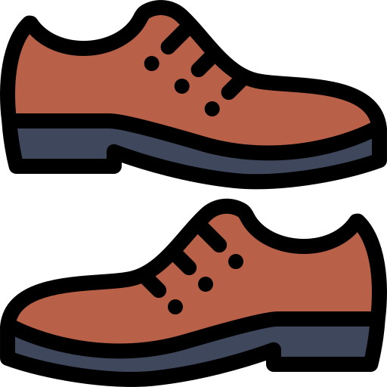
Grasshopper Word of the Day
different
Word Class
Word of the Day:
(adjective)
(dif-fer-ent)
Pronunciation / Syllables
Definition:
If two people or things are different, they are not like each other in one or more ways.
Hana and Leah wore different shoes for school.
Synonym: | Antonym: | Prefix / Suffix: | Rhyme: | Link Word:
dissimilar | same | in- |  | view
unalike | similar | -ly |  | totally

Slide 8

Grasshopper Word of the Day
pay
Word Class
Word of the Day:
(verb)
(pay)
Pronunciation / Syllables
Definition:
When you pay an amount of money to someone, you give it to them because you are buying something from them or because you owe it to them.
Jay needed to pay the teacher for the school trip.
Synonym: | Antonym: | Prefix / Suffix: | Rhyme: | Link Word:
reimburse |  | re- | day | little
tip |  | -ment | play | cash

Slide 9

Grasshopper Word of the Day
speck
Word Class
Word of the Day:
(noun)
(speck)
Pronunciation / Syllables
Definition:
A speck is a very small stain, mark, or shape.
Louise dropped a speck of paint on her jumper.
Synonym: | Antonym: | Prefix / Suffix: | Rhyme: | Link Word:
dot |  | -led | neck | blood
spot |  | -ling | deck | dust

Slide 10

Shinobi Word of the Day
surface
Word Class
Word of the Day:
(noun)
(sur-face)
Pronunciation / Syllables
Definition:
The surface of something is the flat top part of it or the outside of it.
Mr Dickens used a marker to write on the surface of the wipe board.
Synonym: | Antonym: | Prefix / Suffix: | Rhyme: | Link Word:
top | inside | sub- |  | water
exterior | interior | -d |  | building

Slide 11

Shinobi Word of the Day
activate
Word Class
Word of the Day:
(verb)
(ac-ti-vate)
Pronunciation / Syllables
Definition:
If a device or process is activated, something causes it to start working.
Mrs Lines used pictures to activate the children’s imaginations.
Synonym: | Antonym: | Prefix / Suffix: | Rhyme: | Link Word:
operate | switch off | re- |  | computer
start | deactivate | -ed |  | movement

Slide 12

Shinobi Word of the Day
litter
Word Class
Word of the Day:
(verb / noun)
(lit-ter)
Pronunciation / Syllables
Definition:
If a number of things litter a place, they are scattered untidily around it or over it.
The classroom was littered with pieces of paper.
Synonym: | Antonym: | Prefix / Suffix: | Rhyme: | Link Word:
make untidy |  | g- | bitter | pavement
 |  | -ed | twitter | toys

Slide 13

Shinobi Word of the Day
urge
Word Class
Word of the Day:
(verb)
(urge)
Pronunciation / Syllables
Definition:
If you urge someone to do something, you try hard to persuade them to do it.
Mr Sharma urged the children to come away from the window.
Synonym: | Antonym: | Prefix / Suffix: | Rhyme: | Link Word:
advise | discourage | s- | surge | away
council |  | -nt | verge | action

Slide 14

Shinobi Word of the Day
method
Word Class
Word of the Day:
(noun)
(meth-od)
Pronunciation / Syllables
Definition:
A method is a particular way of doing something.
Mrs Lampton showed the class a new method to divide numbers.
Synonym: | Antonym: | Prefix / Suffix | Rhyme: | Link Word:
procedure |  | -s |  | new
practice |  | -ist |  | unusual

Slide 15
Vocabulary Laboratory
Describe / Definition:
Use it in a sentence:
Focus Word (write below):
Word Class:
Synonyms: (words with same / similar meaning) | Antonyms: (words with opposite meaning)
Rhymes: (words that sound the same) | Link Words: (Example: football = pitch, team, player)
Draw your sentence:

Slide 16

Vocabulary Visualiser
Draw the Grasshopper words and bring them to life.
Word: tear | Word: pay
Word: different | Word: speck

Slide 17

Vocabulary Visualiser
Draw the Shinobi words and bring them to life.
Word: surface | Word: urge
Word: litter | Word: method

Slide 18
Matching Meanings
Draw lines from the Grasshopper words to their definitions.
Grasshopper Word
tear
rear
different
pay
speck
Grasshopper Definitions
The *** of something such as a building or vehicle is the back part of it.
When you *** an amount of money to someone, you give it to them because you are buying something from them or because you owe it to them.
If you *** paper, cloth, or another material, or if it ***, you pull it into two pieces or you pull it so that a hole appears in it.
A *** is a very small stain, mark, or shape.
If two people or things are ***, they are not like each other in one or more ways.

Slide 19
Matching Meanings
Draw lines from the Shinobi words to their definitions.
Shinobi Word
surface
activate
litter
urge
method
Shinobi Definitions
A *** is a particular way of doing something.
If you *** someone to do something, you try hard to persuade them to do it.
If a device or process is ***, something causes it to start working.
If a number of things *** a place, they are scattered untidily around it or over it.
The *** of something is the flat top part of it or the outside of it.

Slide 20






Display Slips
The following slides are for classroom display. As you teach each Word of the Day, words can be displayed in the classroom to enable pupils to use the taught vocabulary in an independent manner.

Slide 21
tear
rear

Slide 22
different
pay

Slide 23
speck
surface

Slide 24
activate
litter

Slide 25
urge
method

Slide 26
Font Variation
The following display slips contain the same words, but have a more regular font, which have a more regular formation of ‘a’ and ‘g’. Futura is the name of the font.

Slide 27
tear
rear

Slide 28
different
pay

Slide 29
speck
surface

Slide 30
activate
litter

Slide 31
urge
method

