Slide 1
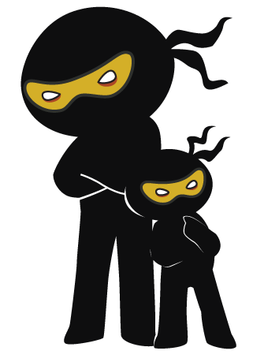



Word of the Day
Summer Term 2023
Week 33 – 5th June 2023
'Words unlock the doors to a world of understanding...'

Slide 2

This Week's Words
Grasshopper
Shinobi
bump
deserve
plaster
comb
hug
confiscate
skin
wriggle
itch
appeal

Slide 3
Grasshopper (Tier 1)
bump
plaster
hug
skin
itch

Slide 4
Shinobi (Tier 2)
deserve
comb
confiscate
wriggle
appeal

Slide 5


Grasshopper Word of the Day
bump
Word Class
Word of the Day:
(noun / verb)
(bump)
Pronunciation / Syllables
Definition:
If you bump into something or someone, you accidentally hit them while you are moving.
Jackson bumped into Mr Evens.
Synonym: | Antonym: | Prefix / Suffix: | Rhyme: | Link Word:
hit | miss | -er | pump | clumsily
ram |  | -ed | jump | hard

Slide 6

Grasshopper Word of the Day
plaster
Word Class
Word of the Day:
(noun / verb)
(plas-ter)
Pronunciation / Syllables
Definition:
A plaster is a strip of sticky material used for covering small cuts or sores on your body.
Sonny needed a plaster on his knee, after falling over.
Synonym: | Antonym: | Prefix / Suffix: | Rhyme: | Link Word:
dressing |  | -ing | master | heal
bandage |  |  | faster | cover

Slide 7
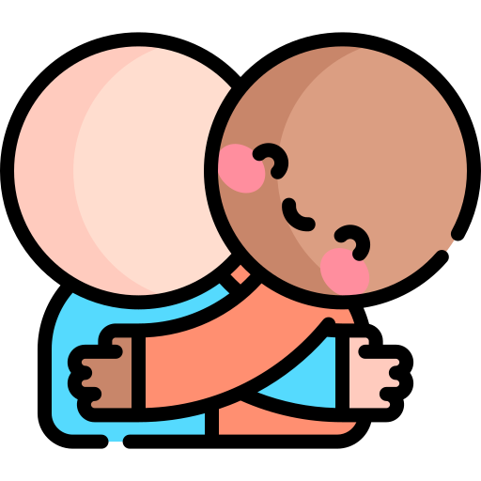
Grasshopper Word of the Day
hug
Word Class
Word of the Day:
(verb / noun)
(hug)
Pronunciation / Syllables
Definition:
When you hug someone, you put your arms around them and hold them tightly
Aarav gave Zane a hug when he was upset.
Synonym: | Antonym: | Prefix / Suffix: | Rhyme: | Link Word:
embrace |  | -ed | plug | long
cuddle |  | -ing | bug | friendly

Slide 8

Grasshopper Word of the Day
skin
Word Class
Word of the Day:
(noun)
(skin)
Pronunciation / Syllables
Definition:
Your skin is the natural covering of your body.
Mrs Cooper had a rash on her skin.
Synonym: | Antonym: | Prefix / Suffix: | Rhyme: | Link Word:
epidermis |  | sheep- | thin | dry
 |  | -ed | win | tough

Slide 9
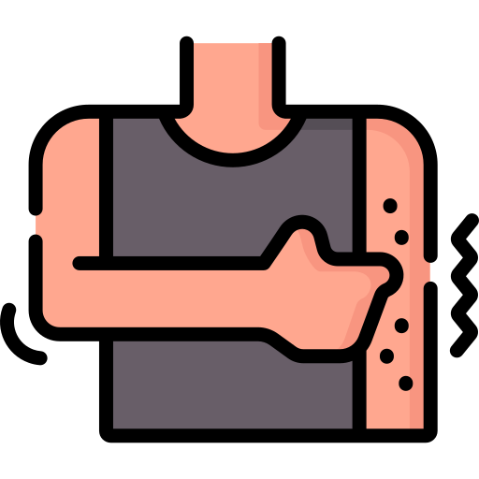
Grasshopper Word of the Day
itch
Word Class
Word of the Day:
(noun / verb)
(itch)
Pronunciation / Syllables
Definition:
When a part of your body itches, you have an unpleasant feeling on your skin that makes you want to scratch.
Lin had an itch on her foot.
Synonym: | Antonym: | Prefix / Suffix: | Rhyme: | Link Word:
tingle |  | -ing | ditch | uncomfortable
irritation |  | -y | witch | little

Slide 10

Shinobi Word of the Day
deserve
Word Class
Word of the Day:
(noun)
(de-serve)
Pronunciation / Syllables
Definition:
If you say that a person or thing deserves something, you mean that they should have it or receive it because of their actions or qualities.
Philip deserved the Family Award this week for good work.
Synonym: | Antonym: | Prefix / Suffix: | Rhyme: | Link Word:
merit | undeserved | -dly | curve | wholeheartedly
earn |  | -dness | nerve | hard

Slide 11
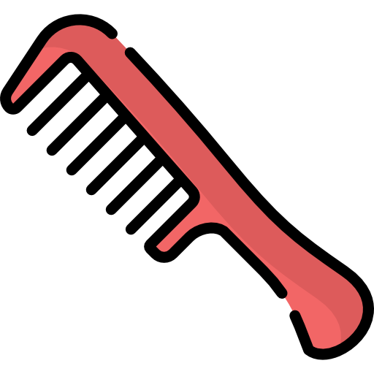
Shinobi Word of the Day
comb
Word Class
Word of the Day:
(noun / verb)
(comb)
Pronunciation / Syllables
Definition:
A comb is a flat piece of plastic or metal with narrow pointed teeth along one side, which you use to tidy your hair.
Noah combed his messy hair.
Synonym: | Antonym: | Prefix / Suffix: | Rhyme: | Link Word:
 |  | honey- | home | through
 |  | -ined | dome | gently

Slide 12


Shinobi Word of the Day
confiscate
Word Class
Word of the Day:
(adjective)
(con-fis-cate)
Pronunciation / Syllables
Definition:
If you confiscate something from someone, you take it away from them, usually as a punishment.
Alex had her toy confiscated.
Synonym: | Antonym: | Prefix / Suffix: | Rhyme: | Link Word:
impound | return | -ed |  | secretly
seize |  |  |  | angrily

Slide 13

Shinobi Word of the Day
wriggle
Word Class
Word of the Day:
(verb)
(wrig-gle)
Pronunciation / Syllables
Definition:
If you wriggle or wriggle part of your body, you twist and turn with quick movements, for example because you are uncomfortable.
The worm wriggled around in the playground.
Synonym: | Antonym: | Prefix / Suffix: | Rhyme: | Link Word:
twist and turn |  | -lers | giggle | lively
jiggle |  | -ing | jiggle | quickly

Slide 14

Shinobi Word of the Day
appeal
Word Class
Word of the Day:
(noun / adjective)
(ap-peal)
Pronunciation / Syllables
Definition:
If something appeals to you, you find it attractive or interesting.
Joanne thought the chocolate pudding looked appealing.
Synonym: | Antonym: | Prefix / Suffix | Rhyme: | Link Word:
attract | bore | un- | real | greatly
interest |  | -ly | feel | beautifully

Slide 15
Vocabulary Laboratory
Describe / Definition:
Use it in a sentence:
Focus Word (write below):
Word Class:
Synonyms: (words with same / similar meaning) | Antonyms: (words with opposite meaning)
Rhymes: (words that sound the same) | Link Words: (Example: football = pitch, team, player)
Draw your sentence:

Slide 16
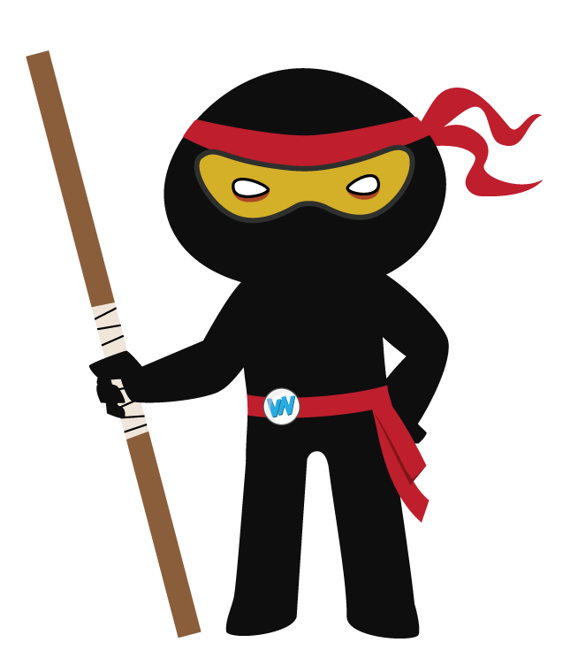
Vocabulary Visualiser
Draw the Grasshopper words and bring them to life.
Word: bump | Word: skin
Word: hug | Word: itch

Slide 17
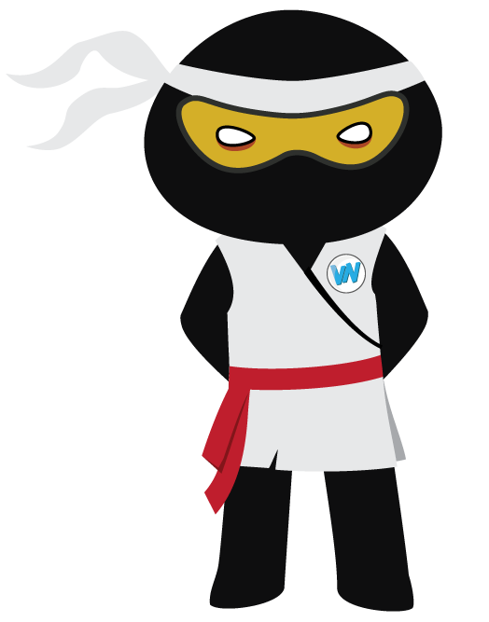
Vocabulary Visualiser
Draw the Shinobi words and bring them to life.
Word: comb | Word: wriggle
Word: confiscate | Word: appeal

Slide 18
Matching Meanings
Draw lines from the Grasshopper words to their definitions.
Grasshopper Word
bump
plaster
hug
skin
itch
Grasshopper Definitions
A *** is a strip of sticky material used for covering small cuts or sores on your body.
When a part of your body ***, you have an unpleasant feeling on your skin that makes you want to scratch.
If you *** into something or someone, you accidentally hit them while you are moving.
When you *** someone, you put your arms around them and hold them tightly
Your *** is the natural covering of your body.

Slide 19
Matching Meanings
Draw lines from the Shinobi words to their definitions.
Shinobi Word
deserve
comb
confiscate
wriggle
appeal
Shinobi Definitions
If you *** or *** part of your body, you twist and turn with quick movements, for example because you are uncomfortable.
If you *** something from someone, you take it away from them, usually as a punishment.
If you say that a person or thing *** something, you mean that they should have it or receive it because of their actions or qualities.
If something *** to you, you find it attractive or interesting.
A *** is a flat piece of plastic or metal with narrow pointed teeth along one side, which you use to tidy your hair.

Slide 20






Display Slips
The following slides are for classroom display. As you teach each Word of the Day, words can be displayed in the classroom to enable pupils to use the taught vocabulary in an independent manner.

Slide 21
bump
plaster

Slide 22
hug
skin

Slide 23
itch
deserve

Slide 24
comb
confiscate

Slide 25
wriggle
appeal

