Slide 1




Word of the Day
Summer Term 2023
Week 35 – 19th June 2023
'Words unlock the doors to a world of understanding...'

Slide 2

This Week's Words
Grasshopper
Shinobi
paint
comfort
stripe
suffer
drop
sequence
dig
schedule
breeze
avert

Slide 3
Grasshopper (Tier 1)
paint
stripe
drop
dig
breeze

Slide 4
Shinobi (Tier 2)
comfort
suffer
sequence
schedule
avert

Slide 5


Grasshopper Word of the Day
paint
Word Class
Word of the Day:
(verb / noun)
(paint)
Pronunciation / Syllables
Definition:
If you paint a wall or an object, you cover it with paint.
The class painted the portraits.
Synonym: | Antonym: | Prefix / Suffix: | Rhyme: | Link Word:
colour |  | re- | saint | colourful
decorate |  | -ing | complaint | walls

Slide 6

Grasshopper Word of the Day
stripe
Word Class
Word of the Day:
(noun)
(stripe)
Pronunciation / Syllables
Definition:
A stripe is a long line which is a different colour from the areas next to it.
David wore a striped shirt for football.
Synonym: | Antonym: | Prefix / Suffix: | Rhyme: | Link Word:
line |  | pin- | type | black and white
strip |  | -ed | pipe | thin

Slide 7

Grasshopper Word of the Day
drop
Word Class
Word of the Day:
(verb / noun)
(drop)
Pronunciation / Syllables
Definition:
If you drop something, you accidentally let it fall.
Amelia dropped her tablet.
Synonym: | Antonym: | Prefix / Suffix: | Rhyme: | Link Word:
let fall | hold-on | back- | top | deep
release | lift | -ed | stop | scary

Slide 8

Grasshopper Word of the Day
dig
Word Class
Word of the Day:
(verb)
(dig)
Pronunciation / Syllables
Definition:
If people or animals dig, they make a hole in the ground or in a pile of earth, stones, or rubbish.
Mr Edwards likes to dig in the school garden.
Synonym: | Antonym: | Prefix / Suffix: | Rhyme: | Link Word:
cultivate |  | shin- | big | hole
delve |  | -ing | pig | mud

Slide 9

Grasshopper Word of the Day
breeze
Word Class
Word of the Day:
(noun)
(breeze)
Pronunciation / Syllables
Definition:
A breeze is a gentle wind.
A lovely cool breeze went through the classroom.
Synonym: | Antonym: | Prefix / Suffix: | Rhyme: | Link Word:
gust |  | -y | these | cold
blow |  | -ed | trees | little

Slide 10

Shinobi Word of the Day
comfort
Word Class
Word of the Day:
(noun / verb)
(com-fort)
Pronunciation / Syllables
Definition:
If you are doing something in comfort, you are physically relaxed and contented.
Han found comfort in the story being read.
Synonym: | Antonym: | Prefix / Suffix: | Rhyme: | Link Word:
sympathy | grief | dis- |  | bed
solace | discomfort | -able |  | blanket

Slide 11

Shinobi Word of the Day
suffer
Word Class
Word of the Day:
(verb)
(suf-fer)
Pronunciation / Syllables
Definition:
If you suffer pain, you feel it in your body or in your mind.
Janie suffered from a pain in her knee when she banged it.
Synonym: | Antonym: | Prefix / Suffix: | Rhyme: | Link Word:
hurt |  | -ing | buffer | badly
ache |  | -ed | rougher | upset

Slide 12
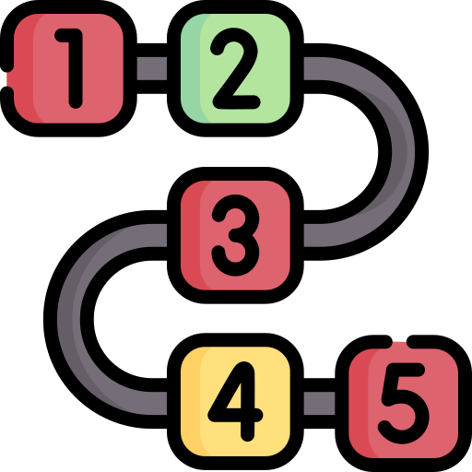
Shinobi Word of the Day
sequence
Word Class
Word of the Day:
(noun)
(se-quence)
Pronunciation / Syllables
Definition:
A sequence of events or things is a number of events or things that come one after another in a particular order.
Annie put the numbers in sequence.
Synonym: | Antonym: | Prefix / Suffix: | Rhyme: | Link Word:
succession |  | con- | frequency | long
order |  | -es |  | large

Slide 13

Shinobi Word of the Day
schedule
Word Class
Word of the Day:
(noun / verb)
(sched-ule)
Pronunciation / Syllables
Definition:
A schedule is a plan that gives a list of events or tasks and the times at which each one should happen or be done.
Mr Hamon made a schedule for the school trip.
Synonym: | Antonym: | Prefix / Suffix: | Rhyme: | Link Word:
plan |  | re- |  | daily
programme |  | -ed |  | full

Slide 14

Shinobi Word of the Day
avert
Word Class
Word of the Day:
(verb)
(a-vert)
Pronunciation / Syllables
Definition:
If you avert something unpleasant, you prevent it from happening or you avert your eyes or gaze from someone or something.
The class averted their eyes from the insect on the screen.
Synonym: | Antonym: | Prefix / Suffix | Rhyme: | Link Word:
turn away |  | ex- | hurt | attention
prevent |  | -ed | desert | eyes

Slide 15
Vocabulary Laboratory
Describe / Definition:
Use it in a sentence:
Focus Word (write below):
Word Class:
Synonyms: (words with same / similar meaning) | Antonyms: (words with opposite meaning)
Rhymes: (words that sound the same) | Link Words: (Example: football = pitch, team, player)
Draw your sentence:

Slide 16

Vocabulary Visualiser
Draw the Grasshopper words and bring them to life.
Word: paint | Word: dig
Word: stripe | Word: breeze

Slide 17
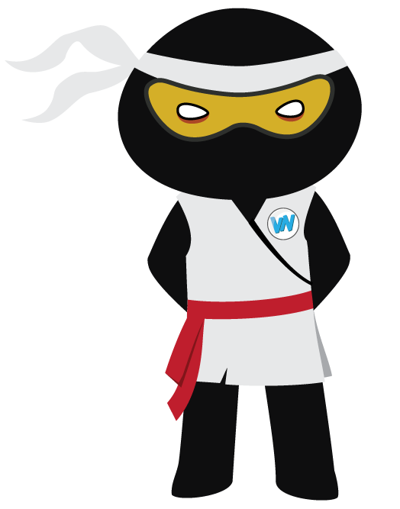
Vocabulary Visualiser
Draw the Shinobi words and bring them to life.
Word: comfort | Word: schedule
Word: suffer | Word: avert

Slide 18
Matching Meanings
Draw lines from the Grasshopper words to their definitions.
Grasshopper Word
paint
stripe
drop
dig
breeze
Grasshopper Definitions
If people or animals ***, they make a hole in the ground or in a pile of earth, stones, or rubbish.
A *** is a gentle wind.
A *** is a long line which is a different colour from the areas next to it.
If you *** a wall or an object, you cover it with ***.
If you *** something, you accidentally let it fall.

Slide 19
Matching Meanings
Draw lines from the Shinobi words to their definitions.
Shinobi Word
comfort
suffer
sequence
schedule
avert
Shinobi Definitions
If you *** pain, you feel it in your body or in your mind.
If you are doing something in ***, you are physically relaxed and contented.
A *** is a plan that gives a list of events or tasks and the times at which each one should happen or be done.
If you *** something unpleasant, you prevent it from happening or you *** your eyes or gaze from someone or something.
A *** of events or things is a number of events or things that come one after another in a particular order.

Slide 20






Display Slips
The following slides are for classroom display. As you teach each Word of the Day, words can be displayed in the classroom to enable pupils to use the taught vocabulary in an independent manner.

Slide 21
paint
stripe

Slide 22
drop
dig

Slide 23
breeze
comfort

Slide 24
suffer
sequence

Slide 25
schedule
avert

