Slide 1
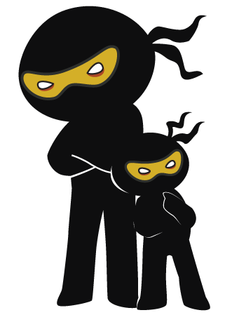



Word of the Day
Summer Term 2023
Week 36 – 26th June 2023
'Words unlock the doors to a world of understanding...'

Slide 2

This Week's Words
Grasshopper
Shinobi
pocket
novelty
swipe
drool
wire
custom
bendy
zeal
give
meaningful

Slide 3
Grasshopper (Tier 1)
pocket
swipe
wire
bendy
give

Slide 4
Shinobi (Tier 2)
novelty
drool
custom
zeal
meaningful

Slide 5


Grasshopper Word of the Day
pocket
Word Class
Word of the Day:
(noun)
(pock-et)
Pronunciation / Syllables
Definition:
A pocket is a kind of small bag which forms part of a piece of clothing, and which is used for carrying small things such as money.
Janet found a pebble in her pocket.
Synonym: | Antonym: | Prefix / Suffix: | Rhyme: | Link Word:
hole |  | -ed | rocket | small
 |  | -ing | socket | hard

Slide 6

Grasshopper Word of the Day
swipe
Word Class
Word of the Day:
(verb / noun)
(swipe)
Pronunciation / Syllables
Definition:
If you swipe something, you steal it quickly.
Dennis swiped the pen from Amir.
Synonym: | Antonym: | Prefix / Suffix: | Rhyme: | Link Word:
steal |  | side- | type | secretly
take |  | -ed | wipe | deliberately

Slide 7

Grasshopper Word of the Day
wire
Word Class
Word of the Day:
(noun / verb)
(wire)
Pronunciation / Syllables
Definition:
A wire is a long thin piece of metal that is used to fasten things or to carry electric current.
Mrs Dodds showed how the wire conducted electricity.
Synonym: | Antonym: | Prefix / Suffix: | Rhyme: | Link Word:
cable |  | hay- | higher | metal
lead |  | -less | fire | electrical

Slide 8

Grasshopper Word of the Day
bendy
Word Class
Word of the Day:
(adjective)
(bend-y)
Pronunciation / Syllables
Definition:
A bendy object bends easily into a curved or angled shape.
The reading card was bendy after being dropped.
Synonym: | Antonym: | Prefix / Suffix: | Rhyme: | Link Word:
flexible | inflexible |  | trendy | toy
 |  |  |  | roads

Slide 9

Grasshopper Word of the Day
give
Word Class
Word of the Day:
(verb)
(give)
Pronunciation / Syllables
Definition:
You use give to say that a person does something for another person.
Juliet wanted to give her heart rubber to John.
Synonym: | Antonym: | Prefix / Suffix: | Rhyme: | Link Word:
offer | receive | for- | live | smile
donate | accept | -n | forgive | hand

Slide 10

Shinobi Word of the Day
novelty
Word Class
Word of the Day:
(noun)
(nov-el-ty)
Pronunciation / Syllables
Definition:
A novelty is something that is new and therefore interesting.
The class liked the novelty of watching a film.
Synonym: | Antonym: | Prefix / Suffix: | Rhyme: | Link Word:
different |  |  | poverty | holiday
original |  |  |  | food

Slide 11

Shinobi Word of the Day
drool
Word Class
Word of the Day:
(verb)
(drool)
Pronunciation / Syllables
Definition:
If a person or animal drools, saliva drops slowly from their mouth.
The chocolate cakes made Anika drool.
Synonym: | Antonym: | Prefix / Suffix: | Rhyme: | Link Word:
salivate |  | -ing | school | dog
dribble |  | -ed | rule | tasty

Slide 12

Shinobi Word of the Day
custom
Word Class
Word of the Day:
(noun)
(cus-tom)
Pronunciation / Syllables
Definition:
A custom is an activity, a way of behaving, or an event which is usual or traditional in a particular society or in particular circumstances.
It is custom to fast for the month of Ramadan.
Synonym: | Antonym: | Prefix / Suffix: | Rhyme: | Link Word:
tradition |  | ac- |  | local
ceremony |  | -ary |  | traditional

Slide 13

Shinobi Word of the Day
zeal
Word Class
Word of the Day:
(noun)
(zeal)
Pronunciation / Syllables
Definition:
Zeal is great enthusiasm, especially in connection with work, religion, or politics
Mr George had a zeal for teaching art.
Synonym: | Antonym: | Prefix / Suffix: | Rhyme: | Link Word:
fondness | indifference | -ous | real | teaching
passion |  | -land | feel | activity

Slide 14

Shinobi Word of the Day
meaningful
Word Class
Word of the Day:
(adjective)
(mean-ing-ful)
Pronunciation / Syllables
Definition:
If you describe something as meaningful, you mean that it is serious, important, or useful in some way.
The book was meaningful to the class.
Synonym: | Antonym: | Prefix / Suffix | Rhyme: | Link Word:
significant | inconsequential | -ly |  | event
relevant |  | -ness |  | present

Slide 15
Vocabulary Laboratory
Describe / Definition:
Use it in a sentence:
Focus Word (write below):
Word Class:
Synonyms: (words with same / similar meaning) | Antonyms: (words with opposite meaning)
Rhymes: (words that sound the same) | Link Words: (Example: football = pitch, team, player)
Draw your sentence:

Slide 16

Vocabulary Visualiser
Draw the Grasshopper words and bring them to life.
Word: pocket | Word: wire
Word: swipe | Word: bendy

Slide 17
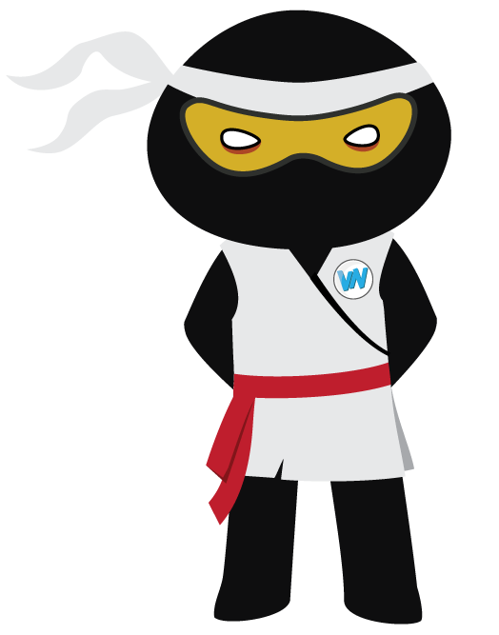
Vocabulary Visualiser
Draw the Shinobi words and bring them to life.
Word: novelty | Word: zeal
Word: drool | Word: meaningful

Slide 18
Matching Meanings
Draw lines from the Grasshopper words to their definitions.
Grasshopper Word
pocket
swipe
wire
bendy
give
Grasshopper Definitions
If you *** something, you steal it quickly.
A *** object bends easily into a curved or angled shape.
A *** is a kind of small bag which forms part of a piece of clothing, and which is used for carrying small things such as money
You use *** to say that a person does something for another person.
A *** is a long thin piece of metal that is used to fasten things or to carry electric current.

Slide 19
Matching Meanings
Draw lines from the Shinobi words to their definitions.
Shinobi Word
novelty
drool
custom
zeal
meaningful
Shinobi Definitions
If you describe something as ***, you mean that it is serious, important, or useful in some way.
A *** is an activity, a way of behaving, or an event which is usual or traditional in a particular society or in particular circumstances.
A *** is something that is new and therefore interesting.
If a person or animal ***, saliva drops slowly from their mouth.
*** is great enthusiasm, especially in connection with work, religion, or politics.

Slide 20






Display Slips
The following slides are for classroom display. As you teach each Word of the Day, words can be displayed in the classroom to enable pupils to use the taught vocabulary in an independent manner.

Slide 21
pocket
swipe

Slide 22
wire
bendy

Slide 23
give
novelty

Slide 24
drool
custom

Slide 25
zeal
meaningful

