Slide 1




Word of the Day
Summer Term 2023
Week 37 – 3rd July 2023
'Words unlock the doors to a world of understanding...'

Slide 2

This Week's Words
Grasshopper
Shinobi
talk
hectic
camp
fate
outfit
gruesome
stamp
fine
ugly
lack

Slide 3
Grasshopper (Tier 1)
talk
camp
outfit
stamp
ugly

Slide 4
Shinobi (Tier 2)
hectic
fate
gruesome
fine
lack

Slide 5


Grasshopper Word of the Day
talk
Word Class
Word of the Day:
(verb / noun)
(talk)
Pronunciation / Syllables
Definition:
When you talk, you use spoken language to express your thoughts, ideas, or feelings.
Dex was told off for talking in the class.
Synonym: | Antonym: | Prefix / Suffix: | Rhyme: | Link Word:
speak |  | small- | walk | understand
chat |  | -ative | chalk | a lot

Slide 6

Grasshopper Word of the Day
camp
Word Class
Word of the Day:
(verb / noun)
(camp)
Pronunciation / Syllables
Definition:
If you camp somewhere, you stay or live there for a short time in a tent or caravan, or in the open air.
The class went to the woods to camp there.
Synonym: | Antonym: | Prefix / Suffix: | Rhyme: | Link Word:
 |  | de- | lamp | outdoor
 |  | -aign | stamp | cosy

Slide 7

Grasshopper Word of the Day
outfit
Word Class
Word of the Day:
(noun)
(out-fit)
Pronunciation / Syllables
Definition:
An outfit is a set of clothes.
Mr McDonald wore his new outfit to school.
Synonym: | Antonym: | Prefix / Suffix: | Rhyme: | Link Word:
costume |  | -ted | outwit | smart
suit |  | -ting |  | functional

Slide 8
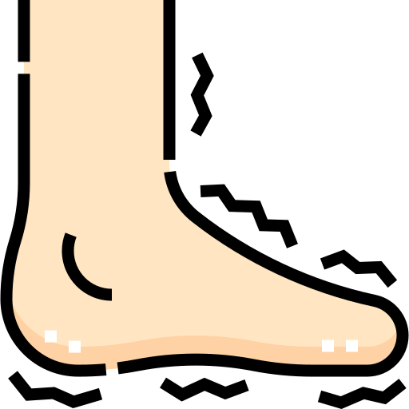
Grasshopper Word of the Day
stamp
Word Class
Word of the Day:
(verb / noun)
(stamp)
Pronunciation / Syllables
Definition:
If you stamp or stamp your foot, you lift your foot and put it down very hard on the ground, for example because you are angry or because your feet are cold.
Jaya stamped her foot in a rage.
Synonym: | Antonym: | Prefix / Suffix: | Rhyme: | Link Word:
tramp |  | time- | camp | hard
crush |  | -ede | lamp | frustrated

Slide 9

Grasshopper Word of the Day
ugly
Word Class
Word of the Day:
(adjective)
(ug-ly)
Pronunciation / Syllables
Definition:
If you say that someone or something is ugly, you mean that they are very unattractive and unpleasant to look at.
The class loved the story about the Ugly Duckling.
Synonym: | Antonym: | Prefix / Suffix: | Rhyme: | Link Word:
hideous | beautiful |  | smugly | appearance
unattractive | attractive |  | snugly | heart

Slide 10

Shinobi Word of the Day
hectic
Word Class
Word of the Day:
(adjective)
(hec-tic)
Pronunciation / Syllables
Definition:
A hectic situation is one that is very busy and involves a lot of rushed activity.
The school fayre was incredibly hectic.
Synonym: | Antonym: | Prefix / Suffix: | Rhyme: | Link Word:
frantic | leisurely | -ally | electric | journey
manic | quiet |  |  | activity

Slide 11

Shinobi Word of the Day
fate
Word Class
Word of the Day:
(noun)
(fate)
Pronunciation / Syllables
Definition:
Fate is a power that some people believe controls and decides
everything that happens, in a way that cannot be prevented or changed.
Tilly and Amelia thought it was fate they were friends.
Synonym: | Antonym: | Prefix / Suffix: | Rhyme: | Link Word:
destiny |  | sul- | state | luck
serendipity |  | -ful | great | overwhelming

Slide 12

Shinobi Word of the Day
gruesome
Word Class
Word of the Day:
(adjective)
(grue-some)
Pronunciation / Syllables
Definition:
Something that is gruesome is extremely unpleasant and
shocking.
The state of Mrs Knott’s desk was gruesome.
Synonym: | Antonym: | Prefix / Suffix: | Rhyme: | Link Word:
hideous | pleasant | -ely | twosome | movie
fearful |  | -ness |  | experience

Slide 13

Shinobi Word of the Day
fine
Word Class
Word of the Day:
(adjective)
(fine)
Pronunciation / Syllables
Definition:
You use fine to describe something that you admire and think is very good.
Mr Lin told Sonny that he did fine work in the lesson.
Synonym: | Antonym: | Prefix / Suffix: | Rhyme: | Link Word:
excellent | poor | de- | line | work
high quality |  | -st | sign | book

Slide 14

Shinobi Word of the Day
lack
Word Class
Word of the Day:
(noun)
(lack)
Pronunciation / Syllables
Definition:
If there is a lack of something, there is not enough of it or it does not exist at all.
Mr Turley told Arun that his writing lacks adjectives.
Synonym: | Antonym: | Prefix / Suffix | Rhyme: | Link Word:
absence | abundance | -ed | back | evidence
shortage | sufficiency | -ing | track | care

Slide 15
Vocabulary Laboratory
Describe / Definition:
Use it in a sentence:
Focus Word (write below):
Word Class:
Synonyms: (words with same / similar meaning) | Antonyms: (words with opposite meaning)
Rhymes: (words that sound the same) | Link Words: (Example: football = pitch, team, player)
Draw your sentence:

Slide 16

Vocabulary Visualiser
Draw the Grasshopper words and bring them to life.
Word: talk | Word: outfit
Word: camp | Word: stamp

Slide 17

Vocabulary Visualiser
Draw the Shinobi words and bring them to life.
Word: hectic | Word: fine
Word: guresome | Word: lack

Slide 18
Matching Meanings
Draw lines from the Grasshopper words to their definitions.
Grasshopper Word
talk
camp
outfit
stamp
ugly
Grasshopper Definitions
When you ***, you use spoken language to express your thoughts, ideas, or feelings.
An *** is a set of clothes.
If you *** somewhere, you stay or live there for a short time in a tent or caravan, or in the open air.
If you say that someone or something is ***, you mean that they are very unattractive and unpleasant to look at.
If you *** or *** your foot, you lift your foot and put it down very hard on the ground, for example because you are angry or because your feet are cold.

Slide 19
Matching Meanings
Draw lines from the Shinobi words to their definitions.
Shinobi Word
hectic
fate
gruesome
fine
lack
Shinobi Definitions
You use *** to describe something that you admire and think is very good.
Something that is *** is extremely unpleasant and shocking.
If there is a *** of something, there is not enough of it or it does not exist at all.
*** is a power that some people believe controls and decides everything that happens, in a way that cannot be prevented or changed.
A *** situation is one that is very busy and involves a lot of rushed activity.

Slide 20






Display Slips
The following slides are for classroom display. As you teach each Word of the Day, words can be displayed in the classroom to enable pupils to use the taught vocabulary in an independent manner.

Slide 21
talk
camp

Slide 22
outfit
stamp

Slide 23
ugly
hectic

Slide 24
fate
gruesome

Slide 25
fine
lack

