Slide 1
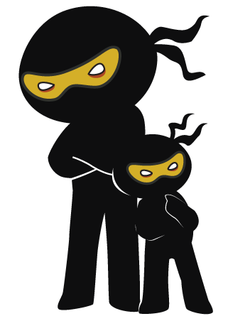



Word of the Day
Summer Term 2023
Week 30 – 8th May 2023
'Words unlock the doors to a world of understanding...'

Slide 2

This Week's Words
Grasshopper
Shinobi
rude
recoil
mouth
motive
basic
sense
dab
subtle
rewind
exact

Slide 3
Grasshopper (Tier 1)
rude
mouth
basic
dab
rewind

Slide 4
Shinobi (Tier 2)
recoil
motive
sense
subtle
exact

Slide 5


Grasshopper Word of the Day
rude
Word Class
Word of the Day:
(adjective)
(rude)
Pronunciation / Syllables
Definition:
When people are rude, they act in an impolite way towards other people or say impolite things about them.
Aaron was rude to Mrs Jenkins
Synonym: | Antonym: | Prefix / Suffix: | Rhyme: | Link Word:
impolite | polite | -ness | food | person
disrespectful |  | -ly | mood | group

Slide 6
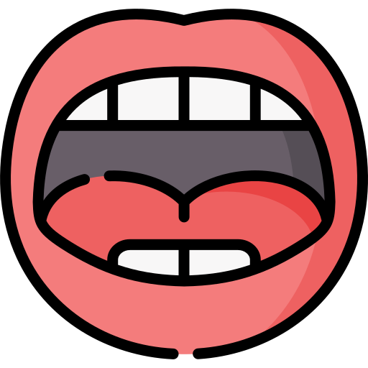
Grasshopper Word of the Day
mouth
Word Class
Word of the Day:
(noun)
(mouth)
Pronunciation / Syllables
Definition:
Your mouth is the area of your face where your lips are or the space behind your lips where your teeth and tongue are.
Alicia put the pen in her mouth.
Synonym: | Antonym: | Prefix / Suffix: | Rhyme: | Link Word:
lips |  | -ing | south | face
 |  |  |  | smile

Slide 7
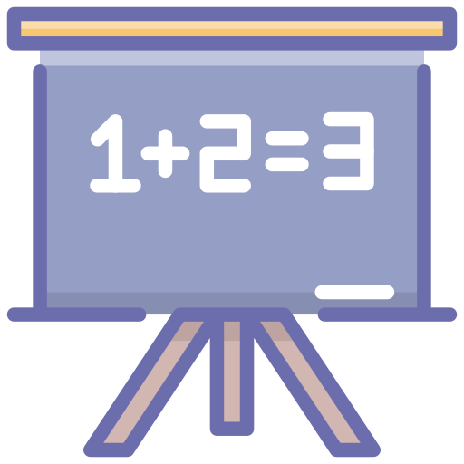
Grasshopper Word of the Day
basic
Word Class
Word of the Day:
(adjective)
(ba-sic)
Pronunciation / Syllables
Definition:
You can use basic to describe something that is very simple in style and has only the most necessary features, without any luxuries.
Kai could do basic maths.
Synonym: | Antonym: | Prefix / Suffix: | Rhyme: | Link Word:
essential | unimportant |  |  | English
primary | secondary |  |  | dancing

Slide 8

Grasshopper Word of the Day
dab
Word Class
Word of the Day:
(verb)
(dab)
Pronunciation / Syllables
Definition:
If you dab something, you touch it several times using quick, light movements.
Henry dabbed his paint brush in to the paint
Synonym: | Antonym: | Prefix / Suffix: | Rhyme: | Link Word:
pat |  | -ing | crab | paint
touch |  | -bed | lab | brush

Slide 9

Grasshopper Word of the Day
rewind
Word Class
Word of the Day:
(adjective / noun)
(re-wind)
Pronunciation / Syllables
Definition:
When the tape in a video or tape recorder rewinds or when you rewind it, the tape goes backwards so that you can play it again.
Fatima liked to rewind the tape back for the teacher
Synonym: | Antonym: | Prefix / Suffix: | Rhyme: | Link Word:
reverse | Fast-forward | -ing | whined | tape
undo |  |  |  | episode

Slide 10
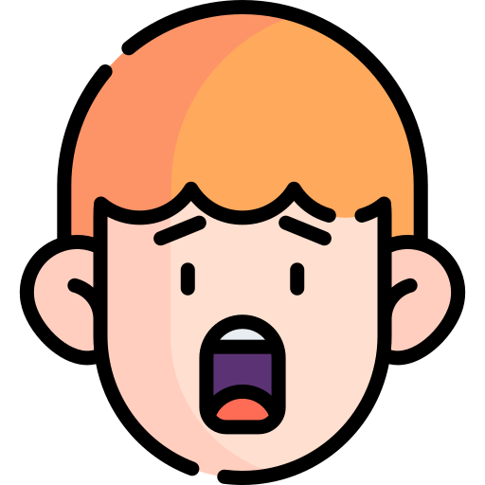
Shinobi Word of the Day
recoil
Word Class
Word of the Day:
(verb)
(re-coil)
Pronunciation / Syllables
Definition:
If something makes you recoil, you move your body quickly away from it because it frightens, offends, or hurts you.
Oliver recoiled at seeing a rat.
Synonym: | Antonym: | Prefix / Suffix: | Rhyme: | Link Word:
pull-back |  | -ed | soil | in horror
flinch |  |  | boil | suddenly

Slide 11

Shinobi Word of the Day
motive
Word Class
Word of the Day:
(noun)
(mo-tive)
Pronunciation / Syllables
Definition:
Your motive for doing something is your reason for doing it.
Jack’s motive for working hard was to get good marks.
Synonym: | Antonym: | Prefix / Suffix: | Rhyme: | Link Word:
reason |  | e- |  | team
cause |  | pro- |  | personal

Slide 12

Shinobi Word of the Day
sense
Word Class
Word of the Day:
(verb / noun)
(sense)
Pronunciation / Syllables
Definition:
If you sense something, you become aware of it or you realise it, although it is not very obvious.
Usman had sensed Mr Smith was watching him work.
Synonym: | Antonym: | Prefix / Suffix: | Rhyme: | Link Word:
feeling |  | non- | dense | presence
awareness |  | -less | intense | their fear

Slide 13

Shinobi Word of the Day
subtle
Word Class
Word of the Day:
(adjective)
(sub-tle)
Pronunciation / Syllables
Definition:
Something that is subtle is not immediately obvious or noticeable.
Sally used subtle shades of brown in her drawing.
Synonym: | Antonym: | Prefix / Suffix: | Rhyme: | Link Word:
delicate | crude | un- | scuttle | whisper
fine |  | -ness |  | touch

Slide 14

Shinobi Word of the Day
exact
Word Class
Word of the Day:
(adjective)
(ex-act)
Pronunciation / Syllables
Definition:
Exact means correct in every detail. For example, an exact copy is the same in every detail as the thing it is copied from.
Mrs Johnson knew the exact definitions.
Synonym: | Antonym: | Prefix / Suffix | Rhyme: | Link Word:
 |  | -ly | fact | detail
 |  | -ness | react | correct

Slide 15
Vocabulary Laboratory
Describe / Definition:
Use it in a sentence:
Focus Word (write below):
Word Class:
Synonyms: (words with same / similar meaning) | Antonyms: (words with opposite meaning)
Rhymes: (words that sound the same) | Link Words: (Example: football = pitch, team, player)
Draw your sentence:

Slide 16
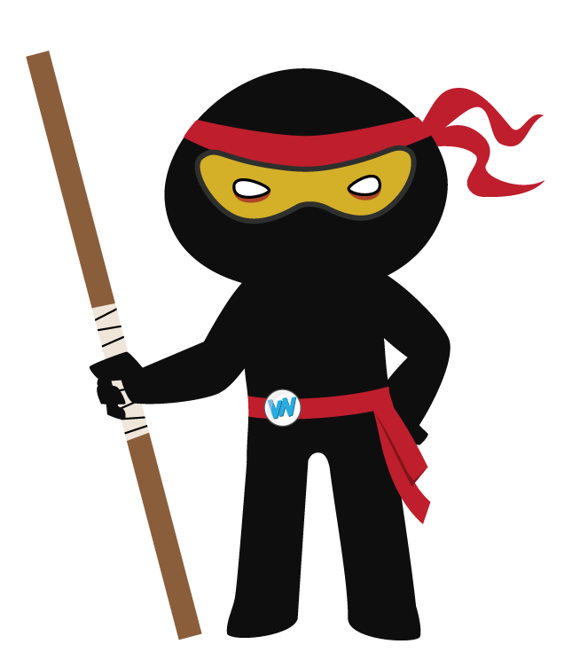
Vocabulary Visualiser
Draw the Grasshopper words and bring them to life.
Word: rude | Word: mouth
Word: dab | Word: rewind

Slide 17
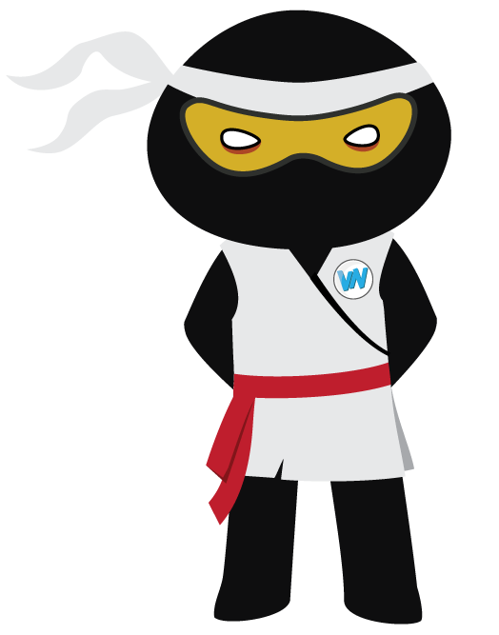
Vocabulary Visualiser
Draw the Shinobi words and bring them to life.
Word: motive | Word: sense
Word: subtle | Word: exact

Slide 18
Matching Meanings
Draw lines from the Grasshopper words to their definitions.
Grasshopper Word
rude
mouth
basic
dab
rewind
Grasshopper Definitions
You can use *** to describe something that is very simple in style and has only the most necessary features, without any luxuries.
If you *** something, you touch it several times using quick, light movements.
When people are ***, they act in an impolite way towards other people or say impolite things about them.
When the tape in a video or tape recorder *** or when you *** it, the tape goes backwards so that you can play it again.
Your *** is the area of your face where your lips are or the space behind your lips where your teeth and tongue are.

Slide 19
Matching Meanings
Draw lines from the Shinobi words to their definitions.
Shinobi Word
recoil
motive
sense
subtle
exact
Shinobi Definitions
If you *** something, you become aware of it or you realize it, although it is not very obvious.
Something that is *** is not immediately obvious or noticeable.
Your *** for doing something is your reason for doing it.
*** means correct in every detail. For example, an *** copy is the same in every detail as the thing it is copied from.
If something makes you ***, you move your body quickly away from it because it frightens, offends, or hurts you.

Slide 20
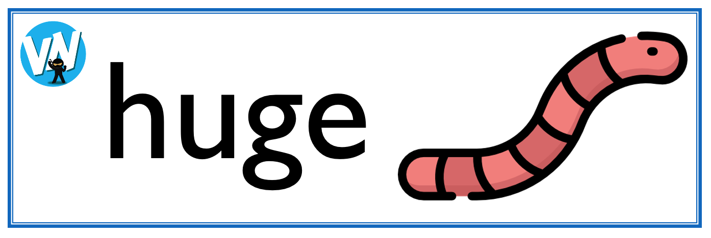
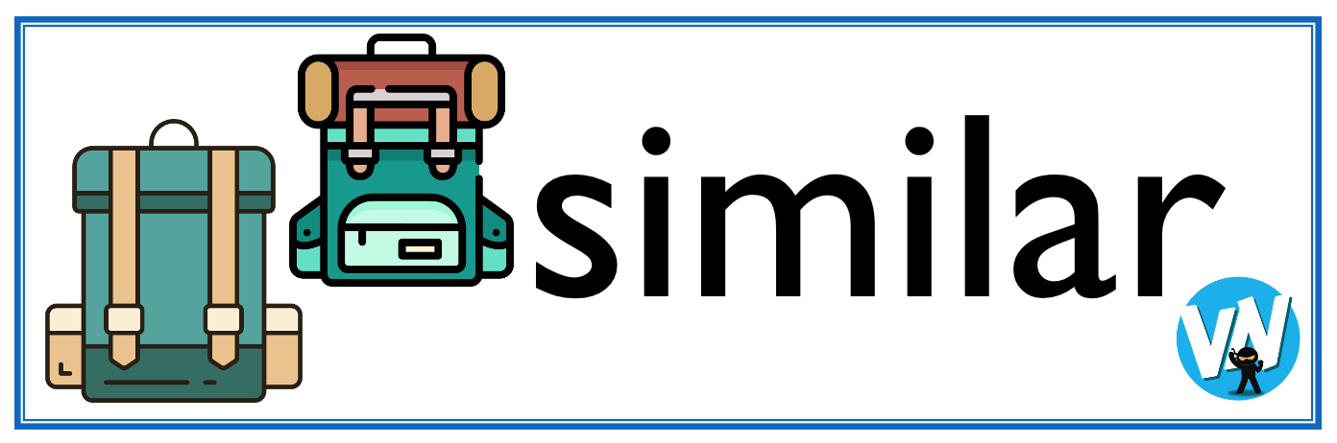




Display Slips
The following slides are for classroom display. As you teach each Word of the Day, words can be displayed in the classroom to enable pupils to use the taught vocabulary in an independent manner.

Slide 21
rude
mouth

Slide 22
basic
dab

Slide 23
rewind
recoil

Slide 24
motive
sense

Slide 25
subtle
exact

