Slide 1




Word of the Day
Summer Term 2023
Week 32 – 22nd May 2023
'Words unlock the doors to a world of understanding...'

Slide 2

This Week's Words
Grasshopper
Shinobi
peel
pressure
change
fond
vehicle
adept
area
success
present
tame

Slide 3
Grasshopper (Tier 1)
peel
change
vehicle
area
present

Slide 4
Shinobi (Tier 2)
pressure
fond
adept
success
tame

Slide 5


Grasshopper Word of the Day
peel
Word Class
Word of the Day:
(noun / verb)
(peel)
Pronunciation / Syllables
Definition:
The peel of a fruit such as a lemon or an apple is its skin.
Mr Simons tripped on the banana peel.
Synonym: | Antonym: | Prefix / Suffix: | Rhyme: | Link Word:
skin |  | un- | reel | skin
covering |  | -ed | feel | carefully

Slide 6

Grasshopper Word of the Day
change
Word Class
Word of the Day:
(noun / verb)
(change)
Pronunciation / Syllables
Definition:
If there is a change in something, it becomes different.
Miss Baxter changed the classroom display.
Synonym: | Antonym: | Prefix / Suffix: | Rhyme: | Link Word:
swap | keep | ex- | strange | clothes
exchange |  | -able | arrange | money

Slide 7

Grasshopper Word of the Day
vehicle
Word Class
Word of the Day:
(noun)
(ve-hi-cle)
Pronunciation / Syllables
Definition:
A vehicle is a machine such as a car, bus, or truck which has an engine and is used to carry people from place to place.
Mr Yadav drove to school in his new vehicle.
Synonym: | Antonym: | Prefix / Suffix: | Rhyme: | Link Word:
automobile |  | -s |  | fast
 |  |  |  | large

Slide 8

Grasshopper Word of the Day
area
Word Class
Word of the Day:
(noun)
(ar-e-a)
Pronunciation / Syllables
Definition:
An area is a particular part of a town, a country, a region, or the world.
Ms Dowey told the class that she lived in an industrial area.
Synonym: | Antonym: | Prefix / Suffix: | Rhyme: | Link Word:
region |  | sub- | malaria | surface
district |  | -s | hysteria | over

Slide 9

Grasshopper Word of the Day
present
Word Class
Word of the Day:
(adjective / noun)
(pres-ent)
Pronunciation / Syllables
Definition:
You use present to describe things and people that exist now, rather than those that existed in the past or those that may exist in the future.
Mr Edwards wrote his sentence in the present tense.
Synonym: | Antonym: | Prefix / Suffix: | Rhyme: | Link Word:
in attendance | absent | re- | pleasant | in the
here | past | -ation | peasant | large

Slide 10

Shinobi Word of the Day
pressure
Word Class
Word of the Day:
(noun)
(pres-sure)
Pronunciation / Syllables
Definition:
Pressure is force that you produce when you press hard on something.
Avni put so much pressure on her pencil that it broke.
Synonym: | Antonym: | Prefix / Suffix: | Rhyme: | Link Word:
force |  | non- |  | high
oppression |  | -d |  | hard

Slide 11

Shinobi Word of the Day
fond
Word Class
Word of the Day:
(adjective)
(fond)
Pronunciation / Syllables
Definition:
If you are fond of someone, you feel affection for them.
Terrence was very fond of maths.
Synonym: | Antonym: | Prefix / Suffix: | Rhyme: | Link Word:
affection for | indifferent to | -ly | beyond | very
 |  | -ness | respond | huge

Slide 12

Shinobi Word of the Day
adept
Word Class
Word of the Day:
(adjective)
(a-dept)
Pronunciation / Syllables
Definition:
Someone who is adept at something can do it skilfully.
Hugo was an adept speller.
Synonym: | Antonym: | Prefix / Suffix: | Rhyme: | Link Word:
expert | inept | -ly | kept | impressively
skilled | unskilled |  | slept | winner

Slide 13

Shinobi Word of the Day
success
Word Class
Word of the Day:
(noun)
(suc-cess)
Pronunciation / Syllables
Definition:
Success is the achievement of something that you have been trying to do.
The school football team celebrated their huge success.
Synonym: | Antonym: | Prefix / Suffix: | Rhyme: | Link Word:
victory | failure | un- | progress | large
triumph |  | -ful | express | career

Slide 14
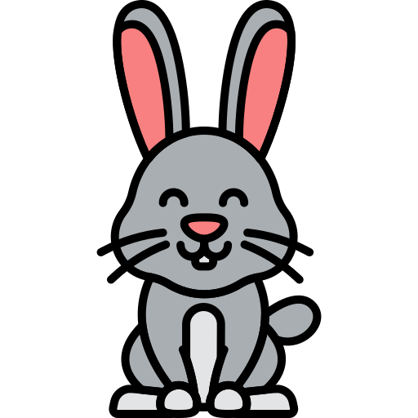
Shinobi Word of the Day
tame
Word Class
Word of the Day:
(adjective)
(tame)
Pronunciation / Syllables
Definition:
A tame animal or bird is one that is not afraid of humans.
The class rabbit was very tame.
Synonym: | Antonym: | Prefix / Suffix | Rhyme: | Link Word:
domesticated | wild | -ed | same | very
docile | fierce | -ly | game | beast

Slide 15
Vocabulary Laboratory
Describe / Definition:
Use it in a sentence:
Focus Word (write below):
Word Class:
Synonyms: (words with same / similar meaning) | Antonyms: (words with opposite meaning)
Rhymes: (words that sound the same) | Link Words: (Example: football = pitch, team, player)
Draw your sentence:

Slide 16

Vocabulary Visualiser
Draw the Grasshopper words and bring them to life.
Word: peel | Word: area
Word: vehicle | Word: present

Slide 17

Vocabulary Visualiser
Draw the Shinobi words and bring them to life.
Word: pressure | Word: success
Word: fond | Word: tame

Slide 18
Matching Meanings
Draw lines from the Grasshopper words to their definitions.
Grasshopper Word
peel
change
vehicle
area
present
Grasshopper Definitions
A *** is a machine such as a car, bus, or truck which has an engine and is used to carry people from place to place.
An *** is a particular part of a town, a country, a region, or the world.
If there is a *** in something, it becomes different.
You use *** to describe things and people that exist now, rather than those that existed in the past or those that may exist in the future.
The *** of a fruit such as a lemon or an apple is its skin.

Slide 19
Matching Meanings
Draw lines from the Shinobi words to their definitions.
Shinobi Word
pressure
fond
adept
success
tame
Shinobi Definitions
*** is the achievement of something that you have been trying to do.
*** is force that you produce when you press hard on something.
If you are *** of someone, you feel affection for them.
A *** animal or bird is one that is not afraid of humans.
Someone who is *** at something can do it skilfully.

Slide 20






Display Slips
The following slides are for classroom display. As you teach each Word of the Day, words can be displayed in the classroom to enable pupils to use the taught vocabulary in an independent manner.

Slide 21
peel
change

Slide 22
vehicle
area

Slide 23
present
pressure

Slide 24
fond
adept

Slide 25
success
tame

