Slide 1
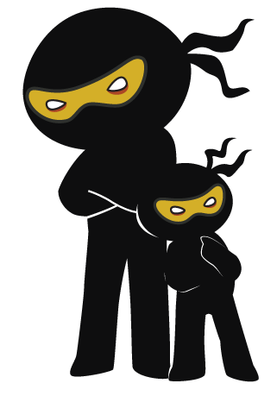



Word of the Day
Summer Term 2023
Week 28 – 24th April 2023
'Words unlock the doors to a world of understanding...'

Slide 2

This Week's Words
Grasshopper
Shinobi
bend
swear
idea
adhere
stand
describe
click
tycoon
wink
flammable

Slide 3
Grasshopper (Tier 1)
bend
idea
stand
click
wink

Slide 4
Shinobi (Tier 2)
swear
adhere
describe
tycoon
flammable

Slide 5


Grasshopper Word of the Day
bend
Word Class
Word of the Day:
(verb)
(bend)
Pronunciation / Syllables
Definition:
If you bend something that is flat or straight, you use force to make it curved or to put an angle in it.
Jessie bent her ruler and it nearly snapped.
Synonym: | Antonym: | Rhyme: | Link Word:
curve | straighten | lend | material
flex |  | send | body

Slide 6

Grasshopper Word of the Day
idea
Word Class
Word of the Day:
(noun)
(i-de-a)
Pronunciation / Syllables
Definition:
An idea is a plan, suggestion, or possible course of action.
Raj had an idea for their new team name.
Synonym: | Antonym: | Rhyme: | Link Word:
plan |  | fear | good
design |  | near | bad

Slide 7

Grasshopper Word of the Day
stand
Word Class
Word of the Day:
(verb)
(stand)
Pronunciation / Syllables
Definition:
When you are standing, your body is upright, your legs are straight, and your weight is supported by your feet.
Romeo was standing next to the apple tree.
Synonym: | Antonym: | Rhyme: | Link Word:
 | sit | hand | up
 | lie | land | next to

Slide 8

Grasshopper Word of the Day
click
Word Class
Word of the Day:
(verb / noun)
(click)
Pronunciation / Syllables
Definition:
If something clicks or if you click it, it makes a short, sharp sound.
Ophelia clicked her fingers at Mia.
Synonym: | Antonym: | Rhyme: | Link Word:
snap |  | thick | angrily
 |  | quick | moodily

Slide 9

Grasshopper Word of the Day
wink
Word Class
Word of the Day:
(verb)
(wink)
Pronunciation / Syllables
Definition:
When you wink at someone, you look towards them and close one eye very briefly, usually as a signal that something is a joke or a secret.
Mrs Holds winked at the class. Everyone laughed.
Synonym: | Antonym: | Rhyme: | Link Word:
blink |  | think | fondly
 |  | drink | jokingly

Slide 10

Shinobi Word of the Day
swear
Word Class
Word of the Day:
(verb)
(swear)
Pronunciation / Syllables
Definition:
If you swear to do something, you promise in a serious way that you will do it.
Malik had sworn that he to come out and play after school.
Synonym: | Antonym: | Prefix / Suffix: | Rhyme: | Link Word:
promise |  |  | where | promise
vow |  |  | care | to

Slide 11

Shinobi Word of the Day
adhere
Word Class
Word of the Day:
(verb)
(ad-here)
Pronunciation / Syllables
Definition:
If something adheres to something else, it sticks firmly to it.
Jenny always adhered to the school rules.
Synonym: | Antonym: | Prefix / Suffix: | Rhyme: | Link Word:
follow |  | -ed | year | rules
stick to |  | -ing | appear | friend

Slide 12

Shinobi Word of the Day
describe
Word Class
Word of the Day:
(verb)
(de-scirbe)
Pronunciation / Syllables
Definition:
If you describe a person, object, event, or situation, you say what they are like or what happened.
Ismail described what had happened on the playground.
Synonym: | Antonym: | Prefix / Suffix: | Rhyme: | Link Word:
report |  | -ing | tribe | person
recount |  | -ed | bribe | event

Slide 13
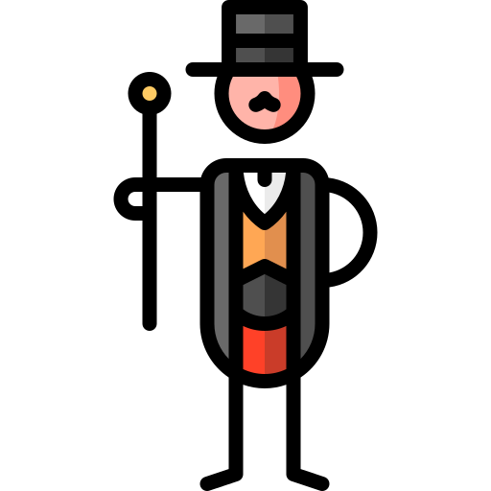
Shinobi Word of the Day
tycoon
Word Class
Word of the Day:
(noun)
(ty-coon)
Pronunciation / Syllables
Definition:
A tycoon is a person who is successful in business and so has become rich and powerful.
Miles wanted to be a tech-tycoon when he was older.
Synonym: | Antonym: | Prefix / Suffix: | Rhyme: | Link Word:
mogul |  |  | soon | business
big shot |  |  | afternoon | media

Slide 14

Shinobi Word of the Day
flammable
Word Class
Word of the Day:
(adjective)
(flam-ma-ble)
Pronunciation / Syllables
Definition:
If something is described as flammable, it can catch fire and burn easily.
Jessy held the flammable material over the flame.
Synonym: | Antonym: | Prefix / Suffix | Rhyme: | Link Word:
combustible | non-flammable | non- | inflammable | situation
unstable |  | in- |  | personality

Slide 15
Vocabulary Laboratory
Describe / Definition:
Use it in a sentence:
Focus Word (write below):
Word Class:
Synonyms: (words with same / similar meaning) | Antonyms: (words with opposite meaning)
Rhymes: (words that sound the same) | Link Words: (Example: football = pitch, team, player)
Draw your sentence:

Slide 16

Vocabulary Visualiser
Draw the Grasshopper words and bring them to life.
Word: bend | Word: idea
Word: stand | Word: click

Slide 17

Vocabulary Visualiser
Draw the Shinobi words and bring them to life.
Word: swear | Word: adhere
Word: describe | Word: flammable

Slide 18
Matching Meanings
Draw lines from the Grasshopper words to their definitions.
Grasshopper Word
bend
idea
stand
click
wink
Grasshopper Definitions
An *** is a plan, suggestion, or possible course of action.
If you *** something that is flat or straight, you use force to make it curved or to put an angle in it.
If something *** or if you *** it, it makes a short, sharp sound.
When you *** at someone, you look towards them and close one eye very briefly, usually as a signal that something is a joke or a secret.
When you are ***, your body is upright, your legs are straight, and your weight is supported by your feet.

Slide 19
Matching Meanings
Draw lines from the Shinobi words to their definitions.
Shinobi Word
swear
adhere
describe
tycoon
flammable
Shinobi Definitions
If something *** to something else, it sticks firmly to it.
If you *** to do something, you promise in a serious way that you will do it.
If you *** a person, object, event, or situation, you say what they are like or what happened.
If something is described as ***, it can catch fire and burn easily.
A *** is a person who is successful in business and so has become rich and powerful.

Slide 20






Display Slips
The following slides are for classroom display. As you teach each Word of the Day, words can be displayed in the classroom to enable pupils to use the taught vocabulary in an independent manner.

Slide 21
bend
idea

Slide 22
stand
click

Slide 23
wink
swear

Slide 24
adhere
describe

Slide 25
tycoon
flammable

