Slide 1
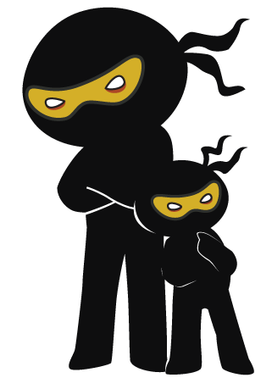



Word of the Day
Summer Term 2023
Week 27 – 17th April 2023
'Words unlock the doors to a world of understanding...'

Slide 2

This Week's Words
Grasshopper
Shinobi
buy
raucous
bite
tarnish
finish
coincidence
hold
clamber
soft
evict

Slide 3
Grasshopper (Tier 1)
buy
bite
finish
hold
soft

Slide 4
Shinobi (Tier 2)
raucous
tarnish
coincidence
clamber
evict

Slide 5


Grasshopper Word of the Day
buy
Word Class
Word of the Day:
(verb)
(buy)
Pronunciation / Syllables
Definition:
If you buy something, you obtain it by paying money for it.
Courtney wanted to buy items from the shop.
Synonym: | Antonym: | Rhyme: | Link Word:
get | sell | fly | food
secure |  | high | clothes

Slide 6

Grasshopper Word of the Day
bite
Word Class
Word of the Day:
(verb)
(bite)
Pronunciation / Syllables
Definition:
If you bite something, you use your teeth to cut into it, for example in order to eat it or break it. If an animal or person bites you, they use their teeth to hurt or injure you.
The dog was about to bite the cookie.
Synonym: | Antonym: | Rhyme: | Link Word:
chew |  | right | food
munch |  | light | person

Slide 7

Grasshopper Word of the Day
finish
Word Class
Word of the Day:
(verb)
(fin-ish)
Pronunciation / Syllables
Definition:
When you finish doing or dealing with something, you do or deal with the last part of it, so that there is no more for you to do or deal with.
Phoebe crossed the finish line!
Synonym: | Antonym: | Rhyme: | Link Word:
complete | start | diminish | race
end |  |  | book

Slide 8

Grasshopper Word of the Day
hold
Word Class
Word of the Day:
(verb)
(hold)
Pronunciation / Syllables
Definition:
When you hold something, you carry or support it, using your hands or your arms.
Teddy was always holding his phone.
Synonym: | Antonym: | Rhyme: | Link Word:
grasp | release | cold | hands
grip | let go of | told | baby

Slide 9

Grasshopper Word of the Day
soft
Word Class
Word of the Day:
(adjective)
(soft)
Pronunciation / Syllables
Definition:
Something that is soft is pleasant to touch, and not rough or hard.
Thea’s teddy bear was very soft.
Synonym: | Antonym: | Rhyme: | Link Word:
squashy | hard | waft | blanket
 | firm | toft | hair

Slide 10

Shinobi Word of the Day
raucous
Word Class
Word of the Day:
(adjective)
(rau-cous)
Pronunciation / Syllables
Definition:
A raucous sound is loud, harsh, and rather unpleasant.
Raucous laughter echoed from Class 5.
Synonym: | Antonym: | Prefix / Suffix: | Rhyme: | Link Word:
rowdy | peaceful | -ly | caucous | crowd
boisterous | quiet |  |  | people

Slide 11

Shinobi Word of the Day
tarnish
Word Class
Word of the Day:
(verb)
(tar-nish)
Pronunciation / Syllables
Definition:
If you say that something tarnishes someone's reputation or image, you mean that it causes people to have a worse opinion of them than they would otherwise have had.
Mr Phillips was late; his reputation tarnished.
Synonym: | Antonym: | Prefix / Suffix: | Rhyme: | Link Word:
stain | brighten | -ed | varnish | reputation
 |  | -ing | garnish | person

Slide 12

Shinobi Word of the Day
coincidence
Word Class
Word of the Day:
(noun)
(co-in-ci-dence)
Pronunciation / Syllables
Definition:
A coincidence is when two or more similar or related events occur at the same time by chance and without any planning.
It was no coincidence they we wearing the same coat.
Synonym: | Antonym: | Prefix / Suffix: | Rhyme: | Link Word:
accident |  | -tally | incidence | is
chance |  | -s |  | isn’t

Slide 13

Shinobi Word of the Day
clamber
Word Class
Word of the Day:
(verb)
(clam-ber)
Pronunciation / Syllables
Definition:
If you clamber somewhere, you climb there with difficulty, usually using your hands as well as your feet.
Miles clambered up the steep hill.
Synonym: | Antonym: | Prefix / Suffix: | Rhyme: | Link Word:
scramble |  | -ed | amber | slowly
climb |  | -ing | camber | upwards

Slide 14

Shinobi Word of the Day
evict
Word Class
Word of the Day:
(verb)
(e-vict)
Pronunciation / Syllables
Definition:
If someone is evicted from the place where they are living, they are forced to leave it.
Freddy had been evicted from the classroom.
Synonym: | Antonym: | Prefix / Suffix | Rhyme: | Link Word:
remove | admit | -ed | strict | home
expel |  | -ion | picked | from

Slide 15
Vocabulary Laboratory
Describe / Definition:
Use it in a sentence:
Focus Word (write below):
Word Class:
Synonyms: (words with same / similar meaning) | Antonyms: (words with opposite meaning)
Rhymes: (words that sound the same) | Link Words: (Example: football = pitch, team, player)
Draw your sentence:

Slide 16

Vocabulary Visualiser
Draw the Grasshopper words and bring them to life.
Word: buy | Word: bite
Word: hold | Word: soft

Slide 17
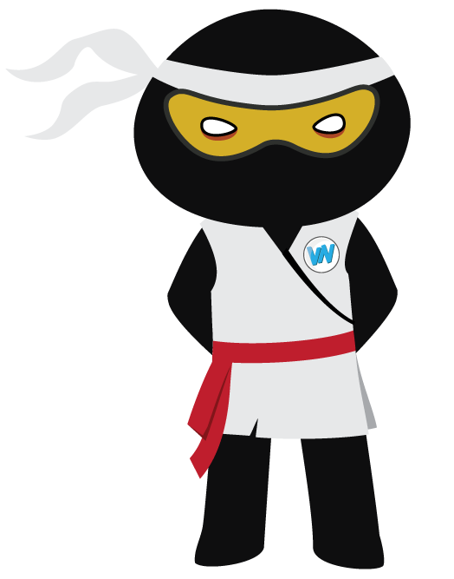
Vocabulary Visualiser
Draw the Shinobi words and bring them to life.
Word: racous | Word: tarnish
Word: coincidence | Word: clamber

Slide 18
Matching Meanings
Draw lines from the Grasshopper words to their definitions.
Grasshopper Word
buy
bite
finish
hold
soft
Grasshopper Definitions
If you *** something, you use your teeth to cut into it, for example in order to eat it or break it. If an animal or person *** you, they use their teeth to hurt or injure you.
Something that is *** is pleasant to touch, and not rough or hard.
If you *** something, you obtain it by paying money for it.
When you *** something, you carry or support it, using your hands or your arms.
When you *** doing or dealing with something, you do or deal with the last part of it, so that there is no more for you to do or deal with.

Slide 19
Matching Meanings
Draw lines from the Shinobi words to their definitions.
Shinobi Word
raucous
tarnish
coincidence
clamber
evict
Shinobi Definitions
A *** is when two or more similar or related events occur at the same time by chance and without any planning.
If you *** somewhere, you climb there with difficulty, usually using your hands as well as your feet.
A *** sound is loud, harsh, and rather unpleasant.
If someone is *** from the place where they are living, they are forced to leave it.
If you say that something *** someone's reputation or image, you mean that it causes people to have a worse opinion of them than they would otherwise have had.

Slide 20






Display Slips
The following slides are for classroom display. As you teach each Word of the Day, words can be displayed in the classroom to enable pupils to use the taught vocabulary in an independent manner.

Slide 21
buy
bite

Slide 22
finish
hold

Slide 23
soft
raucous

Slide 24
tarnish
coincidence

Slide 25
clamber
evict

