Slide 1




Word of the Day
Spring Term 2023
Week 20 – 6th February 2023
'Words unlock the doors to a world of understanding...'

Slide 2

This Week's Words
Grasshopper
Shinobi
open
prod
clap
squish
land
mention
cut
detach
shut
incident

Slide 3
Grasshopper (Tier 1)
open
clap
land
cut
shut

Slide 4
Shinobi (Tier 2)
prod
squish
mention
detach
incident

Slide 5


Grasshopper Word of the Day
open
Word Class
Word of the Day:
(verb)
(o-pen)
Pronunciation / Syllables
Definition:
If you open something such as a door, window, or lid, or if it opens, its position is changed so that it no longer covers a hole or gap.
Freddy opened the window to let in some air.
Synonym: | Antonym: | Rhyme: | Link Word:
unlock | close | fee | door
unlatch | shut | beat | window

Slide 6

Grasshopper Word of the Day
clap
Word Class
Word of the Day:
(verb)
(clap)
Pronunciation / Syllables
Definition:
When you clap, you hit your hands together to show appreciation or attract attention.
Everyone clapped the winner of the certificate.
Synonym: | Antonym: | Rhyme: | Link Word:
applaud | boo | sink | hands
 | jeer | link | together

Slide 7
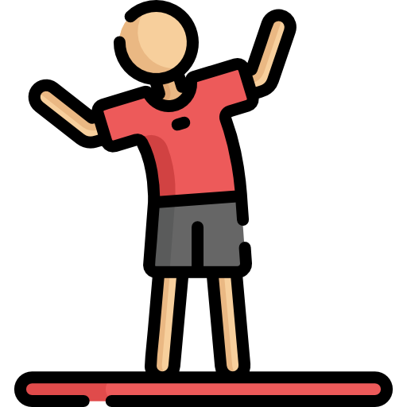
Grasshopper Word of the Day
land
Word Class
Word of the Day:
(verb / noun)
(land)
Pronunciation / Syllables
Definition:
When someone or something lands, they come down to the ground after moving through the air or falling.
Tim landed on the mats.
Synonym: | Antonym: | Rhyme: | Link Word:
touch down | take off | home | on
 |  | dome | gently

Slide 8

Grasshopper Word of the Day
cut
Word Class
Word of the Day:
(verb)
(cut)
Pronunciation / Syllables
Definition:
If you cut something, you use a knife or a similar tool to divide it into pieces, or to mark it or damage it. If you cut a shape or a hole in something, you make the shape or hole by using a knife or similar tool.
Ismail cut the ribbon using scissors.
Synonym: | Antonym: | Rhyme: | Link Word:
snip |  | notch | through
trim |  | botch | around

Slide 9

Grasshopper Word of the Day
shut
Word Class
Word of the Day:
(verb)
(shut)
Pronunciation / Syllables
Definition:
If you shut something such as a door or if it shuts, it moves so that it fills a hole or a space.
Mark shut the door.
Synonym: | Antonym: | Rhyme: | Link Word:
close | open | feed | quietly
slam | unlock | seed | quickly

Slide 10

Shinobi Word of the Day
prod
Word Class
Word of the Day:
(verb)
(prod)
Pronunciation / Syllables
Definition:
If you prod someone or something, you give them a quick push with your finger or with a pointed object.
Alex prodded the mixture to see if it was hard.
Synonym: | Antonym: | Prefix / Suffix: | Rhyme: | Link Word:
poke |  | -ing | odd | person
jab |  | -ed | squad | animal

Slide 11

Shinobi Word of the Day
squish
Word Class
Word of the Day:
(verb)
(squish)
Pronunciation / Syllables
Definition:
To crush or squash, so as to make a soft splashing noise.
Ruby squished the lemons using the press.
Synonym: | Antonym: | Prefix / Suffix: | Rhyme: | Link Word:
 |  | -ed | wish | bug
 |  | -ing | dish | fruit

Slide 12

Shinobi Word of the Day
mention
Word Class
Word of the Day:
(verb)
(men-tion)
Pronunciation / Syllables
Definition:
If you mention something, you say something about it, usually briefly.
Kira mentioned her favourite book in the conversation.
Synonym: | Antonym: | Prefix / Suffix: | Rhyme: | Link Word:
state |  | -ing | apprehension | in
say |  | -ed | convention | a

Slide 13


Shinobi Word of the Day
detach
Word Class
Word of the Day:
(verb)
(de-tach)
Pronunciation / Syllables
Definition:
If you detach one thing from another that it is fixed to, you remove it. If one thing detaches from another, it becomes separated from it.
Robbie detached the clip from the bunch.
Synonym: | Antonym: | Prefix / Suffix: | Rhyme: | Link Word:
unfasten | attach | -ed | catch | house
disconnect |  |  | match | yourself

Slide 14

Shinobi Word of the Day
incident
Word Class
Word of the Day:
(noun)
(in-ci-dent)
Pronunciation / Syllables
Definition:
An incident is something that happens, often something that is unpleasant.
There had been an incident on the playground during lunch.
Synonym: | Antonym: | Prefix / Suffix | Rhyme: | Link Word:
event |  | -ly | coincident | dangerous
episode |  |  | insolent | curious

Slide 15
Vocabulary Laboratory
Describe / Definition:
Use it in a sentence:
Focus Word (write below):
Word Class:
Synonyms: (words with same / similar meaning) | Antonyms: (words with opposite meaning)
Rhymes: (words that sound the same) | Link Words: (Example: football = pitch, team, player)
Draw your sentence:

Slide 16

Vocabulary Visualiser
Draw the Grasshopper words and bring them to life.
Word: open | Word: close
Word: shut | Word: clap

Slide 17

Vocabulary Visualiser
Draw the Shinobi words and bring them to life.
Word: prod | Word: mention
Word: detach | Word: incident

Slide 18
Matching Meanings
Draw lines from the Grasshopper words to their definitions.
Grasshopper Word
open
clap
land
cut
shut
Grasshopper Definitions
When someone or something lands, they come down to the ground after moving through the air or falling.
If you open something such as a door, window, or lid, or if it opens, its position is changed so that it no longer covers a hole or gap.
If you cut something, you use a knife or a similar tool to divide it into pieces, or to mark it or damage it.
If you shut something such as a door or if it shuts, it moves so that it fills a hole or a space.
When you clap, you hit your hands together to show appreciation or attract attention.

Slide 19
Matching Meanings
Draw lines from the Shinobi words to their definitions.
Shinobi Word
prod
squish
mention
detach
incident
Shinobi Definitions
If you mention something, you say something about it, usually briefly.
If you prod someone or something, you give them a quick push with your finger or with a pointed object.
An incident is something that happens, often something that is unpleasant.
If you detach one thing from another that it is fixed to, you remove it. If one thing detaches from another, it becomes separated from it.
To crush or squash, so as to make a soft splashing noise.

Slide 20






Display Slips
The following slides are for classroom display. As you teach each Word of the Day, words can be displayed in the classroom to enable pupils to use the taught vocabulary in an independent manner.

Slide 21
open
clap

Slide 22
land
cut

Slide 23
shut
prod

Slide 24
squish
mention

Slide 25
detach
incident

