Slide 1




Word of the Day
Spring Term 2023
Week 17 – 16th January 2023
'Words unlock the doors to a world of understanding...'

Slide 2

This Week's Words
Grasshopper
Shinobi
shape
trundle
home
gambol
swim
cavort
inside
hoarse
asleep
trample

Slide 3
Grasshopper (Tier 1)
shape
home
swim
inside
asleep

Slide 4
Shinobi (Tier 2)
trundle
gambol
cavort
hoarse
trample

Slide 5


Grasshopper Word of the Day
shape
Word Class
Word of the Day:
(noun)
(shape)
Pronunciation / Syllables
Definition:
The shape of an object, a person, or an area is the appearance of their outside edges or surfaces, for example whether they are round, square or curved.
Ellie picked out different shapes and described them.
Synonym: | Antonym: | Rhyme: | Link Word:
form |  | escape | square
appearance |  | tape | curved

Slide 6

Grasshopper Word of the Day
home
Word Class
Word of the Day:
(noun)
(home)
Pronunciation / Syllables
Definition:
Someone's home is the house or flat where they live.
After school, everyone made their way home.
Synonym: | Antonym: | Rhyme: | Link Word:
pad |  | dome | house
dwelling |  | foam | safe

Slide 7

Grasshopper Word of the Day
swim
Word Class
Word of the Day:
(verb / noun)
(swim)
Pronunciation / Syllables
Definition:
When you swim, you move through water by making movements with your arms and legs.
Year 4 were learning to swim.
Synonym: | Antonym: | Rhyme: | Link Word:
dive |  | him | learn
 |  | dim | water

Slide 8

Grasshopper Word of the Day
inside
Word Class
Word of the Day:
(preposition)
(in-side)
Pronunciation / Syllables
Definition:
Something or someone that is inside a place, container, or object is in it or is surrounded by it.
The children placed the books back inside the box.
Synonym: | Antonym: | Rhyme: | Link Word:
interior | outside | provide | walk
middle | exterior | tried | move

Slide 9

Grasshopper Word of the Day
asleep
Word Class
Word of the Day:
(adjective)
(a-sleep)
Pronunciation / Syllables
Definition:
Someone who is asleep is sleeping.
Jenny had fallen asleep at her desk.
Synonym: | Antonym: | Rhyme: | Link Word:
napping | awake | sheep | fast
dozing |  | keep | fallen

Slide 10

Shinobi Word of the Day
trundle
Word Class
Word of the Day:
(verb)
(trun-dle)
Pronunciation / Syllables
Definition:
If you trundle something somewhere, especially a small, heavy object with wheels, you move or roll it along slowly.
The caretaker trundled along, spreading salt as they went.
Synonym: | Antonym: | Prefix / Suffix: | Rhyme: | Link Word:
 |  | -ation | bundle | slowly
 |  | -ed |  | across

Slide 11
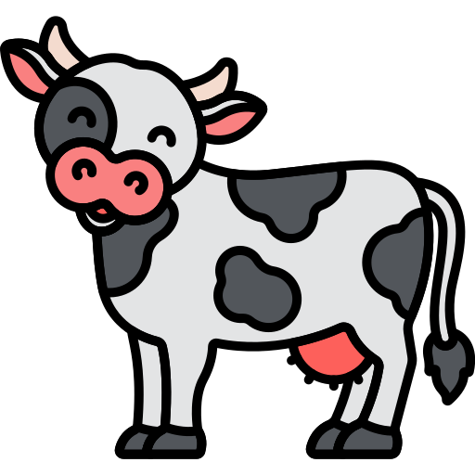
Shinobi Word of the Day
gambol
Word Class
Word of the Day:
(verb)
(gam-bol)
Pronunciation / Syllables
Definition:
If animals or people gambol, they run or jump about in a playful way.
We could see cows gambolling in the field opposite school.
Synonym: | Antonym: | Prefix / Suffix: | Rhyme: | Link Word:
frolic |  | -ing | patrol | animal
cavort |  | -ed | control | joyfully

Slide 12
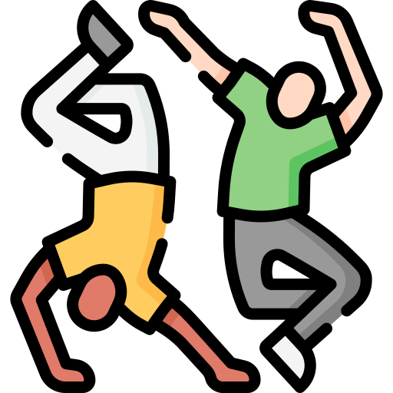
Shinobi Word of the Day
cavort
Word Class
Word of the Day:
(verb)
(ca-vort)
Pronunciation / Syllables
Definition:
When people cavort, they leap about in a noisy and excited way.
It was wonderful to see the children cavorting at the disco.
Synonym: | Antonym: | Prefix / Suffix: | Rhyme: | Link Word:
dance |  | -ing | support | people
frolic |  | -ed | report | children

Slide 13

Shinobi Word of the Day
hoarse
Word Class
Word of the Day:
(adjective)
(hoarse)
Pronunciation / Syllables
Definition:
If your voice is hoarse or if you are hoarse, your voice sounds rough and unclear, for example because your throat is sore.
Mr Gibbs’ voice was hoarse after shouting instructions.
Synonym: | Antonym: | Prefix / Suffix: | Rhyme: | Link Word:
croaky | mellow |  | course | voice
gruff | soft |  | source | sound

Slide 14


Shinobi Word of the Day
trample
Word Class
Word of the Day:
(verb)
(tram-ple)
Pronunciation / Syllables
Definition:
If someone tramples something or tramples on it, they step heavily and carelessly on it and damage it.
Percy accidentally trampled the daffodils.
Synonym: | Antonym: | Prefix / Suffix | Rhyme: | Link Word:
flatten |  | -ed | example | dreams
stamp |  | -ing | sample | plants

Slide 15
Vocabulary Laboratory
Describe / Definition:
Use it in a sentence:
Focus Word (write below):
Word Class:
Synonyms: (words with same / similar meaning) | Antonyms: (words with opposite meaning)
Rhymes: (words that sound the same) | Link Words: (Example: football = pitch, team, player)
Draw your sentence:

Slide 16

Vocabulary Visualiser
Draw the Grasshopper words and bring them to life.
Word: home | Word: swim
Word: inside | Word: asleep

Slide 17

Vocabulary Visualiser
Draw the Shinobi words and bring them to life.
Word: trundle | Word: gambol
Word: cavort | Word: trample

Slide 18
Matching Meanings
Draw lines from the Grasshopper words to their definitions.
Grasshopper Word
shape
home
swim
inside
asleep
Grasshopper Definitions
Someone’s *** is the house or flat where they live.
Something or someone that is *** a place, container, or object is in it or is surrounded by it.
The *** of an object, a person, or an area is the appearance of their outside edges or surfaces, for example whether they are round, square or curved.
Someone who is *** is sleeping.
When you ***, you move through water by making movements with your arms and legs.

Slide 19
Matching Meanings
Draw lines from the Shinobi words to their definitions.
Shinobi Word
trundle
gambol
cavort
hoarse
trample
Shinobi Definitions
When people ***, they leap about in a noisy and excited way.
If someone *** something or tramples on it, they step heavily and carelessly on it and damage it.
If your voice is *** or if you are ***, your voice sounds rough and unclear, for example because your throat is sore.
If you *** something somewhere, especially a small, heavy object with wheels, you move or roll it along slowly.
If animals or people ***, they run or jump about in a playful way.

Slide 20






Display Slips
The following slides are for classroom display. As you teach each Word of the Day, words can be displayed in the classroom to enable pupils to use the taught vocabulary in an independent manner.

Slide 21
shape
home

Slide 22
swim
inside

Slide 23
asleep
trundle

Slide 24
gambol
cavort

Slide 25
hoarse
trample

