Slide 1




Word of the Day
Autumn Term 2022
Week 14 – 12th December 2022
'Words unlock the doors to a world of understanding...'

Slide 2

This Week's Words
Grasshopper
Shinobi
ice
frozen
fleece
downfall
frost
shimmer
temperature
crisp
skate
arctic

Slide 3
Grasshopper (Tier 1)
ice
fleece
frost
temperature
skate

Slide 4
Shinobi (Tier 2)
frozen
downfall
shimmer
crisp
arctic

Slide 5


Grasshopper Word of the Day
ice
Word Class
Word of the Day:
(noun)
(ice)
Pronunciation / Syllables
Definition:
Ice is frozen water.
The playground was covered in ice.
Synonym: | Antonym: | Rhyme: | Link Word:
frost |  | nice | dangerous
 |  | slice | slip

Slide 6
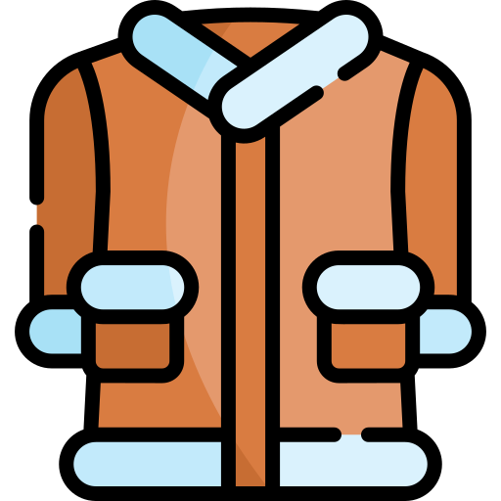
Grasshopper Word of the Day
fleece
Word Class
Word of the Day:
(noun)
(fleece)
Pronunciation / Syllables
Definition:
Fleece is a soft warm artificial fabric.
Anna’s coat was a fleece. It was very warm.
Synonym: | Antonym: | Rhyme: | Link Word:
jacket |  | peace | thick
coat |  | increase | warm

Slide 7
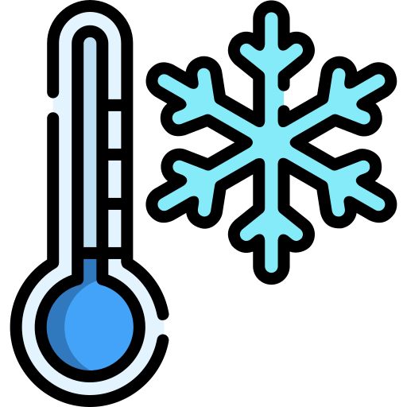
Grasshopper Word of the Day
frost
Word Class
Word of the Day:
(noun)
(frost)
Pronunciation / Syllables
Definition:
When there is frost or a frost, the temperature outside falls below freezing point and the ground becomes covered in ice crystals.
There was a frost last night, it was very cold.
Synonym: | Antonym: | Rhyme: | Link Word:
ice |  | cost | light
 |  | lost | heavy

Slide 8
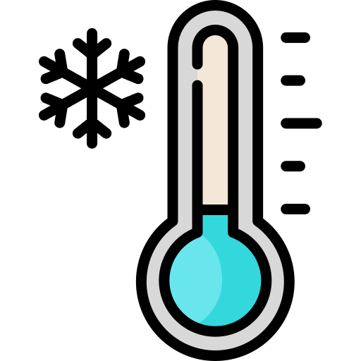
Grasshopper Word of the Day
temperature
Word Class
Word of the Day:
(noun)
(tem-per-a-ture)
Pronunciation / Syllables
Definition:
The temperature of something is a measure of how hot or cold it is.
The temperature outside was very low.
Synonym: | Antonym: | Rhyme: | Link Word:
 |  |  | cold
 |  |  | hot

Slide 9
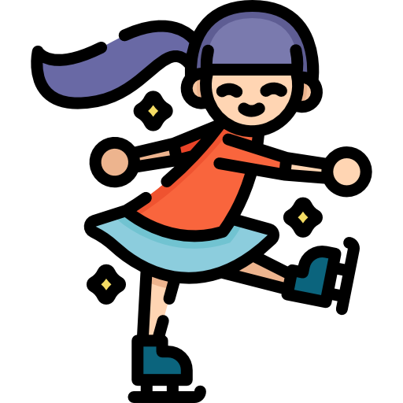
Grasshopper Word of the Day
skate
Word Class
Word of the Day:
(verb)
(skate)
Pronunciation / Syllables
Definition:
If you skate, you move about wearing ice-skates or roller-skates.
Jenny skated across the ice at the leisure centre.
Synonym: | Antonym: | Rhyme: | Link Word:
glide |  | fate | joyfully
 |  | late | effortlessly

Slide 10

Shinobi Word of the Day
frozen
Word Class
Word of the Day:
(adjective)
(fro-zen)
Pronunciation / Syllables
Definition:
If you say that you are frozen, or a part of your body is frozen, you are emphasizing that you feel very cold.
Miss Clapp was frozen in her classroom.
Synonym: | Antonym: | Prefix / Suffix: | Rhyme: | Link Word:
numb | warm | un- | chosen | completely
shivering | boiling | re- |  | solid

Slide 11
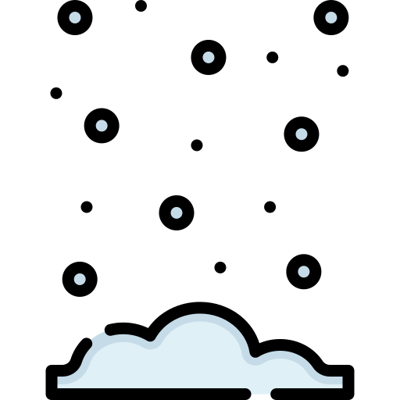
Shinobi Word of the Day
downfall
Word Class
Word of the Day:
(noun)
(down-fall)
Pronunciation / Syllables
Definition:
If their was a downfall of rain, snow, etc, it would be sudden and heavy.
We had a sudden downfall of snow at about 2 o’clock.
Synonym: | Antonym: | Prefix / Suffix: | Rhyme: | Link Word:
deluge |  |  |  | sudden
 |  |  |  | huge

Slide 12


Shinobi Word of the Day
shimmer
Word Class
Word of the Day:
(verb)
(shim-mer)
Pronunciation / Syllables
Definition:
If something shimmers, it shines with a faint, unsteady light or has an unclear, unsteady appearance.
The street light shimmered on the icy road.
Synonym: | Antonym: | Prefix / Suffix: | Rhyme: | Link Word:
glint |  | -ing | glimmer | light
glisten |  | -ed | dimmer | reflection

Slide 13

Shinobi Word of the Day
crisp
Word Class
Word of the Day:
(adjective)
(crisp)
Pronunciation / Syllables
Definition:
Weather that is pleasantly fresh, cold, and dry can be described as crisp.
It was a crisp morning; perfect for a walk.
Synonym: | Antonym: | Prefix / Suffix: | Rhyme: | Link Word:
brisk |  | -er | lisp | morning
fresh |  | -ness | wisp | day

Slide 14

Shinobi Word of the Day
arctic
Word Class
Word of the Day:
(adjective)
(arc-tic)
Pronunciation / Syllables
Definition:
If you describe a place or the weather as arctic, you are emphasizing that it is extremely cold.
The arctic wind whipped across the playground.
Synonym: | Antonym: | Prefix / Suffix | Rhyme: | Link Word:
frosty | tropical |  |  | weather
freezing |  |  |  | wind

Slide 15
Vocabulary Laboratory
Describe / Definition:
Use it in a sentence:
Focus Word (write below):
Word Class:
Synonyms: (words with same / similar meaning) | Antonyms: (words with opposite meaning)
Rhymes: (words that sound the same) | Link Words: (Example: football = pitch, team, player)
Draw your sentence:

Slide 16

Vocabulary Visualiser
Draw the Grasshopper words and bring them to life.
Word: ice | Word: fleece
Word: frost | Word: frozen

Slide 17

Vocabulary Visualiser
Draw the Shinobi words and bring them to life.
Word: skate | Word: downfall
Word: crisp | Word: arctic

Slide 18
Matching Meanings
Draw lines from the Grasshopper words to their definitions.
Grasshopper Word
ice
fleece
frost
temperature
skate
Grasshopper Definitions
If you ***, you move about wearing ice-skates or roller-skates.
*** is a soft warm artificial fabric.
*** is frozen water.
The *** of something is a measure of how hot or cold it is.
When there is *** or a ***, the temperature outside falls below freezing point and the ground becomes covered in ice crystals.

Slide 19
Matching Meanings
Draw lines from the Shinobi words to their definitions.
Shinobi Word
frozen
downfall
shimmer
crisp
arctic
Shinobi Definitions
Weather that is pleasantly fresh, cold, and dry can be described as ***.
If their was a *** of rain, snow, etc, it would be sudden and heavy.
If you describe a place or the weather as ***, you are emphasizing that it is extremely cold.
If you say that you are ***, or a part of your body is ***, you are emphasizing that you feel very cold.
If something ***, it shines with a faint, unsteady light or has an unclear, unsteady appearance.

Slide 20






Display Slips
The following slides are for classroom display. As you teach each Word of the Day, words can be displayed in the classroom to enable pupils to use the taught vocabulary in an independent manner.

Slide 21
ice
fleece

Slide 22
frost
temperature

Slide 23
skate
frozen

Slide 24
downfall
shimmer

Slide 25
crisp
arctic

