Slide 1
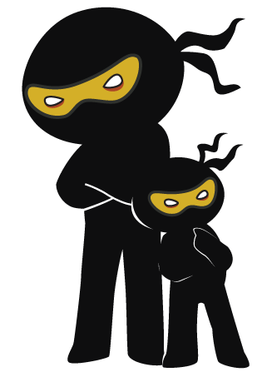



Word of the Day
Autumn Term 2022
Week 10 – 14th November 2022
'Words unlock the doors to a world of understanding...'

Slide 2

This Week's Words
Grasshopper
Shinobi
tall
possess
dip
rumour
memory
instinct
gap
etch
sting
anonymous

Slide 3
Grasshopper (Tier 1)
tall
dip
memory
gap
sting

Slide 4
Shinobi (Tier 2)
possess
rumour
instinct
etch
anonymous

Slide 5


Grasshopper Word of the Day
tall
Word Class
Word of the Day:
(adjective)
(tall)
Pronunciation / Syllables
Definition:
Someone or something that is tall has a greater height than is normal or average.
Mr Summersby was very tall.
Synonym: | Antonym: | Rhyme: | Link Word:
big | wide | call | person
high | small | fall | building

Slide 6

Grasshopper Word of the Day
dip
Word Class
Word of the Day:
(verb)
(dip)
Pronunciation / Syllables
Definition:
If you dip something in a liquid, you put it into the liquid for a short time, so that only part of it is covered, and take it out again.
Mrs Balharry loved dipping strawberries in chocolate.
Synonym: | Antonym: | Rhyme: | Link Word:
plunge | remove | pip | biscuit
dunk |  | sip | tea

Slide 7

Grasshopper Word of the Day
memory
Word Class
Word of the Day:
(noun)
(mem-o-ry)
Pronunciation / Syllables
Definition:
A memory is something that you remember from the past.
My memory of the beach will last forever.
Synonym: | Antonym: | Rhyme: | Link Word:
echo |  | plenary | remember
 |  | documentary | past

Slide 8

Grasshopper Word of the Day
gap
Word Class
Word of the Day:
(noun)
(gap)
Pronunciation / Syllables
Definition:
A gap is a space between two things or a hole in the middle of something solid.
I visited the dentist about the gap between my teeth.
Synonym: | Antonym: | Rhyme: | Link Word:
opening |  | lap | between
cavity |  | map | jump

Slide 9

Grasshopper Word of the Day
sting
Word Class
Word of the Day:
(verb / noun)
(sting)
Pronunciation / Syllables
Definition:
If a plant, animal, or insect stings you, a sharp part of it, usually covered with poison, is pushed into your skin so that you feel a sharp pain.
The wasp sting wasn’t very nice.
Synonym: | Antonym: | Rhyme: | Link Word:
nip |  | ring | nettle
wound |  | bring | insect

Slide 10

Shinobi Word of the Day
possess
Word Class
Word of the Day:
(verb)
(pos-sess)
Pronunciation / Syllables
Definition:
If you possess something, you have it or own it.
Amelia possessed a real talent for singing.
Synonym: | Antonym: | Prefix / Suffix: | Rhyme: | Link Word:
enjoy |  | re- | press | skill
 |  | -ion | success | talent

Slide 11

Shinobi Word of the Day
rumour
Word Class
Word of the Day:
(noun)
(ru-mour)
Pronunciation / Syllables
Definition:
A rumour is a story or piece of information that may or may not be true, but that people are talking about.
It was rumoured that Miss Hanson had won the lottery.
Synonym: | Antonym: | Prefix / Suffix: | Rhyme: | Link Word:
goss | fact | -ed | humour | around
talk |  |  | consumer | spread

Slide 12

Shinobi Word of the Day
instinct
Word Class
Word of the Day:
(noun)
(in-stinct)
Pronunciation / Syllables
Definition:
Instinct is a feeling that you have that something is the case, rather than an opinion or idea based on facts.
Jenny’s instincts told her that she would be picked next.
Synonym: | Antonym: | Prefix / Suffix: | Rhyme: | Link Word:
sense |  | -ive |  | feel
inclination |  | -ively |  | bones

Slide 13
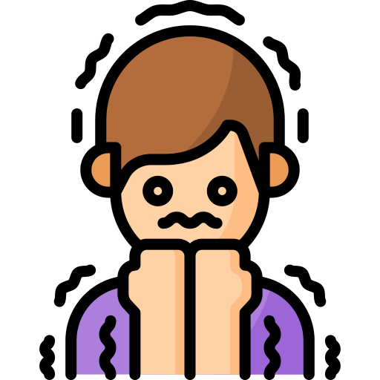
Shinobi Word of the Day
etch
Word Class
Word of the Day:
(verb)
(etch)
Pronunciation / Syllables
Definition:
If you say that feelings are etched on someone's face, you mean that the person is very strongly affected by them, and you can see this in their appearance.
Fear was etched all over her face at the top of the zip wire.
Synonym: | Antonym: | Prefix / Suffix: | Rhyme: | Link Word:
engrave |  | -ed | fetch | emotion
carve |  | -ing | sketch | across

Slide 14

Shinobi Word of the Day
anonymous
Word Class
Word of the Day:
(adjective)
(a-non-y-mous)
Pronunciation / Syllables
Definition:
If you remain anonymous when you do something, you do not let people know that you were the person who did it.
The artist wanted to remain anonymous.
Synonym: | Antonym: | Prefix / Suffix | Rhyme: | Link Word:
nameless | known | -ly | synonymous | person
unknown | signed |  |  | author

Slide 15
Vocabulary Laboratory
Describe / Definition:
Use it in a sentence:
Focus Word (write below):
Word Class:
Synonyms: (words with same / similar meaning) | Antonyms: (words with opposite meaning)
Rhymes: (words that sound the same) | Link Words: (Example: football = pitch, team, player)
Draw your sentence:

Slide 16

Vocabulary Visualiser
Draw the Grasshopper words and bring them to life.
Word: tall | Word: dip
Word: gap | Word: sting

Slide 17

Vocabulary Visualiser
Draw the Shinobi words and bring them to life.
Word: possess | Word: rumour
Word: etch | Word: anonymous

Slide 18
Matching Meanings
Draw lines from the Grasshopper words to their definitions.
Grasshopper Word
tall
dip
memory
gap
sting
Grasshopper Definitions
If a plant, animal, or insect *** you, a sharp part of it, usually covered with poison, is pushed into your skin so that you feel a sharp pain.
Someone or something that is *** has a greater height than is normal or average.
A *** is a space between two things or a hole in the middle of something solid.
If you *** something in a liquid, you put it into the liquid for a short time, so that only part of it is covered, and take it out again.
A *** is something that you remember from the past.

Slide 19
Matching Meanings
Draw lines from the Shinobi words to their definitions.
Shinobi Word
possess
rumour
instinct
etch
anonymous
Shinobi Definitions
If you remain *** when you do something, you do not let people know that you were the person who did it.
A *** is a story or piece of information that may or may not be true, but that people are talking about.
If you say that feelings are *** on someone's face, you mean that the person is very strongly affected by them, and you can see this in their appearance.
If you *** something, you have it or own it.
*** is a feeling that you have that something is the case, rather than an opinion or idea based on facts.

Slide 20
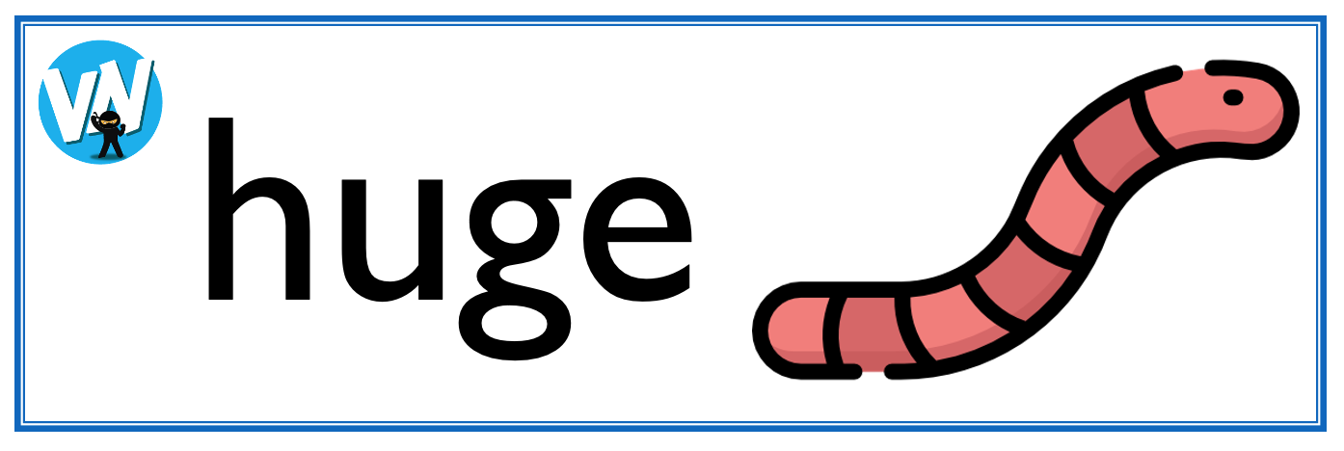





Display Slips
The following slides are for classroom display. As you teach each Word of the Day, words can be displayed in the classroom to enable pupils to use the taught vocabulary in an independent manner.

Slide 21
tall
dip

Slide 22
memory
gap

Slide 23
sting
possess

Slide 24
rumour
instinct

Slide 25
etch
anonymous

