Slide 1




Word of the Day
Autumn Term 2022
Week 12 – 28th November 2022
'Words unlock the doors to a world of understanding...'

Slide 2

This Week's Words
Grasshopper
Shinobi
tie
strategy
position
punish
win
remedy
tackle
master
lose
squeamish

Slide 3
Grasshopper (Tier 1)
tie
position
win
tackle
lose

Slide 4
Shinobi (Tier 2)
strategy
punish
remedy
master
squeamish

Slide 5


Grasshopper Word of the Day
tie
Word Class
Word of the Day:
(noun / verb)
(tie)
Pronunciation / Syllables
Definition:
If two people tie in a competition or game or if they tie with each other, they have the same number of points or the same degree of success.
The game ended in a tie.
Synonym: | Antonym: | Rhyme: | Link Word:
draw |  | cry | game
deadlock |  | fly | result

Slide 6

Grasshopper Word of the Day
position
Word Class
Word of the Day:
(noun)
(po-si-tion)
Pronunciation / Syllables
Definition:
The position of someone or something is the place where they are in relation to other things.
Jim’s position was in defence.
Synonym: | Antonym: | Rhyme: | Link Word:
location |  | tradition | pitch
place |  | condition | team

Slide 7

Grasshopper Word of the Day
win
Word Class
Word of the Day:
(verb)
(win)
Pronunciation / Syllables
Definition:
If you win something such as a competition, battle, or argument, you defeat those people you are competing or fighting against, or you do better than everyone else involved.
The children celebrated the win.
Synonym: | Antonym: | Rhyme: | Link Word:
victory | lose | pin | game
success |  | grin | competition

Slide 8
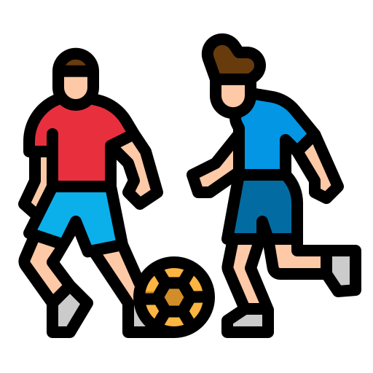
Grasshopper Word of the Day
tackle
Word Class
Word of the Day:
(verb / noun)
(tack-le)
Pronunciation / Syllables
Definition:
If you tackle someone in a game such as hockey or football, you try to take the ball away from them.
Alex ran to the ball to tackle the other player.
Synonym: | Antonym: | Rhyme: | Link Word:
challenge |  | crackle | player
 |  | shackle | opposition

Slide 9

Grasshopper Word of the Day
lose
Word Class
Word of the Day:
(verb)
(lose)
Pronunciation / Syllables
Definition:
If you lose a contest, a fight, or an argument, you do not succeed because someone does better than you and defeats you.
We did our best not to lose.
Synonym: | Antonym: | Rhyme: | Link Word:
fail | win | news | game
 |  | shoes | battle

Slide 10
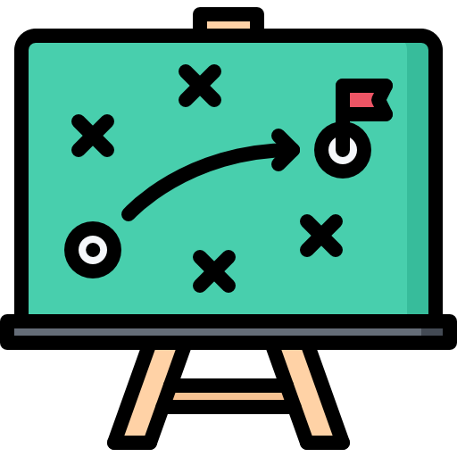
Shinobi Word of the Day
strategy
Word Class
Word of the Day:
(noun)
(strat-e-gy)
Pronunciation / Syllables
Definition:
A strategy is a general plan or set of plans intended to achieve something, especially over a long period.
The team had a clear strategy to score goals.
Synonym: | Antonym: | Prefix / Suffix: | Rhyme: | Link Word:
scheme |  | -ies | battery | team
approach |  | -ise |  | player

Slide 11

Shinobi Word of the Day
punish
Word Class
Word of the Day:
(verb)
(pun-ish)
Pronunciation / Syllables
Definition:
To punish someone means to make them suffer in some way because they have done something wrong.
The bad tackle was punished with a red card.
Synonym: | Antonym: | Prefix / Suffix: | Rhyme: | Link Word:
penalise | pardon | -ment |  | player
discipline | reward | -able |  | crime

Slide 12

Shinobi Word of the Day
remedy
Word Class
Word of the Day:
(noun / verb)
(rem-e-dy)
Pronunciation / Syllables
Definition:
A remedy is a successful way of dealing with a problem.
The manager hoped the substitute would be the remedy.
Synonym: | Antonym: | Prefix / Suffix: | Rhyme: | Link Word:
solution | problem | -ing |  | problem
answer |  |  |  | potion

Slide 13
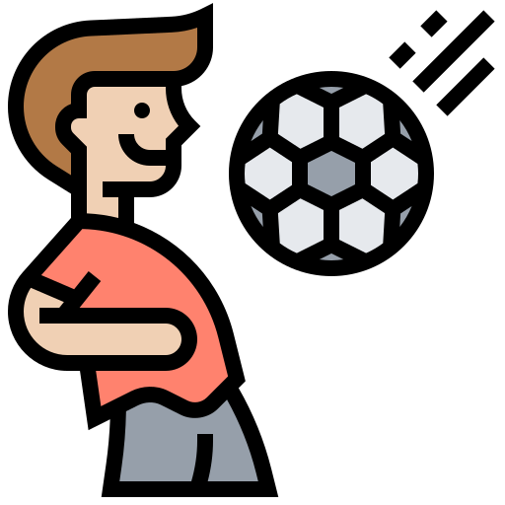
Shinobi Word of the Day
master
Word Class
Word of the Day:
(noun / verb)
(mas-ter)
Pronunciation / Syllables
Definition:
If you say that someone is a master of a particular activity, you mean that they are extremely skilled at it.
Roland was the master of a football.
Synonym: | Antonym: | Prefix / Suffix: | Rhyme: | Link Word:
expert | amateur | -piece | faster | skill
genius | novice | -ful | disaster | tool

Slide 14

Shinobi Word of the Day
squeamish
Word Class
Word of the Day:
(adjective)
(squeam-ish)
Pronunciation / Syllables
Definition:
If you are squeamish, you are easily upset by unpleasant sights or situations.
Paulo was squeamish, so didn’t look at the injury.
Synonym: | Antonym: | Prefix / Suffix | Rhyme: | Link Word:
nervous |  | -ness |  | feeling
sickened |  | -ly |  | person

Slide 15
Vocabulary Laboratory
Describe / Definition:
Use it in a sentence:
Focus Word (write below):
Word Class:
Synonyms: (words with same / similar meaning) | Antonyms: (words with opposite meaning)
Rhymes: (words that sound the same) | Link Words: (Example: football = pitch, team, player)
Draw your sentence:

Slide 16

Vocabulary Visualiser
Draw the Grasshopper words and bring them to life.
Word: tie | Word: position
Word: win | Word: tackle

Slide 17

Vocabulary Visualiser
Draw the Shinobi words and bring them to life.
Word: strategy | Word: remedy
Word: master | Word: squeamish

Slide 18
Matching Meanings
Draw lines from the Grasshopper words to their definitions.
Grasshopper Word
tie
position
win
tackle
lose
Grasshopper Definitions
If you win something such as a competition, battle, or argument, you defeat those people you are competing or fighting against, or you do better than everyone else involved.
If you lose a contest, a fight, or an argument, you do not succeed because someone does better than you and defeats you.
If two people tie in a competition or game or if they tie with each other, they have the same number of points or the same degree of success.
If you tackle someone in a game such as hockey or football, you try to take the ball away from them.
The position of someone or something is the place where they are in relation to other things.

Slide 19
Matching Meanings
Draw lines from the Shinobi words to their definitions.
Shinobi Word
strategy
punish
remedy
master
squeamish
Shinobi Definitions
To punish someone means to make them suffer in some way because they have done something wrong.
A remedy is a successful way of dealing with a problem.
If you are squeamish, you are easily upset by unpleasant sights or situations.
A strategy is a general plan or set of plans intended to achieve something, especially over a long period.
If you say that someone is a master of a particular activity, you mean that they are extremely skilled at it.

Slide 20






Display Slips
The following slides are for classroom display. As you teach each Word of the Day, words can be displayed in the classroom to enable pupils to use the taught vocabulary in an independent manner.

Slide 21
tie
position

Slide 22
win
tackle

Slide 23
lose
strategy

Slide 24
punish
remedy

Slide 25
master
squeamish

