Slide 1
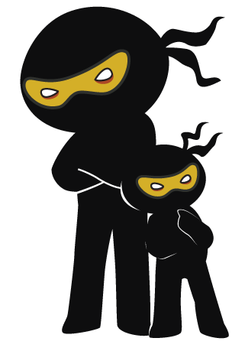



Word of the Day
Autumn Term 2022
Week 11 – 21st November 2022
'Words unlock the doors to a world of understanding...'

Slide 2

This Week's Words
Grasshopper
Shinobi
untidy
trace
dive
circle
alarm
texture
choose
pierce
hurt
satisfy

Slide 3
Grasshopper (Tier 1)
untidy
dive
alarm
choose
hurt

Slide 4
Shinobi (Tier 2)
trace
circle
texture
pierce
satisfy

Slide 5


Grasshopper Word of the Day
untidy
Word Class
Word of the Day:
(adjective)
(un-ti-dy)
Pronunciation / Syllables
Definition:
If you describe something as untidy, you mean that it is not neat or well arranged.
The classroom had become very untidy.
Synonym: | Antonym: | Rhyme: | Link Word:
messy | tidy | Friday | desk
chaotic | orderly | tidy | person

Slide 6

Grasshopper Word of the Day
dive
Word Class
Word of the Day:
(verb)
(dive)
Pronunciation / Syllables
Definition:
If you dive in a particular direction or into a particular place, you jump or move there quickly.
Alice dived to catch the ball.
Synonym: | Antonym: | Rhyme: | Link Word:
leap | remove | alive | into
jump |  | drive | under

Slide 7

Grasshopper Word of the Day
alarm
Word Class
Word of the Day:
(noun / verb)
(a-larm)
Pronunciation / Syllables
Definition:
Alarm is a feeling of fear or anxiety that something unpleasant or dangerous might happen.
Jeremy was alarmed by the loud crashing noise.
Synonym: | Antonym: | Rhyme: | Link Word:
fear | calmness | farm | noise
panic |  | harm | feeling

Slide 8

Grasshopper Word of the Day
choose
Word Class
Word of the Day:
(verb)
(choose)
Pronunciation / Syllables
Definition:
If you choose someone or something from several people or things that are available, you decide which person or thing you want to have.
Everyone needed to choose their favourite book.
Synonym: | Antonym: | Rhyme: | Link Word:
select | reject | views | book
pick | decline | news | food

Slide 9

Grasshopper Word of the Day
hurt
Word Class
Word of the Day:
(verb / adjective)
(hurt)
Pronunciation / Syllables
Definition:
If you hurt yourself or hurt a part of your body, you feel pain because you have injured yourself.
Nancy had hurt her finger.
Synonym: | Antonym: | Rhyme: | Link Word:
injure | heal | alert | finger
damage |  | dirt | feelings

Slide 10

Shinobi Word of the Day
trace
Word Class
Word of the Day:
(noun)
(trace)
Pronunciation / Syllables
Definition:
A trace is a sign which shows you that someone or something has been in a place.
There was no trace of dirt; the pots were clean.
Synonym: | Antonym: | Prefix / Suffix: | Rhyme: | Link Word:
evidence |  | -s | space | amounts
indication |  | -ed | grace | of

Slide 11

Shinobi Word of the Day
circle
Word Class
Word of the Day:
(verb)
(cir-cle)
Pronunciation / Syllables
Definition:
If something circles an object or a place, or circles around it, it forms a circle around it.
The red team circled Mia. Could she survive?
Synonym: | Antonym: | Prefix / Suffix: | Rhyme: | Link Word:
surround |  | en- | purple | around
encircle |  | -ed | encircle | sport

Slide 12

Shinobi Word of the Day
texture
Word Class
Word of the Day:
(noun)
(tex-ture)
Pronunciation / Syllables
Definition:
The texture of something is the way that it feels when you touch it, for example how smooth or rough it is.
The texture of the new jumper was rough and scratchy.
Synonym: | Antonym: | Prefix / Suffix: | Rhyme: | Link Word:
feel |  | -s | lecture | rough
touch |  | -ed | gesture | smooth

Slide 13


Shinobi Word of the Day
pierce
Word Class
Word of the Day:
(verb)
(pierce)
Pronunciation / Syllables
Definition:
If a sharp object pierces something, or if you pierce something with a sharp object, the object goes into it and makes a hole in it.
The arrow easily pierced the knight’s armour.
Synonym: | Antonym: | Prefix / Suffix: | Rhyme: | Link Word:
penetrate |  | -ed | fierce | defence
puncture |  | -ing |  | armour

Slide 14

Shinobi Word of the Day
satisfy
Word Class
Word of the Day:
(verb)
(sat-is-fy)
Pronunciation / Syllables
Definition:
If someone or something satisfies you, they give you enough of what you want or need to make you pleased or contented.
Mr Breads was satisfied with our handwriting.
Synonym: | Antonym: | Prefix / Suffix | Rhyme: | Link Word:
please | frustrate | -ied | dissatisfy | demands
 |  | -ing | gratify | expectations

Slide 15
Vocabulary Laboratory
Describe / Definition:
Use it in a sentence:
Focus Word (write below):
Word Class:
Synonyms: (words with same / similar meaning) | Antonyms: (words with opposite meaning)
Rhymes: (words that sound the same) | Link Words: (Example: football = pitch, team, player)
Draw your sentence:

Slide 16

Vocabulary Visualiser
Draw the Grasshopper words and bring them to life.
Word: untidy | Word: dive
Word: choose | Word: hurt

Slide 17
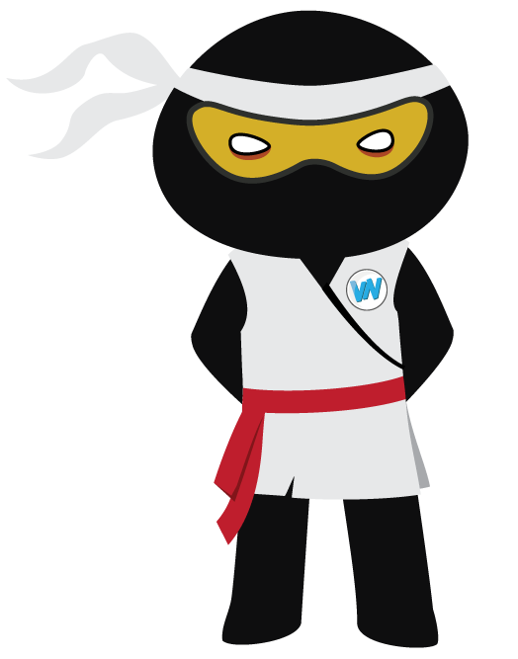
Vocabulary Visualiser
Draw the Shinobi words and bring them to life.
Word: trace | Word: circle
Word: pierce | Word: satisfy

Slide 18
Matching Meanings
Draw lines from the Grasshopper words to their definitions.
Grasshopper Word
untidy
dive
alarm
choose
hurt
Grasshopper Definitions
If you *** in a particular direction or into a particular place, you jump or move there quickly.
If you *** someone or something from several people or things that are available, you decide which person or thing you want to have.
If you describe something as ***, you mean that it is not neat or well arranged.
If you *** yourself or *** a part of your body, you feel pain because you have injured yourself.
*** is a feeling of fear or anxiety that something unpleasant or dangerous might happen.

Slide 19
Matching Meanings
Draw lines from the Shinobi words to their definitions.
Shinobi Word
trace
circle
texture
pierce
satisfy
Shinobi Definitions
If a sharp object *** something, or if you *** something with a sharp object, the object goes into it and makes a hole in it.
If someone or something *** you, they give you enough of what you want or need to make you pleased or contented.
A *** is a sign which shows you that someone or something has been in a place.
The *** of something is the way that it feels when you touch it, for example how smooth or rough it is.
If something *** an object or a place, or *** around it, it forms a *** around it.

Slide 20






Display Slips
The following slides are for classroom display. As you teach each Word of the Day, words can be displayed in the classroom to enable pupils to use the taught vocabulary in an independent manner.

Slide 21
untidy
dive

Slide 22
alarm
choose

Slide 23
hurt
trace

Slide 24
circle
texture

Slide 25
pierce
satisfy

