Slide 1




Word of the Day
Autumn Term 2022
Week 6 – 10th October 2022
'Words unlock the doors to a world of understanding...'

Slide 2

This Week's Words
Grasshopper
Shinobi
image
bait
double
fixed
snarl
wrath
text
ransack
smell
rifle

Slide 3
Grasshopper (Tier 1)
image
double
snarl
text
smell

Slide 4
Shinobi (Tier 2)
bait
fixed
wrath
ransack
rifle

Slide 5


Grasshopper Word of the Day
image
Word Class
Word of the Day:
(noun)
(im-age)
Pronunciation / Syllables
Definition:
An image is a picture of someone or something.
Everyone stared at the images of the countryside.
Synonym: | Antonym: | Rhyme: | Link Word:
picture |  |  | book
portrait |  |  | picture

Slide 6

Grasshopper Word of the Day
double
Word Class
Word of the Day:
(verb / adjective)
(dou-ble)
Pronunciation / Syllables
Definition:
When something doubles or when you double it, it becomes twice as great in number, amount, or size.
The number of robins in the garden doubled.
Synonym: | Antonym: | Rhyme: | Link Word:
doubled | half | trouble | two
twofold |  | rubble | four

Slide 7

Grasshopper Word of the Day
snarl
Word Class
Word of the Day:
(verb / noun)
(snarl)
Pronunciation / Syllables
Definition:
When an animal snarls, it makes a fierce, rough sound in its throat while showing its teeth.
The dog snarled at the cat outside of the window.
Synonym: | Antonym: | Rhyme: | Link Word:
growl |  |  | teeth
show teeth |  |  | anger

Slide 8

Grasshopper Word of the Day
text
Word Class
Word of the Day:
(noun / verb)
(text)
Pronunciation / Syllables
Definition:
The text (the written words) of a book is the main part of it, rather than the introduction, pictures, or notes.
Jennifer carefully read the text.
Synonym: | Antonym: | Rhyme: | Link Word:
book |  | next | books
work |  | perplexed | information

Slide 9
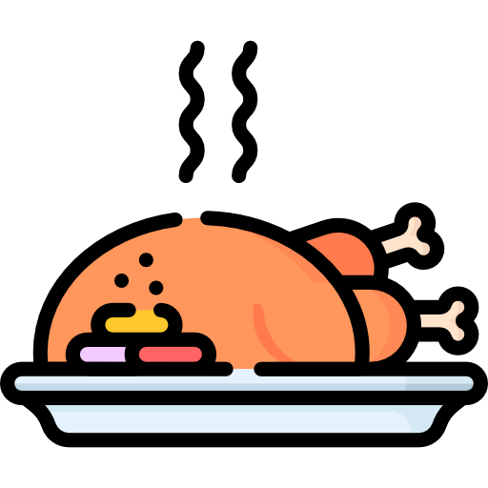
Grasshopper Word of the Day
smell
Word Class
Word of the Day:
(verb / noun)
(smell)
Pronunciation / Syllables
Definition:
If you say that something smells, you mean that it smells unpleasant.
The smell coming from the kitchen was wonderful.
Synonym: | Antonym: | Rhyme: | Link Word:
odour | pong | well | good
aroma | stench | hotel | bad

Slide 10

Shinobi Word of the Day
bait
Word Class
Word of the Day:
(noun / verb)
(bait)
Pronunciation / Syllables
Definition:
To use something as bait means to use it to trick or persuade someone to do something.
The treasure was being used as bait.
Synonym: | Antonym: | Prefix / Suffix: | Rhyme: | Link Word:
lure |  | -ing | state | trick
decoy |  | -ed | late | draw in

Slide 11

Shinobi Word of the Day
fixed
Word Class
Word of the Day:
(adjective)
(fixed)
Pronunciation / Syllables
Definition:
If you say someone’s eyes were fixed on someone or something, their eyes don’t move from that spot, they are fixed.
Imran’s eyes were fixed on the teacher.
Synonym: | Antonym: | Prefix / Suffix: | Rhyme: | Link Word:
direct | lose | -ation | mixed | stare
focus |  |  | transfixed | follow

Slide 12

Shinobi Word of the Day
wrath
Word Class
Word of the Day:
(noun)
(wrath)
Pronunciation / Syllables
Definition:
Wrath means the same as anger.
If Mia didn’t stop; she would feel her mum’s wrath!
Synonym: | Antonym: | Prefix / Suffix: | Rhyme: | Link Word:
rage | happiness | -ful | path | feel
fury |  |  | bath | anger

Slide 13

Shinobi Word of the Day
ransack
Word Class
Word of the Day:
(verb)
(ran-sack)
Pronunciation / Syllables
Definition:
If people ransack a building, they damage things in it or make it very untidy, often because they are looking for something in a quick and careless way.
The shops had been ransacked.
Synonym: | Antonym: | Prefix / Suffix: | Rhyme: | Link Word:
plunder |  | -ed |  | shop
pillage |  | -ing |  | shelves

Slide 14

Shinobi Word of the Day
rifle
Word Class
Word of the Day:
(verb / noun)
(ri-fle)
Pronunciation / Syllables
Definition:
If you rifle through things or rifle them, you make a quick search among them in order to find something or steal something.
Nigel rifled through the drawer to find a red sock.
Synonym: | Antonym: | Prefix / Suffix | Rhyme: | Link Word:
rummage |  | -ed | trifle | fridge
forage |  | -ing | stifle | drawer

Slide 15
Vocabulary Laboratory
Describe / Definition:
Use it in a sentence:
Focus Word (write below):
Word Class:
Synonyms: (words with same / similar meaning) | Antonyms: (words with opposite meaning)
Rhymes: (words that sound the same) | Link Words: (Example: football = pitch, team, player)
Draw your sentence:

Slide 16

Vocabulary Visualiser
Draw the Grasshopper words and bring them to life.
Word: image | Word: double
Word: text | Word: smell

Slide 17

Vocabulary Visualiser
Draw the Shinobi words and bring them to life.
Word: fixed | Word: wrath
Word: ransack | Word: rifle

Slide 18
Matching Meanings
Draw lines from the Grasshopper words to their definitions.
Grasshopper Word
image
double
snarl
text
smell
Grasshopper Definitions
When something *** or when you double it, it becomes twice as great in number, amount, or size.
If you say that something ***, you mean that it *** unpleasant.
An *** is a picture of someone or something.
The *** (the written words) of a book is the main part of it, rather than the introduction, pictures, or notes.
When an animal ***, it makes a fierce, rough sound in its throat while showing its teeth.

Slide 19
Matching Meanings
Draw lines from the Shinobi words to their definitions.
Shinobi Word
bait
fixed
wrath
ransack
rifle
Shinobi Definitions
*** means the same as anger.
If people *** a building, they damage things in it or make it very untidy, often because they are looking for something in a quick and careless way.
To use something as *** means to use it to trick or persuade someone to do something.
If you *** through things or rifle them, you make a quick search among them in order to find something or steal something.
If you say someone’s eyes were ** on someone or something, their eyes don’t move from that spot, they are ***.

Slide 20






Display Slips
The following slides are for classroom display. As you teach each Word of the Day, words can be displayed in the classroom to enable pupils to use the taught vocabulary in an independent manner.

Slide 21
image
double

Slide 22
snarl
text

Slide 23
smell
bait

Slide 24
fixed
wrath

Slide 25
ransack
rifle

