Slide 1
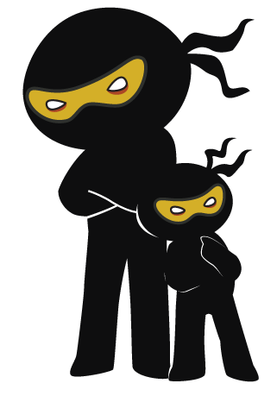



Word of the Day
Autumn Term 2022
Week 8 – 31st October 2022
'Words unlock the doors to a world of understanding...'

Slide 2

This Week's Words
Grasshopper
Shinobi
safe
alter
lost
deviate
pilot
grasp
lead
intertwine
steer
slash

Slide 3
Grasshopper (Tier 1)
safe
lost
pilot
lead
steer

Slide 4
Shinobi (Tier 2)
alter
deviate
grasp
intertwine
slash

Slide 5


Grasshopper Word of the Day
safe
Word Class
Word of the Day:
(adjective)
(safe)
Pronunciation / Syllables
Definition:
If a person or thing is safe from something, they cannot be harmed or damaged by it.
Lydia felt safe at home with Jemma and Paul.
Synonym: | Antonym: | Rhyme: | Link Word:
secure | unsafe | chafe | home
guarded | insecure |  | family

Slide 6

Grasshopper Word of the Day
lost
Word Class
Word of the Day:
(adjective)
(lost)
Pronunciation / Syllables
Definition:
If you are lost or if you get lost, you do not know where you are or are unable to find your way.
Imogen became lost in the fair ground.
Synonym: | Antonym: | Rhyme: | Link Word:
astray |  | frost | woods
disoriented |  | tossed | shops

Slide 7

Grasshopper Word of the Day
pilot
Word Class
Word of the Day:
(verb / noun)
(pi-lot)
Pronunciation / Syllables
Definition:
If someone pilots an aircraft or ship, they act as its pilot.
Julian was piloting the aeroplane today.
Synonym: | Antonym: | Rhyme: | Link Word:
fly |  |  | aeroplane
operate |  |  | ship

Slide 8

Grasshopper Word of the Day
lead
Word Class
Word of the Day:
(verb)
(lead)
Pronunciation / Syllables
Definition:
If you lead a group of people, you walk or ride in front of them.
Miss Robinson was leading the way.
Synonym: | Antonym: | Rhyme: | Link Word:
guide | follow | read | team
show |  | bread | way

Slide 9

Grasshopper Word of the Day
steer
Word Class
Word of the Day:
(verb)
(steer)
Pronunciation / Syllables
Definition:
When you steer a car, boat, or plane, you control it so that it goes in the direction that you want.
Miss Pearce steered the minibus around the streets.
Synonym: | Antonym: | Rhyme: | Link Word:
drive |  | fear | bus
manoeuvre |  | clear | aeroplane

Slide 10
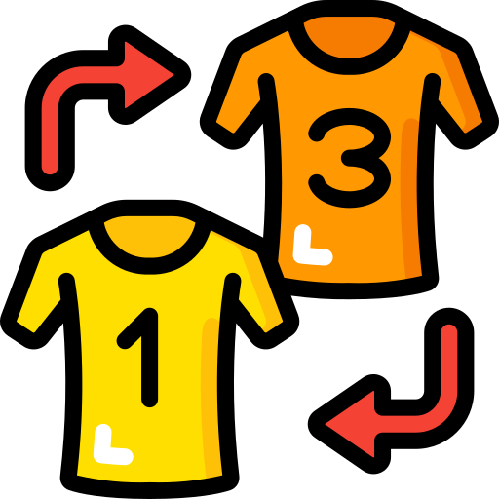
Shinobi Word of the Day
alter
Word Class
Word of the Day:
(verb)
(al-ter)
Pronunciation / Syllables
Definition:
If something alters or if you alter it, it changes.
Mr Hindle altered the team formation.
Synonym: | Antonym: | Prefix / Suffix: | Rhyme: | Link Word:
change | preserve | -ation | falter | plan
adapt |  | -ing | halter | formation

Slide 11

Shinobi Word of the Day
deviate
Word Class
Word of the Day:
(verb)
(de-vi-ate)
Pronunciation / Syllables
Definition:
To deviate from something means to start doing something different or not planned, especially in a way that causes problems for others.
George deviated from the plan and went on his own.
Synonym: | Antonym: | Prefix / Suffix: | Rhyme: | Link Word:
change |  | -tion | alleviate | plan
swerve |  | -ing | abbreviate | directions

Slide 12

Shinobi Word of the Day
grasp
Word Class
Word of the Day:
(verb)
(grasp)
Pronunciation / Syllables
Definition:
If you grasp something, you take it in your hand and hold it very firmly.
All pupils grasped the rope tightly and pulled hard.
Synonym: | Antonym: | Prefix / Suffix: | Rhyme: | Link Word:
pounce |  | -ed | clasp | opportunity
dive |  | -ing | rasp | hold

Slide 13

Shinobi Word of the Day
intertwine
Word Class
Word of the Day:
(verb)
(in-ter-twine)
Pronunciation / Syllables
Definition:
If two or more things are intertwined or intertwine, they are closely connected with each other in many ways.
Our family traditions had become intertwined.
Synonym: | Antonym: | Prefix / Suffix: | Rhyme: | Link Word:
entwine |  | -ed | design | history
twist |  | -ing | combine | family

Slide 14

Shinobi Word of the Day
slash
Word Class
Word of the Day:
(verb)
(slash)
Pronunciation / Syllables
Definition:
To slash something such as costs or jobs means to reduce them by a large amount.
The prices in the shops had been slashed.
Synonym: | Antonym: | Prefix / Suffix | Rhyme: | Link Word:
reduce | raise | -ed | cash | cost
cut | put up | -ing | flash | price

Slide 15
Vocabulary Laboratory
Describe / Definition:
Use it in a sentence:
Focus Word (write below):
Word Class:
Synonyms: (words with same / similar meaning) | Antonyms: (words with opposite meaning)
Rhymes: (words that sound the same) | Link Words: (Example: football = pitch, team, player)
Draw your sentence:

Slide 16
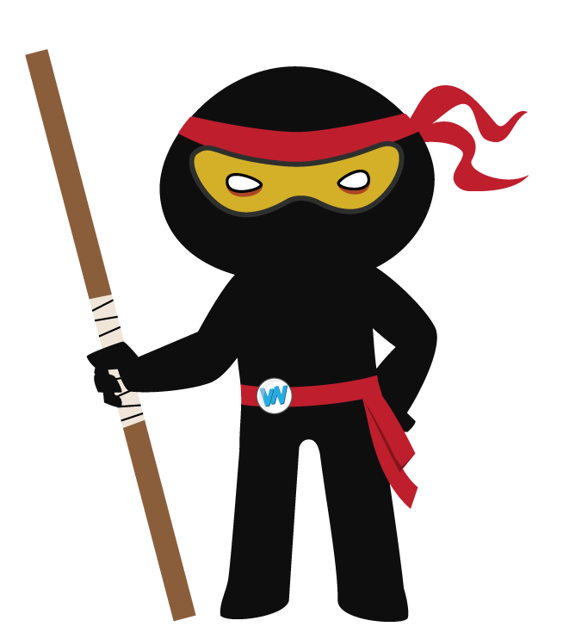
Vocabulary Visualiser
Draw the Grasshopper words and bring them to life.
Word: safe | Word: lost
Word: lead | Word: steer

Slide 17
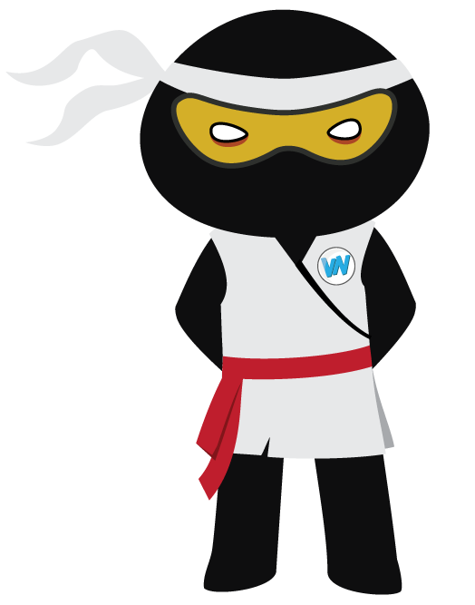
Vocabulary Visualiser
Draw the Shinobi words and bring them to life.
Word: alter | Word: deviate
Word: grasp | Word: intertwine

Slide 18
Matching Meanings
Draw lines from the Grasshopper words to their definitions.
Grasshopper Word
safe
lost
pilot
lead
steer
Grasshopper Definitions
If you are *** or if you get ***, you do not know where you are or are unable to find your way.
When you *** a car, boat, or plane, you control it so that it goes in the direction that you want.
If someone pilots an aircraft or ship, they act as its ***.
If a person or thing is *** from something, they cannot be harmed or damaged by it.
If you *** a group of people, you walk or ride in front of them.

Slide 19
Matching Meanings
Draw lines from the Shinobi words to their definitions.
Shinobi Word
alter
deviate
grasp
intertwine
slash
Shinobi Definitions
If two or more things are *** or ***, they are closely connected with each other in many ways.
To *** something such as costs or jobs means to reduce them by a large amount.
To *** from something means to start doing something different or not planned, especially in a way that causes problems for others.
If you *** something, you take it in your hand and hold it very firmly.
If something *** or if you alter it, it changes.

Slide 20
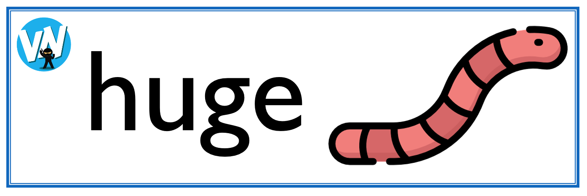
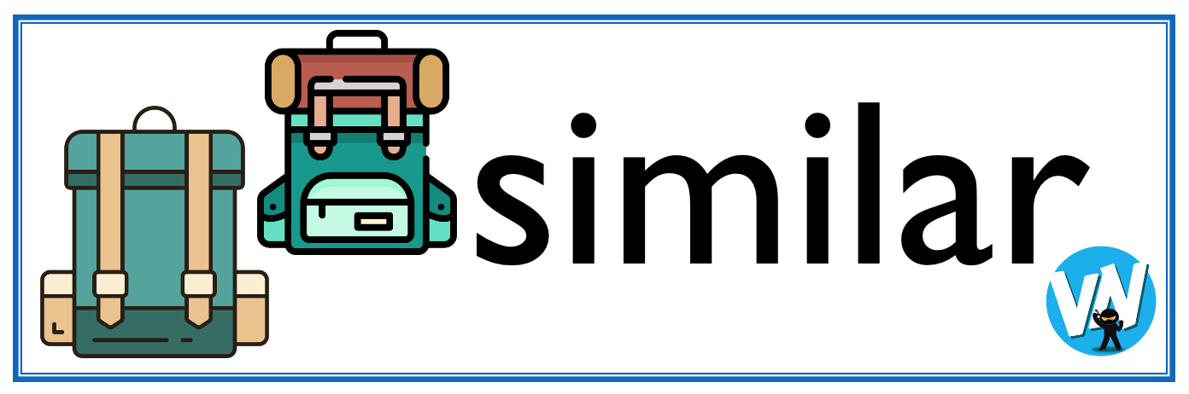




Display Slips
The following slides are for classroom display. As you teach each Word of the Day, words can be displayed in the classroom to enable pupils to use the taught vocabulary in an independent manner.

Slide 21
safe
lost

Slide 22
pilot
lead

Slide 23
steer
alter

Slide 24
deviate
grasp

Slide 25
intertwine
slash

