Slide 1
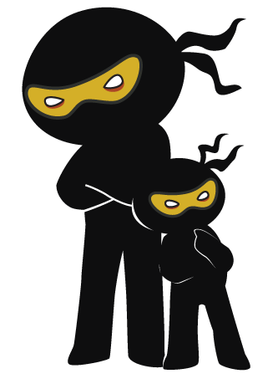



Word of the Day
Autumn Term 2022
Week 3 – 19th September 2022
'Words unlock the doors to a world of understanding...'

Slide 2

This Week's Words
Grasshopper
Shinobi
funeral
mourn
suit
grime
agree
infectious
salute
beast
building
precaution

Slide 3
Grasshopper (Tier 1)
funeral
suit
agree
salute
building

Slide 4
Shinobi (Tier 2)
mourn
grime
infectious
beast
precaution

Slide 5


Grasshopper Word of the Day
funeral
Word Class
Word of the Day:
(noun)
(fu-ner-al)
Pronunciation / Syllables
Definition:
A funeral is the ceremony that is held when the body of someone who has died is buried or cremated.
The Queen’s funeral was watched by everyone.
Synonym: | Antonym: | Rhyme: | Link Word:
burial |  |  | sadness
cremation |  |  | respect

Slide 6

Grasshopper Word of the Day
suit
Word Class
Word of the Day:
(noun)
(suit)
Pronunciation / Syllables
Definition:
A suit consists of a jacket, trousers, skirt and sometimes a waistcoat, all made from the same fabric.
Mrs Tweddle always wore a suit at school.
Synonym: | Antonym: | Rhyme: | Link Word:
outfit |  | fruit | smart
clothing |  | dispute | dark

Slide 7

Grasshopper Word of the Day
agree
Word Class
Word of the Day:
(verb)
(a-gree)
Pronunciation / Syllables
Definition:
If you agree to do something, you say that you will do it. If you agree to a proposal, you accept it.
Paul agreed to help Scott with his homework.
Synonym: | Antonym: | Rhyme: | Link Word:
decide |  | free | with
promise |  | key | to

Slide 8

Grasshopper Word of the Day
salute
Word Class
Word of the Day:
(verb / noun)
(sa-lute)
Pronunciation / Syllables
Definition:
If you salute someone, you greet them or show your respect with a formal sign. Soldiers usually salute officers by raising their right hand so that their fingers touch their forehead.
The guards saluted the King as he drove past.
Synonym: | Antonym: | Rhyme: | Link Word:
address |  | fruit | soldier
greet |  | boot | arm

Slide 9

Grasshopper Word of the Day
building
Word Class
Word of the Day:
(noun)
(build-ing)
Pronunciation / Syllables
Definition:
A building is a structure that has a roof and walls, for example a house or a factory.
The building was full of people.
Synonym: | Antonym: | Rhyme: | Link Word:
structure |  |  | large
property |  |  | empty

Slide 10
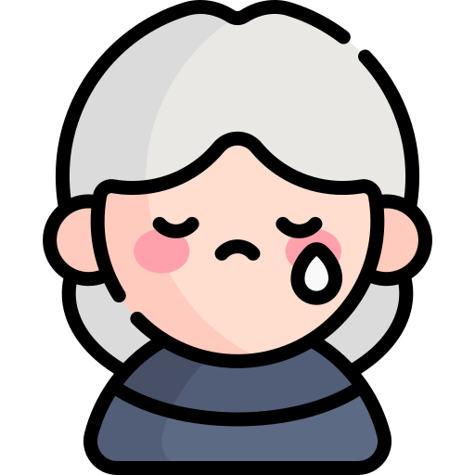
Shinobi Word of the Day
mourn
Word Class
Word of the Day:
(verb)
(mourn)
Pronunciation / Syllables
Definition:
If you mourn someone who has died or mourn for them, you are very sad that they have died and show your sorrow in the way that you behave.
The nation mourned the loss of the Queen.
Synonym: | Antonym: | Prefix / Suffix: | Rhyme: | Link Word:
regret | rejoice | -ing | born | cry
grieve |  | -ed | torn | sadness

Slide 11

Shinobi Word of the Day
grime
Word Class
Word of the Day:
(noun)
(grime)
Pronunciation / Syllables
Definition:
Grime is dirt which has collected on the surface of something.
Ravi’s hands were covered in grime.
Synonym: | Antonym: | Prefix / Suffix: | Rhyme: | Link Word:
dirt |  | -ed | slime | dirty
sludge |  | be- | crime | clean

Slide 12

Shinobi Word of the Day
infectious
Word Class
Word of the Day:
(adjective)
(in-fec-tious)
Pronunciation / Syllables
Definition:
If a feeling is infectious, it spreads to other people. Something that spreads to others easily.
Mel’s laughter was infectious.
Synonym: | Antonym: | Prefix / Suffix: | Rhyme: | Link Word:
contagious |  | non- |  | feeling
spreading |  | -ly |  | disease

Slide 13

Shinobi Word of the Day
beast
Word Class
Word of the Day:
(noun)
(beast)
Pronunciation / Syllables
Definition:
You can refer to an animal as a beast, especially if it is a large, dangerous, unknown or unusual one.
The beast had left behind large tracks in the mud.
Synonym: | Antonym: | Prefix / Suffix: | Rhyme: | Link Word:
creature |  | -ly | least | animal
critter |  |  | feast | creature

Slide 14

Shinobi Word of the Day
precaution
Word Class
Word of the Day:
(noun)
(pre-cau-tion)
Pronunciation / Syllables
Definition:
A precaution is an action that is intended to prevent something dangerous or unpleasant from happening.
Mr Hinds wore goggles and a helmet as a precaution.
Synonym: | Antonym: | Prefix / Suffix | Rhyme: | Link Word:
safeguard |  | -s | caution | safety
defence |  | -ary |  | protect

Slide 15
Vocabulary Laboratory
Describe / Definition:
Use it in a sentence:
Focus Word (write below):
Word Class:
Synonyms: (words with same / similar meaning) | Antonyms: (words with opposite meaning)
Rhymes: (words that sound the same) | Link Words: (Example: football = pitch, team, player)
Draw your sentence:

Slide 16

Vocabulary Visualiser
Draw the Grasshopper words and bring them to life.
Word: funeral | Word: suit
Word: salute | Word: building

Slide 17

Vocabulary Visualiser
Draw the Shinobi words and bring them to life.
Word: mourn | Word: infectious
Word: beast | Word: precaution

Slide 18
Matching Meanings
Draw lines from the Grasshopper words to their definitions.
Grasshopper Word
funeral
suit
agree
salute
building
Grasshopper Definitions
If you *** to do something, you say that you will do it. If you *** to a proposal, you accept it.
A *** is a structure that has a roof and walls, for example a house or a factory.
A *** consists of a jacket, trousers, skirt and sometimes a waistcoat, all made from the same fabric.
A *** is the ceremony that is held when the body of someone who has died is buried or cremated.
If you *** someone, you greet them or show your respect with a formal sign. Soldiers usually *** officers by raising their right hand so that their fingers touch their forehead.

Slide 19
Matching Meanings
Draw lines from the Shinobi words to their definitions.
Shinobi Word
mourn
grime
infectious
beast
precaution
Shinobi Definitions
If a feeling is ***, it spreads to other people. Something that spreads to others easily.
A *** is an action that is intended to prevent something dangerous or unpleasant from happening.
If you *** someone who has died or *** for them, you are very sad that they have died and show your sorrow in the way that you behave.
You can refer to an animal as a ***, especially if it is a large, dangerous, or unusual one.
*** is dirt which has collected on the surface of something.

Slide 20






Display Slips
The following slides are for classroom display. As you teach each Word of the Day, words can be displayed in the classroom to enable pupils to use the taught vocabulary in an independent manner.

Slide 21
funeral
suit

Slide 22
agree
salute

Slide 23
building
mourn

Slide 24
grime
infectious

Slide 25
beast
precaution

