Slide 1
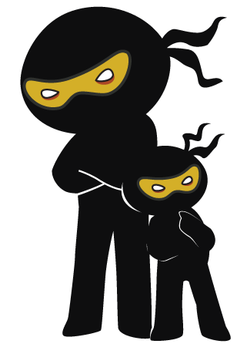



Word of the Day
Autumn Term 2022
Week 4 – 26th September 2022
'Words unlock the doors to a world of understanding...'

Slide 2

This Week's Words
Grasshopper
Shinobi
tiny
grit
badge
crestfallen
draw
warn
belt
deflate
deflate
hurl

Slide 3
Grasshopper (Tier 1)
tiny
badge
draw
belt
deflate

Slide 4
Shinobi (Tier 2)
grit
crestfallen
warn
deflate
hurl

Slide 5


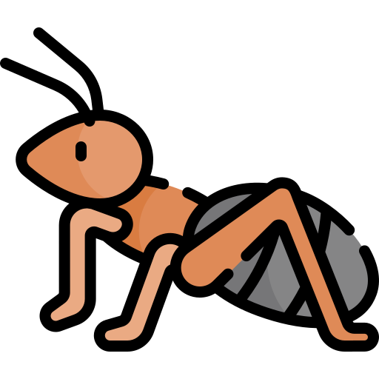
Grasshopper Word of the Day
tiny
Word Class
Word of the Day:
(adjective)
(ti-ny)
Pronunciation / Syllables
Definition:
Something or someone that is tiny is extremely small.
The children watched the tiny ants on the floor.
Synonym: | Antonym: | Rhyme: | Link Word:
mini | huge | shiny | creature
micro |  |  | animal

Slide 6
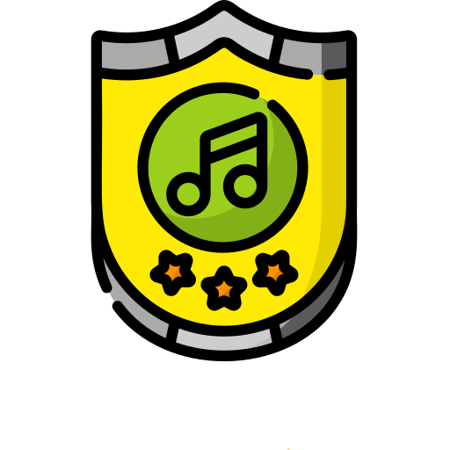
Grasshopper Word of the Day
badge
Word Class
Word of the Day:
(noun)
(badge)
Pronunciation / Syllables
Definition:
A badge is a piece of metal or cloth which you wear to show that you belong to an organisation or support a cause.
Alex was given a badge for joining music club.
Synonym: | Antonym: | Rhyme: | Link Word:
pin |  |  | uniform
button |  |  | club

Slide 7

Grasshopper Word of the Day
draw
Word Class
Word of the Day:
(verb)
(draw)
Pronunciation / Syllables
Definition:
When you draw, or when you draw something, you use a pencil or pen to produce a picture, pattern, or diagram.
Mr Jones asked the children to draw themselves.
Synonym: | Antonym: | Rhyme: | Link Word:
sketch |  | saw | picture
design |  | law | design

Slide 8
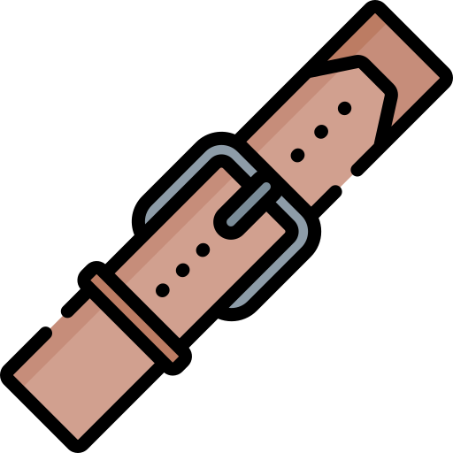
Grasshopper Word of the Day
belt
Word Class
Word of the Day:
(noun)
(belt)
Pronunciation / Syllables
Definition:
A belt is a strip of leather or cloth that you fasten round your waist.
Raul tightened the belt around his waist.
Synonym: | Antonym: | Rhyme: | Link Word:
strap |  | knelt | safety
 |  | melt | trousers

Slide 9

Grasshopper Word of the Day
deflate
Word Class
Word of the Day:
(verb)
(de-flate)
Pronunciation / Syllables
Definition:
When something such as a tyre or balloon deflates, or when you deflate it, all the air comes out of it.
The tyre on the car was deflated.
Synonym: | Antonym: | Rhyme: | Link Word:
let down | blow up | elate | tyre
puncture | inflate | create | balloon

Slide 10

Shinobi Word of the Day
grit
Word Class
Word of the Day:
(noun)
(grit)
Pronunciation / Syllables
Definition:
If someone has grit, they have the determination and courage to continue doing something even though it is very difficult.
Felix showed grit and determination to finish the race.
Synonym: | Antonym: | Prefix / Suffix: | Rhyme: | Link Word:
courage |  | -y | bit | effort
bravery |  |  | sit | lose

Slide 11
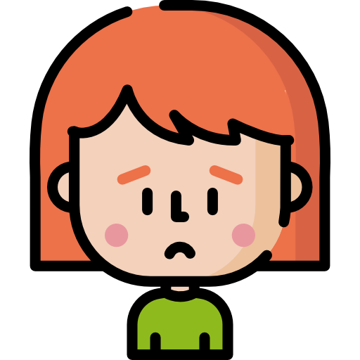
Shinobi Word of the Day
crestfallen
Word Class
Word of the Day:
(adjective)
(crest-fall-en)
Pronunciation / Syllables
Definition:
If you look crestfallen, you look sad and disappointed about something.
Mia felt crestfallen after reading the end of the book.
Synonym: | Antonym: | Prefix / Suffix: | Rhyme: | Link Word:
disappointed | cheerful |  |  | outcome
downcast |  |  |  | disappointed

Slide 12
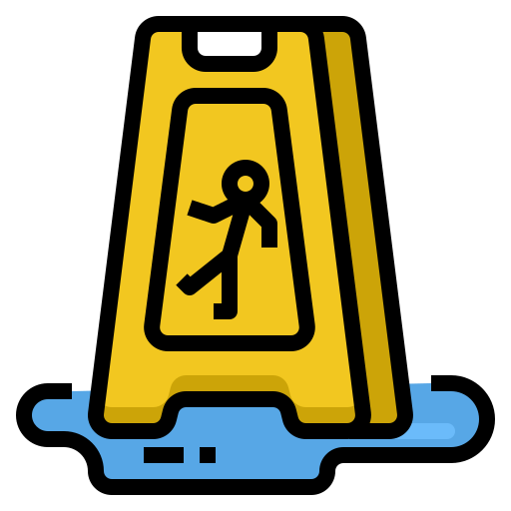
Shinobi Word of the Day
warn
Word Class
Word of the Day:
(verb)
(warn)
Pronunciation / Syllables
Definition:
If you warn someone about something such as a possible danger or problem, you tell them about it so that they are aware of it.
Danny tried to warn Faz about the slippery floor.
Synonym: | Antonym: | Prefix / Suffix: | Rhyme: | Link Word:
alert |  | -ing | scorn | danger
tell |  | -ed | torn | shout

Slide 13
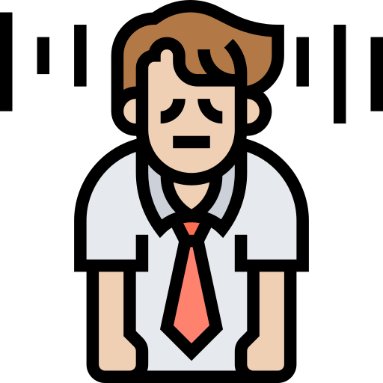
Shinobi Word of the Day
deflate
Word Class
Word of the Day:
(verb)
(de-flate)
Pronunciation / Syllables
Definition:
If you deflate someone or something, you take away their confidence or make them seem less important.
John felt deflated after his disappointing tennis match.
Synonym: | Antonym: | Prefix / Suffix: | Rhyme: | Link Word:
dishearten |  | -ed | elate | emotion
humiliate |  | -ing | create | feeling

Slide 14
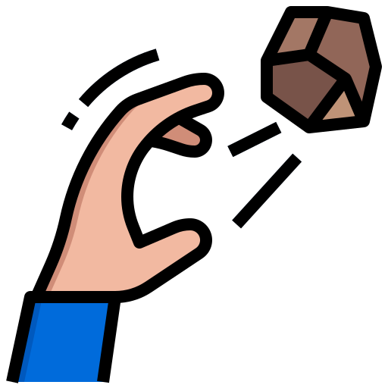
Shinobi Word of the Day
hurl
Word Class
Word of the Day:
(verb)
(hurl)
Pronunciation / Syllables
Definition:
If you hurl something, you throw it violently and with a lot of force.
Kelly hurled the stone into the sea.
Synonym: | Antonym: | Prefix / Suffix | Rhyme: | Link Word:
launch | catch | -ed | curl | rock
fling | hold | -ing | pearl | bag

Slide 15
Vocabulary Laboratory
Describe / Definition:
Use it in a sentence:
Focus Word (write below):
Word Class:
Synonyms: (words with same / similar meaning) | Antonyms: (words with opposite meaning)
Rhymes: (words that sound the same) | Link Words: (Example: football = pitch, team, player)
Draw your sentence:

Slide 16
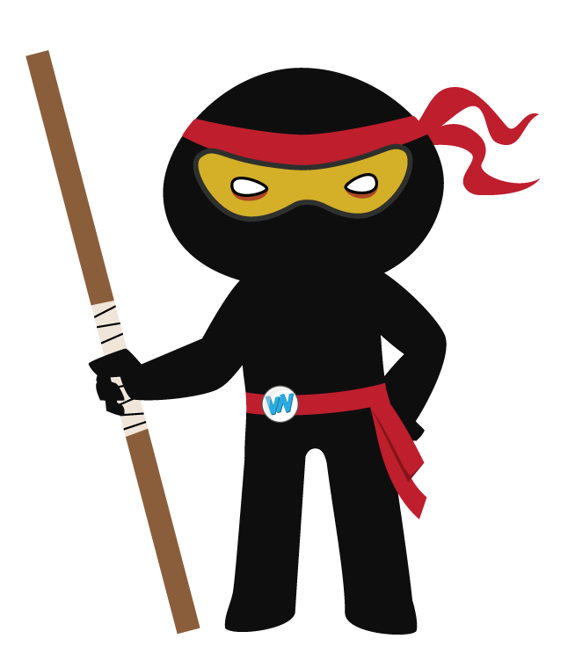
Vocabulary Visualiser
Draw the Grasshopper words and bring them to life.
Word: tiny | Word: badge
Word: draw | Word: deflate

Slide 17
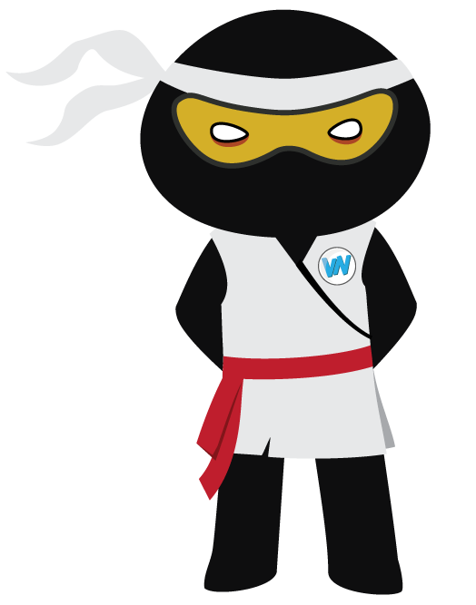
Vocabulary Visualiser
Draw the Shinobi words and bring them to life.
Word: warn | Word: grit
Word: hurl | Word: crestfallen

Slide 18
Matching Meanings
Draw lines from the Grasshopper words to their definitions.
Grasshopper Word
tiny
badge
draw
belt
deflate
Grasshopper Definitions
When you ***, or when you draw something, you use a pencil or pen to produce a picture, pattern, or diagram.
Something or someone that is *** is extremely small.
When something such as a tyre or balloon ***, or when you deflate it, all the air comes out of it.
A *** is a piece of metal or cloth which you wear to show that you belong to an organisation or support a cause.
A *** is a strip of leather or cloth that you fasten round your waist.

Slide 19
Matching Meanings
Draw lines from the Shinobi words to their definitions.
Shinobi Word
grit
crestfallen
warn
deflate
hurl
Shinobi Definitions
If you look ***, you look sad and disappointed about something.
If you *** something, you throw it violently and with a lot of force.
If someone has ***, they have the determination and courage to continue doing something even though it is very difficult.
If you *** someone or something, you take away their confidence or make them seem less important.
If you *** someone about something such as a possible danger or problem, you tell them about it so that they are aware of it.

Slide 20

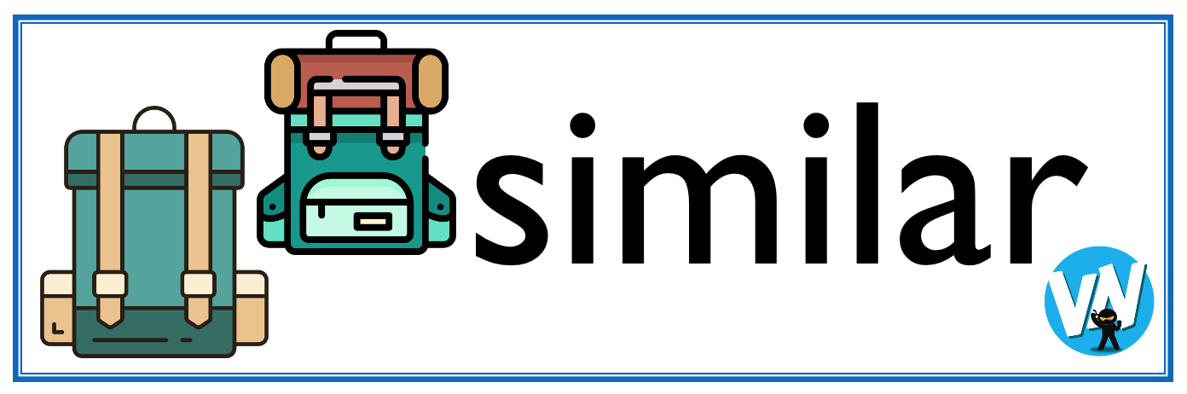




Display Slips
The following slides are for classroom display. As you teach each Word of the Day, words can be displayed in the classroom to enable pupils to use the taught vocabulary in an independent manner.

Slide 21
tiny
badge

Slide 22
draw
belt

Slide 23
deflate
crestfallen

Slide 24
grit
warn

Slide 25
deflate
hurl

