Slide 1




Word of the Day
Summer Term 2022
Week 38 – 19th July 2022
'Words unlock the doors to a world of understanding...'

Slide 2

This Week's Words
Grasshopper
Shinobi
tourist
withdraw
drought
alongside
island
wounded
pool
absorb
beach
transfer

Slide 3
Grasshopper (Tier 1)
tourist
drought
island
pool
beach

Slide 4
Shinobi (Tier 2)
withdraw
alongside
wounded
absorb
transfer

Slide 5


Grasshopper Word of the Day
tourist
Word Class
Word of the Day:
(noun)
(tour-ist)
Pronunciation / Syllables
Definition:
A tourist is a person who is visiting a place for pleasure and interest, especially when they are on holiday.
The city was full of tourists.
Phrases: | excited tourist | tourists everywhere
Synonym: | Antonym: | Rhyme: | Link Word:
traveller | local | purest | travel
visitor |  |  | visit

Slide 6

Grasshopper Word of the Day
drought
Word Class
Word of the Day:
(noun)
(drought)
Pronunciation / Syllables
Definition:
A drought is a long period of time during which no rain falls.
The drought was a huge problem.
Phrases: | Painful drought | deadly drought
Synonym: | Antonym: | Rhyme: | Link Word:
dry spell |  | without | heat
 |  | doubt | water

Slide 7

Grasshopper Word of the Day
island
Word Class
Word of the Day:
(noun)
(is-land)
Pronunciation / Syllables
Definition:
An island is a piece of land that is completely surrounded by water.
The island was surrounded by the ocean.
Phrases: | lonely island | relaxing island
Synonym: | Antonym: | Rhyme: | Link Word:
isle | mainland |  | water
key |  |  | alone

Slide 8

Grasshopper Word of the Day
pool
Word Class
Word of the Day:
(noun / verb)
(pool)
Pronunciation / Syllables
Definition:
A pool is a fairly small area of still water.
Pools of water appeared as it began to rain.
Phrases: | growing pool of | filthy pool of
Synonym: | Antonym: | Rhyme: | Link Word:
puddle |  | cool | water
 |  | drool | swim

Slide 9

Grasshopper Word of the Day
beach
Word Class
Word of the Day:
(noun)
(beach)
Pronunciation / Syllables
Definition:
A beach is an area of sand or stones beside the sea.
Today we are visiting the beach.
Phrases: | beautiful beach | long, rolling beach
Synonym: | Antonym: | Rhyme: | Link Word:
shore |  | reach | day
coast |  | teach | wear

Slide 10

Shinobi Word of the Day
withdraw
Word Class
Word of the Day:
(verb)
(with-draw)
Pronunciation / Syllables
Definition:
If you withdraw something from a place, you remove it or take it away.
Mia’s mum withdrew money from the bank.
Phrases: | needed to withdraw | withdrew from
Synonym: | Antonym: | Prefix / Suffix: | Rhyme: | Link Word:
remove | insert | -able | law | money
extract | deposit | -ing | saw | form

Slide 11

Shinobi Word of the Day
alongside
Word Class
Word of the Day:
(preposition)
(a-long-side)
Pronunciation / Syllables
Definition:
If one thing is alongside another thing, the first thing is next to the second.
Rosie worked alongside her friends on the computers.
Phrases: | worked alongside | played alongside
Synonym: | Antonym: | Prefix / Suffix: | Rhyme: | Link Word:
next to |  |  | wrong side | friends
with |  |  |  | enemies

Slide 12

Shinobi Word of the Day
wounded
Word Class
Word of the Day:
(verb)
(wound-ed)
Pronunciation / Syllables
Definition:
If a weapon or something sharp wounds you, it damages your body.
Joe had been wounded by the loose wire on the fence.
Phrases: | wounded badly by | had been wounded by
Synonym: | Antonym: | Prefix / Suffix: | Rhyme: | Link Word:
injure | heal |  | included | skin
main |  |  | concluded | flesh

Slide 13
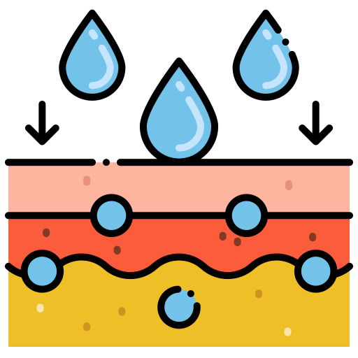
Shinobi Word of the Day
absorb
Word Class
Word of the Day:
(verb)
(ab-sorb)
Pronunciation / Syllables
Definition:
If something absorbs a liquid, gas, or other substance, it soaks it up or takes it in.
My skin quickly absorbed the sun screen.
Phrases: | quickly absorbed the | absorbed every drop
Synonym: | Antonym: | Prefix / Suffix: | Rhyme: | Link Word:
soak up | exude | -ent |  | water
 | give out | -tion |  | damage

Slide 14

Shinobi Word of the Day
transfer
Word Class
Word of the Day:
(verb / noun)
(trans-fer)
Pronunciation / Syllables
Definition:
If you transfer something or someone from one place to another, or they transfer from one place to another, they go from the first place to the second.
Dad quickly transferred money to pay for a ticket.
Phrases: | was transferred to | quickly transferred
Synonym: | Antonym: | Prefix / Suffix | Rhyme: | Link Word:
move |  | -ed | prefer | money
send |  | -ing | deter | food

Slide 15
Vocabulary Laboratory
Describe / Definition:
Use it in a sentence:
Focus Word (write below):
Word Class:
Synonyms: (words with same / similar meaning) | Antonyms: (words with opposite meaning)
Rhymes: (words that sound the same) | Link Words: (Example: football = pitch, team, player)
Draw your sentence:

Slide 16

Vocabulary Visualiser
Draw the Grasshopper words and bring them to life.
Word: tourist | Word: drought
Word: island | Word: pool

Slide 17

Vocabulary Visualiser
Draw the Shinobi words and bring them to life.
Word: withdraw | Word: alongside
Word: absorb | Word: transfer

Slide 18
Matching Meanings
Draw lines from the Grasshopper words to their definitions.
Grasshopper Word
tourist
drought
island
pool
beach
Grasshopper Definitions
A *** is a long period of time during which no rain falls.
A *** is a fairly small area of still water.
A *** is a person who is visiting a place for pleasure and interest, especially when they are on holiday.
A *** is an area of sand or stones beside the sea.
An *** is a piece of land that is completely surrounded by water.

Slide 19
Matching Meanings
Draw lines from the Shinobi words to their definitions.
Shinobi Word
withdraw
alongside
wounded
absorb
transfer
Shinobi Definitions
If you *** something or someone from one place to another, or they *** from one place to another, they go from the first place to the second.
If one thing is *** another thing, the first thing is next to the second.
If something *** a liquid, gas, or other substance, it soaks it up or takes it in.
If you *** something from a place, you remove it or take it away.
If a weapon or something sharp *** you, it damages your body.

Slide 20






Display Slips
The following slides are for classroom display. As you teach each Word of the Day, words can be displayed in the classroom to enable pupils to use the taught vocabulary in an independent manner.

Slide 21
tourist
drought

Slide 22
island
pool

Slide 23
beach
withdraw

Slide 24
alongside
wounded

Slide 25
absorb
transfer

