Slide 1




Word of the Day
Summer Term 2022
Week 35 – 27th June 2022
'Words unlock the doors to a world of understanding...'

Slide 2

This Week's Words
Grasshopper
Shinobi
chew
dejected
cold
occupy
heat
united
cosy
gain
ache
crisis

Slide 3
Grasshopper (Tier 1)
chew
cold
heat
cosy
ache

Slide 4
Shinobi (Tier 2)
dejected
occupy
united
gain
crisis

Slide 5


Grasshopper Word of the Day
chew
Word Class
Word of the Day:
(verb)
(chew)
Pronunciation / Syllables
Definition:
When you chew food, you use your teeth to break it up in your mouth so that it becomes easier to swallow.
The beaver chewed the trunk of the tree.
Phrases: | chew and destroy | chew through
Synonym: | Antonym: | Rhyme: | Link Word:
munch |  | few | swallow
chomp |  | knew | food

Slide 6
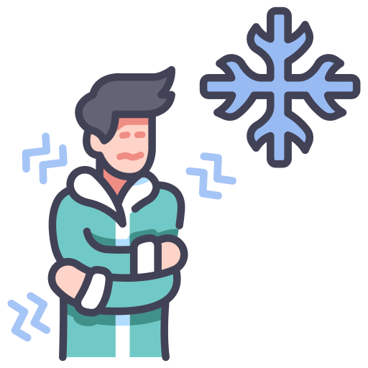
Grasshopper Word of the Day
cold
Word Class
Word of the Day:
(adjective)
(cold)
Pronunciation / Syllables
Definition:
Something that is cold has a very low temperature or a lower temperature than is normal or acceptable.
It was cold in the classroom.
Phrases: | cold room | became colder
Synonym: | Antonym: | Rhyme: | Link Word:
chilly | warm | old | room
cool | hot | fold | air

Slide 7

Grasshopper Word of the Day
heat
Word Class
Word of the Day:
(verb / noun)
(heat)
Pronunciation / Syllables
Definition:
When you heat something, you raise its temperature, for example by using a flame or a special piece of equipment.
Jill could feel the heat from the radiator.
Phrases: | heat up | heat the space
Synonym: | Antonym: | Rhyme: | Link Word:
warm | cool | meat | space
 |  | beat | room

Slide 8

Grasshopper Word of the Day
cosy
Word Class
Word of the Day:
(adjective)
(co-sy)
Pronunciation / Syllables
Definition:
A house or room that is cosy is comfortable and warm.
The blanket made the sofa feel very cosy.
Phrases: | cosy and warm | soft and cosy
Synonym: | Antonym: | Rhyme: | Link Word:
snug | uncomfortable | rosy | feeling
restful |  | nosy | chair

Slide 9
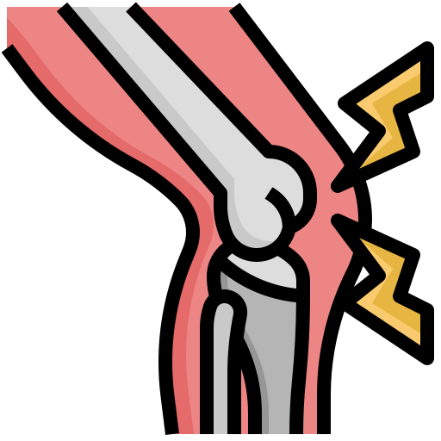
Grasshopper Word of the Day
ache
Word Class
Word of the Day:
(verb / noun)
(ache)
Pronunciation / Syllables
Definition:
If you ache or a part of your body aches, you feel a steady, fairly strong pain.
Dad’s knee ached after playing football.
Phrases: | started to ache | deep aching
Synonym: | Antonym: | Rhyme: | Link Word:
throb |  | bake | pain
pound |  | break | body

Slide 10

Shinobi Word of the Day
dejected
Word Class
Word of the Day:
(adjective)
(de-ject-ed)
Pronunciation / Syllables
Definition:
If you are dejected, you feel miserable or unhappy, especially because you have just been disappointed by something.
Rohan felt dejected after not being chosen for the team.
Phrases: | completely dejected | dejected and broken
Synonym: | Antonym: | Prefix / Suffix: | Rhyme: | Link Word:
downcast | cheerful | -ly | ejected | feeling
dispirited | happy |  | expected | person

Slide 11

Shinobi Word of the Day
occupy
Word Class
Word of the Day:
(verb)
(oc-cu-py)
Pronunciation / Syllables
Definition:
The people who occupy a building or a place are the people who live or work there.
The family were the new occupants of the house.
Phrases: | occupy and own | was the occupant of
Synonym: | Antonym: | Prefix / Suffix: | Rhyme: | Link Word:
inhabit |  | -ancy |  | building
 |  | -ied |  | room

Slide 12

Shinobi Word of the Day
united
Word Class
Word of the Day:
(adjective)
(u-nit-ed)
Pronunciation / Syllables
Definition:
When people are united about something, they agree about it and act together.
The children were united in their opinion.
Phrases: | were united against | united to stand up for
Synonym: | Antonym: | Prefix / Suffix: | Rhyme: | Link Word:
allied | divided | re- | invited | approach
unified |  |  | excited | thoughts

Slide 13

Shinobi Word of the Day
gain
Word Class
Word of the Day:
(verb)
(gain)
Pronunciation / Syllables
Definition:
If a person or place gains something such as an ability or quality, they gradually get more of it.
Everyone had gained a lot of knowledge about the climate.
Phrases: | started to gain | gained a lot of
Synonym: | Antonym: | Prefix / Suffix: | Rhyme: | Link Word:
obtain | lose | re- | pain | knowledge
acquire |  | -ed | main | money

Slide 14

Shinobi Word of the Day
crisis
Word Class
Word of the Day:
(noun)
(cri-sis)
Pronunciation / Syllables
Definition:
A crisis is a situation in which something or someone is affected by one or more very serious problems.
The children had learned about the climate crisis.
Phrases: | had become a crisis | crisis had worsened
Synonym: | Antonym: | Prefix / Suffix | Rhyme: | Link Word:
catastrophe |  | post- |  | climate
disaster |  |  |  | situation

Slide 15
Vocabulary Laboratory
Describe / Definition:
Use it in a sentence:
Focus Word (write below):
Word Class:
Synonyms: (words with same / similar meaning) | Antonyms: (words with opposite meaning)
Rhymes: (words that sound the same) | Link Words: (Example: football = pitch, team, player)
Draw your sentence:

Slide 16

Vocabulary Visualiser
Draw the Grasshopper words and bring them to life.
Word: chew | Word: cold
Word: heat | Word: cosy

Slide 17

Vocabulary Visualiser
Draw the Shinobi words and bring them to life.
Word: dejected | Word: united
Word: gain | Word: crisis

Slide 18
Matching Meanings
Draw lines from the Grasshopper words to their definitions.
Grasshopper Word
chew
cold
heat
cosy
ache
Grasshopper Definitions
Something that is *** has a very low temperature or a lower temperature than is normal or acceptable.
A house or room that is *** is comfortable and warm.
When you *** food, you use your teeth to break it up in your mouth so that it becomes easier to swallow.
When you *** something, you raise its temperature, for example by using a flame or a special piece of equipment.
If you *** or a part of your body ***, you feel a steady, fairly strong pain.

Slide 19
Matching Meanings
Draw lines from the Shinobi words to their definitions.
Shinobi Word
dejected
occupy
united
gain
crisis
Shinobi Definitions
When people are *** about something, they agree about it and act together.
If you are ***, you feel miserable or unhappy, especially because you have just been disappointed by something.
A *** is a situation in which something or someone is affected by one or more very serious problems.
The people who *** a building or a place are the people who live or work there.
If a person or place *** something such as an ability or quality, they gradually get more of it.

Slide 20






Display Slips
The following slides are for classroom display. As you teach each Word of the Day, words can be displayed in the classroom to enable pupils to use the taught vocabulary in an independent manner.

Slide 21
chew
cold

Slide 22
heat
cosy

Slide 23
ache
dejected

Slide 24
occupy
united

Slide 25
gain
crisis

