Slide 1




Word of the Day
Summer Term 2022
Week 36 – 4th July 2022
'Words unlock the doors to a world of understanding...'

Slide 2

This Week's Words
Grasshopper
Shinobi
squeak
wade
swallow
display
impossible
surge
yell
refresh
grab
retain

Slide 3
Grasshopper (Tier 1)
squeak
swallow
impossible
yell
grab

Slide 4
Shinobi (Tier 2)
wade
display
surge
refresh
retain

Slide 5


Grasshopper Word of the Day
squeak
Word Class
Word of the Day:
(verb / noun)
(squeak)
Pronunciation / Syllables
Definition:
If something or someone squeaks, they make a short, high-pitched sound.
The hamster squeaked as it played in the cage.
Phrases: | very squeaky | squeak loudly
Synonym: | Antonym: | Rhyme: | Link Word:
squeal |  | weak | quiet
cheep |  | peak | loud

Slide 6
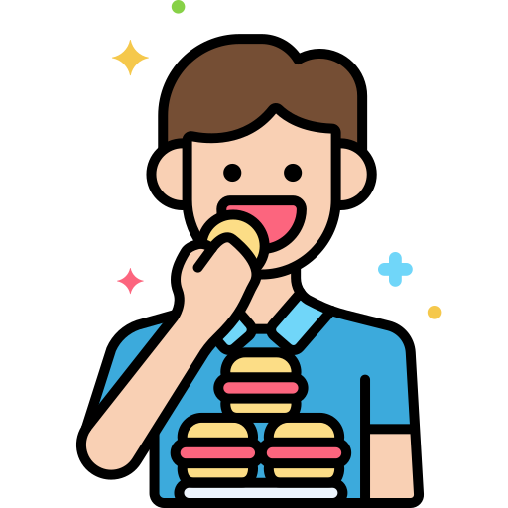
Grasshopper Word of the Day
swallow
Word Class
Word of the Day:
(verb)
(swal-low)
Pronunciation / Syllables
Definition:
If you swallow something, you cause it to go from your mouth down into your stomach.
Jim chewed and swallowed the whole sandwich.
Phrases: | swallowed in one bite | accidentally swallowed
Synonym: | Antonym: | Rhyme: | Link Word:
consume |  | follow | quickly
devour |  | hollow | whole

Slide 7

Grasshopper Word of the Day
impossible
Word Class
Word of the Day:
(adjective)
(im-pos-si-ble)
Pronunciation / Syllables
Definition:
Something that is impossible cannot be done or cannot happen.
The maths question was impossible to solve.
Phrases: | felt impossible | nothing is impossible
Synonym: | Antonym: | Rhyme: | Link Word:
hopeless | possible | possible | task
absurd | easy | crossable | decision

Slide 8

Grasshopper Word of the Day
yell
Word Class
Word of the Day:
(verb)
(yell)
Pronunciation / Syllables
Definition:
If you yell, you shout loudly, usually because you are excited, angry, or in pain.
Mrs Hope yelled across the playground.
Phrases: | yell loudly | always yelled at
Synonym: | Antonym: | Rhyme: | Link Word:
call | whisper | bell | loudly
shout | murmur | fell | angrily

Slide 9

Grasshopper Word of the Day
grab
Word Class
Word of the Day:
(verb)
(grab)
Pronunciation / Syllables
Definition:
If you grab something, you take it or pick it up suddenly and roughly.
Fiona quickly grabbed some fruit.
Phrases: | grabbed a handful of | quickly grabbed
Synonym: | Antonym: | Rhyme: | Link Word:
grasp | release | cab | handful
pluck |  | tab | rough

Slide 10

Shinobi Word of the Day
wade
Word Class
Word of the Day:
(verb)
(wade)
Pronunciation / Syllables
Definition:
If you wade through something that makes it difficult to walk, usually water or mud, you walk through it.
The pig waded slowly through the thick mud.
Phrases: | carefully waded | waded and trudged through
Synonym: | Antonym: | Prefix / Suffix: | Rhyme: | Link Word:
trudge |  | -ed | trade | through
plod |  | -ing | played | slowly

Slide 11

Shinobi Word of the Day
display
Word Class
Word of the Day:
(verb / noun)
(dis-play)
Pronunciation / Syllables
Definition:
If you display something that you want people to see, you put it in a particular place, so that people can see it easily.
Amelia really wanted the t-shirt that was on display.
Phrases: | displayed for all to see | reluctantly displayed
Synonym: | Antonym: | Prefix / Suffix: | Rhyme: | Link Word:
exhibit |  | re- | they | proudly
show |  |  | away | openly

Slide 12

Shinobi Word of the Day
surge
Word Class
Word of the Day:
(noun / verb)
(surge)
Pronunciation / Syllables
Definition:
A surge is a sudden large increase in something that has previously been steady, or has only increased or developed slowly.
The waves suddenly surged towards the houses.
Phrases: | an unexpected surge of | a quick surge of
Synonym: | Antonym: | Prefix / Suffix: | Rhyme: | Link Word:
rush |  | up- | urge | forward
sweep |  | -ed | emerge | powerfully

Slide 13


Shinobi Word of the Day
refresh
Word Class
Word of the Day:
(verb)
(re-fresh)
Pronunciation / Syllables
Definition:
If someone refreshes your memory, they tell you something that you had forgotten.
Mr Jones refreshed our memories about fractions.
Phrases: | needed to refresh the | a quick refresher
Synonym: | Antonym: | Prefix / Suffix: | Rhyme: | Link Word:
stimulate |  | -ing | flesh | memory
prompt |  | -ed | mesh | clothes

Slide 14

Shinobi Word of the Day
retain
Word Class
Word of the Day:
(verb)
(re-tain)
Pronunciation / Syllables
Definition:
To retain something means to continue to have that thing.
Mihai had successfully retained the title.
Phrases: | was desperate to retain | fought to retain the
Synonym: | Antonym: | Prefix / Suffix | Rhyme: | Link Word:
keep | give up | re- | again | status
preserve | lose | -ed | pain | title

Slide 15
Vocabulary Laboratory
Describe / Definition:
Use it in a sentence:
Focus Word (write below):
Word Class:
Synonyms: (words with same / similar meaning) | Antonyms: (words with opposite meaning)
Rhymes: (words that sound the same) | Link Words: (Example: football = pitch, team, player)
Draw your sentence:

Slide 16

Vocabulary Visualiser
Draw the Grasshopper words and bring them to life.
Word: swallow | Word: squeak
Word: yell | Word: grab

Slide 17

Vocabulary Visualiser
Draw the Shinobi words and bring them to life.
Word: wade | Word: display
Word: surge | Word: retain

Slide 18
Matching Meanings
Draw lines from the Grasshopper words to their definitions.
Grasshopper Word
squeak
swallow
impossible
yell
grab
Grasshopper Definitions
If you ***, you shout loudly, usually because you are excited, angry, or in pain.
If something or someone ***, they make a short, high-pitched sound.
Something that is *** cannot be done or cannot happen.
If you *** something, you take it or pick it up suddenly and roughly.
If you *** something, you cause it to go from your mouth down into your stomach.

Slide 19
Matching Meanings
Draw lines from the Shinobi words to their definitions.
Shinobi Word
wade
display
surge
refresh
retain
Shinobi Definitions
If you *** something that you want people to see, you put it in a particular place, so that people can see it easily.
A *** is a sudden large increase in something that has previously been steady, or has only increased or developed slowly.
To *** something means to continue to have that thing.
If you *** through something that makes it difficult to walk, usually water or mud, you walk through it.
If someone *** your memory, they tell you something that you had forgotten.

Slide 20






Display Slips
The following slides are for classroom display. As you teach each Word of the Day, words can be displayed in the classroom to enable pupils to use the taught vocabulary in an independent manner.

Slide 21
squeak
swallow

Slide 22
impossible
yell

Slide 23
grab
wade

Slide 24
display
surge

Slide 25
refresh
retain

