Slide 1




Word of the Day
Summer Term 2022
Week 30 – 9th May 2022
'Words unlock the doors to a world of understanding...'

Slide 2

This Week's Words
Grasshopper
Shinobi
simple
disagree
quick
gauge
store
sort
arch
enhance
centre
strengthen

Slide 3
Grasshopper (Tier 1)
simple
quick
store
arch
centre

Slide 4
Shinobi (Tier 2)
disagree
gauge
sort
enhance
strengthen

Slide 5


Grasshopper Word of the Day
simple
Word Class
Word of the Day:
(adjective)
(sim-ple)
Pronunciation / Syllables
Definition:
If you describe something as simple, you mean that it is not complicated, and is therefore easy to understand.
Everyone needed to write simple instructions.
Phrases: | simple to understand | simple to create
Synonym: | Antonym: | Rhyme: | Link Word:
easy | hard | dimple | idea
effortless | difficult | pimple | game

Slide 6

Grasshopper Word of the Day
quick
Word Class
Word of the Day:
(adjective)
(quick)
Pronunciation / Syllables
Definition:
Someone or something that is quick moves or does things with great speed. Something that is quick takes or lasts only a short time.
The science lesson was very quick.
Phrases: | quickly over | extremely quick
Synonym: | Antonym: | Rhyme: | Link Word:
fast | slow | slick | game
swift |  | chick | lesson

Slide 7

Grasshopper Word of the Day
store
Word Class
Word of the Day:
(verb / noun)
(store)
Pronunciation / Syllables
Definition:
When you store things, you put them in a container or other place and leave them there until they are needed.
The coloured pencils were stored in the pots.
Phrases: | store in a cool place | store neatly
Synonym: | Antonym: | Rhyme: | Link Word:
put away | use | pour | equipment
stash | discard | more | computer

Slide 8

Grasshopper Word of the Day
arch
Word Class
Word of the Day:
(noun)
(arch)
Pronunciation / Syllables
Definition:
An arch is a structure that is curved at the top and is supported on either side by a pillar, post, or wall.
The doors in the hall were arch shaped.
Phrases: | huge arch | ancient arch
Synonym: | Antonym: | Rhyme: | Link Word:
 |  | march | bridge
 |  |  | doorway

Slide 9

Grasshopper Word of the Day
centre
Word Class
Word of the Day:
(noun)
(cen-tre)
Pronunciation / Syllables
Definition:
The centre of something is the middle of it.
The centre of the cake was full of cream.
Phrases: | right to the centre of | centre of
Synonym: | Antonym: | Rhyme: | Link Word:
middle | outside | enter | outside
heart | exterior | inventor | middle

Slide 10

Shinobi Word of the Day
disagree
Word Class
Word of the Day:
(verb)
(dis-a-gree)
Pronunciation / Syllables
Definition:
If you disagree with someone or disagree with what they say, you do not accept that what they say is true or correct. You can also say that two people disagree.
Mia disagreed with Mrs Watson.
Phrases: | disagree with | strongly disagree
Synonym: | Antonym: | Prefix / Suffix: | Rhyme: | Link Word:
oppose | agree | -ed | degree | with
 |  | -ment | key | opinion

Slide 11

Shinobi Word of the Day
gauge
Word Class
Word of the Day:
(verb / noun)
(gauge)
Pronunciation / Syllables
Definition:
If you gauge the speed or strength of something, or if you gauge an amount, you measure or calculate it, often by using a device of some kind.
Rita tried to gauge the mood of her friends.
Phrases: | carefully gauge | Take time to gauge
Synonym: | Antonym: | Prefix / Suffix: | Rhyme: | Link Word:
measure |  | -ing | stage | mood
calculate |  | -ed | page | measure

Slide 12

Shinobi Word of the Day
sort
Word Class
Word of the Day:
(verb)
(sort)
Pronunciation / Syllables
Definition:
If you sort things, you separate them into different classes, groups, or places, for example so that you can do different things with them.
Danielle was eager to sort the recycling.
Phrases: | sort and arrange | sort alphabetically
Synonym: | Antonym: | Prefix / Suffix: | Rhyme: | Link Word:
group |  | -ing | fort | materials
arrange |  | -ed | port | objects

Slide 13

Shinobi Word of the Day
enhance
Word Class
Word of the Day:
(adjective)
(en-hance)
Pronunciation / Syllables
Definition:
To enhance something means to improve its value, quality, or attractiveness.
The new player enhanced the team.
Phrases: | easily enhance | enhanced the team
Synonym: | Antonym: | Prefix / Suffix: | Rhyme: | Link Word:
improve | diminish | -ed | chance | quality
increase | mar | -ing | advance | team

Slide 14
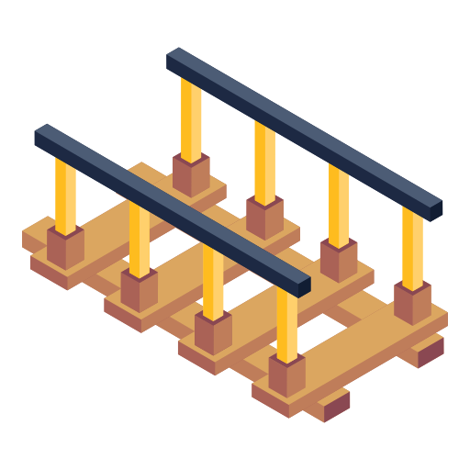
Shinobi Word of the Day
strengthen
Word Class
Word of the Day:
(verb)
(strength-en)
Pronunciation / Syllables
Definition:
If you strengthen something, you support it, making it stronger or more powerful.
The repairs strengthened the bridge.
Phrases: | strengthened the defence | strengthened her opinion
Synonym: | Antonym: | Prefix / Suffix | Rhyme: | Link Word:
toughen | weaken | -ed | lengthen | door
reinforce |  | -ing |  | bridge

Slide 15
Vocabulary Laboratory
Describe / Definition:
Use it in a sentence:
Focus Word (write below):
Word Class:
Synonyms: (words with same / similar meaning) | Antonyms: (words with opposite meaning)
Rhymes: (words that sound the same) | Link Words: (Example: football = pitch, team, player)
Draw your sentence:

Slide 16

Vocabulary Visualiser
Draw the Grasshopper words and bring them to life.
Word: simple | Word: quick
Word: arch | Word: centre

Slide 17

Vocabulary Visualiser
Draw the Shinobi words and bring them to life.
Word: disagree | Word: sort
Word: enhance | Word: strengthen

Slide 18
Matching Meanings
Draw lines from the Grasshopper words to their definitions.
Grasshopper Word
simple
quick
store
arch
centre
Grasshopper Definitions
The *** of something is the middle of it.
Someone or something that is *** moves or does things with great speed. Something that is *** takes or lasts only a short time.
An *** is a structure that is curved at the top and is supported on either side by a pillar, post, or wall.
If you describe something as ***, you mean that it is not complicated, and is therefore easy to understand.
When you *** things, you put them in a container or other place and leave them there until they are needed.

Slide 19
Matching Meanings
Draw lines from the Shinobi words to their definitions.
Shinobi Word
disagree
gauge
sort
enhance
strengthen
Shinobi Definitions
If you *** things, you separate them into different classes, groups, or places, for example so that you can do different things with them.
If you *** with someone or *** with what they say, you do not accept that what they say is true or correct. You can also say that two people ***.
To enhance something means to improve its value, quality, or attractiveness.
If you *** something, you support it, making it stronger or more powerful.
If you *** the speed or strength of something, or if you *** an amount, you measure or calculate it, often by using a device of some kind.

Slide 20






Display Slips
The following slides are for classroom display. As you teach each Word of the Day, words can be displayed in the classroom to enable pupils to use the taught vocabulary in an independent manner.

Slide 21
simple
quick

Slide 22
store
arch

Slide 23
centre
disagree

Slide 24
gauge
sort

Slide 25
enhance
strengthen

