Slide 1
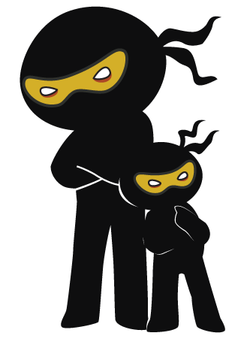



Word of the Day
Spring Term 2022
Week 23 – 7th March 2022
'Words unlock the doors to a world of understanding...'

Slide 2

This Week's Words
Grasshopper
Shinobi
carry
wary
awake
frugal
sob
parched
middle
collaborate
globe
static

Slide 3
Grasshopper (Tier 1)
carry
awake
sob
middle
globe

Slide 4
Shinobi (Tier 2)
wary
frugal
parched
collaborate
static

Slide 5


Grasshopper Word of the Day
carry
Word Class
Word of the Day:
(verb)
(car-ry)
Pronunciation / Syllables
Definition:
If you carry something, you take it with you, holding it so that it does not touch the ground.
Roberto carried the box of books.
Phrases: | carried the heavy | was carrying the
Synonym: | Antonym: | Rhyme: | Link Word:
transfer |  |  | heavy
move |  |  | across

Slide 6

Grasshopper Word of the Day
awake
Word Class
Word of the Day:
(adjective)
(a-wake)
Pronunciation / Syllables
Definition:
Someone who is awake is not sleeping.
Mark was awake before his alarm.
Phrases: | was wide-awake before | always awake on
Synonym: | Antonym: | Rhyme: | Link Word:
wide awake | asleep | make | day
 |  | take | wide

Slide 7

Grasshopper Word of the Day
sob
Word Class
Word of the Day:
(verb)
(sob)
Pronunciation / Syllables
Definition:
When someone sobs, they cry in a noisy way, breathing in short breaths.
Mary’s sister was sobbing before bed.
Phrases: | sobbed non-stop | sobbed endlessly
Synonym: | Antonym: | Rhyme: | Link Word:
weep |  | job | uncontrollably
whimper |  | rob | sadness

Slide 8

Grasshopper Word of the Day
middle
Word Class
Word of the Day:
(noun)
(mid-dle)
Pronunciation / Syllables
Definition:
The middle of something is the part of it that is furthest from its edges, ends, or outside surface.
Mia was in the middle of Fran and Ruby.
Phrases: | in the middle of | the middle of the
Synonym: | Antonym: | Rhyme: | Link Word:
centre | outside | riddle | outside
heart |  | fiddle | inside

Slide 9

Grasshopper Word of the Day
globe
Word Class
Word of the Day:
(noun)
(globe)
Pronunciation / Syllables
Definition:
A globe is a ball-shaped object with a map of the world on it. It is usually fixed on a stand.
We looked at the countries on the globe.
Phrases: | the snow globe was | A globe of the Earth
Synonym: | Antonym: | Rhyme: | Link Word:
world |  | probe | ball
sphere |  | robe | sphere

Slide 10

Shinobi Word of the Day
wary
Word Class
Word of the Day:
(adjective)
(war-y)
Pronunciation / Syllables
Definition:
If you are wary of something or someone, you are cautious because you do not know much about them and you believe they may be dangerous or cause problems.
Mia was wary about crossing the busy road.
Phrases: | very wary of | wary and unsure about
Synonym: | Antonym: | Prefix / Suffix: | Rhyme: | Link Word:
careful | unwary | -ily | hairy | about
cautious | trustful | un- | scary | of

Slide 11

Shinobi Word of the Day
frugal
Word Class
Word of the Day:
(adjective)
(fru-gal)
Pronunciation / Syllables
Definition:
People who are frugal or who live frugal lives do not eat much or spend much money on themselves.
The family needed to be frugal with their money.
Phrases: | sensible and frugal | frugal-minded
Synonym: | Antonym: | Prefix / Suffix: | Rhyme: | Link Word:
thrifty | extravagant | -ly |  | saving
sparing |  |  |  | safe

Slide 12

Shinobi Word of the Day
parched
Word Class
Word of the Day:
(adjective)
(parched)
Pronunciation / Syllables
Definition:
If something, especially the ground or a plant, is parched, it is very dry, because there has been no rain.
The ground was parched and dry.
Phrases: | cracked and parched | parched by the
Synonym: | Antonym: | Prefix / Suffix: | Rhyme: | Link Word:
dry | wet | -ed | marched | land
withered | soaking |  | arched | thirsty

Slide 13

Shinobi Word of the Day
collaborate
Word Class
Word of the Day:
(verb)
(col-lab-o-rate)
Pronunciation / Syllables
Definition:
When one person or group collaborates with another, they work together, especially on a book or on some research.
We collaborated on our science homework.
Phrases: | worked collaboratively | always collaborate
Synonym: | Antonym: | Prefix / Suffix: | Rhyme: | Link Word:
cooperate | resist | -tion | elaborate | project
unite |  | -ed | exaggerate | game

Slide 14

Shinobi Word of the Day
static
Word Class
Word of the Day:
(adjective)
(stat-ic)
Pronunciation / Syllables
Definition:
Something that is static does not move or change.
The static scarecrow looked lonely in the huge field.
Phrases: | static and constant | static and fixed
Synonym: | Antonym: | Prefix / Suffix | Rhyme: | Link Word:
fixed | variable |  | dramatic | person
constant |  |  | problematic | vehicle

Slide 15
Vocabulary Laboratory
Describe / Definition:
Use it in a sentence:
Focus Word (write below):
Word Class:
Synonyms: (words with same / similar meaning) | Antonyms: (words with opposite meaning)
Rhymes: (words that sound the same) | Link Words: (Example: football = pitch, team, player)
Draw your sentence:

Slide 16
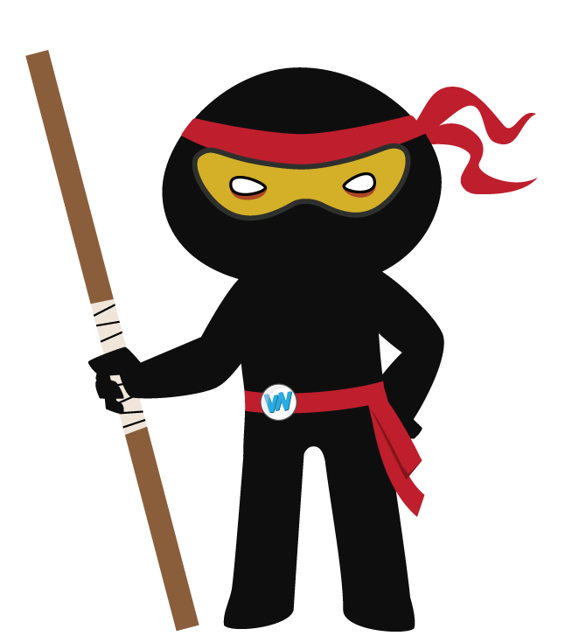
Vocabulary Visualiser
Draw the Grasshopper words and bring them to life.
Word: carry | Word: awake
Word: sob | Word: globe

Slide 17
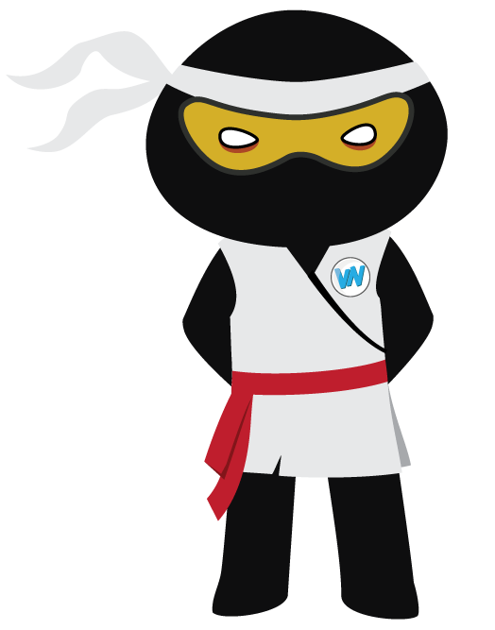
Vocabulary Visualiser
Draw the Shinobi words and bring them to life.
Word: wary | Word: frugal
Word: parched | Word: collaborate

Slide 18
Matching Meanings
Draw lines from the Grasshopper words to their definitions.
Grasshopper Word
carry
awake
sob
middle
globe
Grasshopper Definitions
Someone who is *** is not sleeping.
The *** of something is the part of it that is furthest from its edges, ends, or outside surface.
If you *** something, you take it with you, holding it so that it does not touch the ground.
A *** is a ball-shaped object with a map of the world on it. It is usually fixed on a stand.
When someone ***, they cry in a noisy way, breathing in short breaths.

Slide 19
Matching Meanings
Draw lines from the Shinobi words to their definitions.
Shinobi Word
wary
frugal
parched
collaborate
static
Shinobi Definitions
If something, especially the ground or a plant, is ***, it is very dry, because there has been no rain.
If you are *** of something or someone, you are cautious because you do not know much about them and you believe they may be dangerous or cause problems.
When one person or group *** with another, they work together, especially on a book or on some research.
Something that is *** does not move or change.
People who are *** or who live *** lives do not eat much or spend much money on themselves.

Slide 20






Display Slips
The following slides are for classroom display. As you teach each Word of the Day, words can be displayed in the classroom to enable pupils to use the taught vocabulary in an independent manner.

Slide 21
carry
awake

Slide 22
sob
middle

Slide 23
globe
wary

Slide 24
frugal
parched

Slide 25
collaborate
static

