Slide 1




Word of the Day
Spring Term 2022
Week 20 – 7th February 2022
'Words unlock the doors to a world of understanding...'

Slide 2

This Week's Words
Grasshopper
Shinobi
spin
trek
shade
spiral
friendly
swept
split
guardian
heard
intruder

Slide 3
Grasshopper (Tier 1)
spin
shade
friendly
split
heard

Slide 4
Shinobi (Tier 2)
trek
spiral
swept
guardian
intruder

Slide 5


Grasshopper Word of the Day
spin
Word Class
Word of the Day:
(verb)
(spin)
Pronunciation / Syllables
Definition:
If something spins or if you spin it, it turns quickly around a central point.
The spinning fidget was so much fun.
Phrases: | spin and spin | endless spinning
Synonym: | Antonym: | Rhyme: | Link Word:
rotate |  | win | slowly
turn |  | thin | rapidly

Slide 6

Grasshopper Word of the Day
shade
Word Class
Word of the Day:
(noun / verb)
(shade)
Pronunciation / Syllables
Definition:
Shade is an area of darkness under or next to an object such as a tree, where sunlight does not reach.
The sunglasses shaded my eyes from the sun.
Phrases: | shade from the sun | sit in the shade
Synonym: | Antonym: | Rhyme: | Link Word:
shadow | glare | made | from
 | light | laid | under

Slide 7

Grasshopper Word of the Day
friendly
Word Class
Word of the Day:
(adjective)
(friend-ly)
Pronunciation / Syllables
Definition:
If someone is friendly, they behave in a pleasant, kind way, and like to be with other people.
Emily was always very friendly.
Phrases: | extremely friendly | friendly and polite
Synonym: | Antonym: | Rhyme: | Link Word:
warm | unfriendly |  | people
 | hostile |  | behaviour

Slide 8

Grasshopper Word of the Day
split
Word Class
Word of the Day:
(verb)
(split)
Pronunciation / Syllables
Definition:
If something splits or if you split it, it is divided into two or more parts.
They split the screen so both children could play.
Phrases: | split in half | split into two teams
Synonym: | Antonym: | Rhyme: | Link Word:
divide |  | sit | screen
 |  | fit | desert

Slide 9

Grasshopper Word of the Day
heard
Word Class
Word of the Day:
(verb)
(heard)
Pronunciation / Syllables
Definition:
When you hear a sound, you become aware of it through your ears.
Alfie heard Brennan shouting on the playground.
Phrases: | heard in the distance | heard coming from the
Synonym: | Antonym: | Rhyme: | Link Word:
 |  | bird | screaming
 |  | third | whispering

Slide 10
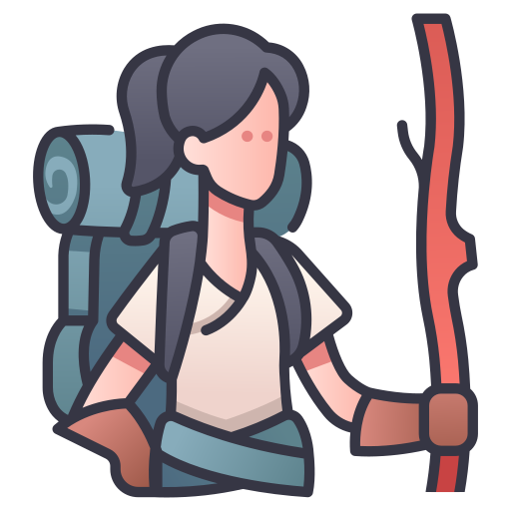
Shinobi Word of the Day
trek
Word Class
Word of the Day:
(verb / noun)
(trek)
Pronunciation / Syllables
Definition:
If you trek somewhere, you go on a journey across difficult country, usually on foot.
Mira trekked across the wasteland.
Phrases: | lengthy trek | dangerous trek across
Synonym: | Antonym: | Prefix / Suffix: | Rhyme: | Link Word:
journey |  | -ed | neck | across
slog |  | -ing | wreck | through

Slide 11

Shinobi Word of the Day
spiral
Word Class
Word of the Day:
(verb / noun)
(spi-ral)
Pronunciation / Syllables
Definition:
If something spirals or is spiralled somewhere, it grows or moves in a spiral curve.
The planets and stars spiralled in the night sky.
Phrases: | spiralled upwards | spiralled away from
Synonym: | Antonym: | Prefix / Suffix: | Rhyme: | Link Word:
twisting |  | -ing | viral | firework
winding |  | -ed |  | out of control

Slide 12

Shinobi Word of the Day
swept
Word Class
Word of the Day:
(verb)
(swept)
Pronunciation / Syllables
Definition:
If something sweeps from one place to another, it moves there extremely quickly.
Out of nowhere, the rain swept across the playground.
Phrases: | quickly swept across | quickly swept through
Synonym: | Antonym: | Prefix / Suffix: | Rhyme: | Link Word:
engulf |  |  | crept | heat
overwhelm |  |  | wept | weather

Slide 13


Shinobi Word of the Day
guardian
Word Class
Word of the Day:
(noun)
(guard-i-an)
Pronunciation / Syllables
Definition:
The guardian of something is someone who defends and protects it.
Frank was the guardian of the glue sticks.
Phrases: | experienced guardian | brave guardian
Synonym: | Antonym: | Prefix / Suffix: | Rhyme: | Link Word:
protector |  | -s |  | of
defender |  |  |  | riches

Slide 14

Shinobi Word of the Day
intruder
Word Class
Word of the Day:
(noun)
(in-trud-er)
Pronunciation / Syllables
Definition:
An intruder is a person who goes into a place where they are not supposed to be.
There had been an intruder in the classroom.
Phrases: | unwanted intruder | the unknown intruder
Synonym: | Antonym: | Prefix / Suffix | Rhyme: | Link Word:
trespasser |  |  | cruder | sneaky
raider |  |  | shrewder | illegal

Slide 15
Vocabulary Laboratory
Describe / Definition:
Use it in a sentence:
Focus Word (write below):
Word Class:
Synonyms: (words with same / similar meaning) | Antonyms: (words with opposite meaning)
Rhymes: (words that sound the same) | Link Words: (Example: football = pitch, team, player)
Draw your sentence:

Slide 16

Vocabulary Visualiser
Draw the Grasshopper words and bring them to life.
Word: spin | Word: shade
Word: split | Word: heard

Slide 17

Vocabulary Visualiser
Draw the Shinobi words and bring them to life.
Word: trek | Word: spiral
Word: intruder | Word: swept

Slide 18
Matching Meanings
Draw lines from the Grasshopper words to their definitions.
Grasshopper Word
spin
shade
friendly
split
heard
Grasshopper Definitions
If someone is ***, they behave in a pleasant, kind way, and like to be with other people.
If something *** or if you *** it, it turns quickly around a central point.
*** is an area of darkness under or next to an object such as a tree, where sunlight does not reach.
When you *** a sound, you become aware of it through your ears.
If something *** or if you *** it, it is divided into two or more parts.

Slide 19
Matching Meanings
Draw lines from the Shinobi words to their definitions.
Shinobi Word
trek
spiral
swept
guardian
intruder
Shinobi Definitions
If something *** or is *** somewhere, it grows or moves in a *** curve.
If something *** from one place to another, it moves there extremely quickly.
The *** of something is someone who defends and protects it.
An *** is a person who goes into a place where they are not supposed to be.
If you *** somewhere, you go on a journey across difficult country, usually on foot.

Slide 20






Display Slips
The following slides are for classroom display. As you teach each Word of the Day, words can be displayed in the classroom to enable pupils to use the taught vocabulary in an independent manner.

Slide 21
spin
shade

Slide 22
friendly
split

Slide 23
heard
trek

Slide 24
spiral
swept

Slide 25
guardian
intruder

