Slide 1




Word of the Day
Spring Term 2022
Week 16 – 10th January 2022
'Words unlock the doors to a world of understanding...'

Slide 2

This Week's Words
Grasshopper
Shinobi
lovely
casualty
negative
solution
note
substitute
positive
derogatory
suggest
novice

Slide 3
Grasshopper (Tier 1)
lovely
negative
note
positive
suggest

Slide 4
Shinobi (Tier 2)
casualty
solution
substitute
derogatory
novice

Slide 5


Grasshopper Word of the Day
lovely
Word Class
Word of the Day:
(adjective)
(love-ly)
Pronunciation / Syllables
Definition:
If you describe someone or something as lovely, you mean that they are very beautiful and therefore pleasing to look at or listen to.
It was lovely to come back to school and see everyone.
Phrases: | lovely day when | rather lovely
Synonym: | Antonym: | Rhyme: | Link Word:
pleasing | hideous |  | time
splendid |  |  | day

Slide 6

Grasshopper Word of the Day
negative
Word Class
Word of the Day:
(adjective)
(neg-a-tive)
Pronunciation / Syllables
Definition:
A fact, situation, or experience that is negative is unpleasant, depressing, or harmful.
Jimmy had a negative break time.
Phrases: | negative test | negative experience
Synonym: | Antonym: | Rhyme: | Link Word:
bad | positive |  | experience
unfortunate |  |  | result

Slide 7

Grasshopper Word of the Day
note
Word Class
Word of the Day:
(noun)
(note)
Pronunciation / Syllables
Definition:
A note is something that you write down to remind yourself of something.
The children wrote kind notes for each other.
Phrases: | short note | kind note
Synonym: | Antonym: | Rhyme: | Link Word:
message |  | coat | reminder
 |  | vote | short

Slide 8

Grasshopper Word of the Day
positive
Word Class
Word of the Day:
(adjective)
(pos-i-tive)
Pronunciation / Syllables
Definition:
A positive fact, situation, or experience is pleasant and helpful to you in some way.
Our chances of winning the game were positive.
Phrases: | positive person | positive experience
Synonym: | Antonym: | Rhyme: | Link Word:
good | negative |  | experience
 |  |  | result

Slide 9

Grasshopper Word of the Day
suggest
Word Class
Word of the Day:
(verb)
(sug-gest)
Pronunciation / Syllables
Definition:
If you suggest something, you put forward a plan or idea for someone to think about.
I wanted to suggest my ideas to the class.
Phrases: | wanted to suggest | my suggestion was
Synonym: | Antonym: | Rhyme: | Link Word:
propose | -ion | best | idea
submit | -ing | test | solution

Slide 10

Shinobi Word of the Day
casualty
Word Class
Word of the Day:
(noun)
(cas-u-al-ty)
Pronunciation / Syllables
Definition:
A casualty is a person who is injured or killed in a war or in an accident.
Billy had been a casualty of the hockey game.
Phrases: | a casualty of | had become a casualty
Synonym: | Antonym: | Prefix / Suffix: | Rhyme: | Link Word:
victim |  | -ies | casually | war
sufferer |  |  |  | accident

Slide 11

Shinobi Word of the Day
solution
Word Class
Word of the Day:
(noun)
(so-lu-tion)
Pronunciation / Syllables
Definition:
A solution to a problem or difficult situation is a way of dealing with it so that the difficulty is removed.
Mia knew the solution to the maths problem.
Phrases: | the only solution | any other solution
Synonym: | Antonym: | Prefix / Suffix: | Rhyme: | Link Word:
answer |  | re- | revolution | problem
result |  | -s | evolution | solve

Slide 12
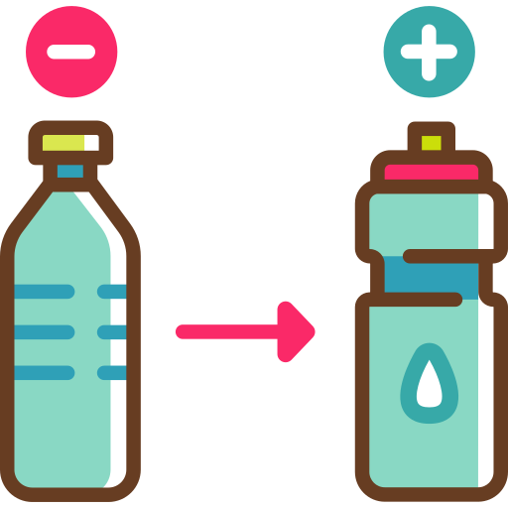
Shinobi Word of the Day
substitute
Word Class
Word of the Day:
(verb / noun)
(sub-sti-tute)
Pronunciation / Syllables
Definition:
If you substitute one thing for another, or if one thing substitutes for another, it takes the place or performs the function of the other thing.
The school decided to substitute single use plastic bottles.
Phrases: | wanted to substitute | a great substitute
Synonym: | Antonym: | Prefix / Suffix: | Rhyme: | Link Word:
switch |  | -ed | institute | player
swap |  | -ing |  | bottle

Slide 13

Shinobi Word of the Day
derogatory
Word Class
Word of the Day:
(adjective)
(de-rog-a-to-ry)
Pronunciation / Syllables
Definition:
If you make a derogatory remark or comment about someone or something, you express your low opinion of them.
Olivia whispered derogatory words about the school lunch.
Phrases: | derogatory remark | derogatory comment
Synonym: | Antonym: | Prefix / Suffix: | Rhyme: | Link Word:
rude | complimentary |  |  | remark
critical | flattering |  |  | words

Slide 14

Shinobi Word of the Day
novice
Word Class
Word of the Day:
(noun)
(nov-ice)
Pronunciation / Syllables
Definition:
A novice is someone who has been doing a job or other activity for only a short time and so is not experienced at it.
Mrs Robson was a complete novice when it came to golf.
Phrases: | a complete novice | a novice when it came to
Synonym: | Antonym: | Prefix / Suffix | Rhyme: | Link Word:
beginner | expert | -s |  | job
learner | veteran |  |  | sport

Slide 15
Vocabulary Laboratory
Describe / Definition:
Use it in a sentence:
Focus Word (write below):
Word Class:
Synonyms: (words with same / similar meaning) | Antonyms: (words with opposite meaning)
Rhymes: (words that sound the same) | Link Words: (Example: football = pitch, team, player)
Draw your sentence:

Slide 16

Vocabulary Visualiser
Draw the Grasshopper words and bring them to life.
Word: lovely | Word: negative
Word: note | Word: positive

Slide 17

Vocabulary Visualiser
Draw the Shinobi words and bring them to life.
Word: casualty | Word: solution
Word: substitute | Word: novice

Slide 18
Matching Meanings
Draw lines from the Grasshopper words to their definitions.
Grasshopper Word
lovely
negative
note
positive
suggest
Grasshopper Definitions
A fact, situation, or experience that is *** is unpleasant, depressing, or harmful.
A *** is something that you write down to remind yourself of something.
If you describe someone or something as ***, you mean that they are very beautiful and therefore pleasing to look at or listen to.
If you *** something, you put forward a plan or idea for someone to think about.
A *** fact, situation, or experience is pleasant and helpful to you in some way.

Slide 19
Matching Meanings
Draw lines from the Shinobi words to their definitions.
Shinobi Word
casualty
solution
substitute
derogatory
novice
Shinobi Definitions
A *** to a problem or difficult situation is a way of dealing with it so that the difficulty is removed.
If you make a *** remark or comment about someone or something, you express your low opinion of them.
A *** is a person who is injured or killed in a war or in an accident.
A *** is someone who has been doing a job or other activity for only a short time and so is not experienced at it.
If you *** one thing for another, or if one thing *** for another, it takes the place or performs the function of the other thing.

Slide 20






Display Slips
The following slides are for classroom display. As you teach each Word of the Day, words can be displayed in the classroom to enable pupils to use the taught vocabulary in an independent manner.

Slide 21
lovely
negative

Slide 22
note
positive

Slide 23
suggest
casualty

Slide 24
solution
substitute

Slide 25
derogatory
novice

