Slide 1




Word of the Day
Spring Term 2022
Week 18 – 24th January 2022
'Words unlock the doors to a world of understanding...'

Slide 2

This Week's Words
Grasshopper
Shinobi
work
trickle
buy
scheme
tap
congeal
damp
rid
worse
reasonable

Slide 3
Grasshopper (Tier 1)
work
buy
tap
damp
worse

Slide 4
Shinobi (Tier 2)
trickle
scheme
congeal
rid
reasonable

Slide 5

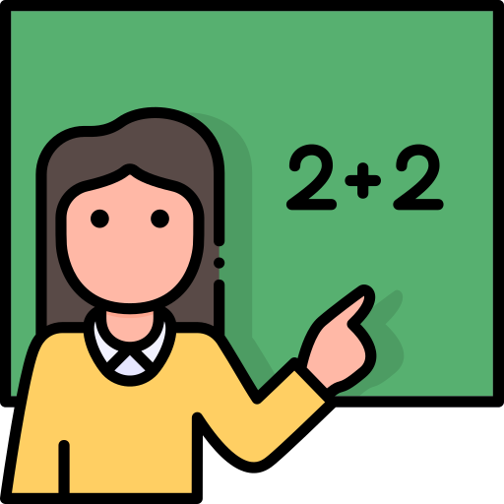
Grasshopper Word of the Day
work
Word Class
Word of the Day:
(noun / verb)
(work)
Pronunciation / Syllables
Definition:
People who work have a job, usually one which they are paid to do.
When teachers are at school, they are at work.
Phrases: | work at | go to work to
Synonym: | Antonym: | Rhyme: | Link Word:
job |  | perk | hard
 |  | lurk | through

Slide 6

Grasshopper Word of the Day
buy
Word Class
Word of the Day:
(verb / noun)
(buy)
Pronunciation / Syllables
Definition:
If you buy something, you obtain it by paying money for it.
We needed to buy some new felt tips and pencils.
Phrases: | quickly buy | buy from
Synonym: | Antonym: | Rhyme: | Link Word:
purchase |  | high | stock
get |  | shy | quickly

Slide 7

Grasshopper Word of the Day
tap
Word Class
Word of the Day:
(verb / noun)
(tap)
Pronunciation / Syllables
Definition:
If you tap something, you hit it with a quick light blow or a series of quick light blows.
Dante was tapping his finger on the window.
Phrases: | tap relentlessly on | tap annoyingly
Synonym: | Antonym: | Rhyme: | Link Word:
knock |  | rap | on
rap |  | bap | again

Slide 8

Grasshopper Word of the Day
damp
Word Class
Word of the Day:
(adjective)
(damp)
Pronunciation / Syllables
Definition:
Something that is damp is slightly wet.
Mark’s jumper was damp because it had started to rain.
Phrases: | damp fabric | became damp
Synonym: | Antonym: | Rhyme: | Link Word:
moist | dry | camp | clothes
muggy |  | ramp | mood

Slide 9

Grasshopper Word of the Day
worse
Word Class
Word of the Day:
(adjective)
(worse)
Pronunciation / Syllables
Definition:
Worse is the comparative of bad.
Phil said his toothache was now worse.
Phrases: | much worse | had worsened
Synonym: | Antonym: | Rhyme: | Link Word:
 |  | verse | than before
 |  | curse | than

Slide 10

Shinobi Word of the Day
trickle
Word Class
Word of the Day:
(verb)
(trick-le)
Pronunciation / Syllables
Definition:
When a liquid trickles, or when you trickle it, it flows slowly in very small amounts.
The sauce trickled down the side of the bowl.
Phrases: | a slow trickle | trickled from the
Synonym: | Antonym: | Prefix / Suffix: | Rhyme: | Link Word:
dribble | pour | -ed | pickle | down
drizzle | gush | -ing | tickle | out

Slide 11

Shinobi Word of the Day
scheme
Word Class
Word of the Day:
(verb / noun)
(scheme)
Pronunciation / Syllables
Definition:
If you say that people are scheming, you mean that they are making secret plans in order to gain something for themselves.
Boris was always scheming.
Phrases: | was scheming about | always scheming
Synonym: | Antonym: | Prefix / Suffix: | Rhyme: | Link Word:
plan |  | -er | cream | evil
plot |  | -ed | dream | person

Slide 12

Shinobi Word of the Day
congeal
Word Class
Word of the Day:
(verb)
(con-geal)
Pronunciation / Syllables
Definition:
When a liquid congeals, it becomes very thick and sticky and almost solid.
The custard looked like it had congealed.
Phrases: | began to congeal | looked congealed
Synonym: | Antonym: | Prefix / Suffix: | Rhyme: | Link Word:
clot | soften | -ed | steel | harden
thicken |  | -ing | meal | liquid

Slide 13

Shinobi Word of the Day
rid
Word Class
Word of the Day:
(verb)
(rid)
Pronunciation / Syllables
Definition:
If you rid a place or person of something undesirable or unwanted, you succeed in removing it completely from that place or person.
The school need to get rid of the old, electronic items.
Phrases: | wanted rid of | rid the of
Synonym: | Antonym: | Prefix / Suffix: | Rhyme: | Link Word:
free |  | -s | kid | broken
clear |  | -ing | hid | evil

Slide 14

Shinobi Word of the Day
reasonable
Word Class
Word of the Day:
(adjective)
(rea-son-a-ble)
Pronunciation / Syllables
Definition:
If you say that a decision or action is reasonable, you mean that it is fair and sensible.
Mr Jones was being reasonable and gave us extra break because we had worked so hard in the lesson.
Phrases: | was reasonable to | reasonable of her to
Synonym: | Antonym: | Prefix / Suffix | Rhyme: | Link Word:
sensible | unreasonable | -ly |  | person
fair | illogical | un- |  | decision

Slide 15
Vocabulary Laboratory
Describe / Definition:
Use it in a sentence:
Focus Word (write below):
Word Class:
Synonyms: (words with same / similar meaning) | Antonyms: (words with opposite meaning)
Rhymes: (words that sound the same) | Link Words: (Example: football = pitch, team, player)
Draw your sentence:

Slide 16

Vocabulary Visualiser
Draw the Grasshopper words and bring them to life.
Word: work | Word: buy
Word: tap | Word: damp

Slide 17

Vocabulary Visualiser
Draw the Shinobi words and bring them to life.
Word: trickle | Word: scheme
Word: congeal | Word: rid

Slide 18
Matching Meanings
Draw lines from the Grasshopper words to their definitions.
Grasshopper Word
work
buy
tap
damp
worse
Grasshopper Definitions
Something that is *** is slightly wet.
*** is the comparative of bad.
People who *** have a job, usually one which they are paid to do.
If you *** something, you obtain it by paying money for it.
If you *** something, you hit it with a quick light blow or a series of quick light blows.

Slide 19
Matching Meanings
Draw lines from the Shinobi words to their definitions.
Shinobi Word
trickle
scheme
congeal
rid
reasonable
Shinobi Definitions
If you *** a place or person of something undesirable or unwanted, you succeed in removing it completely from that place or person.
When a liquid ***, it becomes very thick and sticky and almost solid.
If you say that people are ***, you mean that they are making secret plans in order to gain something for themselves.
If you say that a decision or action is ***, you mean that it is fair and sensible.
When a liquid ***, or when you ** it, it flows slowly in very small amounts.

Slide 20





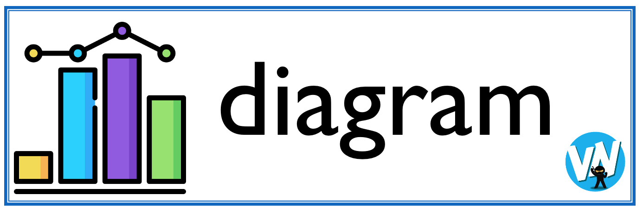
Display Slips
The following slides are for classroom display. As you teach each Word of the Day, words can be displayed in the classroom to enable pupils to use the taught vocabulary in an independent manner.

Slide 21
work
buy

Slide 22
tap
damp

Slide 23
worse
trickle

Slide 24
scheme
congeal

Slide 25
rid
reasonable

