Slide 1
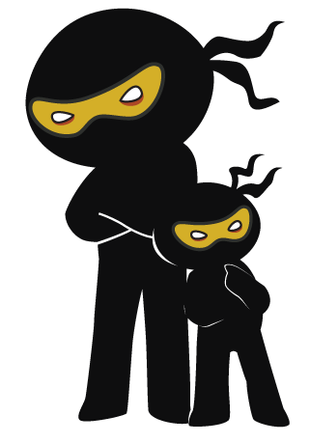



Word of the Day
Spring Term 2022
Week 19 – 31st January 2022
'Words unlock the doors to a world of understanding...'

Slide 2

This Week's Words
Grasshopper
Shinobi
spy
pester
partner
underestimate
false
brutal
difficult
outrage
study
tedious

Slide 3
Grasshopper (Tier 1)
spy
partner
false
difficult
study

Slide 4
Shinobi (Tier 2)
pester
underestimate
brutal
outrage
tedious

Slide 5


Grasshopper Word of the Day
spy
Word Class
Word of the Day:
(verb / noun)
(spy)
Pronunciation / Syllables
Definition:
If you spy on someone, you watch them secretly.
Class 5 were spying on Class 4’s new teacher.
Phrases: | sneakily spied on | always spying on
Synonym: | Antonym: | Rhyme: | Link Word:
observe |  | high | on
watch |  | why

Slide 6

Grasshopper Word of the Day
partner
Word Class
Word of the Day:
(noun)
(part-ner)
Pronunciation / Syllables
Definition:
Your partner is the person you are doing something with, for example dancing with or playing with in a game against two other people.
Miriam picked Alfie to be her partner.
Phrases: | a great partner for | partner up with
Synonym: | Antonym: | Rhyme: | Link Word:
teammate |  | smarter | with
ally |  | barter | together

Slide 7

Grasshopper Word of the Day
false
Word Class
Word of the Day:
(adjective)
(false)
Pronunciation / Syllables
Definition:
If something is false, it is incorrect, untrue, or mistaken.
Robbie knew the answer was false.
Phrases: | was false because | true or false
Synonym: | Antonym: | Rhyme: | Link Word:
incorrect | correct |  | answer
untrue | truthful |  | fact

Slide 8
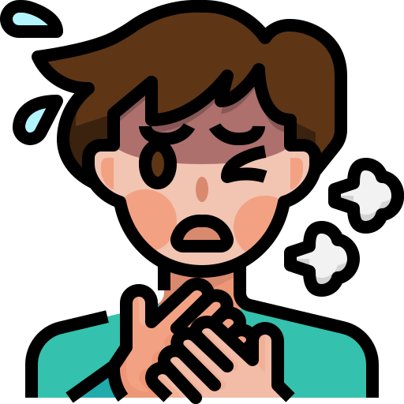
Grasshopper Word of the Day
difficult
Word Class
Word of the Day:
(adjective)
(dif-fi-cult)
Pronunciation / Syllables
Definition:
Something that is difficult is not easy to do, understand, or deal with.
It was difficult to breathe after the running games in PE.
Phrases: | more difficult than | became difficult to
Synonym: | Antonym: | Rhyme: | Link Word:
hard | easy |  | task
tough | simple |  | situation

Slide 9

Grasshopper Word of the Day
study
Word Class
Word of the Day:
(verb / noun)
(stud-y)
Pronunciation / Syllables
Definition:
If you study something, you look at it or watch it very carefully, in order to find something out.
Harry studied the dinosaurs in his new books.
Phrases: | carefully studied | studied the
Synonym: | Antonym: | Rhyme: | Link Word:
observe |  | buddy | carefully
learn |  | muddy | in detail

Slide 10

Shinobi Word of the Day
pester
Word Class
Word of the Day:
(verb)
(pes-ter)
Pronunciation / Syllables
Definition:
If you say that someone is pestering you, you mean that they keep asking you to do something, or keep talking to you, and you find this annoying.
Miss Khan was tired of being pestered!
Phrases: | continued to pester | was always pestering
Synonym: | Antonym: | Prefix / Suffix: | Rhyme: | Link Word:
badger |  | -ed | investor | teacher
harass |  | -ing |  | parent

Slide 11

Shinobi Word of the Day
Word Class
Word of the Day:
underestimate
(verb)
(un-der-es-ti-mate)
Pronunciation / Syllables
Definition:
If you underestimate someone, you do not realise what they are capable of doing.
The wolf underestimated Little Red Riding Hood.
Phrases: | totally underestimated | underestimated her
Synonym: | Antonym: | Prefix / Suffix: | Rhyme: | Link Word:
miscalculate | overestimate | -ing |  | person
 |  | -ed |  | them

Slide 12

Shinobi Word of the Day
brutal
Word Class
Word of the Day:
(adjective)
(bru-tal)
Pronunciation / Syllables
Definition:
Brutal is used to describe things that have an extremely unpleasant effect on people.
Pollution has a brutal effect on the ocean.
Phrases: | brutal actions | brutal and dangerous
Synonym: | Antonym: | Prefix / Suffix: | Rhyme: | Link Word:
savage | gentle | -ly | futile | effect
barbaric | humane | -ist |  | actions

Slide 13

Shinobi Word of the Day
outrage
Word Class
Word of the Day:
(verb)
(out-rage)
Pronunciation / Syllables
Definition:
If you are outraged by something, it makes you extremely shocked and angry.
The children were outraged by lunchtime being shortened.
Phrases: | was outraged by | completely outrageous
Synonym: | Antonym: | Prefix / Suffix: | Rhyme: | Link Word:
fury |  | -eous |  | life
anger |  | -ly |  | decision

Slide 14

Shinobi Word of the Day
tedious
Word Class
Word of the Day:
(adjective)
(te-di-ous)
Pronunciation / Syllables
Definition:
If you describe something such as a job, task, or situation as tedious, you mean it is boring and rather frustrating.
Waiting in the line had become tedious.
Phrases: | was now very tedious | was tedious because
Synonym: | Antonym: | Prefix / Suffix | Rhyme: | Link Word:
boring | exciting | -ly |  | situation
dull | interesting | -ness |  | person

Slide 15
Vocabulary Laboratory
Describe / Definition:
Use it in a sentence:
Focus Word (write below):
Word Class:
Synonyms: (words with same / similar meaning) | Antonyms: (words with opposite meaning)
Rhymes: (words that sound the same) | Link Words: (Example: football = pitch, team, player)
Draw your sentence:

Slide 16

Vocabulary Visualiser
Draw the Grasshopper words and bring them to life.
Word: partner | Word: false
Word: difficult | Word: study

Slide 17
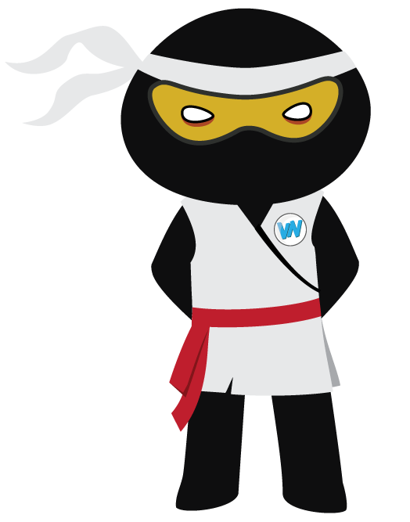
Vocabulary Visualiser
Draw the Shinobi words and bring them to life.
Word: pester | Word: brutal
Word: outrage | Word: tedious

Slide 18
Matching Meanings
Draw lines from the Grasshopper words to their definitions.
Grasshopper Word
spy
partner
false
difficult
study
Grasshopper Definitions
Your **** is the person you are doing something with, for example dancing with or playing with in a game against two other people.
Something that is *** is not easy to do, understand, or deal with.
If you *** on someone, you watch them secretly.
If you *** something, you look at it or watch it very carefully, in order to find something out.
If something is ***, it is incorrect, untrue, or mistaken.

Slide 19
Matching Meanings
Draw lines from the Shinobi words to their definitions.
Shinobi Word
pester
underestimate
brutal
outrage
tedious
Shinobi Definitions
If you *** someone, you do not realise what they are capable of doing.
If you are *** by something, it makes you extremely shocked and angry.
If you say that someone is *** you, you mean that they keep asking you to do something, or keep talking to you, and you find this annoying.
If you describe something such as a job, task, or situation as ***, you mean it is boring and rather frustrating.
*** is used to describe things that have an extremely unpleasant effect on people.

Slide 20






Display Slips
The following slides are for classroom display. As you teach each Word of the Day, words can be displayed in the classroom to enable pupils to use the taught vocabulary in an independent manner.

Slide 21
spy
partner

Slide 22
false
difficult

Slide 23
study
pester

Slide 24
underestimate
brutal

Slide 25
outrage
tedious

