Slide 1
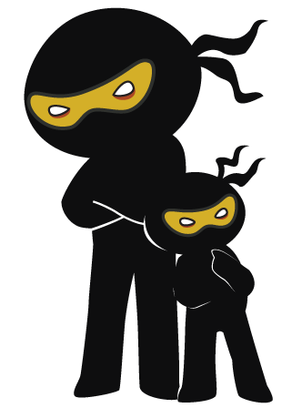



Word of the Day
Spring Term 2022
Week 15 – 3rd January 2022
'Words unlock the doors to a world of understanding...'

Slide 2

This Week's Words
Grasshopper
Shinobi
lean
majestic
label
mandatory
cheer
pacify
touch
oblivious
collect
preposterous

Slide 3
Grasshopper (Tier 1)
lean
label
cheer
touch
collect

Slide 4
Shinobi (Tier 2)
majestic
mandatory
pacify
oblivious
preposterous

Slide 5


Grasshopper Word of the Day
lean
Word Class
Word of the Day:
(verb / noun)
(lean)
Pronunciation / Syllables
Definition:
When you lean in a particular direction, you bend your body in that direction.
The tower leaned to the left.
Phrases: | leaning more and more | leaned slightly
Synonym: | Antonym: | Rhyme: | Link Word:
bend |  | bean | chair
tilt |  | clean | tower

Slide 6

Grasshopper Word of the Day
label
Word Class
Word of the Day:
(noun / verb)
(la-bel)
Pronunciation / Syllables
Definition:
A label is a piece of paper or plastic that is attached to an object in order to give information about it.
Salma wrote her name on the label.
Phrases: | labelled each | an old label
Synonym: | Antonym: | Rhyme: | Link Word:
tag |  | table | bottle
ticket |  | stable | coat

Slide 7
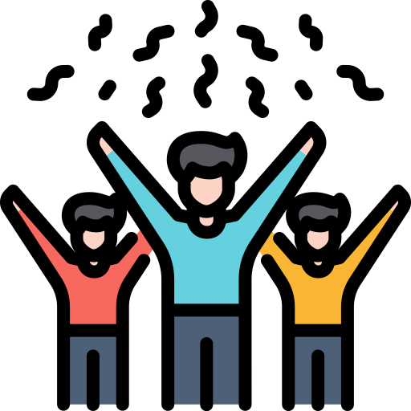
Grasshopper Word of the Day
cheer
Word Class
Word of the Day:
(verb)
(cheer)
Pronunciation / Syllables
Definition:
When people cheer, they shout loudly to show their approval or to encourage someone who is doing something such as taking part in a game.
The children cheered because they had won.
Phrases: | cheered loudly | cheered for
Synonym: | Antonym: | Rhyme: | Link Word:
clap | boo | clear | victory
applaud |  | near | goal

Slide 8

Grasshopper Word of the Day
touch
Word Class
Word of the Day:
(verb)
(touch)
Pronunciation / Syllables
Definition:
If you touch something, you put your hand onto it in order to feel it or to make contact with it.
Alf touched the iPad screen during computing.
Phrases: | softly touched | firmly touched
Synonym: | Antonym: | Rhyme: | Link Word:
tap |  | such | screen
nudge |  | much | skin

Slide 9

Grasshopper Word of the Day
collect
Word Class
Word of the Day:
(verb)
(col-lect)
Pronunciation / Syllables
Definition:
If you collect a number of things, you bring them together from several places or from several people.
Paul loved to collect Pokemon with his friends.
Phrases: | quickly collected | collected attentively
Synonym: | Antonym: | Rhyme: | Link Word:
gather | distribute | effect | stamp
pile up |  | direct | toys

Slide 10
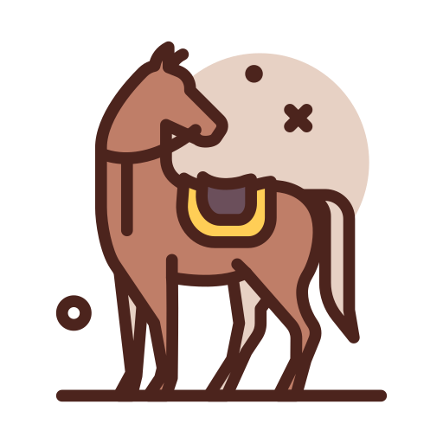
Shinobi Word of the Day
majestic
Word Class
Word of the Day:
(adjective)
(ma-jes-tic)
Pronunciation / Syllables
Definition:
If you describe something or someone as majestic, you think they are very beautiful, dignified, and impressive.
The horse looked majestic.
Phrases: | elegant and majestic | more majestic than
Synonym: | Antonym: | Prefix / Suffix: | Rhyme: | Link Word:
sublime | pitiful | -ally | domestic | beast
dignified | pathetic | -al | pathetic | creature

Slide 11

Shinobi Word of the Day
mandatory
Word Class
Word of the Day:
(adjective)
(man-da-to-ry)
Pronunciation / Syllables
Definition:
If an action or procedure is mandatory, people have to do it, because it is a rule or a law.
It was mandatory to wear a mask.
Phrases: | completely mandatory | became mandatory
Synonym: | Antonym: | Prefix / Suffix: | Rhyme: | Link Word:
required | optional | non- |  | rule
essential |  |  |  | law

Slide 12
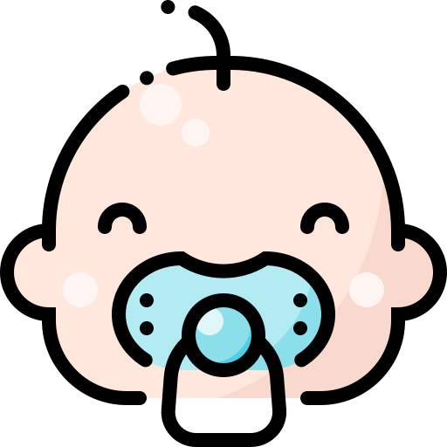
Shinobi Word of the Day
pacify
Word Class
Word of the Day:
(verb)
(pac-i-fy)
Pronunciation / Syllables
Definition:
If you pacify someone who is angry, upset, or not pleased, you succeed in making them calm or pleased.
They gave the crying baby a dummy to pacify her.
Phrases: | quickly pacify | expertly pacify
Synonym: | Antonym: | Prefix / Suffix: | Rhyme: | Link Word:
appease | provoke | -ied | classify | animal
sooth | enrage | -ing |  | person

Slide 13
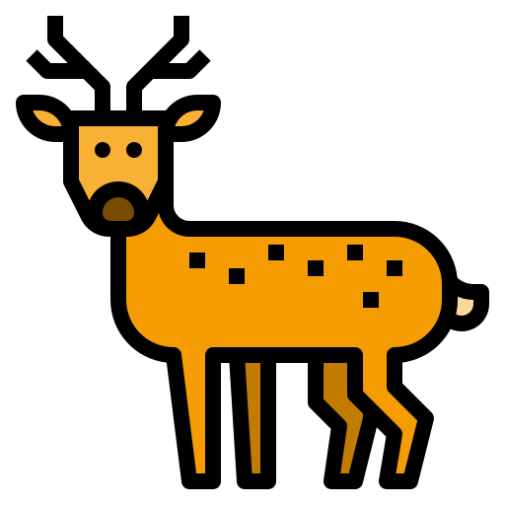
Shinobi Word of the Day
oblivious
Word Class
Word of the Day:
(adjective)
(ob-liv-i-ous)
Pronunciation / Syllables
Definition:
If you are oblivious to something or oblivious of it, you are not aware of it.
The deer was oblivious to the danger of the wolf.
Phrases: | completely oblivious | oblivious to
Synonym: | Antonym: | Prefix / Suffix: | Rhyme: | Link Word:
unaware | aware | -ness | serious | danger
unsuspecting |  | -ly |  | risk

Slide 14

Shinobi Word of the Day
preposterous
Word Class
Word of the Day:
(adjective)
(pre-pos-ter-ous)
Pronunciation / Syllables
Definition:
If you describe something as preposterous, you mean that it is extremely unreasonable and foolish.
The cost of food had become preposterous.
Phrases: | a preposterous request | preposterous decision
Synonym: | Antonym: | Prefix / Suffix | Rhyme: | Link Word:
absurd | reasonable | -ly | prosperous | action
laughable | sensible | -ness |  | decision

Slide 15
Vocabulary Laboratory
Describe / Definition:
Use it in a sentence:
Focus Word (write below):
Word Class:
Synonyms: (words with same / similar meaning) | Antonyms: (words with opposite meaning)
Rhymes: (words that sound the same) | Link Words: (Example: football = pitch, team, player)
Draw your sentence:

Slide 16
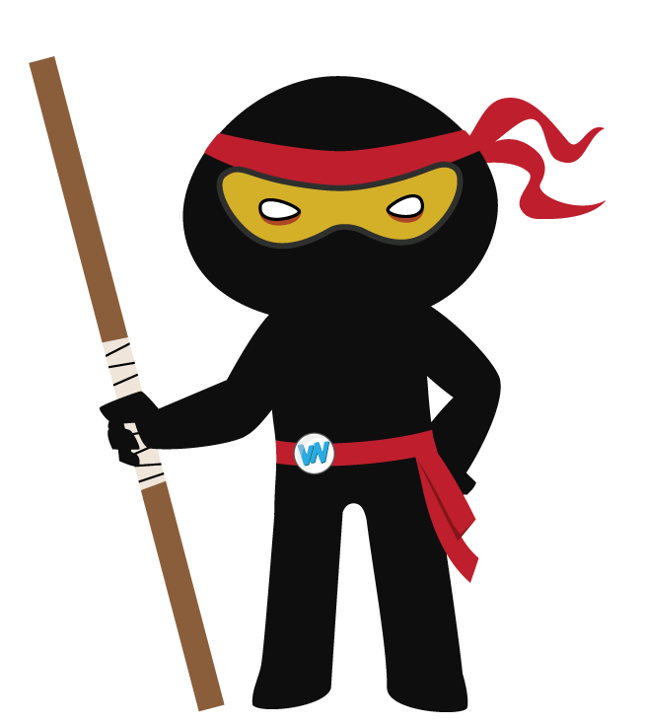
Vocabulary Visualiser
Draw the Grasshopper words and bring them to life.
Word: label | Word: cheer
Word: touch | Word: collect

Slide 17
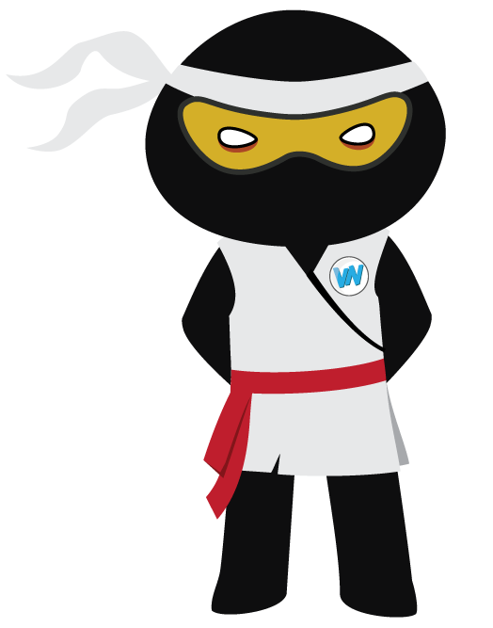
Vocabulary Visualiser
Draw the Shinobi words and bring them to life.
Word: majestic | Word: mandatory
Word: oblivious | Word: preposterous

Slide 18
Matching Meanings
Draw lines from the Grasshopper words to their definitions.
Grasshopper Word
lean
label
cheer
touch
collect
Grasshopper Definitions
A *** is a piece of paper or plastic that is attached to an object in order to give information about it.
If you *** something, you put your hand onto it in order to feel it or to make contact with it.
When you *** in a particular direction, you bend your body in that direction.
If you *** a number of things, you bring them together from several places or from several people.
When people ***, they shout loudly to show their approval or to encourage someone who is doing something such as taking part in a game.

Slide 19
Matching Meanings
Draw lines from the Shinobi words to their definitions.
Shinobi Word
majestic
mandatory
pacify
oblivious
preposterous
Shinobi Definitions
A person whose lack of enthusiasm or bad temper has a depressing effect on others.
If you describe something as ***, you mean that it is extremely unreasonable and foolish.
If you *** someone who is angry, upset, or not pleased, you succeed in making them calm or pleased.
If you describe something or someone as ***, you think they are very beautiful, dignified, and impressive.
If you are *** to something or *** of it, you are not aware of it.

Slide 20

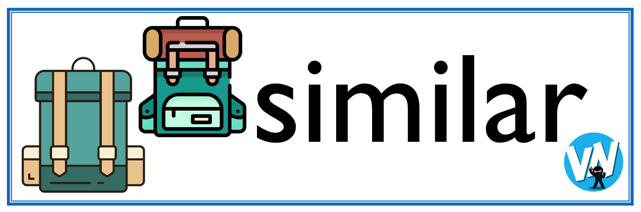



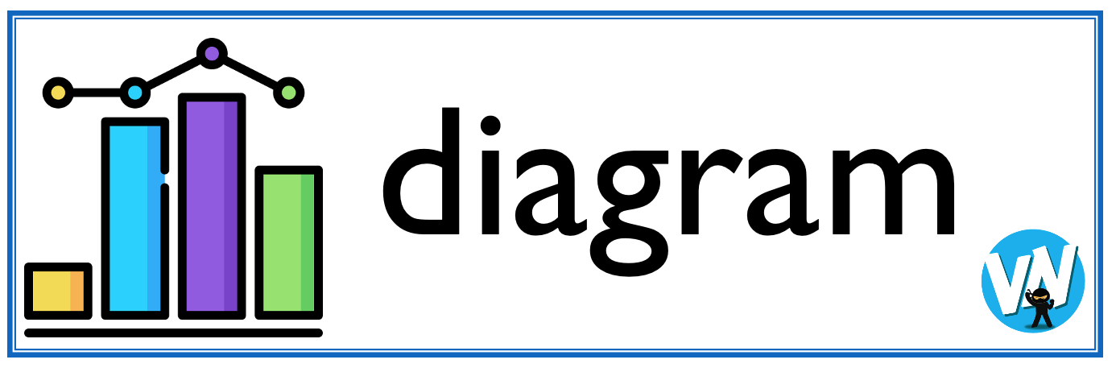
Display Slips
The following slides are for classroom display. As you teach each Word of the Day, words can be displayed in the classroom to enable pupils to use the taught vocabulary in an independent manner.

Slide 21
lean
label

Slide 22
cheer
touch

Slide 23
collect
majestic

Slide 24
mandatory
pacify

Slide 25
oblivious
preposterous

