Slide 1
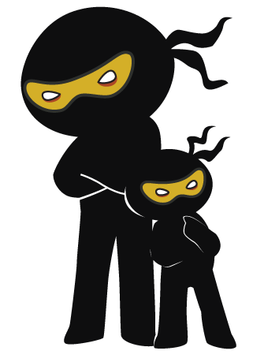



Word of the Day
Autumn Term 2021
Week 9 – 8th November 2021
'Words unlock the doors to a world of understanding...'

Slide 2

This Week's Words
Grasshopper
Shinobi
fasten
design
lock
ideal
untie
forage
expensive
intricate
perfect
clench

Slide 3
Grasshopper (Tier 1)
fasten
lock
untie
expensive
perfect

Slide 4
Shinobi (Tier 2)
design
ideal
forage
intricate
clench

Slide 5

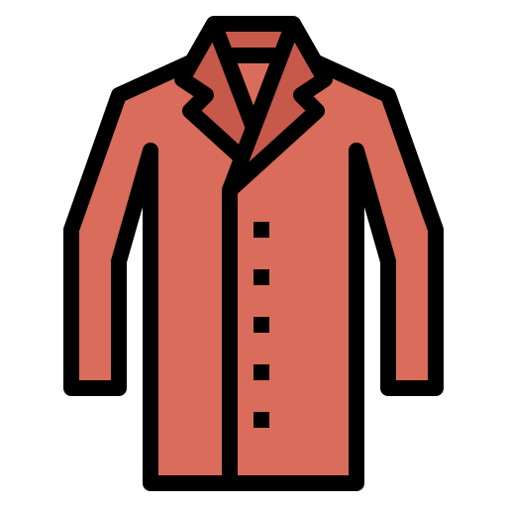
Grasshopper Word of the Day
fasten
Word Class
Word of the Day:
(verb)
(fas-ten)
Pronunciation / Syllables
Definition:
When you fasten something, you close it by means of buttons or a strap, or some other device. If something fastens with buttons or straps, you can close it in this way.
Danny needed to fasten his coat buttons before playing.
Phrases: | fasten tightly | quickly fasten
Synonym: | Antonym: | Rhyme: | Link Word:
link | unfasten |  | clothing
secure | open |  | belt

Slide 6

Grasshopper Word of the Day
lock
Word Class
Word of the Day:
(verb / noun)
(lock)
Pronunciation / Syllables
Definition:
When you lock something such as a door, drawer, or case, you fasten it, usually with a key, so that other people cannot open it.
The caretaker locked the windows on an evening.
Phrases: | lock up | close and lock
Synonym: | Antonym: | Rhyme: | Link Word:
bolt | unlock | block | door
secure | release | shock | crime

Slide 7

Grasshopper Word of the Day
untie
Word Class
Word of the Day:
(verb)
(un-tie)
Pronunciation / Syllables
Definition:
If you untie something that is tied to another thing or if you untie two things that are tied together, you remove the string or rope that holds them or that has been tied round them.
Ismail untied his shoe laces.
Phrases: | carefully untie | quickly untie
Synonym: | Antonym: | Rhyme: | Link Word:
undo | tie up | why | shoes
unfasten |  | try | laces

Slide 8

Grasshopper Word of the Day
expensive
Word Class
Word of the Day:
(adjective)
(ex-pen-sive)
Pronunciation / Syllables
Definition:
If something is expensive, it costs a lot of money.
Olive said her new party shoes were very expensive.
Phrases: | very expensive | expensive and costly
Synonym: | Antonym: | Rhyme: | Link Word:
costly | cheap | extensive | clothes
overpriced | economical | offensive | food

Slide 9

Grasshopper Word of the Day
perfect
Word Class
Word of the Day:
(adjective)
(per-fect)
Pronunciation / Syllables
Definition:
Something that is perfect is as good as it could possibly be.
Corey drew the perfect circle.
Phrases: | completely perfect | unbelievably perfect
Synonym: | Antonym: | Rhyme: | Link Word:
exact | rough | effect | idea
precise | imperfect | subject | product

Slide 10

Shinobi Word of the Day
design
Word Class
Word of the Day:
(noun / verb)
(de-sign)
Pronunciation / Syllables
Definition:
When someone designs a garment, building, machine, or other object, they plan it and make a detailed drawing of it from which it can be built or made.
The children designed and coded a new game.
Phrases: | design in detail | step by step design
Synonym: | Antonym: | Prefix / Suffix: | Rhyme: | Link Word:
create |  | -er | fine | games
plan |  | re- | sign | sketch

Slide 11


Shinobi Word of the Day
ideal
Word Class
Word of the Day:
(adjective)
(i-de-al)
Pronunciation / Syllables
Definition:
The ideal person or thing for a particular task or purpose is the best possible person or thing for it.
The weather was ideal for cricket.
Phrases: | ideal weather for | the ideal time for
Synonym: | Antonym: | Prefix / Suffix: | Rhyme: | Link Word:
perfect | bad | -ly | real | weather
 |  | non- | meal | conditions

Slide 12

Shinobi Word of the Day
forage
Word Class
Word of the Day:
(verb)
(for-age)
Pronunciation / Syllables
Definition:
If someone forages for something, they search for it in a busy way.
The squirrels foraged for nuts.
Phrases: | forage relentlessly | tirelessly forage for
Synonym: | Antonym: | Prefix / Suffix: | Rhyme: | Link Word:
hunt |  | -ed | storage | food
search |  | -ing |  | searching

Slide 13

Shinobi Word of the Day
intricate
Word Class
Word of the Day:
(adjective)
(in-tri-cate)
Pronunciation / Syllables
Definition:
You use intricate to describe something that has many small parts or details.
The rangoli pattern was intricate and beautiful.
Phrases: | delicate and intricate | mesmerisingly intricate
Synonym: | Antonym: | Prefix / Suffix: | Rhyme: | Link Word:
complicated | simple | dis- |  | design
elaborate | straightforward |  |  | pattern

Slide 14

Shinobi Word of the Day
clench
Word Class
Word of the Day:
(verb)
(clench)
Pronunciation / Syllables
Definition:
If you clench something in your hand or in your teeth, you hold it tightly with your hand or your teeth.
Robert clenched his pound coin tightly.
Phrases: | clench tightly | clench lovingly
Synonym: | Antonym: | Prefix / Suffix | Rhyme: | Link Word:
grip |  | -ed | bench | teeth
grasp |  | un- | stench | fist

Slide 15
Vocabulary Laboratory
Describe / Definition:
Use it in a sentence:
Focus Word (write below):
Word Class:
Synonyms: (words with same / similar meaning) | Antonyms: (words with opposite meaning)
Rhymes: (words that sound the same) | Link Words: (Example: football = pitch, team, player)
Draw your sentence:

Slide 16
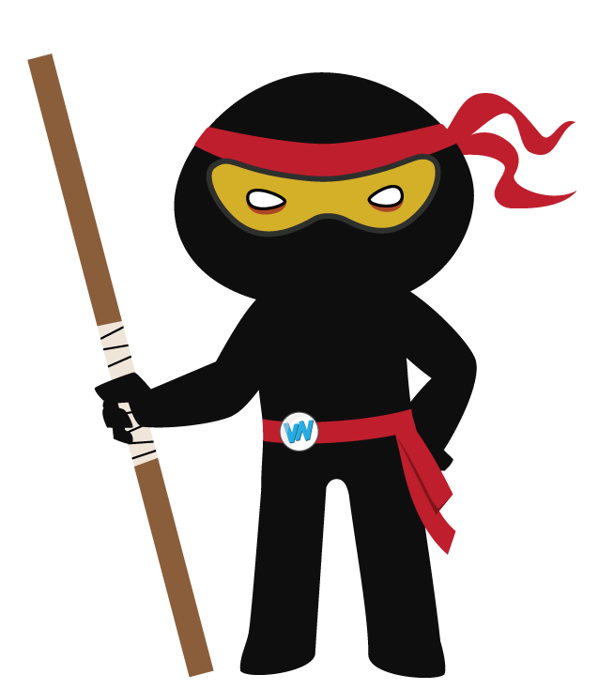
Vocabulary Visualiser
Draw the Grasshopper words and bring them to life.
Word: fasten | Word: lock
Word: untie | Word: expensive

Slide 17

Vocabulary Visualiser
Draw the Shinobi words and bring them to life.
Word: ideal | Word: design
Word: clench | Word: intricate

Slide 18
Matching Meanings
Draw lines from the Grasshopper words to their definitions.
Grasshopper Word
fasten
lock
untie
expensive
perfect
Grasshopper Definitions
When you *** something such as a door, drawer, or case, you fasten it, usually with a key, so that other people cannot open it.
If something is ***, it costs a lot of money.
Something that is *** is as good as it could possibly be.
When you *** something, you close it by means of buttons or a strap, or some other device. If something *** with buttons or straps, you can close it in this way.
If you *** something that is tied to another thing or if you *** two things that are tied together, you remove the string or rope that holds them or that has been tied round them.

Slide 19
Matching Meanings
Draw lines from the Shinobi words to their definitions.
Shinobi Word
design
ideal
forage
intricate
clench
Shinobi Definitions
The *** person or thing for a particular task or purpose is the best possible person or thing for it.
If someone *** for something, they search for it in a busy way.
When someone *** a garment, building, machine, or other object, they plan it and make a detailed drawing of it from which it can be built or made.
You use *** to describe something that has many small parts or details.
If you *** something in your hand or in your teeth, you hold it tightly with your hand or your teeth.

Slide 20

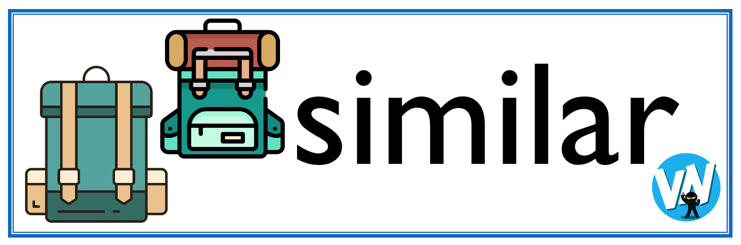




Display Slips
The following slides are for classroom display. As you teach each Word of the Day, words can be displayed in the classroom to enable pupils to use the taught vocabulary in an independent manner.

Slide 21
fasten
lock

Slide 22
untie
expensive

Slide 23
perfect
design

Slide 24
ideal
forage

Slide 25
intricate
clench

