Slide 1
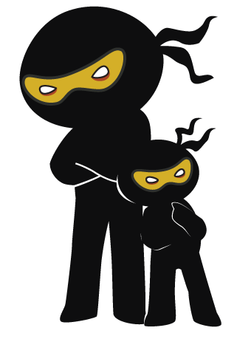



Word of the Day
Autumn Term 2021
Week 13 – 6th December 2021
'Words unlock the doors to a world of understanding...'

Slide 2

This Week's Words
Grasshopper
Shinobi
enemy
beckon
snack
sensation
sticky
strain
thick
expect
murky
thread

Slide 3
Grasshopper (Tier 1)
enemy
snack
sticky
thick
murky

Slide 4
Shinobi (Tier 2)
beckon
sensation
strain
expect
thread

Slide 5


Grasshopper Word of the Day
enemy
Word Class
Word of the Day:
(noun)
(en-e-my)
Pronunciation / Syllables
Definition:
If someone is your enemy, they hate you or want to harm you.
The red team were the enemy in the game.
Phrases: | sneaky enemy | dangerous enemy
Synonym: | Antonym: | Rhyme: | Link Word:
foe | friend |  | friend
rival | ally |  | game

Slide 6
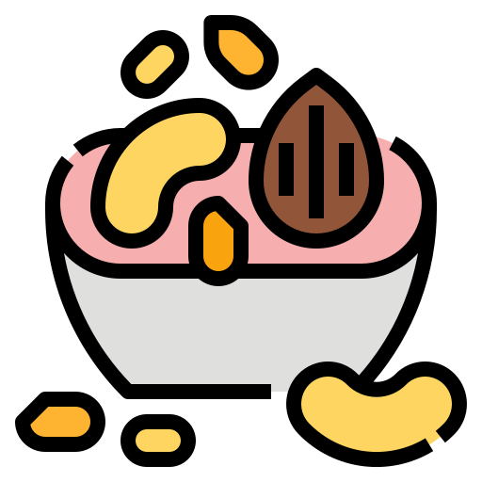
Grasshopper Word of the Day
snack
Word Class
Word of the Day:
(noun)
(snack)
Pronunciation / Syllables
Definition:
A snack is a simple meal that is quick to cook and to eat.
It was time for a snack, as everyone was hungry.
Phrases: | delicious snack | tasty snack
Synonym: | Antonym: | Rhyme: | Link Word:
nibble | meal | back | time
bite |  | lack | tasty

Slide 7

Grasshopper Word of the Day
sticky
Word Class
Word of the Day:
(adjective)
(stick-y)
Pronunciation / Syllables
Definition:
A sticky substance is soft, or thick and liquid, and can stick to other things. Sticky things are covered with a sticky substance.
The mud was sticky and left footprints everywhere.
Phrases: | gloopy and sticky | annoyingly sticky
Synonym: | Antonym: | Rhyme: | Link Word:
adhesive | dry | tricky | situation
gluey |  | picky | substance

Slide 8

Grasshopper Word of the Day
thick
Word Class
Word of the Day:
(adjective)
(thick)
Pronunciation / Syllables
Definition:
Something that is thick has a large distance between its two opposite sides.
The tree trunck was thick and strong.
Phrases: | large and thick | a thick piece of
Synonym: | Antonym: | Rhyme: | Link Word:
chunky | thin | quick | branch
bulky | light | lick | layer

Slide 9

Grasshopper Word of the Day
murky
Word Class
Word of the Day:
(adjective)
(murk-y)
Pronunciation / Syllables
Definition:
A murky place or time of day is dark and rather unpleasant because there is not enough light.
The sky was murky and it started to rain.
Phrases: | cold and murky | unusually murky
Synonym: | Antonym: | Rhyme: | Link Word:
dark | bright | quirky | sky
gloomy | sunny | turkey | water

Slide 10

Shinobi Word of the Day
beckon
Word Class
Word of the Day:
(verb)
(beck-on)
Pronunciation / Syllables
Definition:
If you beckon to someone, you signal to them to come to you.
The teacher beckoned the children into the hall.
Phrases: | beckon excitedly | slowly beckoned
Synonym: | Antonym: | Prefix / Suffix: | Rhyme: | Link Word:
signal |  | -ed | reckon | people
wave |  | -ing | second | friend

Slide 11

Shinobi Word of the Day
sensation
Word Class
Word of the Day:
(noun)
(sen-sa-tion)
Pronunciation / Syllables
Definition:
Sensation is your ability to feel things physically, especially through your sense of touch.
Eating the ice-cream too fast created a painful sensation.
Phrases: | new sensation | unusual sensation
Synonym: | Antonym: | Prefix / Suffix: | Rhyme: | Link Word:
feeling |  | -al | information | hot
sense |  | -ally | situation | cold

Slide 12

Shinobi Word of the Day
strain
Word Class
Word of the Day:
(verb / noun)
(strain)
Pronunciation / Syllables
Definition:
If you strain to do something, you make a great effort to do it when it is difficult to do.
Alex strained to hold his position in gymnastics.
Phrases: | under great strain | strain and injure
Synonym: | Antonym: | Prefix / Suffix: | Rhyme: | Link Word:
struggle |  | -ed | brain | muscle
toil |  | -ing | pain | energy

Slide 13

Shinobi Word of the Day
expect
Word Class
Word of the Day:
(adjective)
(ex-pect)
Pronunciation / Syllables
Definition:
If you expect something to happen, you believe that it will happen.
Igor expected to get full marks in the test.
Phrases: | expect to find | always expects
Synonym: | Antonym: | Prefix / Suffix: | Rhyme: | Link Word:
anticipate |  | -ation | effect | delivery
await |  | -antly | subject | result

Slide 14
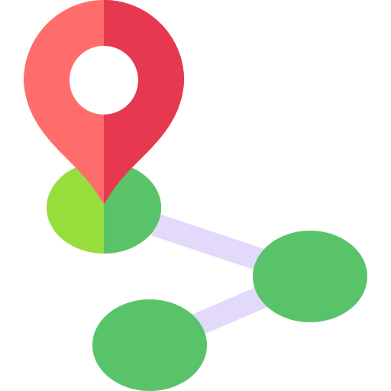
Shinobi Word of the Day
thread
Word Class
Word of the Day:
(verb / noun)
(thread)
Pronunciation / Syllables
Definition:
If you thread your way through a group of people or things, or thread through it, you move through it carefully or slowly, changing direction frequently as you move.
Mr Jones threaded his way through the children.
Phrases: | thread and weave | carefully thread
Synonym: | Antonym: | Prefix / Suffix | Rhyme: | Link Word:
file |  | -ing | bread | way
progress |  | -ed | dead | path

Slide 15
Vocabulary Laboratory
Describe / Definition:
Use it in a sentence:
Focus Word (write below):
Word Class:
Synonyms: (words with same / similar meaning) | Antonyms: (words with opposite meaning)
Rhymes: (words that sound the same) | Link Words: (Example: football = pitch, team, player)
Draw your sentence:

Slide 16

Vocabulary Visualiser
Draw the Grasshopper words and bring them to life.
Word: enemy | Word: snack
Word: thick | Word: murky

Slide 17
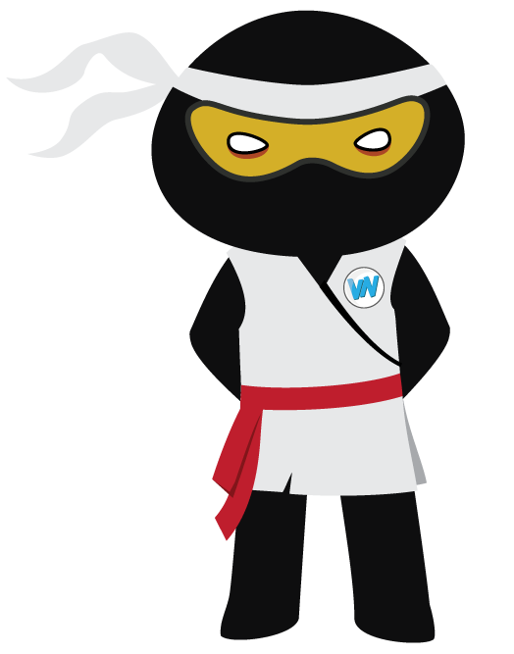
Vocabulary Visualiser
Draw the Shinobi words and bring them to life.
Word: beckon | Word: sensation
Word: strain | Word: expect

Slide 18
Matching Meanings
Draw lines from the Grasshopper words to their definitions.
Grasshopper Word
enemy
snack
sticky
thick
murky
Grasshopper Definitions
A *** substance is soft, or thick and liquid, and can *** to other things. *** things are covered with a *** substance.
If someone is your ***, they hate you or want to harm you.
A *** place or time of day is dark and rather unpleasant because there is not enough light.
A *** is a simple meal that is quick to cook and to eat.
Something that is *** has a large distance between its two opposite sides.

Slide 19
Matching Meanings
Draw lines from the Shinobi words to their definitions.
Shinobi Word
beckon
sensation
strain
expect
thread
Shinobi Definitions
*** is your ability to feel things physically, especially through your sense of touch.
If you *** something to happen, you believe that it will happen.
If you *** to someone, you signal to them to come to you.
If you *** your way through a group of people or things, or thread through it, you move through it carefully or slowly, changing direction frequently as you move.
If you *** to do something, you make a great effort to do it when it is difficult to do.

Slide 20






Display Slips
The following slides are for classroom display. As you teach each Word of the Day, words can be displayed in the classroom to enable pupils to use the taught vocabulary in an independent manner.

Slide 21
enemy
snack

Slide 22
sticky
thick

Slide 23
murky
beckon

Slide 24
sensation
strain

Slide 25
expect
thread

