Slide 1
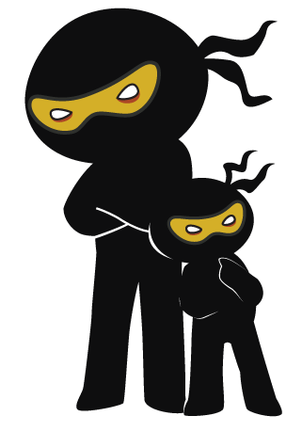



Word of the Day
Autumn Term 2021
Week 12 – 29th November 2021
'Words unlock the doors to a world of understanding...'

Slide 2

This Week's Words
Grasshopper
Shinobi
tough
charisma
rough
protect
weigh
stranded
catch
useless
train
compare

Slide 3
Grasshopper (Tier 1)
tough
rough
weigh
catch
train

Slide 4
Shinobi (Tier 2)
charisma
protect
stranded
useless
compare

Slide 5


Grasshopper Word of the Day
tough
Word Class
Word of the Day:
(adjective)
(tough)
Pronunciation / Syllables
Definition:
A tough task or problem is difficult to do or solve.
Today’s reading questions were very tough.
Phrases: | tough and difficult | tough to take
Synonym: | Antonym: | Rhyme: | Link Word:
hard | easy | enough | activity
difficult |  | rough | test

Slide 6

Grasshopper Word of the Day
rough
Word Class
Word of the Day:
(adjective)
(rough)
Pronunciation / Syllables
Definition:
If a surface is rough, it is uneven and not smooth.
The animal’s fur was very rough.
Phrases: | rough and uncomfortable | rough and ready
Synonym: | Antonym: | Rhyme: | Link Word:
hoarse | soft | stuff | material
harsh |  | bluff | feeling

Slide 7

Grasshopper Word of the Day
weigh
Word Class
Word of the Day:
(verb / noun)
(weigh)
Pronunciation / Syllables
Definition:
If someone or something weighs a particular amount, this amount is how heavy they are.
Bilal weighed the different ingredients on a scale.
Phrases: | weigh and measure | weight the ingredients
Synonym: | Antonym: | Rhyme: | Link Word:
measure |  | they | food
 |  | away | people

Slide 8

Grasshopper Word of the Day
catch
Word Class
Word of the Day:
(verb)
(catch)
Pronunciation / Syllables
Definition:
If you catch a person or animal, you capture them after chasing them, or by using a trap, net, or other device.
Ralph was trying to catch Firma on the playground.
Phrases: | quickly catch | catch up
Synonym: | Antonym: | Rhyme: | Link Word:
capture | release | match | games
seize |  | patch | animal

Slide 9

Grasshopper Word of the Day
train
Word Class
Word of the Day:
(verb)
(train)
Pronunciation / Syllables
Definition:
If someone trains you to do something, they teach you the skills that you need in order to do it. If you train to do something, you learn the skills that you need in order to do it.
The girls were training for the football tournament.
Phrases: | trained hard | needed to train
Synonym: | Antonym: | Rhyme: | Link Word:
exercise |  | again | sports
upskill |  | pain | skill

Slide 10

Shinobi Word of the Day
charisma
Word Class
Word of the Day:
(noun / adjective)
(cha-ris-ma)
Pronunciation / Syllables
Definition:
You say that someone has charisma when they can attract, influence, and inspire people by their personal qualities.
Darren was full of charisma and was a great nativity actor.
Phrases: | brilliant and charismatic | full of charisma
Synonym: | Antonym: | Prefix / Suffix: | Rhyme: | Link Word:
charm |  | -tic |  | people
personality |  |  |  | quality

Slide 11

Shinobi Word of the Day
protect
Word Class
Word of the Day:
(verb)
(pro-tect)
Pronunciation / Syllables
Definition:
To protect someone or something means to prevent them from being harmed or damaged.
They recycled to protect the planet.
Phrases: | protect completely | protect from danger
Synonym: | Antonym: | Prefix / Suffix: | Rhyme: | Link Word:
guard | attack | -tion | effect | danger
defend | harm | -ed | direct | evil

Slide 12

Shinobi Word of the Day
stranded
Word Class
Word of the Day:
(adjective)
(strand-ed)
Pronunciation / Syllables
Definition:
Being stranded means to be left without the means to move from somewhere.
Ruby was stranded on the island.
Phrases: | stranded and alone | completely stranded
Synonym: | Antonym: | Prefix / Suffix: | Rhyme: | Link Word:
stuck |  |  | handed | island
helpless |  |  | expanded | alone

Slide 13
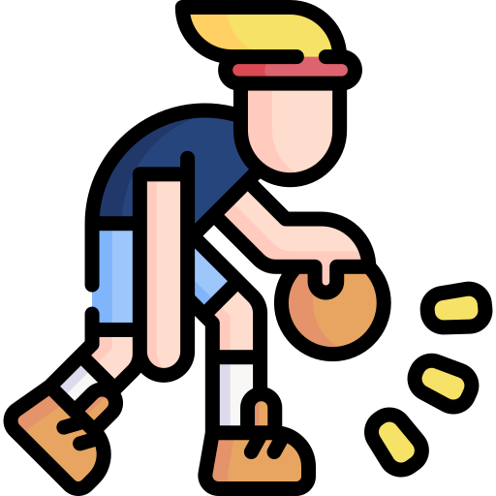
Shinobi Word of the Day
useless
Word Class
Word of the Day:
(adjective)
(use-less)
Pronunciation / Syllables
Definition:
If something is useless, you cannot use it. If someone feels useless, they feel bad because they are unable to help someone or achieve anything.
Dan felt like he was useless at basketball.
Phrases: | totally useless | felt useless when
Synonym: | Antonym: | Prefix / Suffix: | Rhyme: | Link Word:
worthless | effective | -ness | juiceless | sports
inept | competent | -ly |  | maths

Slide 14

Shinobi Word of the Day
compare
Word Class
Word of the Day:
(verb)
(com-pare)
Pronunciation / Syllables
Definition:
When you compare things, you consider them and discover the differences or similarities between them.
The children compared materials in science.
Phrases: | compare closely | compare every detail
Synonym: | Antonym: | Prefix / Suffix | Rhyme: | Link Word:
contrast |  | -ing | share | clothes
liken |  | -ed | square | people

Slide 15
Vocabulary Laboratory
Describe / Definition:
Use it in a sentence:
Focus Word (write below):
Word Class:
Synonyms: (words with same / similar meaning) | Antonyms: (words with opposite meaning)
Rhymes: (words that sound the same) | Link Words: (Example: football = pitch, team, player)
Draw your sentence:

Slide 16

Vocabulary Visualiser
Draw the Grasshopper words and bring them to life.
Word: rough | Word: tough
Word: weigh | Word: catch

Slide 17
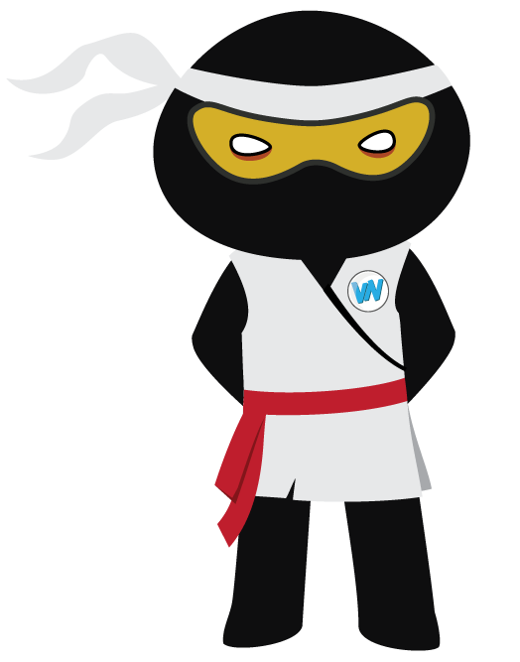
Vocabulary Visualiser
Draw the Shinobi words and bring them to life.
Word: protest | Word: stranded
Word: useless | Word: compare

Slide 18
Matching Meanings
Draw lines from the Grasshopper words to their definitions.
Grasshopper Word
tough
rough
weigh
catch
train
Grasshopper Definitions
If someone or something *** a particular amount, this amount is how heavy they are.
If you *** a person or animal, you capture them after chasing them, or by using a trap, net, or other device.
If a surface is ***, it is uneven and not smooth.
A *** task or problem is difficult to do or solve.
If someone *** you to do something, they teach you the skills that you need in order to do it. If you *** to do something, you learn the skills that you need in order to do it.

Slide 19
Matching Meanings
Draw lines from the Shinobi words to their definitions.
Shinobi Word
charisma
protect
stranded
useless
compare
Shinobi Definitions
Being *** means to be left without the means to move from somewhere.
To *** someone or something means to prevent them from being harmed or damaged.
When you *** things, you consider them and discover the differences or similarities between them.
If you *** something, you take hold of it quickly, firmly, and forcefully.
If something is ***, you cannot use it. If someone feels ***, they feel bad because they are unable to help someone or achieve anything.

Slide 20






Display Slips
The following slides are for classroom display. As you teach each Word of the Day, words can be displayed in the classroom to enable pupils to use the taught vocabulary in an independent manner.

Slide 21
tough
rough

Slide 22
weigh
catch

Slide 23
train
charisma

Slide 24
protect
stranded

Slide 25
useless
compare

