Slide 1
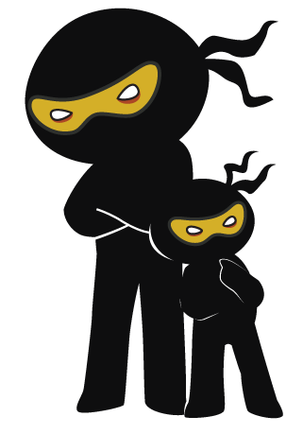



Word of the Day
Autumn Term 2021
Week 7 – 18th October 2021
'Words unlock the doors to a world of understanding...'

Slide 2

This Week's Words
Grasshopper
Shinobi
shrink
animosity
kneel
imply
flutter
jeopardise
costume
succumb
plan
wince

Slide 3
Grasshopper (Tier 1)
shrink
kneel
flutter
costume
plan

Slide 4
Shinobi (Tier 2)
animosity
imply
jeopardise
succumb
wince

Slide 5


Grasshopper Word of the Day
shrink
Word Class
Word of the Day:
(verb)
(shrink)
Pronunciation / Syllables
Definition:
If something shrinks or something else shrinks it, it becomes smaller.
Andrew shrank the image on the computer.
Phrases: | shrink and reduce | shrink down
Synonym: | Antonym: | Rhyme: | Link Word:
reduce | expand | think | clothes
 |  | ink | person

Slide 6
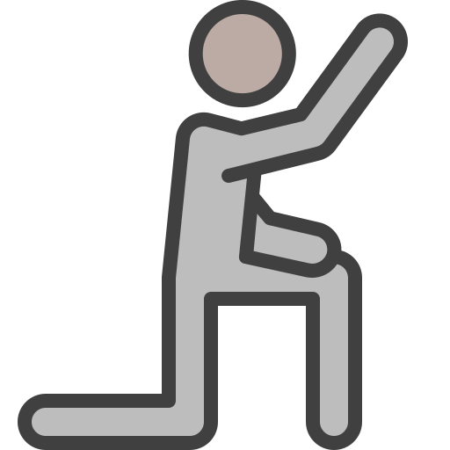
Grasshopper Word of the Day
kneel
Word Class
Word of the Day:
(verb)
(kneel)
Pronunciation / Syllables
Definition:
When you kneel, you bend your legs so that your knees are touching the ground.
The knight knelt before the queen
Phrases: | kneel and bow | take the knee
Synonym: | Antonym: | Rhyme: | Link Word:
bow |  | feel | royal
curtsy |  | peel | pray

Slide 7

Grasshopper Word of the Day
flutter
Word Class
Word of the Day:
(verb)
(flut-ter)
Pronunciation / Syllables
Definition:
If something thin or light flutters, or if you flutter it, it moves up and down or from side to side with a lot of quick, light movements.
The purple flag fluttered in the wind.
Phrases: | peacefully flutter | flutter softly
Synonym: | Antonym: | Rhyme: | Link Word:
flicker |  | mutter | wind
ripple |  | butter | fall

Slide 8

Grasshopper Word of the Day
costume
Word Class
Word of the Day:
(noun)
(cos-tume)
Pronunciation / Syllables
Definition:
An actor's or performer's costume is the set of clothes they wear while they are performing.
Jenny had a new costume for Halloween.
Phrases: | old costume | smelly costume
Synonym: | Antonym: | Rhyme: | Link Word:
outfit |  | bloom | party
uniform |  | room | fun

Slide 9

Grasshopper Word of the Day
plan
Word Class
Word of the Day:
(verb / noun)
(plan)
Pronunciation / Syllables
Definition:
A plan is a method of achieving something that you have worked out in detail beforehand.
The children planned their way to the park.
Phrases: | clever plan | cunning plan
Synonym: | Antonym: | Rhyme: | Link Word:
idea |  | man | route
scheme |  | van | event

Slide 10

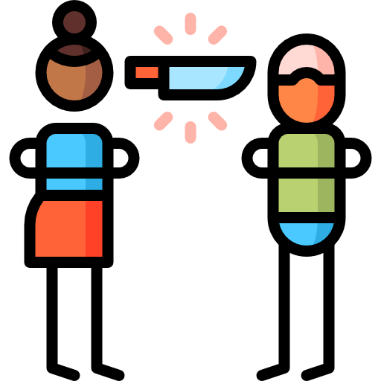
Shinobi Word of the Day
animosity
Word Class
Word of the Day:
(noun)
(an-i-mos-i-ty)
Pronunciation / Syllables
Definition:
Animosity is a strong feeling of dislike and anger. Animosities are feelings of this kind.
The animosity between Jenny and Freya was obvious.
Phrases: | genuine animosity | unknown animosity
Synonym: | Antonym: | Prefix / Suffix: | Rhyme: | Link Word:
hostility | goodwill |  | velocity | enemy
friction | friendship |  | curiosity | grudge

Slide 11
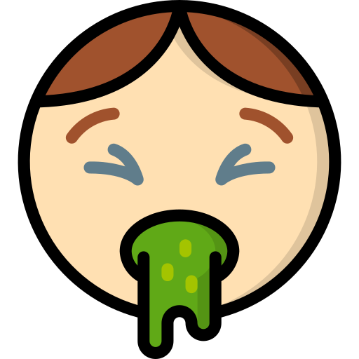
Shinobi Word of the Day
imply
Word Class
Word of the Day:
(verb)
(im-ply)
Pronunciation / Syllables
Definition:
If you imply that something is the case, you say something which indicates that it is the case in an indirect way.
His actions implied his dislike for the cake.
Phrases: | rudely implied | honestly imply
Synonym: | Antonym: | Prefix / Suffix: | Rhyme: | Link Word:
suggest | direct | -ied | high | sense
hint |  | -ication | why | show

Slide 12
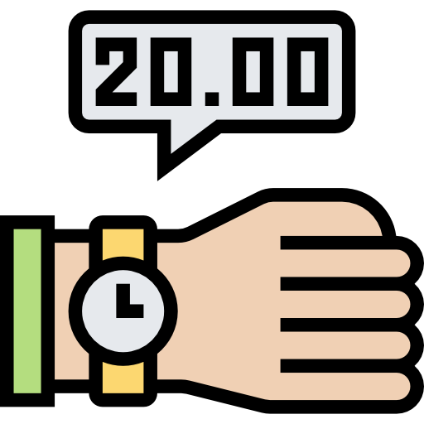
Shinobi Word of the Day
jeopardise
Word Class
Word of the Day:
(verb)
(jeop-ard-ise)
Pronunciation / Syllables
Definition:
To jeopardise a situation or activity means to do something that may destroy it or cause it to fail.
Being late had jeopardised their chance to get in.
Phrases: | unintentionally jeopardise | wanted to jeopardise
Synonym: | Antonym: | Prefix / Suffix: | Rhyme: | Link Word:
threaten | safeguard | -ed |  | fail
endanger |  | -ing |  | risk

Slide 13

Shinobi Word of the Day
succumb
Word Class
Word of the Day:
(verb)
(suc-cumb)
Pronunciation / Syllables
Definition:
If you succumb to temptation or pressure, you do something that you want to do, or that other people want you to do, although you feel it might be wrong.
Mrs Jones succumbed to the children's book request.
Phrases: | slowly succumbed | had succumbed to
Synonym: | Antonym: | Prefix / Suffix: | Rhyme: | Link Word:
give in | resist | -ed | thumb | pressure
surrender |  | -ing | become | requests

Slide 14

Shinobi Word of the Day
wince
Word Class
Word of the Day:
(verb / noun)
(wince)
Pronunciation / Syllables
Definition:
If you wince, the muscles of your face tighten suddenly because you have felt a pain or because you have just seen, heard, or remembered something unpleasant.
Alfie winced as Jeremy tripped on the playground.
Phrases: | winced in pain | suddenly winced
Synonym: | Antonym: | Prefix / Suffix | Rhyme: | Link Word:
grimace |  | -ed | since | pain
cringe |  | -ing | rinse | ouch

Slide 15
Vocabulary Laboratory
Describe / Definition:
Use it in a sentence:
Focus Word (write below):
Word Class:
Synonyms: (words with same / similar meaning) | Antonyms: (words with opposite meaning)
Rhymes: (words that sound the same) | Link Words: (Example: football = pitch, team, player)
Draw your sentence:

Slide 16
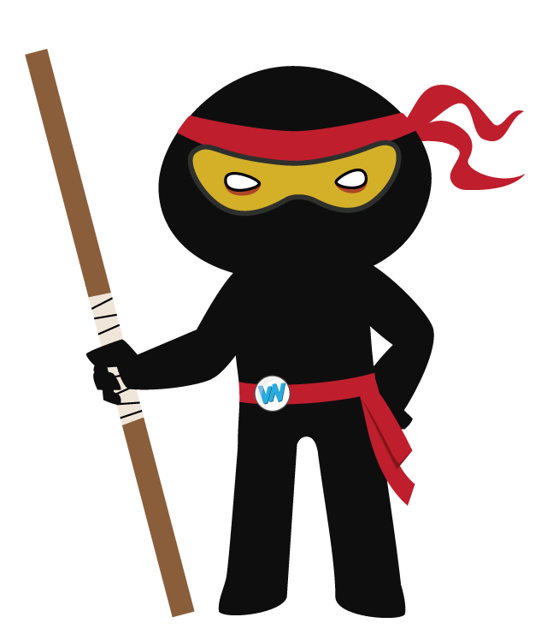
Vocabulary Visualiser
Draw the Grasshopper words and bring them to life.
Word: shrink | Word: flutter
Word: plan | Word: kneel

Slide 17
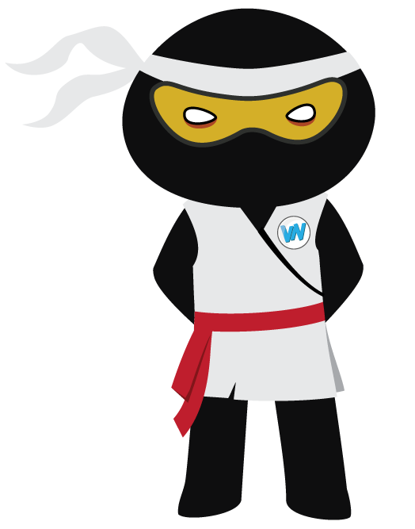
Vocabulary Visualiser
Draw the Shinobi words and bring them to life.
Word: animosity | Word: imply
Word: wince | Word: jeopardise

Slide 18
Matching Meanings
Draw lines from the Grasshopper words to their definitions.
Grasshopper Word
shrink
kneel
flutter
costume
plan
Grasshopper Definitions
When you ***, you bend your legs so that your knees are touching the ground.
An actor's or performer’s *** is the set of clothes they wear while they are performing.
A *** is a method of achieving something that you have worked out in detail beforehand.
If something *** or something else *** it, it becomes smaller.
If something thin or light ***, or if you *** it, it moves up and down or from side to side with a lot of quick, light movements.

Slide 19
Matching Meanings
Draw lines from the Shinobi words to their definitions.
Shinobi Word
animosity
imply
jeopardise
succumb
wince
Shinobi Definitions
If you *** that something is the case, you say something which indicates that it is the case in an indirect way.
If you ***, the muscles of your face tighten suddenly because you have felt a pain or because you have just seen, heard, or remembered something unpleasant.
*** is a strong feeling of dislike and anger. *** are feelings of this kind.
If you *** to temptation or pressure, you do something that you want to do, or that other people want you to do, although you feel it might be wrong.
To *** a situation or activity means to do something that may destroy it or cause it to fail.

Slide 20
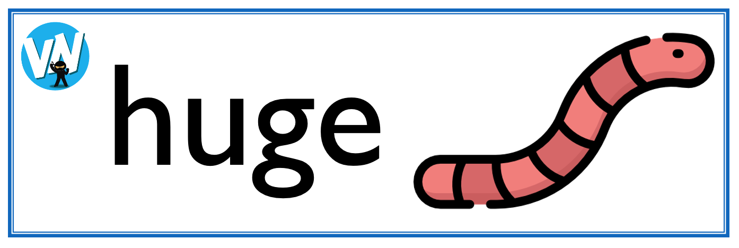
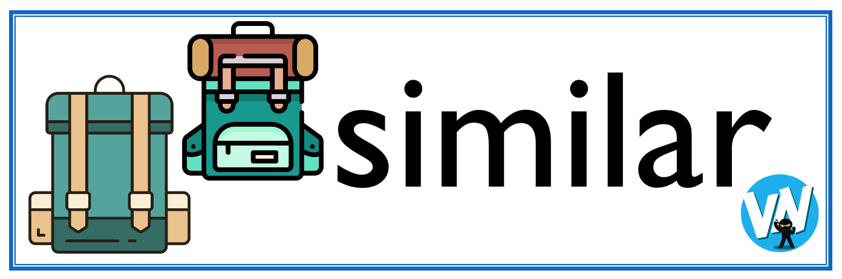



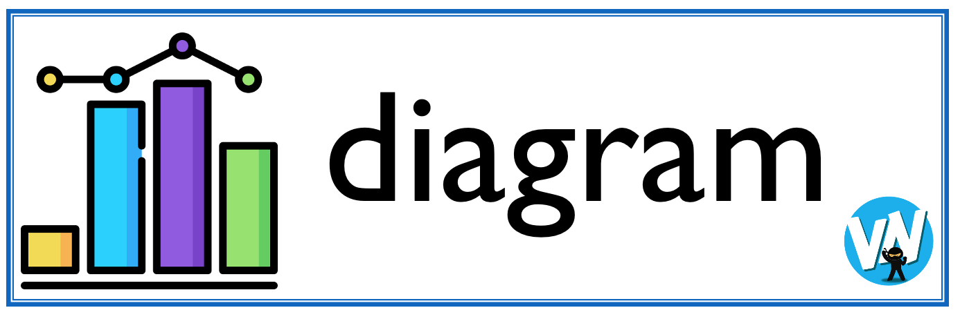
Display Slips
The following slides are for classroom display. As you teach each Word of the Day, words can be displayed in the classroom to enable pupils to use the taught vocabulary in an independent manner.

Slide 21
shrink
kneel

Slide 22
flutter
costume

Slide 23
plan
animosity

Slide 24
imply
jeopardise

Slide 25
succumb
wince

