Slide 1




Word of the Day
Autumn Term 2021
Week 1 – 6th September 2021
'Words unlock the doors to a world of understanding...'

Slide 2

This Week's Words
Grasshopper
Shinobi
cycle
hilarious
flip
elusive
pour
falter
stack
devastate
freeze
influence

Slide 3
Grasshopper (Tier 1)
cycle
flip
pour
stack
freeze

Slide 4
Shinobi (Tier 2)
hilarious
elusive
falter
devastate
influence

Slide 5


Grasshopper Word of the Day
cycle
Word Class
Word of the Day:
(verb)
(cy-cle)
Pronunciation / Syllables
Definition:
If you cycle, you ride a bicycle.
Mr Henson began to cycle to school.
Phrases: | cycled along the | cycled quickly to
Synonym: | Antonym: | Rhyme: | Link Word:
ride |  | recycle | race
 |  |  | travel

Slide 6

Grasshopper Word of the Day
flip
Word Class
Word of the Day:
(verb)
(flip)
Pronunciation / Syllables
Definition:
If you flip something, especially a coin, you use your thumb to make it turn over and over, as it goes through the air.
JP flipped the page of the book.
Phrases: | flipped over | softly flipped
Synonym: | Antonym: | Rhyme: | Link Word:
turn |  | ship | coin
flick |  | trip | over

Slide 7

Grasshopper Word of the Day
pour
Word Class
Word of the Day:
(verb)
(pour)
Pronunciation / Syllables
Definition:
If you pour a liquid or other substance, you make it flow steadily out of a container by holding the container at an angle.
Jenny poured the juice into the bowl.
Phrases: | poured messily | poured with care
Synonym: | Antonym: | Rhyme: | Link Word:
drizzle |  | floor | bake
empty |  | four | fill

Slide 8

Grasshopper Word of the Day
stack
Word Class
Word of the Day:
(verb / noun)
(stack)
Pronunciation / Syllables
Definition:
If you stack a number of things, you arrange them in neat piles.
Stacking blocks was Alfie’s favourite activity.
Phrases: | carefully stacked | a huge stack of
Synonym: | Antonym: | Rhyme: | Link Word:
assemble |  | black | create
pile |  | track | destroy

Slide 9
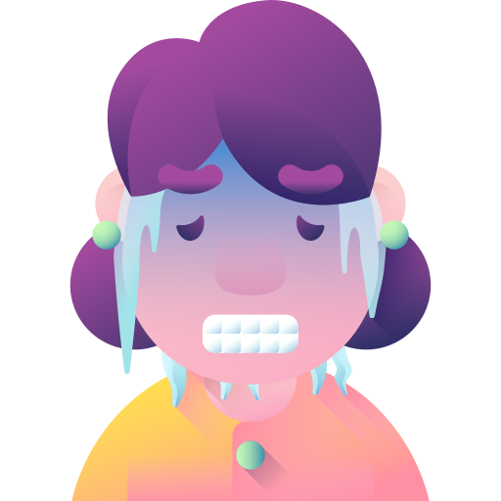
Grasshopper Word of the Day
freeze
Word Class
Word of the Day:
(verb / adjective)
(freeze)
Pronunciation / Syllables
Definition:
If a liquid or a substance containing a liquid freezes, or if something freezes it, it becomes solid because of low temperatures.
The children were freezing in the classroom.
Phrases: | began to freeze | was beginning to freeze
Synonym: | Antonym: | Rhyme: | Link Word:
ice over | thaw | these | cold
 | melt | breeze | room

Slide 10

Shinobi Word of the Day
hilarious
Word Class
Word of the Day:
(adjective)
(hi-lar-i-ous)
Pronunciation / Syllables
Definition:
If something is hilarious, it is extremely funny and makes you laugh a lot.
Jamal’s new joke was hilarious.
Phrases: | was rather hilarious | hilarious and cool
Synonym: | Antonym: | Prefix / Suffix: | Rhyme: | Link Word:
hysterical | sad | -ly | various | joke
side-splitting |  |  |  | person

Slide 11

Shinobi Word of the Day
elusive
Word Class
Word of the Day:
(adjective)
(e-lu-sive)
Pronunciation / Syllables
Definition:
Something or someone that is elusive is difficult to find, describe, remember, or achieve.
Mrs Hepson’s PE whistle had become rather elusive.
Phrases: | he could remember the elusive | the forgotten and hard to find
Synonym: | Antonym: | Prefix / Suffix: | Rhyme: | Link Word:
evasive |  | -ness | exclusive | person
slippery |  | -ly | abusive | character

Slide 12

Shinobi Word of the Day
falter
Word Class
Word of the Day:
(verb)
(fal-ter)
Pronunciation / Syllables
Definition:
If something falters, it loses power or strength in an uneven way, or no longer makes much progress.
Rami faltered as he walked across the school hall.
Phrases: | faltered as they | he tried not to falter as
Synonym: | Antonym: | Prefix / Suffix: | Rhyme: | Link Word:
stutter |  | -ed | alter | trip
hesitate |  | un- | altar | mistake

Slide 13

Shinobi Word of the Day
devastate
Word Class
Word of the Day:
(verb)
(dev-as-tate)
Pronunciation / Syllables
Definition:
If you are devastated by something, you are very shocked and upset by it.
Music being cancelled devastated the children.
Phrases: | was devastated when | was devastated because
Synonym: | Antonym: | Prefix / Suffix: | Rhyme: | Link Word:
destroy |  | -ed |  | stop
ruin |  | -ing |  | sadness

Slide 14

Shinobi Word of the Day
influence
Word Class
Word of the Day:
(verb)
(in-flu-ence)
Pronunciation / Syllables
Definition:
If you influence someone, you use your power to make them agree with you or do what you want.
Jeremy had a positive influence over his friends.
Phrases: | a positive influence | a negative influence
Synonym: | Antonym: | Prefix / Suffix | Rhyme: | Link Word:
effect |  | -ing |  | good
impact |  | -ed |  | bad

Slide 15
Vocabulary Laboratory
Describe / Definition:
Use it in a sentence:
Focus Word (write below):
Word Class:
Synonyms: (words with same / similar meaning) | Antonyms: (words with opposite meaning)
Rhymes: (words that sound the same) | Link Words: (Example: football = pitch, team, player)
Draw your sentence:

Slide 16

Vocabulary Visualiser
Draw the Grasshopper words and bring them to life.
Word: cycle | Word: flip
Word: pour | Word: stack

Slide 17

Vocabulary Visualiser
Draw the Shinobi words and bring them to life.
Word: hilarious | Word: elusive
Word: devastate | Word: falter

Slide 18
Matching Meanings
Draw lines from the Grasshopper words to their definitions.
Grasshopper Word
cycle
flip
pour
stack
freeze
Grasshopper Definitions
If you *** something, especially a coin, you use your thumb to make it turn over and over, as it goes through the air.
If you ***, you ride a bicycle.
If you *** a number of things, you arrange them in neat piles.
If a liquid or a substance containing a liquid ***, or if something *** it, it becomes solid because of low temperatures.
If you *** a liquid or other substance, you make it flow steadily out of a container by holding the container at an angle.

Slide 19
Matching Meanings
Draw lines from the Shinobi words to their definitions.
Shinobi Word
hilarious
elusive
falter
devastate
influence
Shinobi Definitions
If you are *** by something, you are very shocked and upset by it.
If you *** someone, you use your power to make them agree with you or do what you want.
Something or someone that is *** is difficult to find, describe, remember, or achieve.
If something is ***, it is extremely funny and makes you laugh a lot.
If something ***, it loses power or strength in an uneven way, or no longer makes much progress.

Slide 20






Display Slips
The following slides are for classroom display. As you teach each Word of the Day, words can be displayed in the classroom to enable pupils to use the taught vocabulary in an independent manner.

Slide 21
cycle
flip

Slide 22
pour
stack

Slide 23
freeze
hilarious

Slide 24
elusive
falter

Slide 25
devastated
influence

