Slide 1
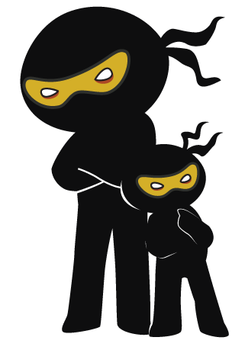



Word of the Day
Autumn Term 2021
Week 3 – 20th September 2021
'Words unlock the doors to a world of understanding...'

Slide 2

This Week's Words
Grasshopper
Shinobi
noise
obvious
face
pale
scream
sensational
twist
delicate
excuse
grim

Slide 3
Grasshopper (Tier 1)
noise
face
scream
twist
excuse

Slide 4
Shinobi (Tier 2)
obvious
pale
sensational
delicate
grim

Slide 5


Grasshopper Word of the Day
noise
Word Class
Word of the Day:
(noun)
(noise)
Pronunciation / Syllables
Definition:
Noise is a loud or unpleasant sound.
There was a loud noise coming from the school hall.
Phrases: | unusual noise | noisy room
Synonym: | Antonym: | Rhyme: | Link Word:
hubbub | silence | boys | music
din |  | toys | pollution

Slide 6

Grasshopper Word of the Day
face
Word Class
Word of the Day:
(verb / noun)
(face)
Pronunciation / Syllables
Definition:
If you face someone or something, you turn so that you are looking at them.
Mr Jones turned and faced the children.
Phrases: | quickly faced | face-to-face with
Synonym: | Antonym: | Rhyme: | Link Word:
 |  | case | ignore
 |  | space | listen

Slide 7

Grasshopper Word of the Day
scream
Word Class
Word of the Day:
(verb / noun)
(scream)
Pronunciation / Syllables
Definition:
When someone screams, they make a very loud, high-pitched cry, for example because they are in pain or are very frightened.
Children were running and screaming on the playground.
Phrases: | a shrill scream | screamed loudly
Synonym: | Antonym: | Rhyme: | Link Word:
shriek | whisper | team | scared
screech |  | dream | excited

Slide 8

Grasshopper Word of the Day
twist
Word Class
Word of the Day:
(verb)
(twist)
Pronunciation / Syllables
Definition:
If you twist something, you turn it to make a spiral shape, for example by turning the two ends of it in opposite directions.
The children pulled and twisted different materials.
Phrases: | twisted and twisted | gently twisted the
Synonym: | Antonym: | Rhyme: | Link Word:
crumple | straighten | list | material
mangle |  | resist | body

Slide 9

Grasshopper Word of the Day
excuse
Word Class
Word of the Day:
(noun)
(ex-cuse)
Pronunciation / Syllables
Definition:
An excuse is a reason which you give in order to explain why something has been done or has not been done, or in order to avoid doing something.
The was no excuse for talking over the teacher.
Phrases: | gave an excuse for | a poor excuse
Synonym: | Antonym: | Rhyme: | Link Word:
reason |  | reduce | lies
plea |  | loose | truth

Slide 10

Shinobi Word of the Day
obvious
Word Class
Word of the Day:
(adjective)
(ob-vi-ous)
Pronunciation / Syllables
Definition:
If something is obvious, it is easy to see or understand.
The answer was obvious to everyone but Richard.
Phrases: | very obvious | so obvious
Synonym: | Antonym: | Prefix / Suffix: | Rhyme: | Link Word:
clear | obscure | non- |  | answer
apparent |  | -ly |  | idea

Slide 11
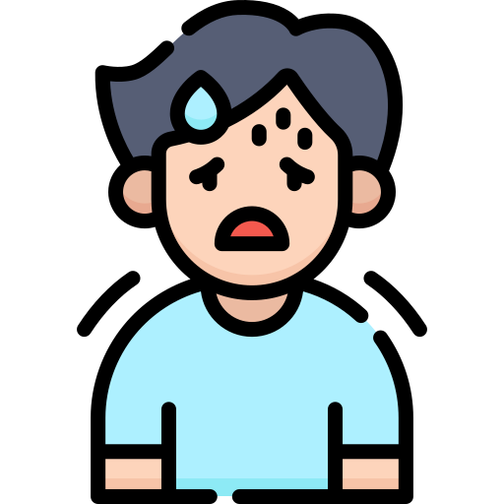
Shinobi Word of the Day
pale
Word Class
Word of the Day:
(adjective)
(pale)
Pronunciation / Syllables
Definition:
If something is pale, it is very light in colour or almost white.
Alex’s face turned pale when he saw what was for lunch.
Phrases: | pale and unwell | became pale
Synonym: | Antonym: | Prefix / Suffix: | Rhyme: | Link Word:
pasty | flushed | -r | scale | colour
grey | rosy | -ness | detail | person

Slide 12
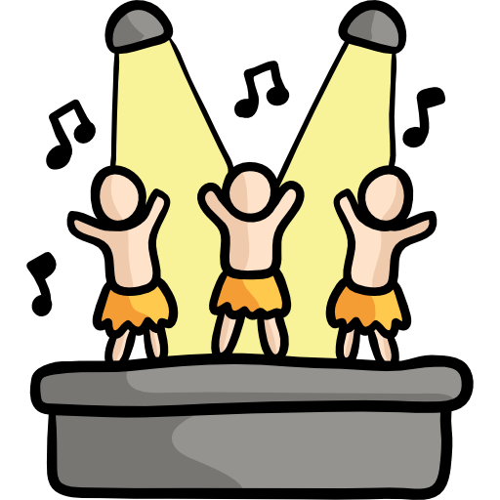
Shinobi Word of the Day
sensational
Word Class
Word of the Day:
(adjective)
(sen-sa-tion-al)
Pronunciation / Syllables
Definition:
A sensational result, event, or situation is so remarkable that it causes great excitement and interest.
The class assembly was sensational!
Phrases: | truly sensational | completely sensational
Synonym: | Antonym: | Prefix / Suffix: | Rhyme: | Link Word:
amazing |  | -ly | educational | performance
astonishing |  | un- | inspirational | feeling

Slide 13

Shinobi Word of the Day
delicate
Word Class
Word of the Day:
(adjective)
(del-i-cate)
Pronunciation / Syllables
Definition:
If something is delicate, it is easy to harm, damage, or break, and needs to be handled or treated carefully.
They took turns at holding the delicate Roman vase.
Phrases: | delicate and breakable | expensive and delicate
Synonym: | Antonym: | Prefix / Suffix: | Rhyme: | Link Word:
fragile | strong | -ness |  | item
breakable | durable | -ly |  | feeling

Slide 14

Shinobi Word of the Day
grim
Word Class
Word of the Day:
(adjective)
(grim)
Pronunciation / Syllables
Definition:
A situation or piece of information that is grim is unpleasant, depressing, and difficult to accept.
The weather outside was looking particularly grim.
Phrases: | a grim look | looked grimly at
Synonym: | Antonym: | Prefix / Suffix | Rhyme: | Link Word:
bleak | pleasant | -ly | swim | decision
dark |  | -ace | limb | outcome

Slide 15
Vocabulary Laboratory
Describe / Definition:
Use it in a sentence:
Focus Word (write below):
Word Class:
Synonyms: (words with same / similar meaning) | Antonyms: (words with opposite meaning)
Rhymes: (words that sound the same) | Link Words: (Example: football = pitch, team, player)
Draw your sentence:

Slide 16

Vocabulary Visualiser
Draw the Grasshopper words and bring them to life.
Word: noise | Word: scream
Word: twist | Word: excuse

Slide 17

Vocabulary Visualiser
Draw the Shinobi words and bring them to life.
Word: pale | Word: sensational
Word: delicate | Word: grim

Slide 18
Matching Meanings
Draw lines from the Grasshopper words to their definitions.
Grasshopper Word
noise
face
scream
twist
excuse
Grasshopper Definitions
When someone ***, they make a very loud, high-pitched cry, for example because they are in pain or are very frightened.
*** is a loud or unpleasant sound.
An *** is a reason which you give in order to explain why something has been done or has not been done, or in order to avoid doing something.
If you *** something, you turn it to make a spiral shape, for example by turning the two ends of it in opposite directions.
If you *** someone or something, you turn so that you are looking at them.

Slide 19
Matching Meanings
Draw lines from the Shinobi words to their definitions.
Shinobi Word
obvious
pale
sensational
delicate
grim
Shinobi Definitions
If something is ***, it is very light in colour or almost white.
A *** result, event, or situation is so remarkable that it causes great excitement and interest.
If something is ***, it is easy to see or understand.
A situation or piece of information that is *** is unpleasant, depressing, and difficult to accept.
If something is ***, it is easy to harm, damage, or break, and needs to be handled or treated carefully.

Slide 20






Display Slips
The following slides are for classroom display. As you teach each Word of the Day, words can be displayed in the classroom to enable pupils to use the taught vocabulary in an independent manner.

Slide 21
noise
face

Slide 22
scream
twist

Slide 23
excuse
obvious

Slide 24
pale
sensational

Slide 25
delicate
grim

