Slide 1
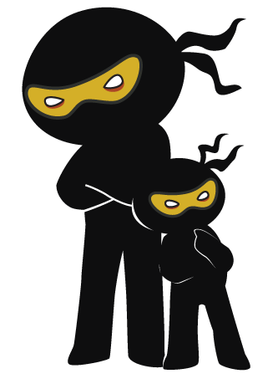



Word of the Day
Summer Term 2021
Week 36 – 14th June 2021
'Words unlock the doors to a world of understanding...'

Slide 2

This Week's Words
Grasshopper
Shinobi
thirsty
diverse
ground
fabricate
nickname
debacle
ambulance
cajole
weekend
impartial

Slide 3
Grasshopper (Tier 1)
thirsty
ground
nickname
ambulance
weekend

Slide 4
Shinobi (Tier 2)
diverse
fabricate
debacle
cajole
impartial

Slide 5

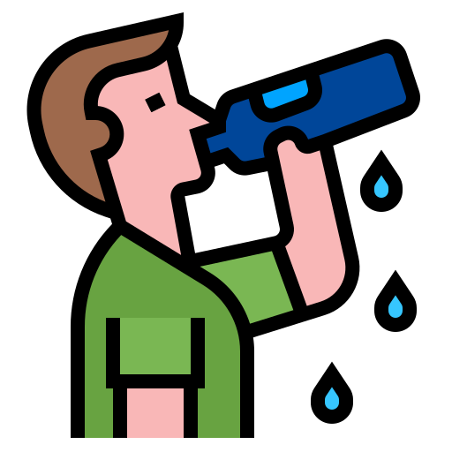
Grasshopper Word of the Day
thirsty
Word Class
Word of the Day:
(noun)
(thirst-y)
Pronunciation / Syllables
Definition:
If you are thirsty, you feel a need to drink something.
John was thirsty after the PE lesson.
Phrases: | thirsty work | extremely thirsty
Synonym: | Antonym: | Rhyme: | Link Word:
parched |  |  | hunger
gasping |  |  | exercise

Slide 6

Grasshopper Word of the Day
ground
Word Class
Word of the Day:
(noun / verb)
(ground)
Pronunciation / Syllables
Definition:
The ground is the soil and rock on the earth's surface.
Fred dug a hole in the ground with a spade.
Phrases: | soft ground | hard ground
Synonym: | Antonym: | Rhyme: | Link Word:
earth |  | found | mud
land |  | around | grass

Slide 7

Grasshopper Word of the Day
nickname
Word Class
Word of the Day:
(noun)
(nick-name)
Pronunciation / Syllables
Definition:
A nickname is an informal name for someone or something.
Alvaro’s nickname was on his tags.
Phrases: | a cool nickname | nice nickname
Synonym: | Antonym: | Rhyme: | Link Word:
tag |  |  | short
label |  |  | friends

Slide 8

Grasshopper Word of the Day
ambulance
Word Class
Word of the Day:
(noun)
(am-bu-lance)
Pronunciation / Syllables
Definition:
An ambulance is a vehicle for taking people to and from hospital.
The ambulance sounded the siren.
Phrases: | speeding ambulance | white and red ambulance
Synonym: | Antonym: | Rhyme: | Link Word:
 |  |  | paramedic
 |  |  | hospital

Slide 9
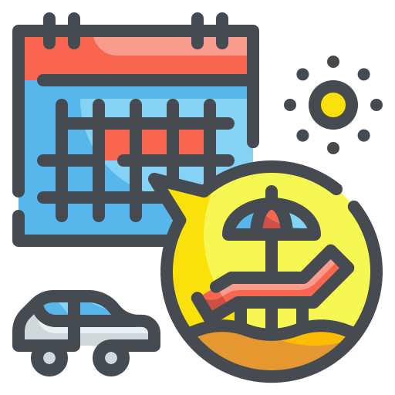
Grasshopper Word of the Day
weekend
Word Class
Word of the Day:
(noun)
(week-end)
Pronunciation / Syllables
Definition:
A weekend is Saturday and Sunday.
The family were visiting the beach at the weekend.
Phrases: | relaxing weekend | weekend away
Synonym: | Antonym: | Rhyme: | Link Word:
 |  |  | week
 |  |  | fortnight

Slide 10

Shinobi Word of the Day
diverse
Word Class
Word of the Day:
(adjective)
(di-verse)
Pronunciation / Syllables
Definition:
If a group or range of things is diverse, it is made up of a wide variety of things.
School is a diverse and welcoming place.
Phrases: | important diversity | culturally diverse
Synonym: | Antonym: | Prefix / Suffix: | Rhyme: | Link Word:
assorted | similar | -ity | nurse | community
varied |  | -ify | curse | culture

Slide 11

Shinobi Word of the Day
fabricate
Word Class
Word of the Day:
(verb)
(fab-ri-cate)
Pronunciation / Syllables
Definition:
If someone fabricates information, they invent it in order to deceive people.
Jenny had fabricated what had happened at playtime.
Phrases: | fabricated the whole story | always fabricates
Synonym: | Antonym: | Prefix / Suffix: | Rhyme: | Link Word:
concoct |  | -tion | abdicate | trick
invent |  | -ed |  | make up

Slide 12

Shinobi Word of the Day
debacle
Word Class
Word of the Day:
(noun)
(de-ba-cle)
Pronunciation / Syllables
Definition:
A debacle is an event or attempt that is a complete failure.
The talent show was a complete debacle.
Phrases: | a complete debacle | a fiasco and a debacle
Synonym: | Antonym: | Prefix / Suffix: | Rhyme: | Link Word:
fiasco | success | -ed |  | event
failure |  | re- |  | show

Slide 13

Shinobi Word of the Day
cajole
Word Class
Word of the Day:
(verb)
(ca-jole)
Pronunciation / Syllables
Definition:
If you cajole someone into doing something, you get them to do it after persuading them for some time.
Mrs Cooke cajoled the children in reading during break.
Phrases: | cleverly cajoled | gently cajoled
Synonym: | Antonym: | Prefix / Suffix: | Rhyme: | Link Word:
persuade | bully | -ed | soul | trick
coax |  | -ing | whole | force

Slide 14

Shinobi Word of the Day
impartial
Word Class
Word of the Day:
(adjective)
(im-par-tial)
Pronunciation / Syllables
Definition:
Someone who is impartial is not directly involved in a particular situation, and is therefore able to give a fair opinion or decision about it.
Mr Francis was always a fair and impartial referee.
Phrases: | always impartial | Impartial and unbiased
Synonym: | Antonym: | Prefix / Suffix | Rhyme: | Link Word:
neutral | biased | -ly | marshal | game
unbiased |  |  | partial | judge

Slide 15
Vocabulary Laboratory
Describe / Definition:
Use it in a sentence:
Focus Word (write below):
Word Class:
Synonyms: (words with same / similar meaning) | Antonyms: (words with opposite meaning)
Rhymes: (words that sound the same) | Link Words: (Example: football = pitch, team, player)
Draw your sentence:

Slide 16
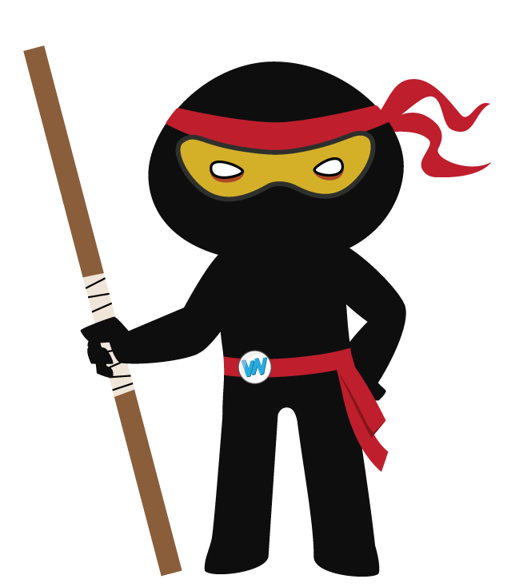
Vocabulary Visualiser
Draw the Grasshopper words and bring them to life.
Word: thirsty | Word: ground
Word: ambulance | Word: weekend

Slide 17
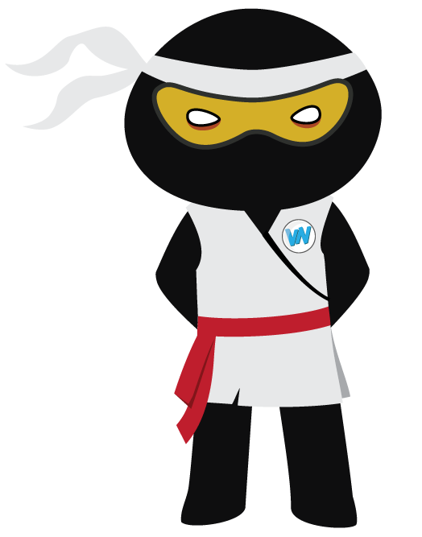
Vocabulary Visualiser
Draw the Shinobi words and bring them to life.
Word: diverse | Word: fabricate
Word: cajole | Word: impartial

Slide 18
Matching Meanings
Draw lines from the Grasshopper words to their definitions.
Grasshopper Word
thirsty
ground
nickname
ambulance
weekend
Grasshopper Definitions
The *** is the soil and rock on the earth's surface.
An *** is a vehicle for taking people to and from hospital.
A *** is Saturday and Sunday.
If you are ***, you feel a need to drink something.
A *** is an informal name for someone or something.

Slide 19
Matching Meanings
Draw lines from the Shinobi words to their definitions.
Shinobi Word
diverse
fabricate
debacle
cajole
impartial
Shinobi Definitions
If someone *** information, they invent it in order to deceive people.
A *** is an event or attempt that is a complete failure.
If you *** someone into doing something, you get them to do it after persuading them for some time.
Someone who is *** is not directly involved in a particular situation, and is therefore able to give a fair opinion or decision about it.
If a group or range of things is ***, it is made up of a wide variety of things.

Slide 20
thirsty
ground

Slide 21
nickname
ambulance

Slide 22
weekend
diverse

Slide 23
fabricate
debacle

Slide 24
cajole
impartial

