Slide 1
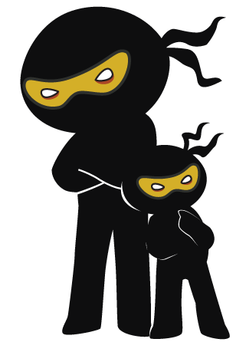



Word of the Day
Summer Term 2021
Week 37 – 21st June 2021
'Words unlock the doors to a world of understanding...'

Slide 2

This Week's Words
Grasshopper
Shinobi
brick
belligerent
straw
consecutive
basket
conspicuous
scarf
simultaneous
cloak
diligent

Slide 3
Grasshopper (Tier 1)
brick
straw
basket
scarf
cloak

Slide 4
Shinobi (Tier 2)
belligerent
consecutive
conspicuous
simultaneous
diligent

Slide 5


Grasshopper Word of the Day
brick
Word Class
Word of the Day:
(noun)
(brick)
Pronunciation / Syllables
Definition:
Bricks are rectangular blocks of baked clay used for building walls, which are usually red or brown.
Bricks were used to build a strong house.
Phrases: | red brick | brown, thick brick
Synonym: | Antonym: | Rhyme: | Link Word:
stone |  | stick | wall
 |  | thick | building

Slide 6
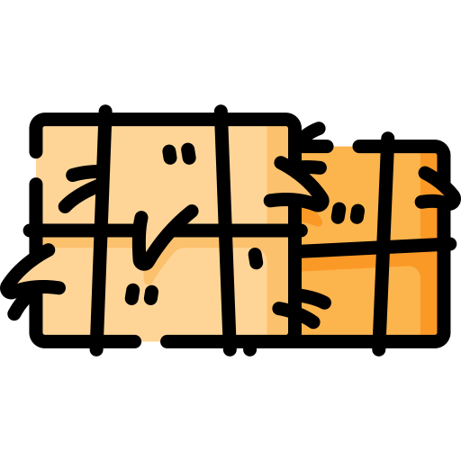
Grasshopper Word of the Day
straw
Word Class
Word of the Day:
(noun)
(straw)
Pronunciation / Syllables
Definition:
Straw consists of the dried, yellowish stalks from crops such as wheat or barley.
The house made of straw was easy to blow down.
Phrases: | soft, yellow straw | wavy straw
Synonym: | Antonym: | Rhyme: | Link Word:
hay |  | floor | farm
 |  | shore | animal

Slide 7

Grasshopper Word of the Day
basket
Word Class
Word of the Day:
(noun)
(bas-ket)
Pronunciation / Syllables
Definition:
A basket is a stiff container that is used for carrying or storing objects. Baskets are made from thin strips of materials such as straw, plastic, or wire woven together.
The basket was full of tasty goodies.
Phrases: | brown, wicker basket | strong, wooden basket
Synonym: | Antonym: | Rhyme: | Link Word:
holder |  | casket | food
case |  | gasket | picnic

Slide 8

Grasshopper Word of the Day
scarf
Word Class
Word of the Day:
(noun)
(scarf)
Pronunciation / Syllables
Definition:
A scarf is a piece of cloth that you wear round your neck or head, usually to keep yourself warm.
She wore a scarf around her neck to keep her warm.
Phrases: | bright, green scarf | warm, colourful scarf
Synonym: | Antonym: | Rhyme: | Link Word:
neckerchief |  | barf | warm
muffler |  |  | clothing

Slide 9
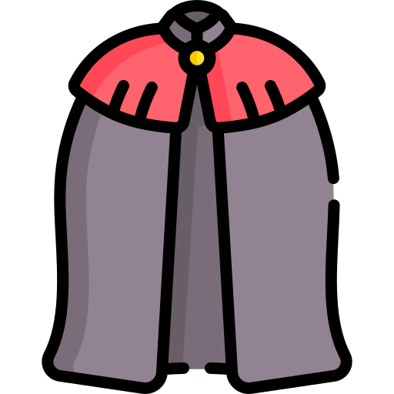
Grasshopper Word of the Day
cloak
Word Class
Word of the Day:
(noun)
(cloak)
Pronunciation / Syllables
Definition:
A cloak is a long, loose, sleeveless piece of clothing which people used to wear over their other clothes when they went out.
The red cloak protected her from the rain.
Phrases: | protective cloak | stylish cloak
Synonym: | Antonym: | Rhyme: | Link Word:
cape |  | spoke | protective
robe |  | broke | beautiful

Slide 10

Shinobi Word of the Day
belligerent
Word Class
Word of the Day:
(adjective)
(bel-lig-er-ent)
Pronunciation / Syllables
Definition:
A belligerent person is hostile and aggressive.
The monkeys in the city were belligerent with tourists.
Phrases: | acted belligerently when | belligerent actions caused
Synonym: | Antonym: | Prefix / Suffix: | Rhyme: | Link Word:
threatening | friendly | -ly | different | person
antagonistic |  |  |  | behaviour

Slide 11

Shinobi Word of the Day
consecutive
Word Class
Word of the Day:
(adjective)
(con-sec-u-tive)
Pronunciation / Syllables
Definition:
Consecutive periods of time or events happen one after the other without interruption.
Jenny won consecutive spelling competitions.
Phrases: | won consecutive | lost consecutive
Synonym: | Antonym: | Prefix / Suffix: | Rhyme: | Link Word:
in a row | separate | -ly | executive | win
successive |  |  | decorative | double

Slide 12


Shinobi Word of the Day
conspicuous
Word Class
Word of the Day:
(adjective)
(con-spic-u-ous)
Pronunciation / Syllables
Definition:
If someone or something is conspicuous, people can see or notice them very easily.
John got up and conspicuously moved seats.
Phrases: | extremely conspicuous | moved conspicuously
Synonym: | Antonym: | Prefix / Suffix: | Rhyme: | Link Word:
noticeable | inconspicuous | -ly |  | behaviour
visible |  | in- |  | person

Slide 13

Shinobi Word of the Day
simultaneous
Word Class
Word of the Day:
(adjective)
(si-mul-ta-ne-ous)
Pronunciation / Syllables
Definition:
Things which are simultaneous happen or exist at the same time.
Mia and Hamza shouted the answer out simultaneously.
Phrases: | moved simultaneously across | answered simultaneously
Synonym: | Antonym: | Prefix / Suffix: | Rhyme: | Link Word:
concurrent |  | -ly | spontaneous | event
coinciding |  |  | miscellaneous | perform

Slide 14

Shinobi Word of the Day
diligent
Word Class
Word of the Day:
(adjective)
(dil-i-gent)
Pronunciation / Syllables
Definition:
Someone who is diligent works hard in a careful and thorough way.
Shanza diligently shaded her wonderful sketches.
Phrases: | always worked diligently | beautifully diligent
Synonym: | Antonym: | Prefix / Suffix | Rhyme: | Link Word:
meticulous | lazy | -ly |  | detail
attentive | casual | -ence |  | work

Slide 15
Vocabulary Laboratory
Describe / Definition:
Use it in a sentence:
Focus Word (write below):
Word Class:
Synonyms: (words with same / similar meaning) | Antonyms: (words with opposite meaning)
Rhymes: (words that sound the same) | Link Words: (Example: football = pitch, team, player)
Draw your sentence:

Slide 16

Vocabulary Visualiser
Draw the Grasshopper words and bring them to life.
Word: brick | Word: straw
Word: basket | Word: scarf

Slide 17

Vocabulary Visualiser
Draw the Shinobi words and bring them to life.
Word: belligerent | Word: consecutive
Word: simultaneous | Word: diligent

Slide 18
Matching Meanings
Draw lines from the Grasshopper words to their definitions.
Grasshopper Word
brick
straw
basket
scarf
cloak
Grasshopper Definitions
A *** is a piece of cloth that you wear round your neck or head, usually to keep yourself warm.
A *** is a long, loose, sleeveless piece of clothing which people used to wear over their other clothes when they went out.
*** are rectangular blocks of baked clay used for building walls, which are usually red or brown.
*** consists of the dried, yellowish stalks from crops such as wheat or barley.
A *** is a stiff container that is used for carrying or storing objects. *** are made from thin strips of materials such as straw, plastic, or wire woven together.

Slide 19
Matching Meanings
Draw lines from the Shinobi words to their definitions.
Shinobi Word
belligerent
consecutive
conspicuous
simultaneous
diligent
Shinobi Definitions
Things which are *** happen or exist at the same time.
If someone or something is ***, people can see or notice them very easily.
A *** person is hostile and aggressive.
Someone who is *** works hard in a careful and thorough way.
*** periods of time or events happen one after the other without interruption.

Slide 20
brick
straw

Slide 21
basket
scarf

Slide 22
cloak
belligerent

Slide 23
consecutive
conspicuous

Slide 24
simultaneous
diligent

